Slide 1
The Great Migration
1915-1930

Slide 2
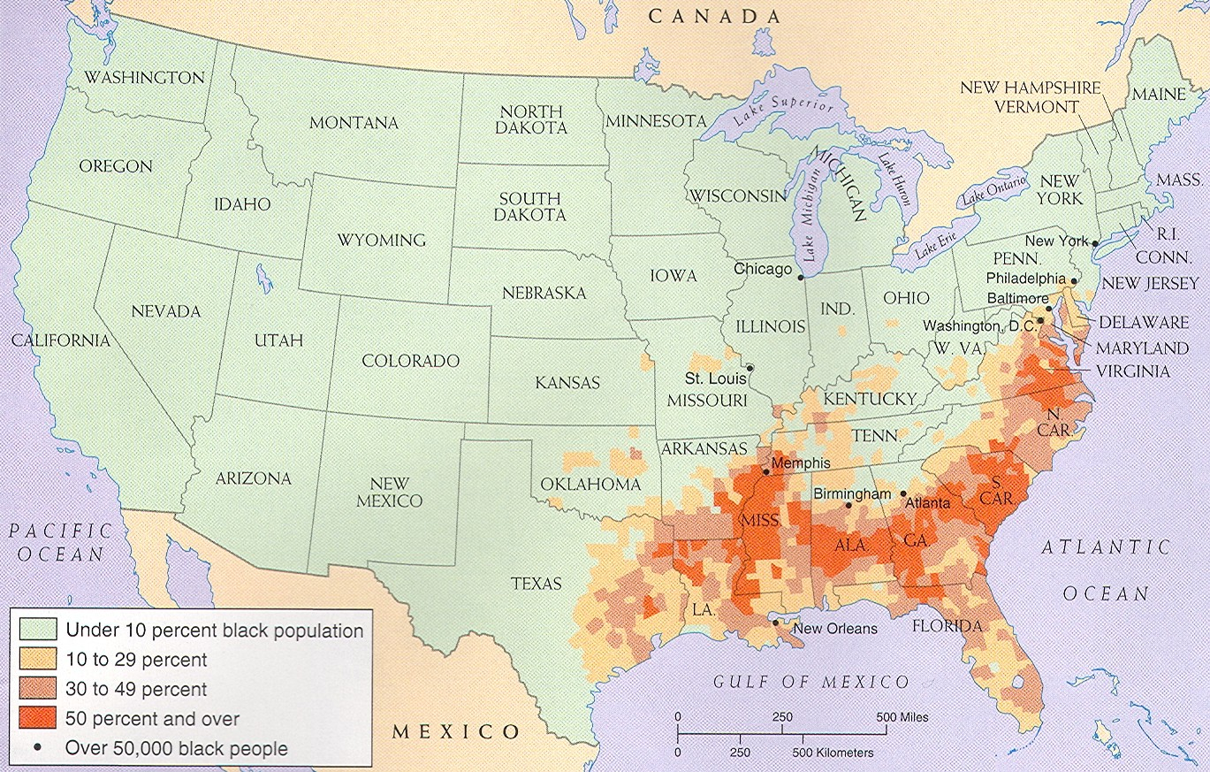

Slide 3
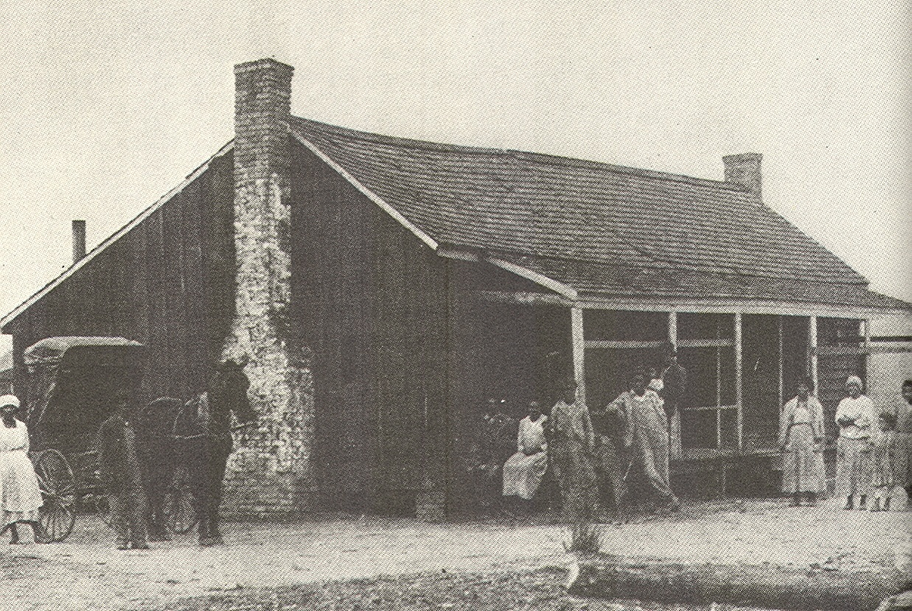
Sharecropper Cabin in the South, 1910

Slide 4
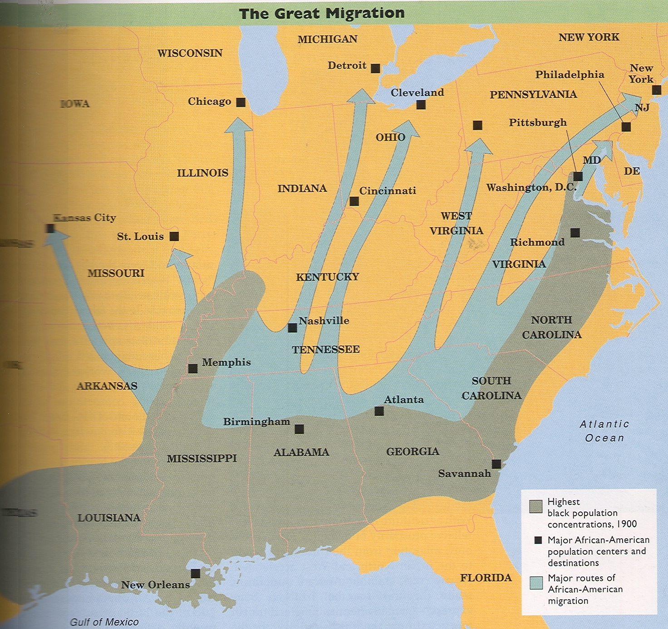

Slide 5
Growth of the Northern Black Population, 1915-1970
1915-1920 500,000 blacks leave the South
1921-1940 1,000,000 blacks leave the South
1941-1970 5,000,000 blacks leave the South

Slide 6
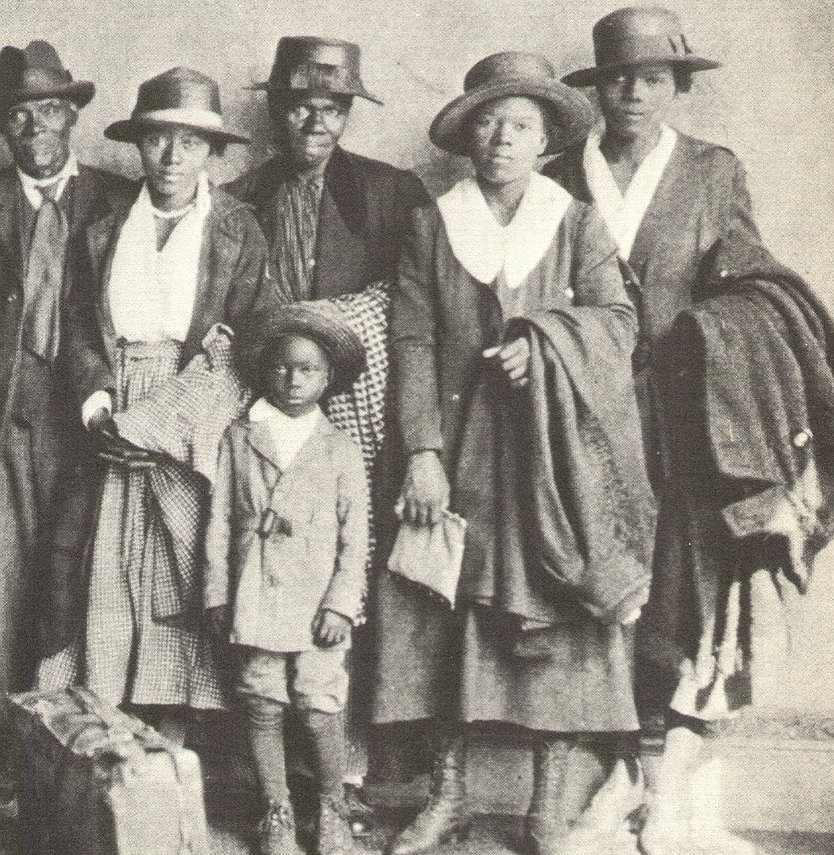

Slide 7
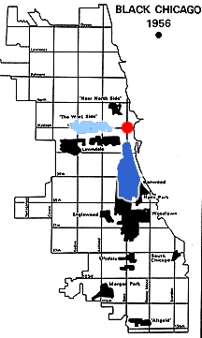
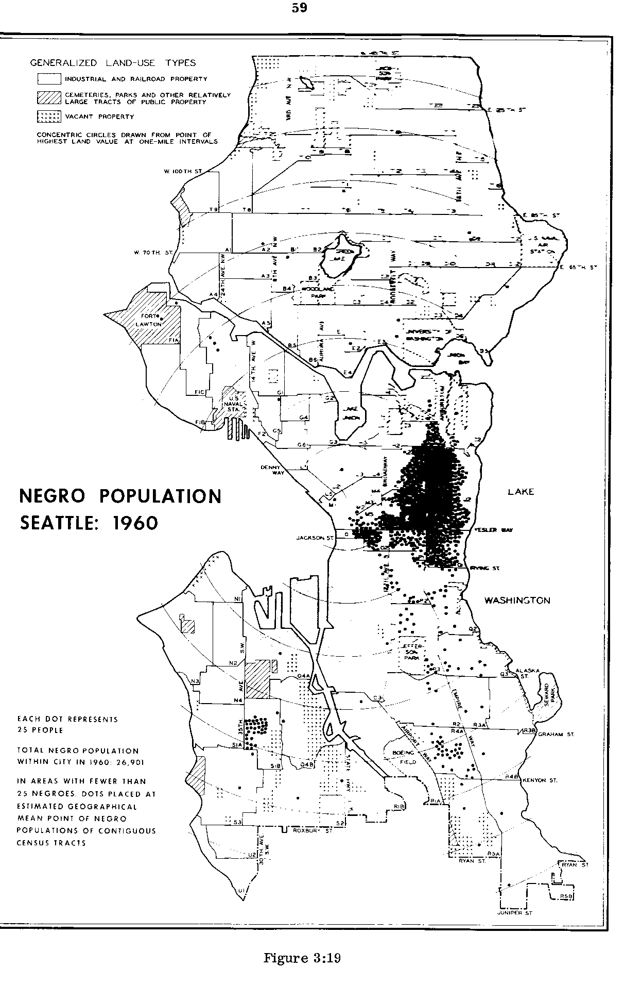
The Chicago Ghetto, 1920-1956,and Seattle, 1960

Slide 8
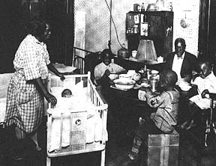
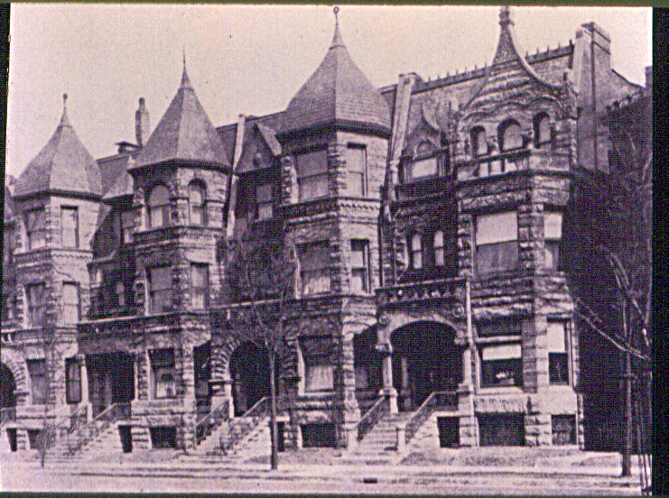
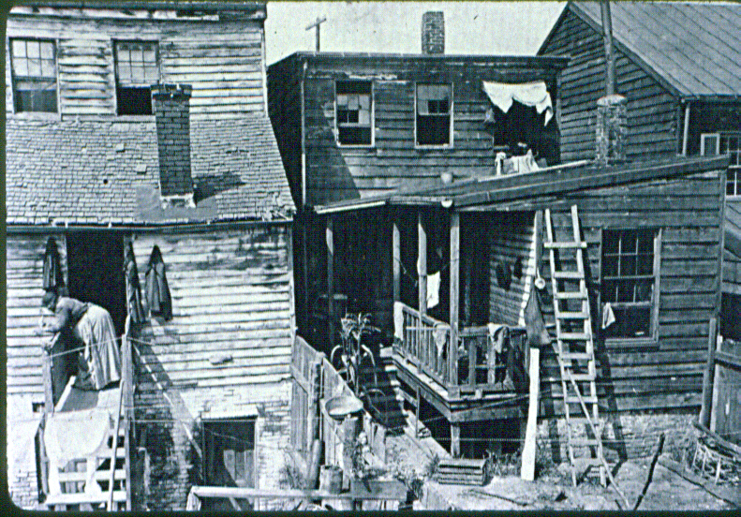
Notes:
8

Slide 9
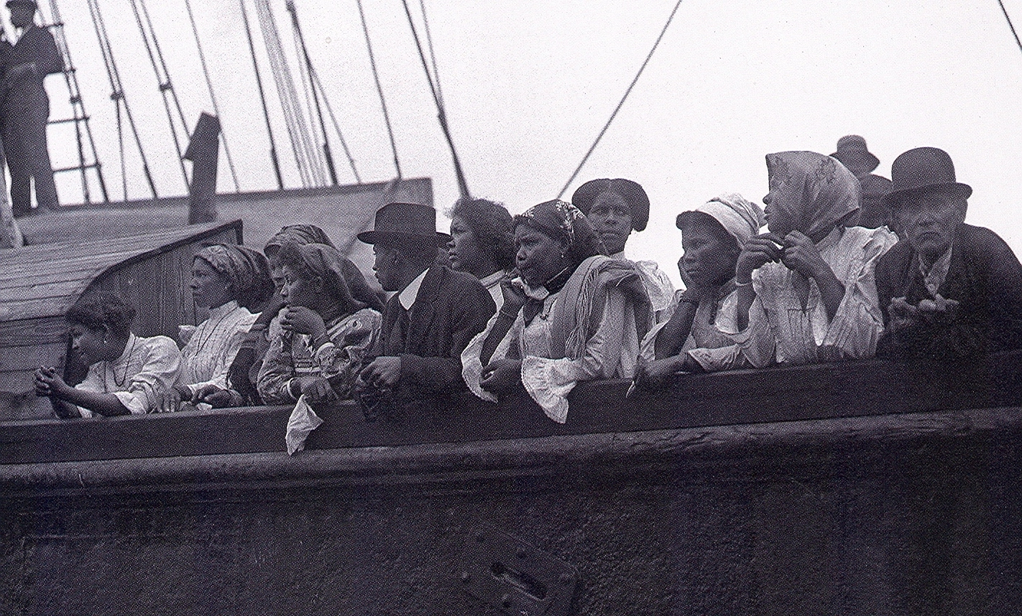
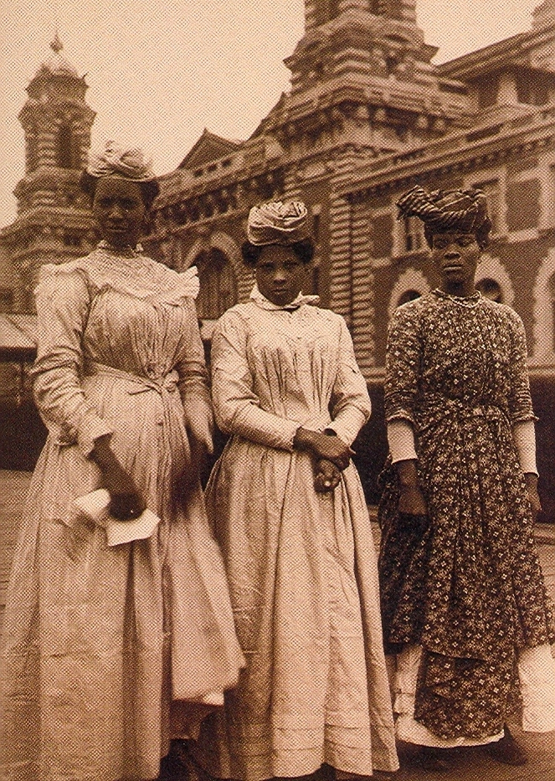
The Great Migration: Immigrants from Africa
& The West Indies

Slide 10
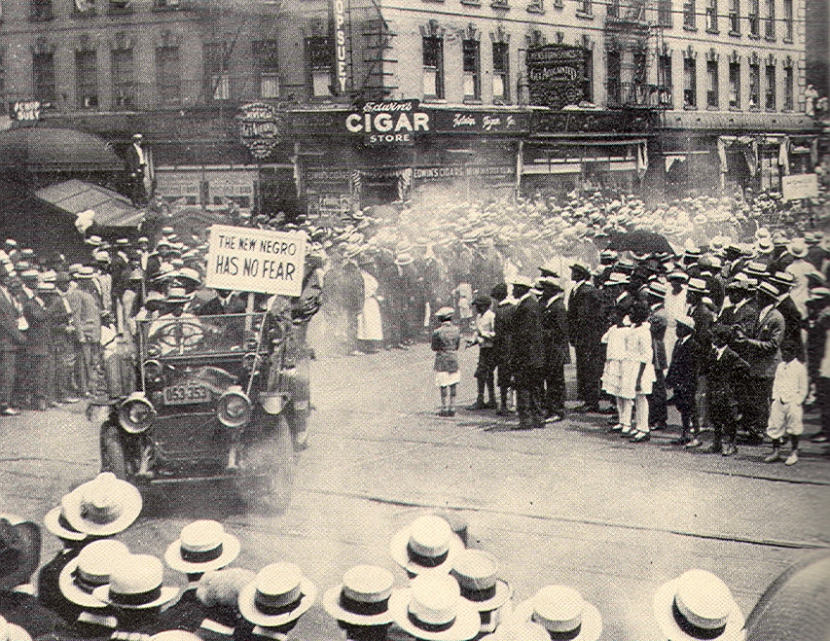

Slide 11
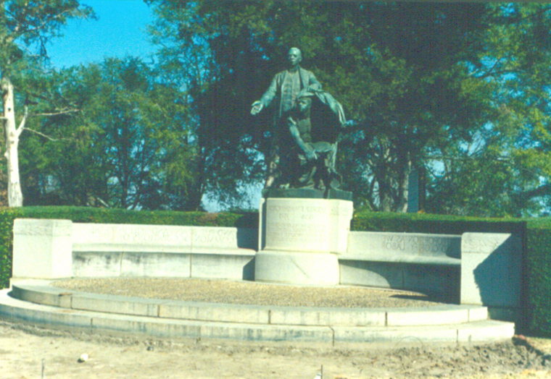

Slide 12
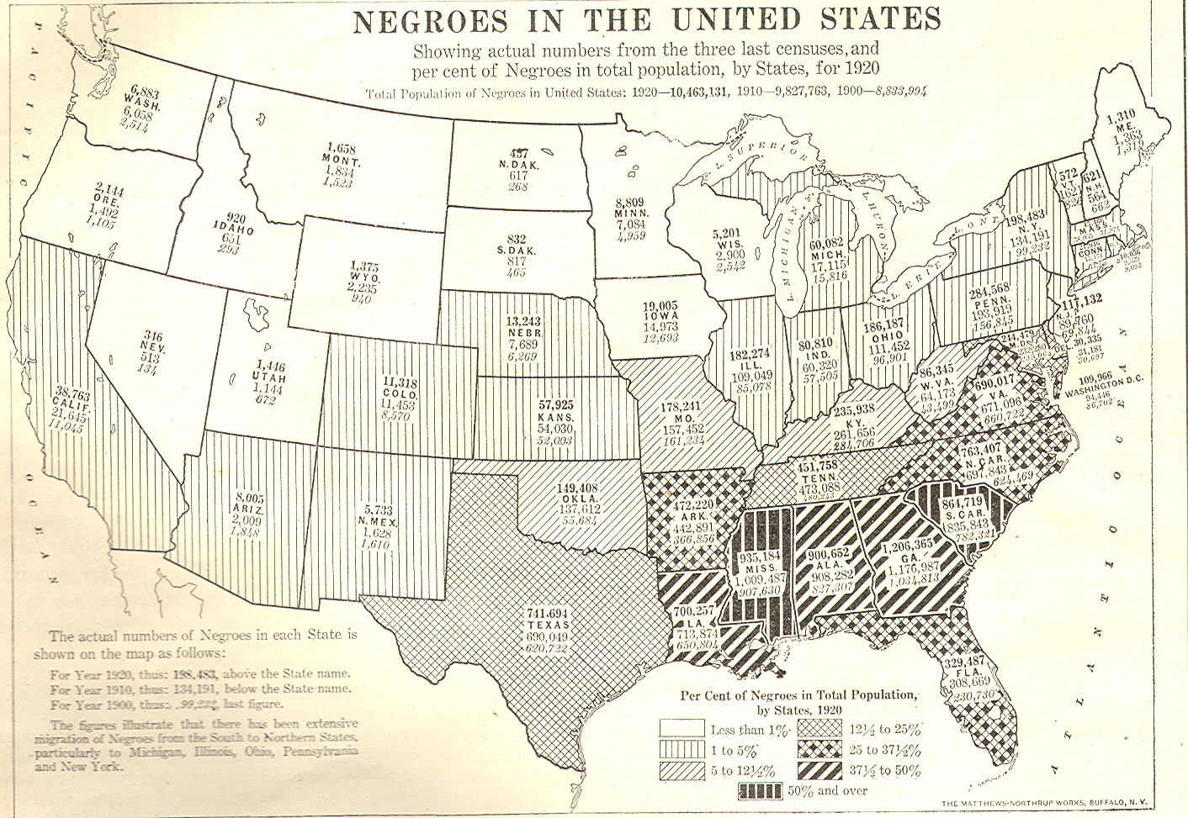
Is The Black Belt Fading?

Slide 13
Movement North: 1915-1919
1915 60,000
1916 100,000
1917 150,000
1918 120,000
1919 70,000

Slide 14
The Great Migration:
Sara Rice Remembers, 1918
In the train station it was just like an exodus of black people traveling, going north to better their lives... It was pathetic, like you see these people in [Third World] countries now, escaping for their lives with the bundles and stuff like that, because they didn’t have suitcases. They just had sacks to put their clothes in, head rags on and everything, going north.

Slide 15
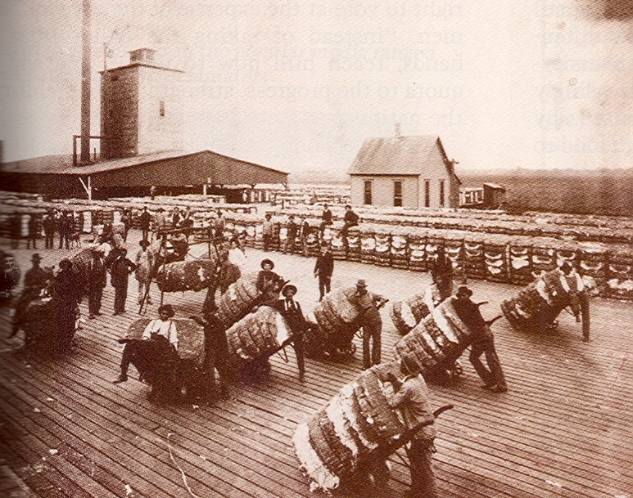
Loading Cotton in Alabama, 1915

Slide 16
Growth of African American Population in Selected Cities, 1915-1920
1910 1920
Chicago 44,103 109,458
New York City 91,709 152,467
Philadelphia 84,459 134,229
Detroit 5,741 40,838
Gary 383 5,299
Akron 657 5,580

Slide 17
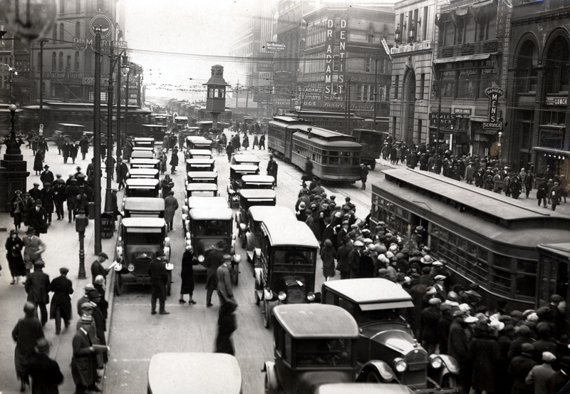
Downtown Detroit, 1925

Slide 18
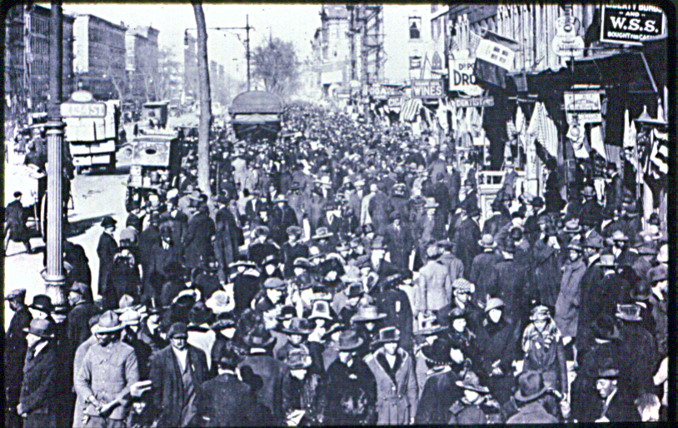

Slide 19
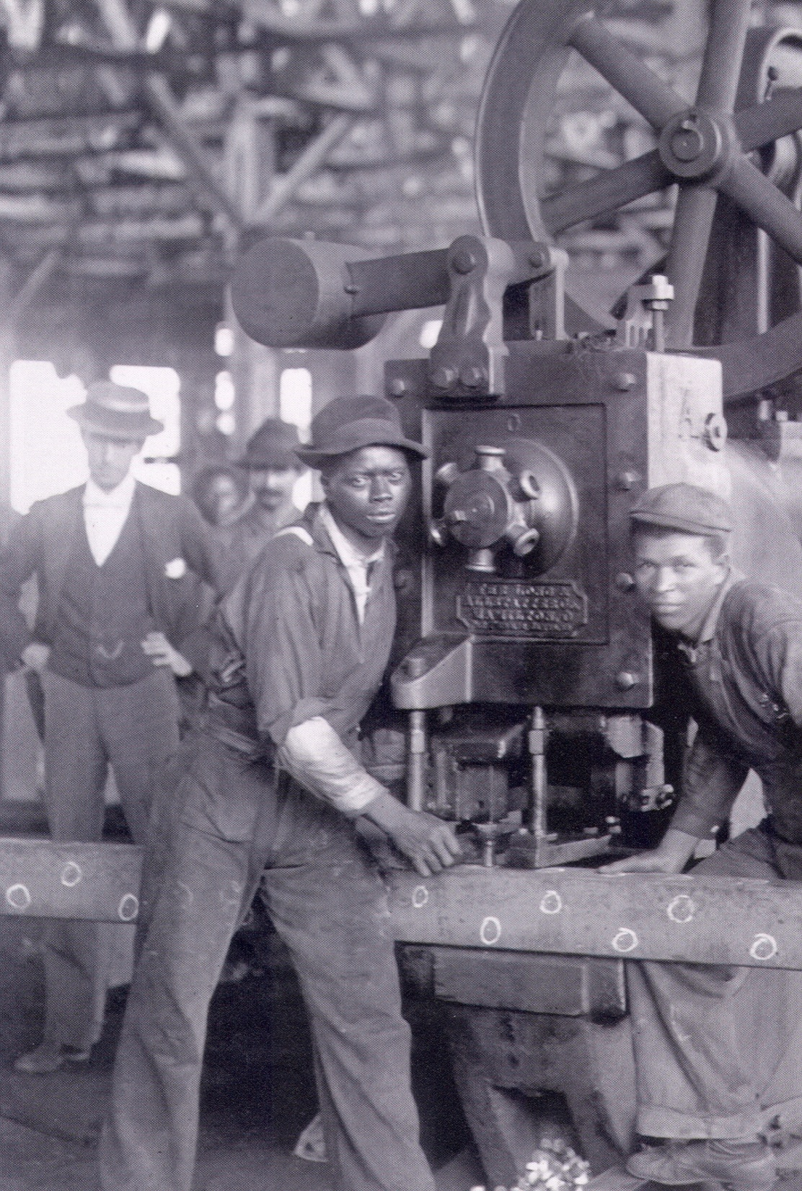

Slide 20
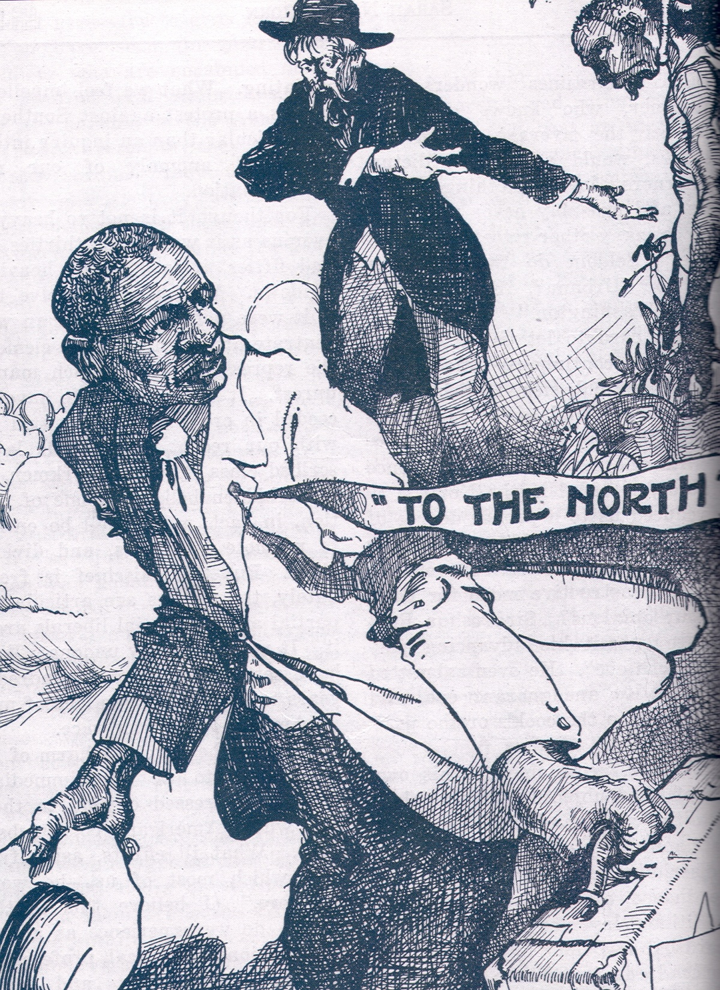

Slide 22
Mary Debardeleben on Georgia Violence in 1918
The old man with trembling fingers, drew from his pocket a crumbled paper and spread it out for me to see. At the top of the sheet were a crudely drawn skull and crossbones.
Below it was written: “You are hereby warned that you and your entire family must be gone from this community within 48 hours.”
Recalling that a black woman was burned at the stake in the county a few months earlier when she attempted to keep a white man from striking her child, the old man, fearing for his life, fled the town in the dead of the night.

Slide 23
Letters from the Chicago Defender
Alabama—”Twenty families want to leave this hard luck place. Please find someone that need this kind of people and send at once for us. We can’t talk to you over the phone here, we are afraid to. They don’t want to hear one say he wants to leave here. If we do we are apt to be killed.
Louisiana—”The people is getting so bad with us Black people down South here. Please help me get my family away.
Mississippi—”I want to come North on the 15th of May. I am a poor woman and have a husband and five children. This is my native home but it is not fit to live in. Will you please let me know where the cars is going to stop. Hoping to hear from you soon, your needed and worried friend.

Slide 24
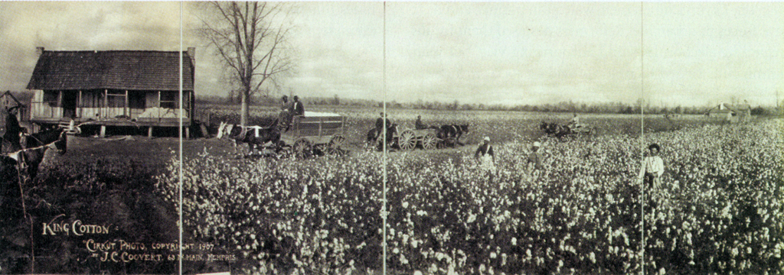
Postcard from Mississippi, 1907

Slide 25
Migrant or Refugee?
“In 1916 I made sixteen bales of cotton; in 1917 that was cut in half, and the next year there was nothing. People that use to have eighteen and nineteen bales of cotton were lucky to get three... That’s where we got our money from. But the bowl weevil came in and that’s what started people comin’ here [to the North] because the farmer he didn’t have no other place to go.”

Slide 26
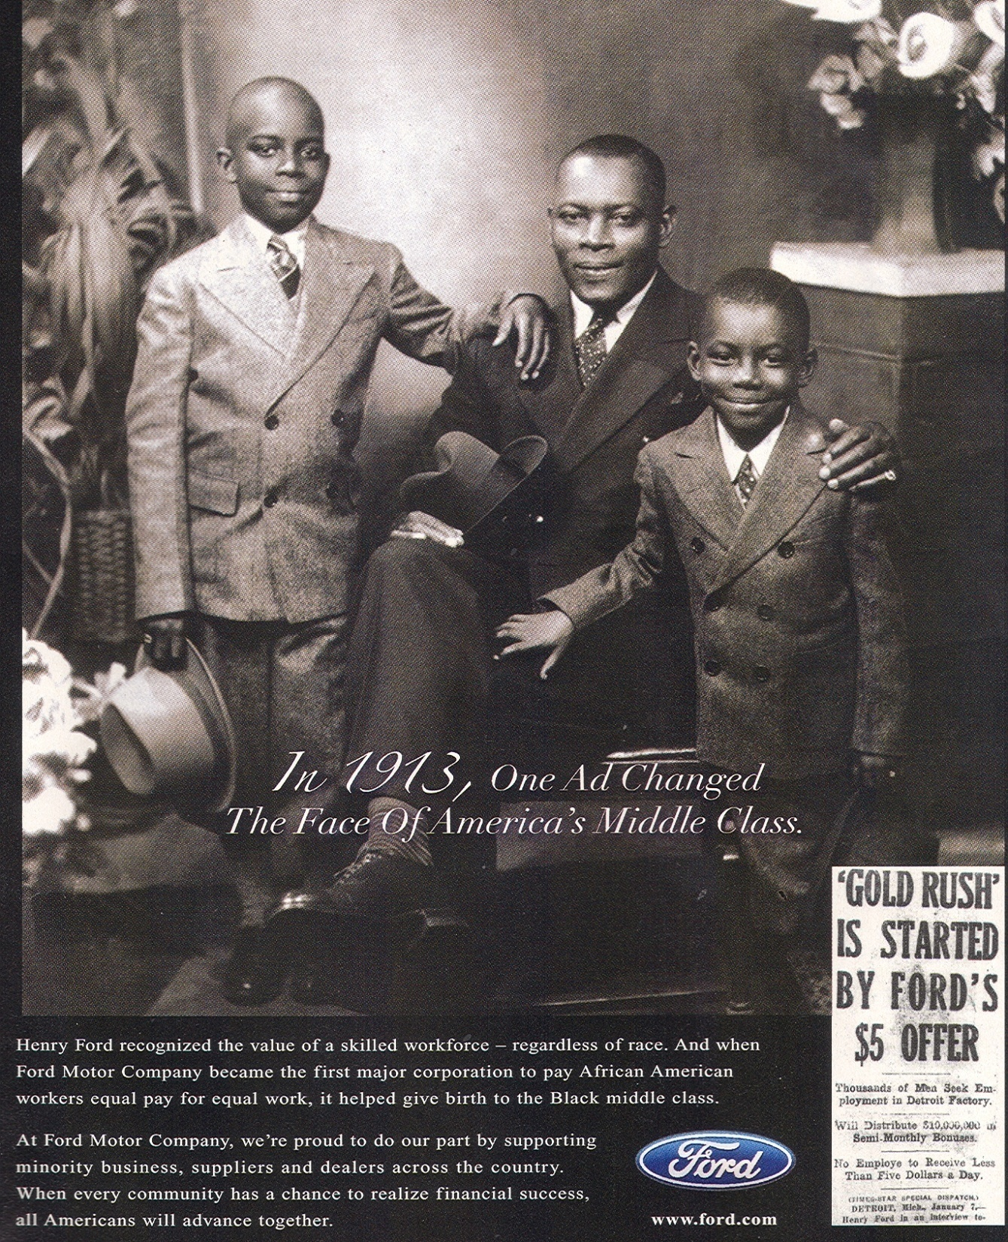

Slide 27
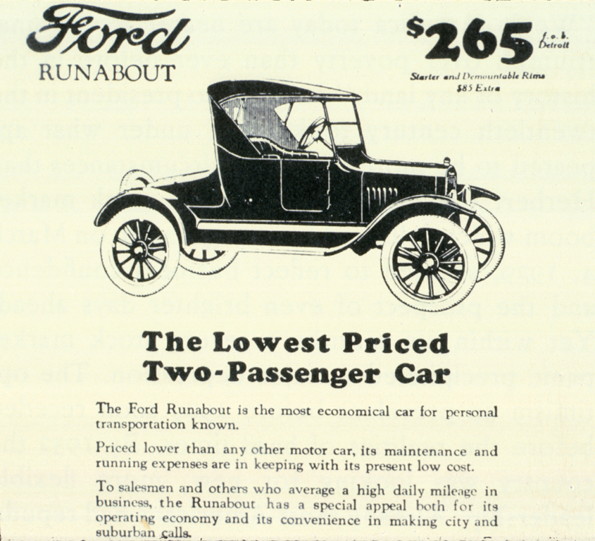

Slide 28
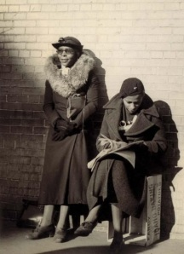
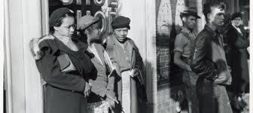
Black Domestic Servants Waiting for
Day Work Employers, ca. 1930

Slide 29

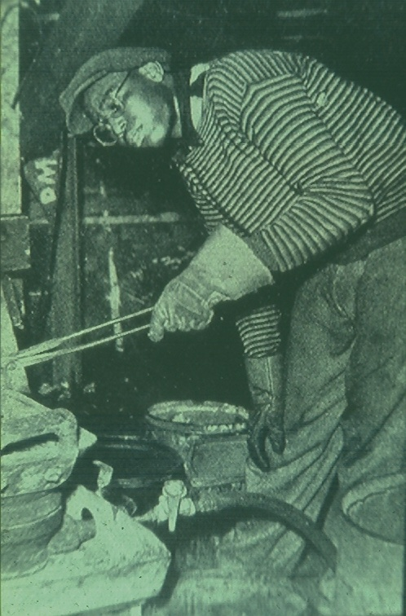

Slide 30
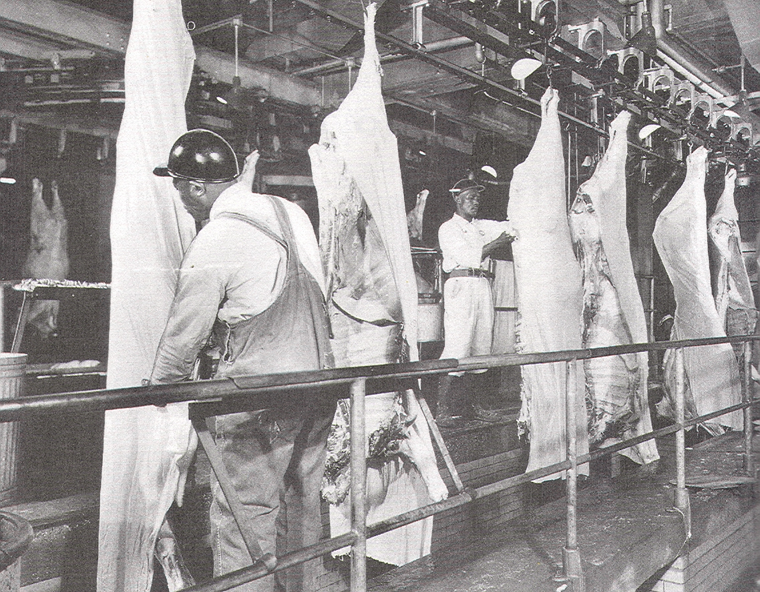

Slide 31
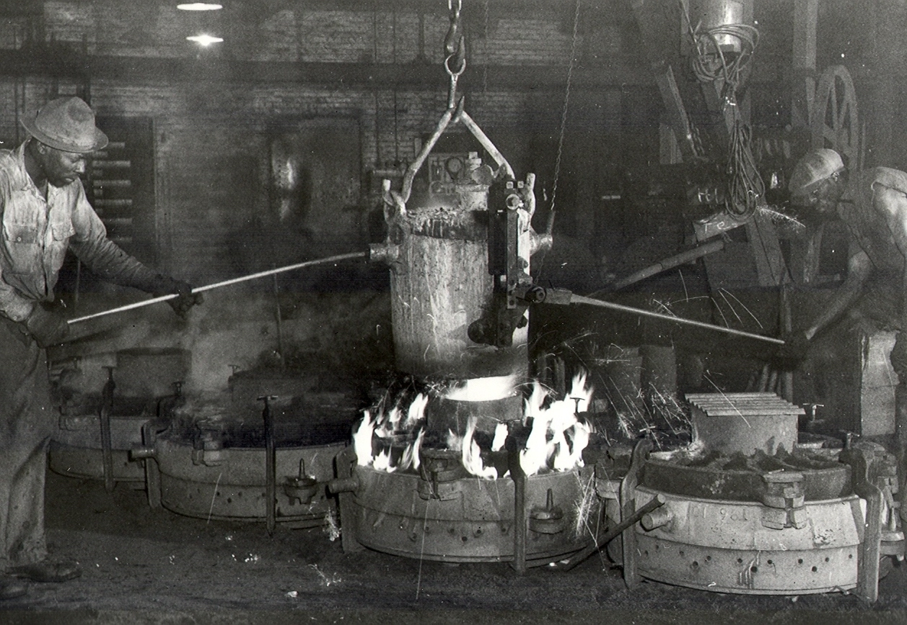
Steel Mill Workers

Slide 32
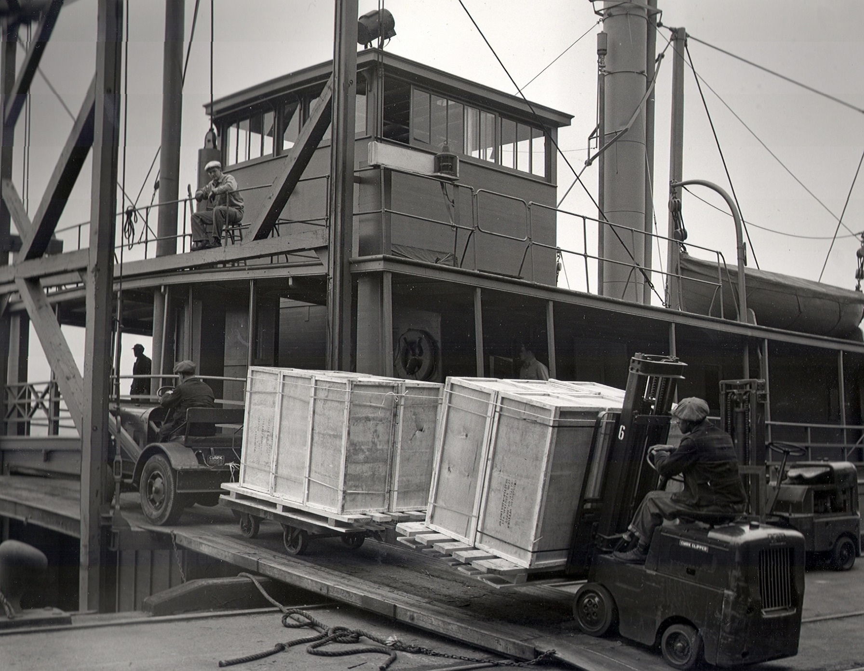
Longshoremen

Slide 33
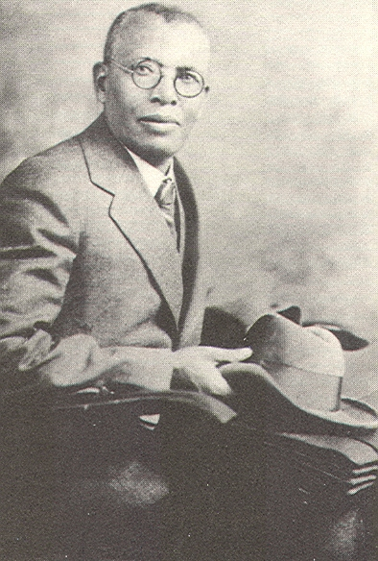
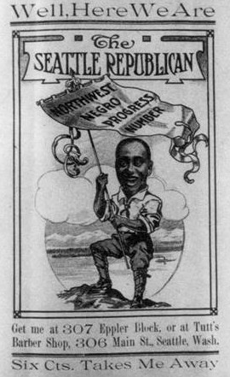
Horace Cayton and the Seattle Republican, ca. 1908

Slide 34
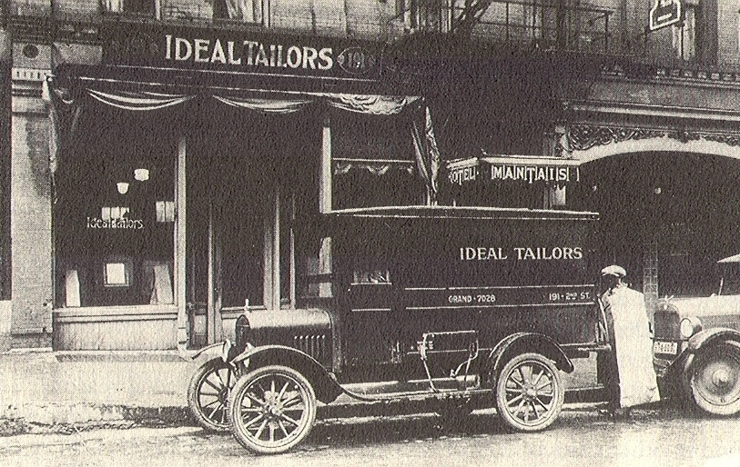
Small Business in Milwaukee, 1919

Slide 35
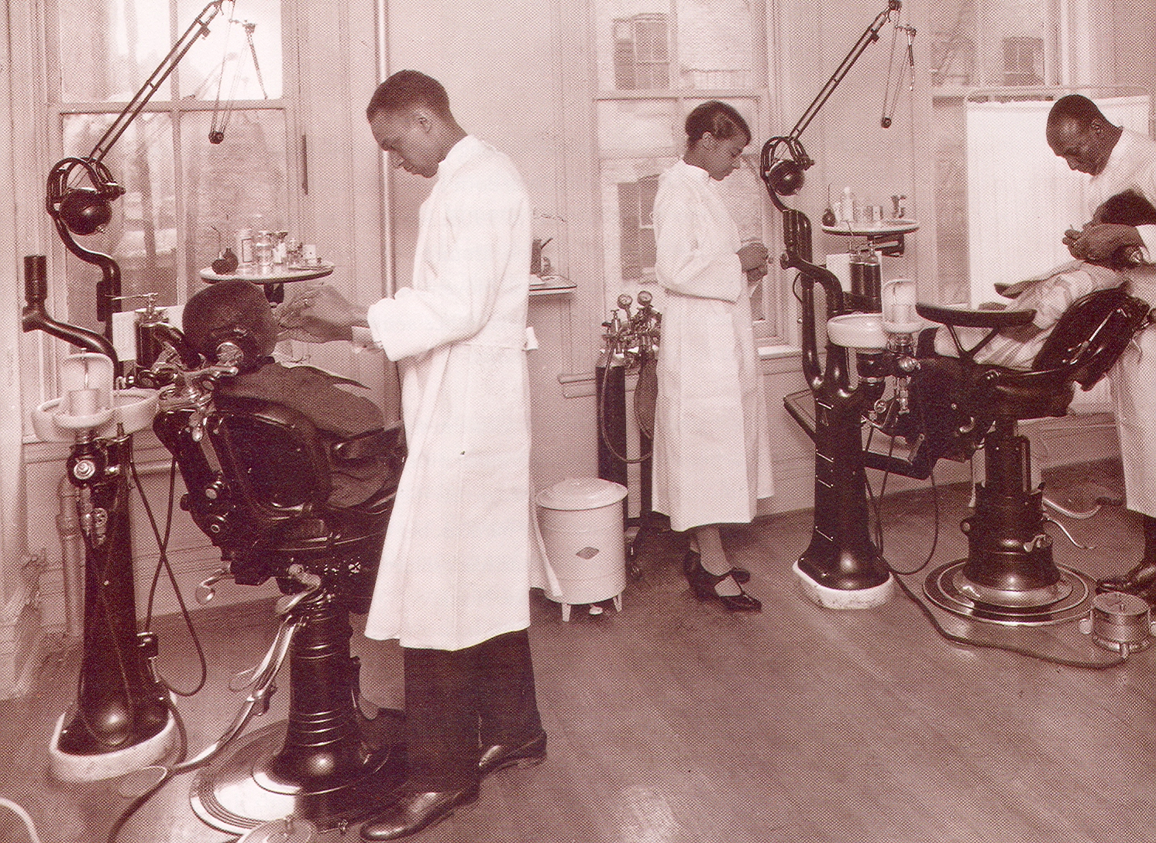
Black Dentists in Detroit, 1930

Slide 36
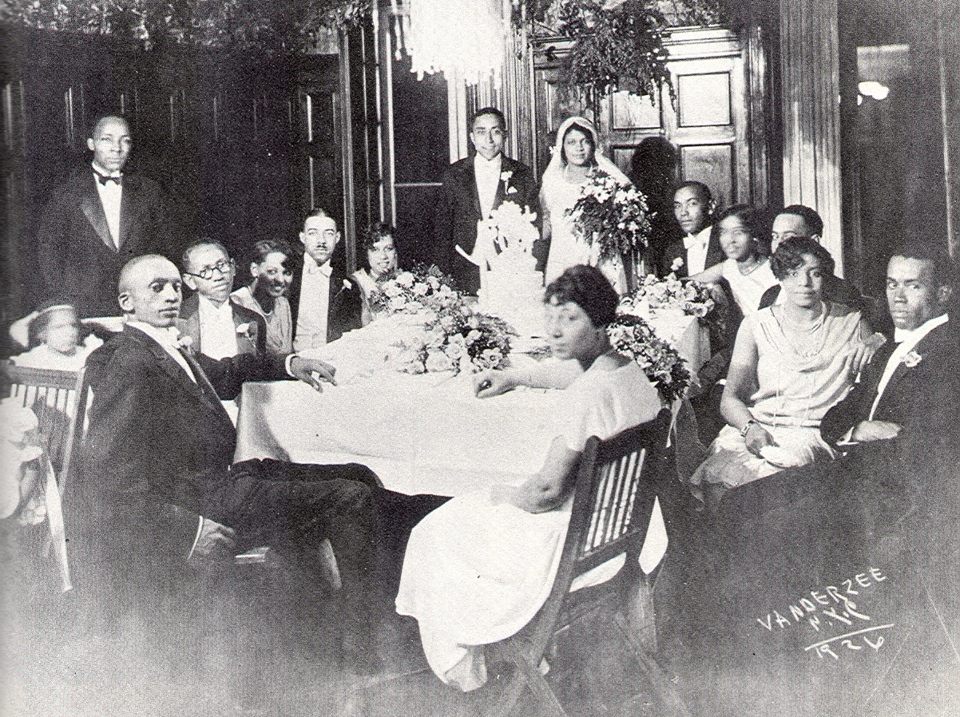
Middle Class Harlem Wedding, 1926

Slide 37
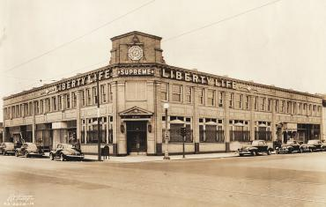
Arkansas Migrant Frank Gillespie on Liberty Life Insurance Company, Founded 1919 in Chicago
At last, at last, the Negroes are going to get together. If we ever expect to get anywhere as a race of people, we must first learn to stick together. The day of Negro enterprises has arrived. The Liberty Life Insurance Company is the first ever incorporated north of the Mason-Dixon line that is owned and controlled by Negroes.

Slide 38
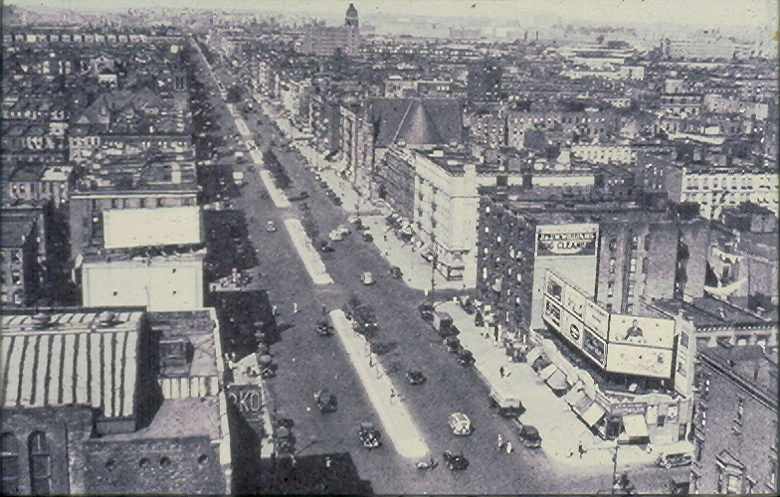
Harlem in 1930

Slide 39
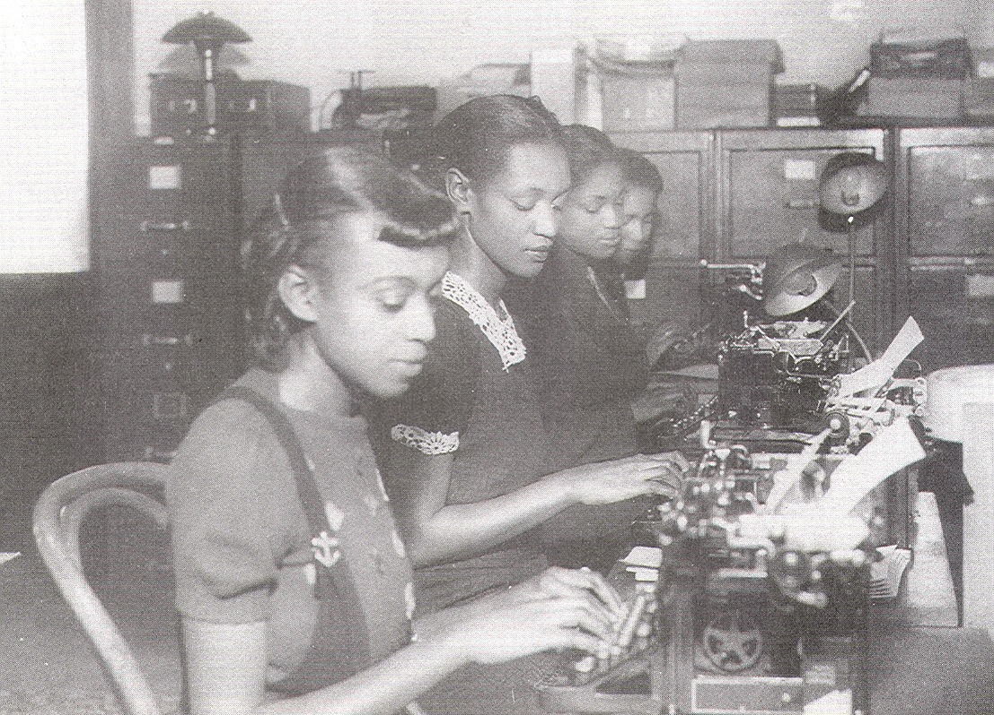

Slide 40
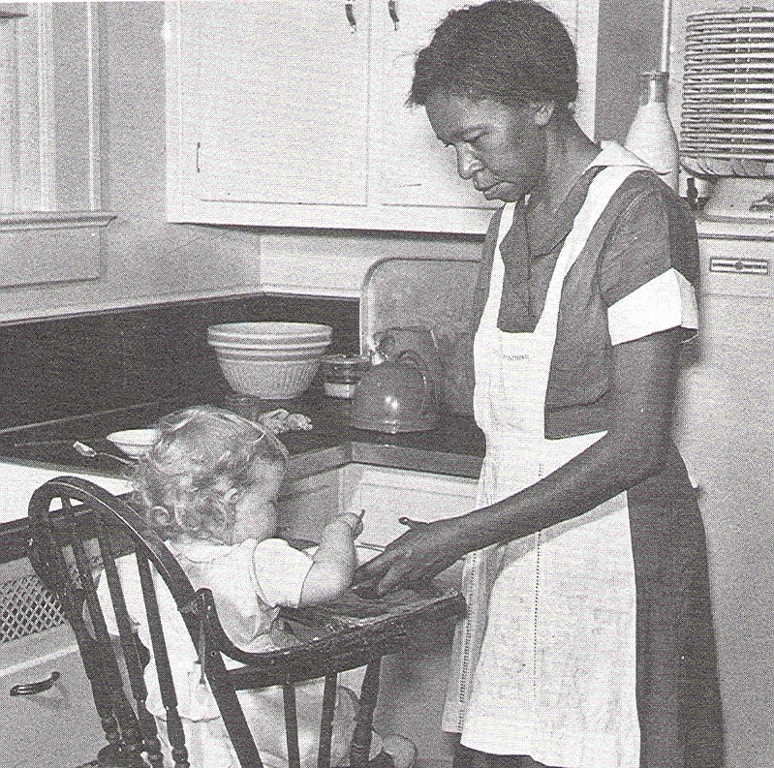

Slide 41
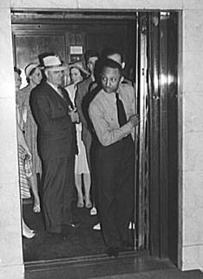
New York City Elevator Operator

Slide 42
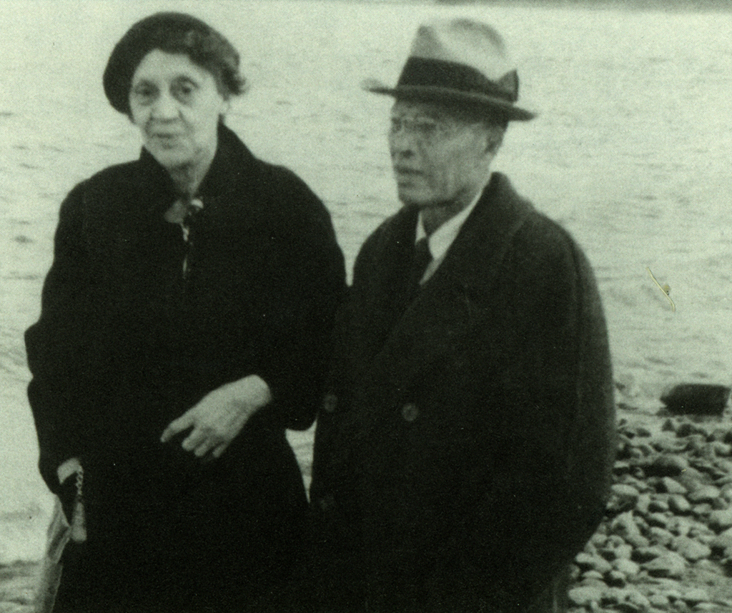
Horace and Susie Revels Cayton on
Lake Washington, 1930

Slide 43
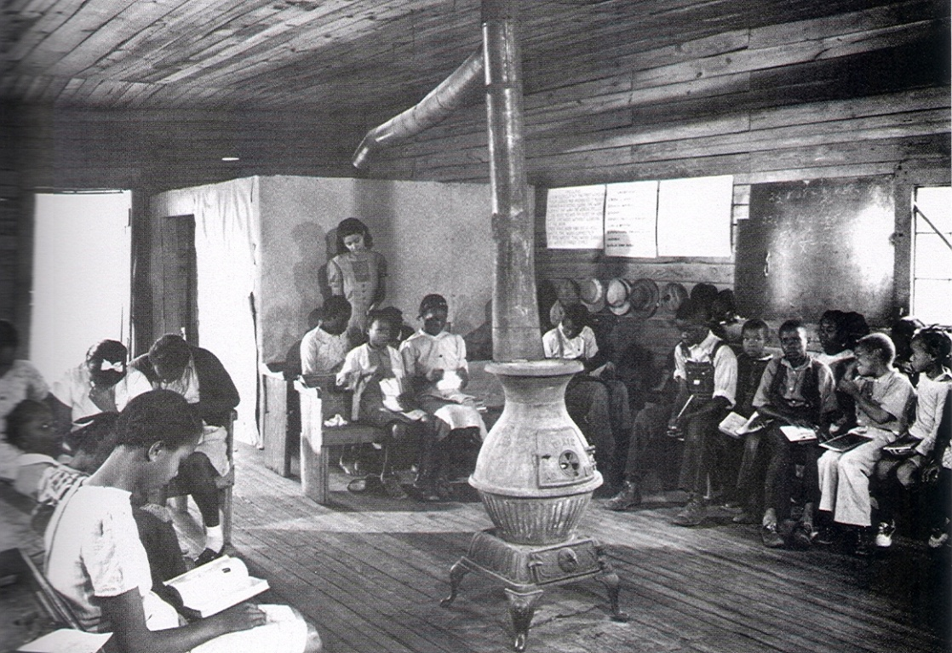
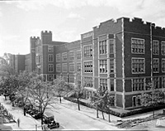
Black Education: South and North
Georgia School, Dunbar High in Washington, D.C

Slide 44
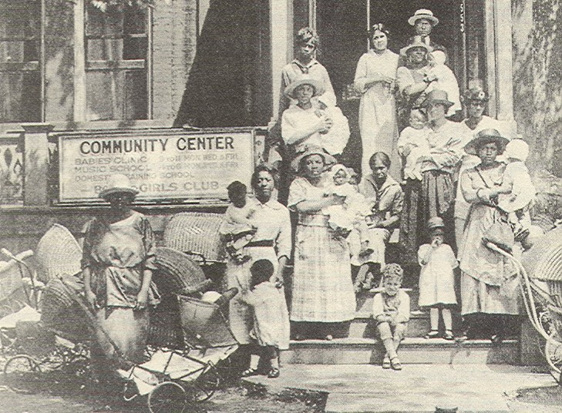
Detroit Urban League Well Baby Clinic, 1925

Slide 45
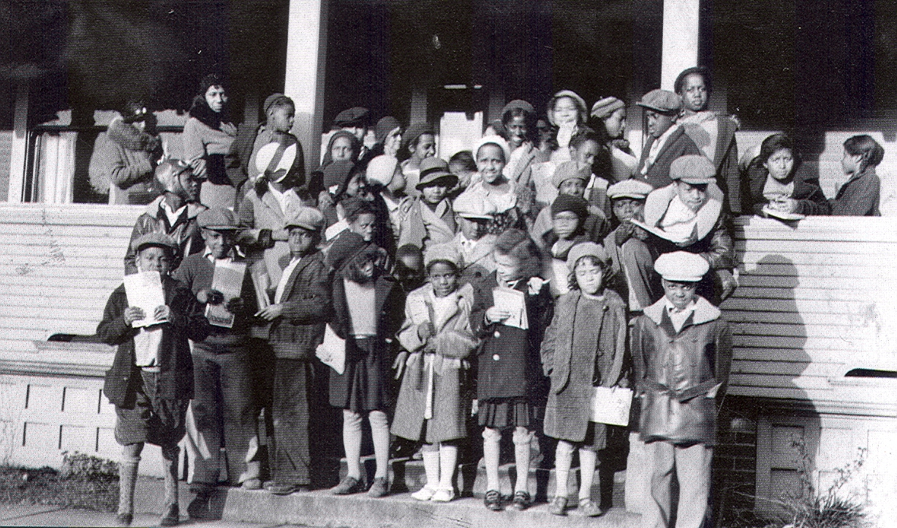
Negro Health Week at Phyllis Wheatley Community Center, Seattle, April 1932

Slide 46
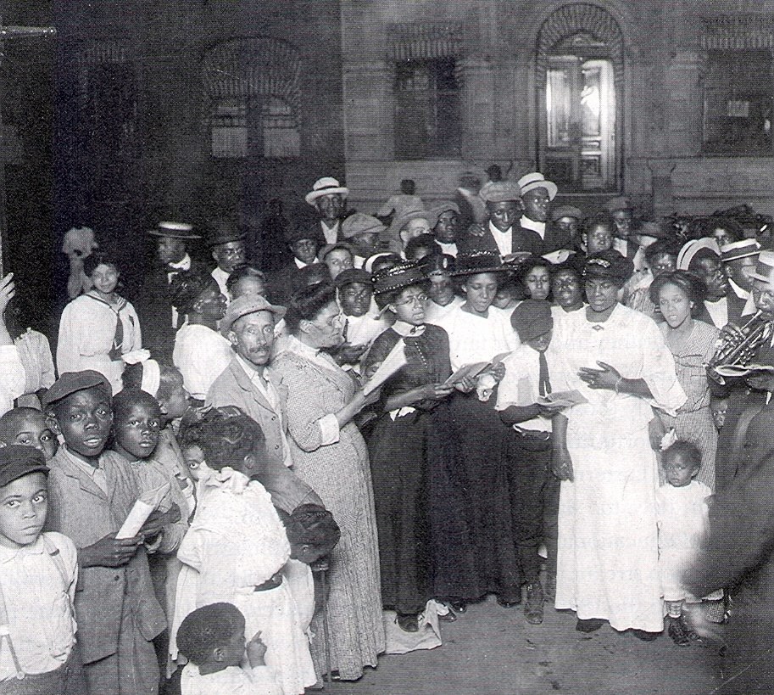
Black Church Service, New York City, ca. 1918

Slide 47
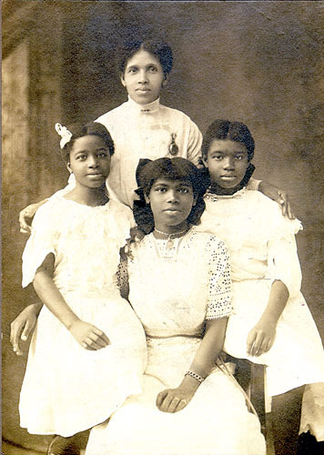

Slide 48
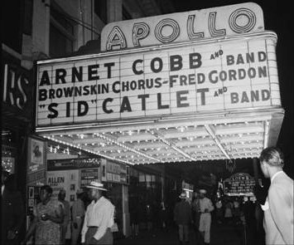
The Apollo Theatre, Founded 1913

Slide 49
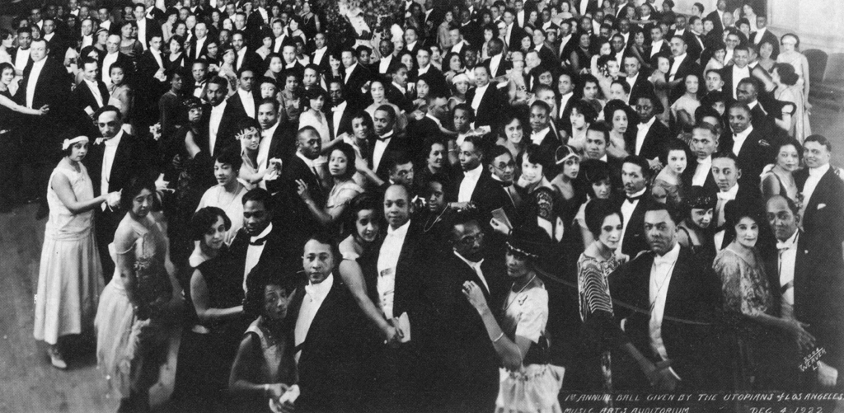
[During the Depression] I didn’t see any difference in the money you could earn in New York City and the money you could make in South Carolina. But I found the living in the South oppressive and I wanted the expansiveness of the city, the advantages of the libraries, the movies, and the social activities.
----Josephus Hicks

Slide 50
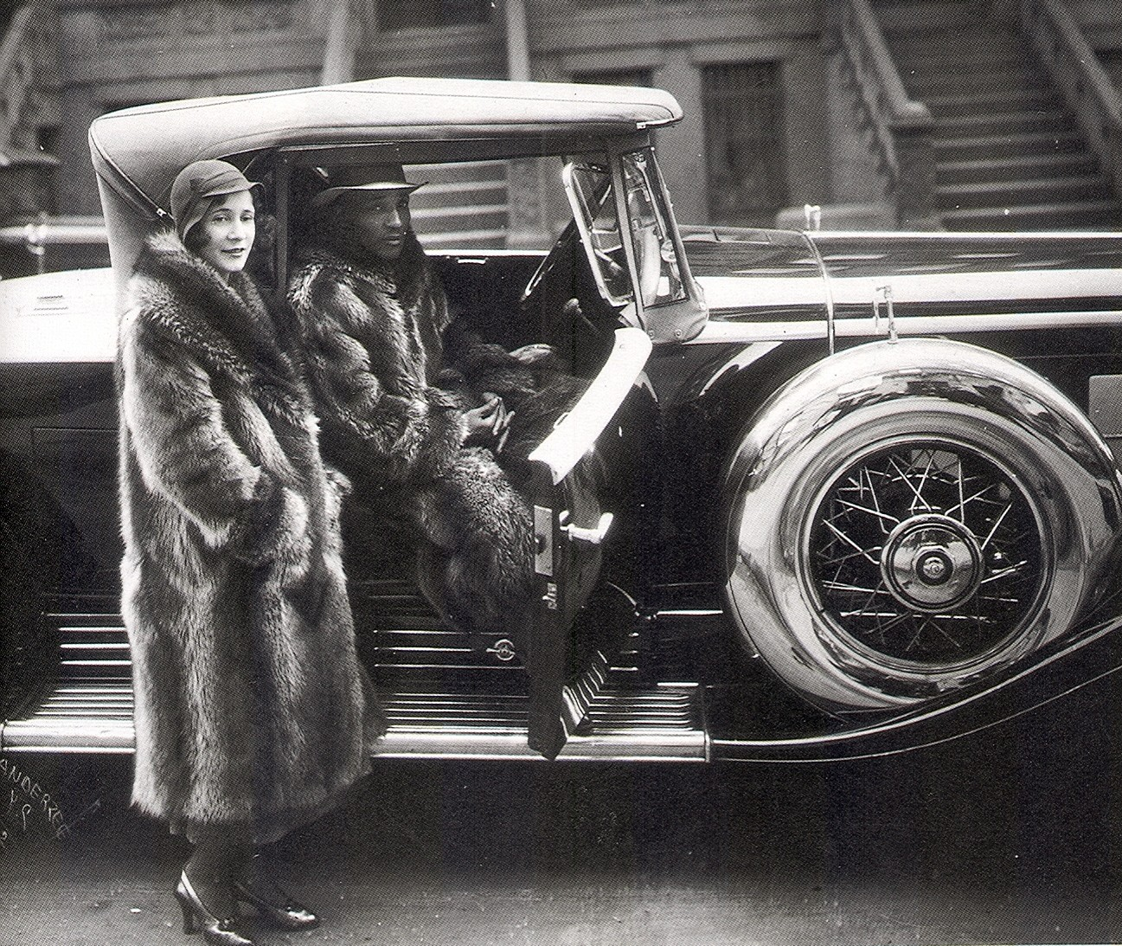
Stylin’ in Harlem: Couple and Their 1925 Cadillac Roadster

Slide 51
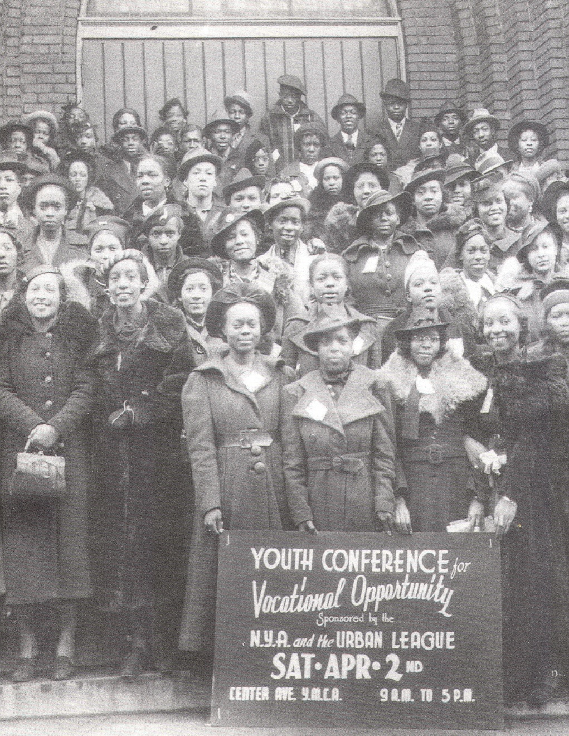
Urban League Sponsored Youth Conference, Detroit, 1935

Slide 52
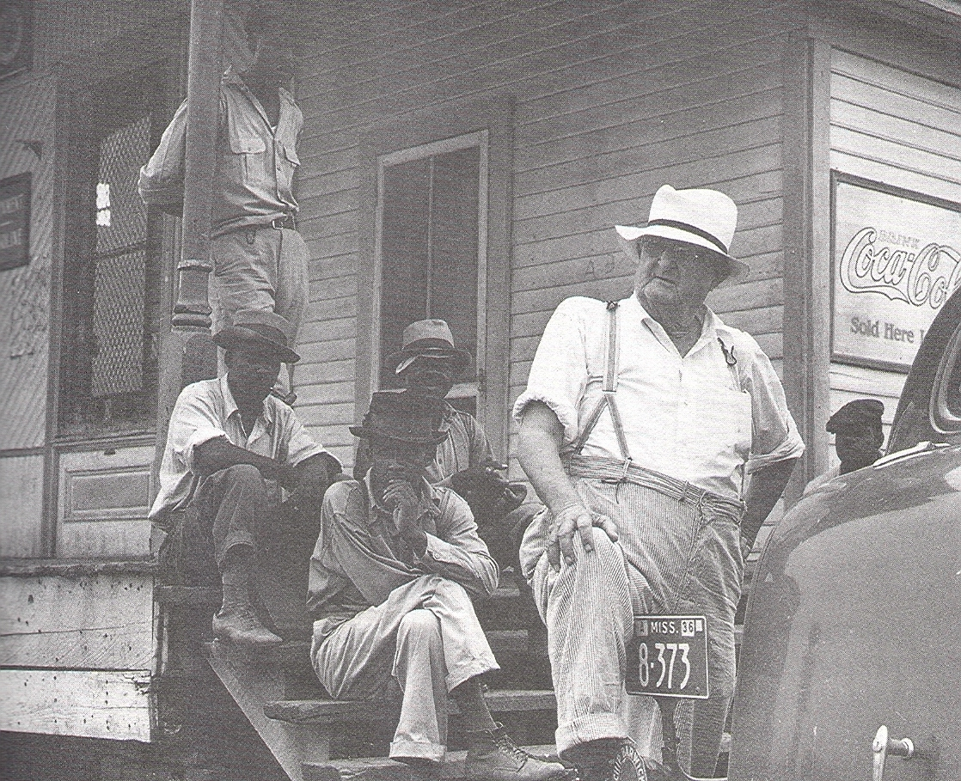
Mississippi Plantation Owner and His Workers, 1936

Slide 53

Heading North from Florida, 1940

Slide 54

Cardozo High School,
Washington, D.C., Opening Day, 1925

Slide 55


Chicago Mayor Big Bill Thompson and the Black Vote, 1918

Slide 56

Illinois Congressman Oscar DePriest (center) Representing Illinois’ First Congressional District

Slide 57


The Chicago Defender
Founder Robert Abbott and His Mother,
Ad for Daily Defender, ca. 1930

Slide 58


Slide 59

Reporters at the Chicago Defender, 1940

Slide 60




Slide 61

The East St. Louis Riot, 1917
Guarding An African American Heading to Work

Slide 62
Black Man Stay South
Chicago Tribune Editorial, 1918
We taunt the South with race prejudice when it burns a “bad nigger” but just see how we northerners detest “good niggers.” Negroes by the thousands have undertaken to find a place for themselves, they have come North. It was a huge mistake... They are disliked and when their presence becomes a burden as in East St. Louis, they are abused.

Slide 63



Chicago as the “Promised Land?”
It is a fiction that the Negro has full civil rights in any city in the United States, including Chicago….
  The Chicago Tribune, 1920

Slide 64

The “Battle for Chicago”:
Expansion of the Chicago Ghetto

Slide 65


Residential Segregation, Detroit, 1939, 1950

Slide 66
Hyde Park Property Owners Association Newsletter, July 1919
As the negro has increased his invasion and his looking for the opportunity to deliver a blow to property values, he is attempting to justify his actions by vague phrases about constitutional rights. Negroes whose knowledge of the constitution is about as comprehensive as their understanding of the fourth dimension, are shouting “constitutional rights.”
There is nothing in the makeup of a negro physically or mentally, which should induce anyone to welcome him as a neighbor. The best of them are unsanitary...ruin follows their path. They are as proud as peacocks, but have nothing of the peacock’s beauty... Niggers are undesirable neighbors and entirely irresponsible and vicious.

Slide 67

Philip Payton and Harlem

Slide 68

Chicago House Bombed, 1919

Slide 69
Residential Segregation, Chicago, 1915--- ?

Slide 70


Unemployment and Underemployment Dilemmas: Black Seattle, 1910-1941
You know early in the history of Seattle, there wasn’t an awful lot of prejudice. But there wasn’t an awful lot of job opportunities either. When job competition because acute then you notice the difference in the way the Negro is treated. It’s because he is a threat to jobs.
Mattie Vineyard Harris, 1930

Slide 72




Slide 73

Scene From the Chicago Race Riot, 1919

Slide 74


Scenes From the Chicago Race Riot, 1919

Slide 75

The Chicago Race Riot, 1919

Slide 76


Slide 77
The New Negro
The Old Negro teaches his children to fear an authoritative white person and to disrespect intelligent and cultured persons of their own race in the same position; the New Negro teaches his children to fear no one and to respect every one who is worthy of respect.
      Alain Locke, 1925

Slide 78

Claude McKay, “If We Must Die,” 1919
If we must die, let it not be like hogs
Hunted and penned in an inglorious spot,
While round us bark the mad and hungry dogs,
Making their mock at our accursed lot.
If we must die, O let us nobly die,
So that our precious blood may not be shed
In vain; then even the monsters we defy
Shall be constrained to honor us though dead!
O kinsmen! we must meet the common foe!
Though far outnumbered let us show brave,
And for their thousand blows deal one deathblow!
What though before us lies the open grave?
Like men we'll face the murderous, cowardly pack,
Pressed to the wall, dying but fighting back!

Slide 79

Black Voters in Harlem, 1936

Slide 80
Oscar DePriest (middle) and Friends, 1928

Slide 81

Congressman Oscar De Priest Visits the Dunbar Hotel,
Los Angeles, California, April 1929
As De Priest’s automobile caravan made its way south from the Southern Pacific depot along Central Avenue to the Dunbar Hotel where an anxious crowd waited, he looked up and saw a single-engine plane following the entourage. The pilots, Lt. William J. Powell and Herbert Banning (who later trained the Ethiopian Air Force), used the Congressman’s visit to promote their airplane construction company, Bessie Coleman Aero. They flew low enough so that everyone could see the name of the plane,
The Oscar De Priest.

Slide 82

2012 Electoral Map:
Blue (332) for Obama, Red (206) for Romney

Slide 83


Slide 84

Harlemites at 5:00 p.m. Tea, ca. 1925

Slide 85


Madam C.J. Walker
Her Mansion at Irvington-on-Hudson, NY, 1917
Driving Her Car in Indianapolis with Friends, 1912

Slide 86


Madam C.J. Walker’s Impact
(L) Walker Magazine Ad
(R) Convention of Walker Sales Representatives

Slide 87


Villa Lewaro, A’Lelia Walker

Slide 88

Philip Payton and Harlem

Slide 89

Golden State Mutual Life Insurance Headquarters
Los Angeles

Slide 90

Chicago Black Businesses in 1920
731 Businesses in 61 Lines of Work. Collectively they are Worth $100 million,
Four Newspapers
One Cosmetics Firm
Seven Insurance Companies
Five Hotels

Slide 91


Jesse Binga and the Binga State Bank, Chicago

Slide 92


Dr. Daniel Hale Williams and
Provident Hospital, Chicago
In 1920 Chicago had 176 physicians and 104 attorneys

Slide 93

Chicago’s South Side
New York’s Harlem

Slide 95

Women From The West Indies Bound for Harlem

Slide 96




Slide 97

A Library in Harlem:
The Harlem Renaissance

Slide 98

The Schomburg Center on Malcolm X Boulevard in Harlem

Slide 99


Langston Hughes, “The Negro Artist and the Racial Mountain,” 1926
We younger Negro artists who create now intend to express our individual dark-skinned selves without fear or shame. If white people are pleased, we are glad. If they are not, it doesn't matter. We know we are beautiful. And ugly too… If colored people are pleased we are glad. If they are not, their displeasure doesn't matter either. We build our temples for tomorrow, strong as we know how, and we stand on top of the mountain, free within ourselves.

Slide 100

Harlem Renaissance Art:
Augusta Savage in Her Harlem Studio

Slide 101

The Harlem Renaissance on Broadway
Partial Cast of “Shuffle Along,” Which in 1921 Became the First Black Theatrical Production to Appear on Broadway

Slide 102


Jacob Lawrence, 1917-2000

Slide 103


Harlem Renaissance: Jazz

Slide 104


Ma Rainey and Bessie Smith, Blues Artists

Slide 105




The Harlem Renaissance in the West
Anita Scott Coleman, New Mexico
Wallace Thurman, Utah
Langston Hughes, Kansas
Arna Bontemps, California

Slide 106

Howard University Faculty, 1950:
James Nabrit, Charles Drew, Sterling Brown,
E. Franklin Frazier, Rayford Logan, Alain Locke

Slide 107

Congregation of the Second Baptist Church, Detroit, 1923

Slide 108

Abyssinian Baptist Church, Harlem

Slide 109

Adam Clayton Powell Jr. Leading Harlem Protest, 1942

Slide 110

Olivet Baptist Church, Chicago, 1938

Slide 111


Seattle Mega-Churches:
First AME Church & Mt. Zion Baptist Church

Slide 112


Seattle Mayor Norm Rice 1990-1998
King County Executive Ron Sims, 1996-2009

Slide 113


Storefront Churches

Slide 114



Church of God in Christ

Slide 115


Left: Dwayne Wade Helping His Mother Open New Church of God in Christ on Chicago’s West Side, 2010, Right: Sarah Palin

Slide 116


Judaism in Urban Black America
(L) Black Jews of Harlem, 1925
(R ) Temple Beth ‘El, Philadelphia, 2009

Slide 117


Daddy Grace and Father Divine (and Mrs. Divine)

Slide 118


Slide 119

Nation of Islam Rally Outside Hyde Park, London, 1999

Slide 120


The Negro League, 1920-1950

Slide 121

The Seattle Royal Giants, ca. 1933

Slide 122


The Ubangi Blackhawks and their Fans, ca. 1936

Slide 123

The Shifting Black Population

Slide 124


