Slide 1
The Struggle Continues:
The Black Power Era

Slide 2
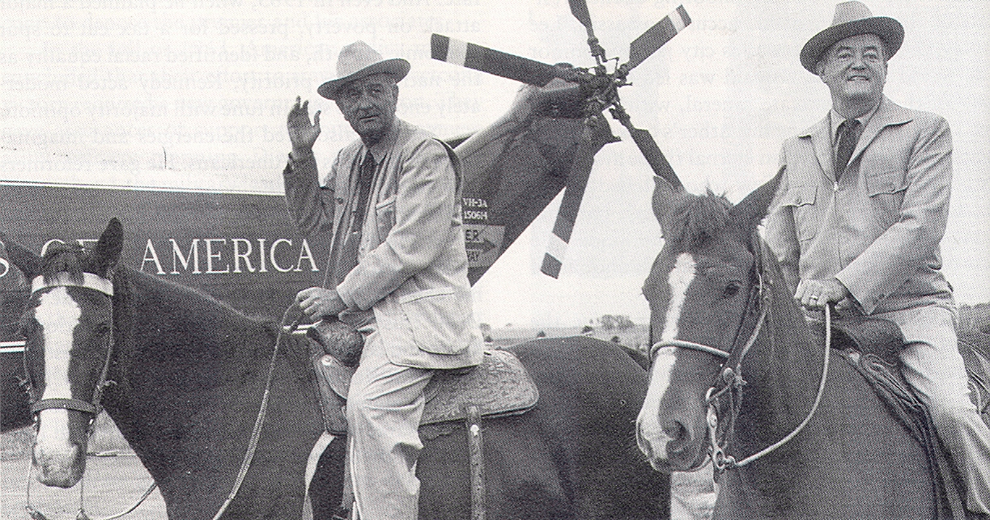
Lyndon Baines Johnson and Hubert Horatio Humphrey on Horseback at Johnson’s Ranch, 1964

Slide 3
The Civil Rights Act of 1964
An Act
To enforce the constitutional right to vote, to confer jurisdiction upon the district courts of the United States to provide injunctive relief against discrimination in public accommodations, to authorize the Attorney General to institute suits to protect constitutional rights in public facilities and public education, to extend the Commission on Civil Rights, to prevent discrimination in federally assisted programs, to establish a Commission on Equal Employment Opportunity, and for other purposes.
Be it enacted by the Senate and House of Representatives of the United States of America in Congress assembled, That this Act may be cited as the "Civil Rights Act of 1964".
TITLE I--VOTING RIGHTS
SEC. 101. Section 2004 of the Revised Statutes (42 U.S.C. 1971), as amended by section 131 of the Civil Rights Act of 1957 (71 Stat. 637), and as further amended by section 601 of the Civil Rights Act of 1960 (74 Stat. 90), is further amended as follows:
(a) Insert "1" after "(a)" in subsection (a) and add at the end of subsection (a) the following new paragraphs:
"(2) No person acting under color of law shall--
"(A) in determining whether any individual is qualified under State law or laws to vote in any Federal election, apply any standard, practice, or procedure different from the standards, practices, or procedures applied under such law or laws to other individuals within the same county, parish, or similar political subdivision who have been found by State officials to be qualified to vote;

Slide 4
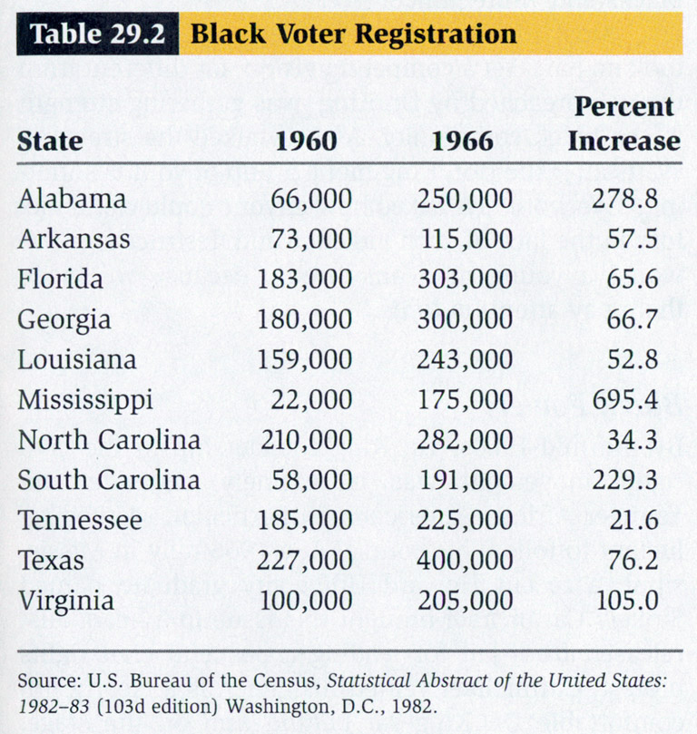
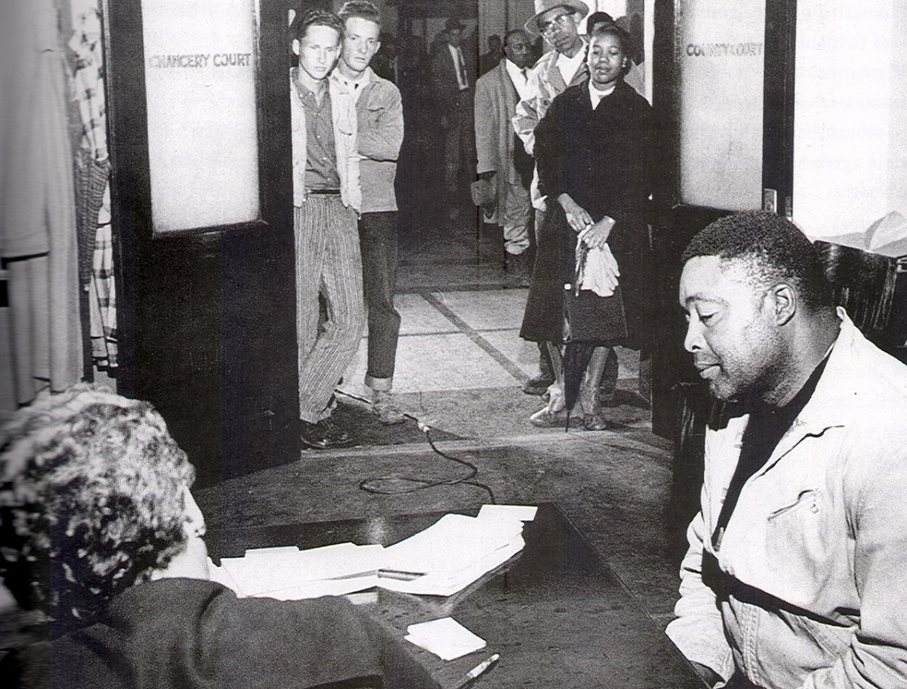
The Impact of the 1965 Voting Rights Act:
Left: Registering to Vote in Mississippi

Slide 5
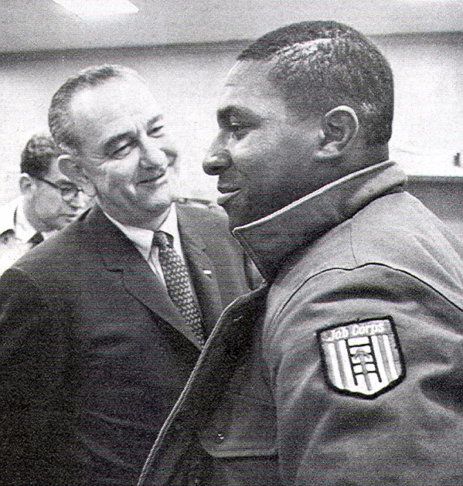
LBJ With Jobs Corps Volunteer James Truesville of Raleigh, North Carolina, 1966

Slide 6
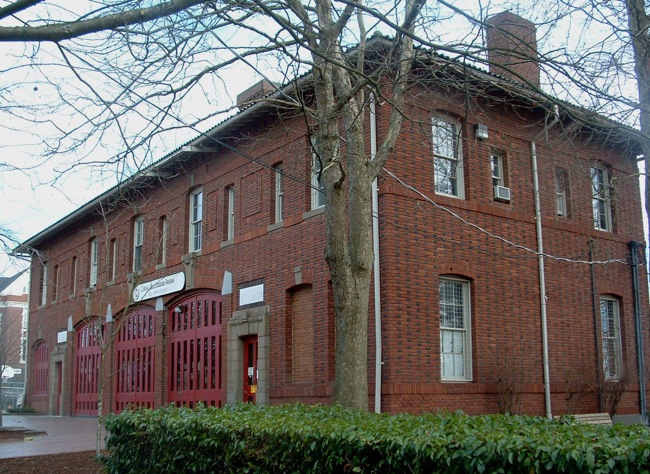
Central Area Motivation Program Office in Seattle

Slide 7
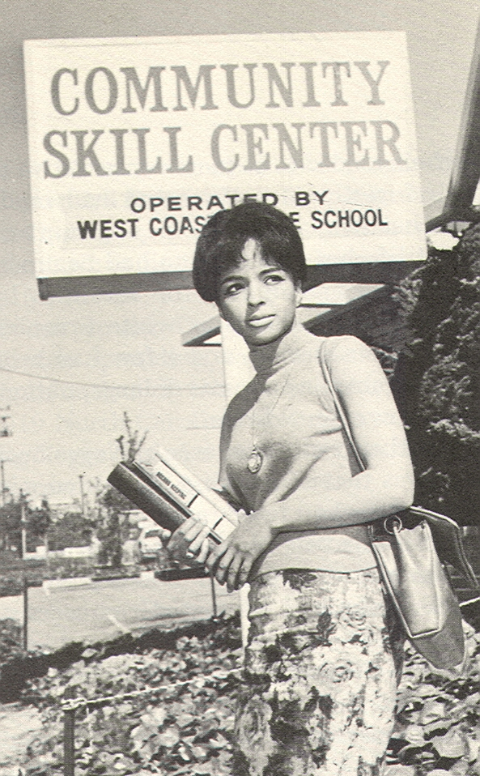
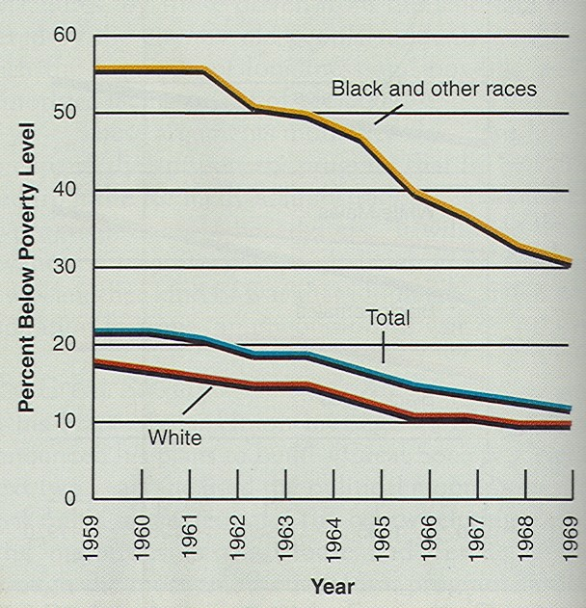
Fighting the War on Poverty

Slide 8
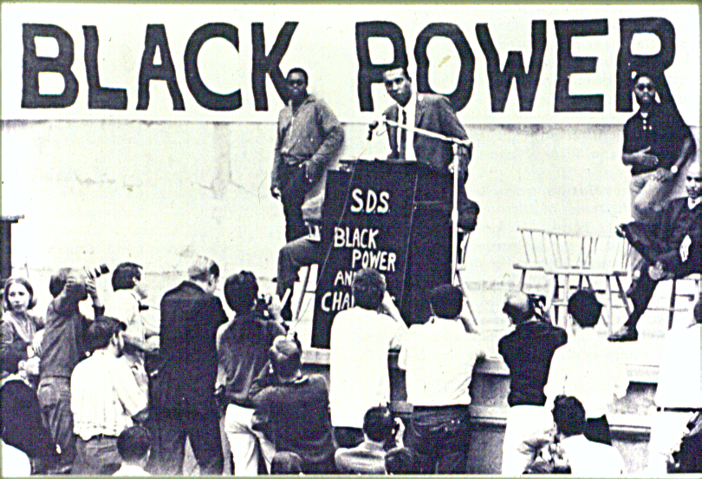

Slide 9
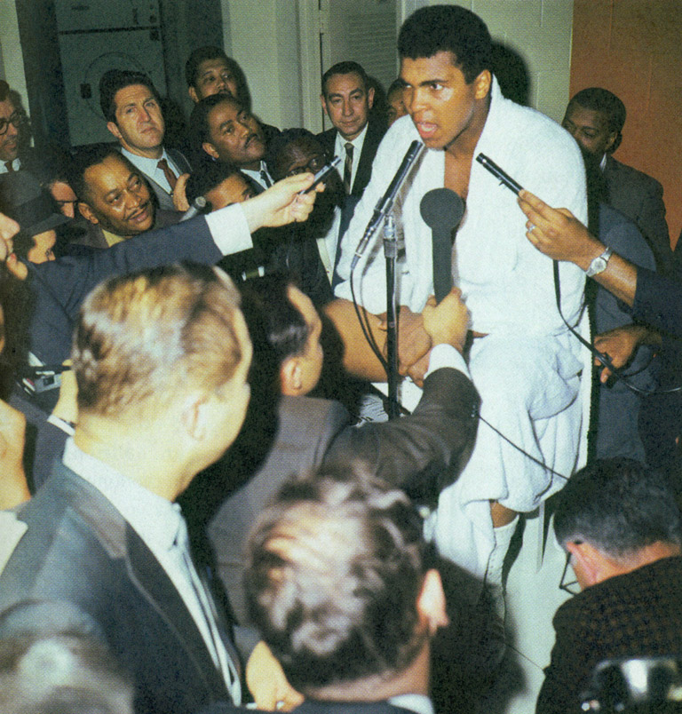
Black Nationalism Personified
Muhammad Ali’s Self-Definition
I am America. I am the part you won’t recognize, but get used to me. Black, confident, cocky—my name, not yours. My religion, not yours. My goals, my own. Get used to me.

Slide 10
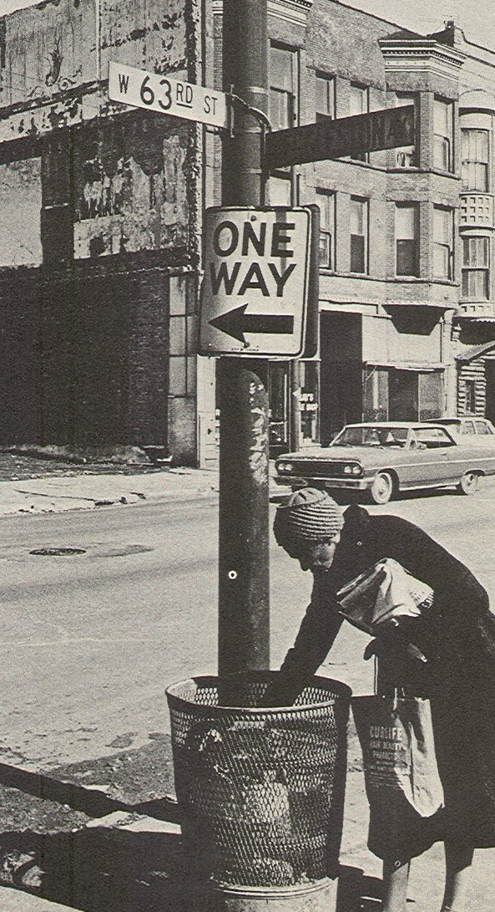
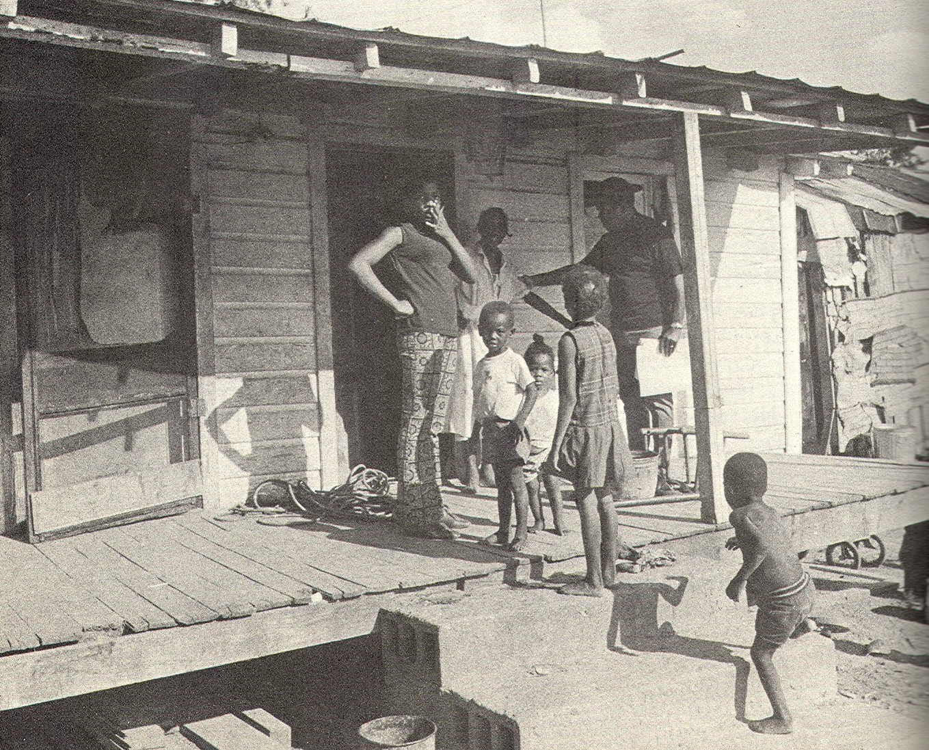
Poverty, North and South:
Woman Searching Garbage for Food, Chicago, 1964
Sharecropper Cabin, Alabama, 1966

Slide 11
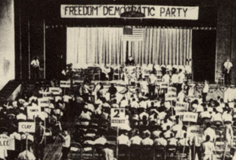
Mississippi Freedom Democratic Convention,
Jackson, Mississippi, 1964

Slide 12
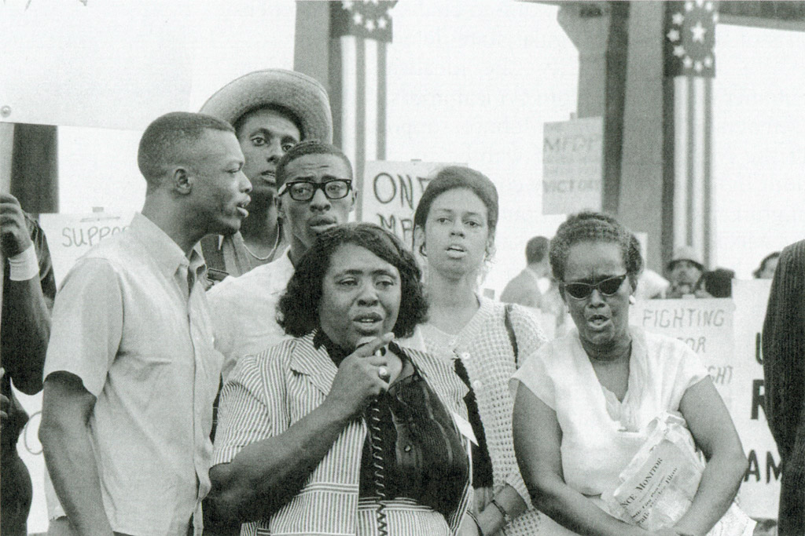
Fannie Lou Hamer and Supporters of the MFDP at the Democratic National Convention, 1964
Stokely Carmichael in Hat, Ella Baker on Right

Slide 13
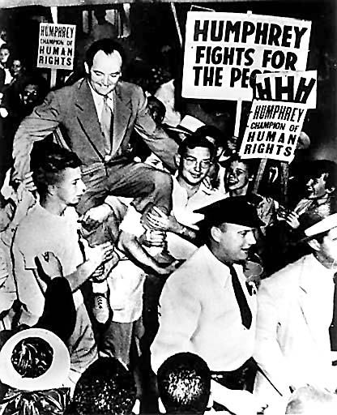
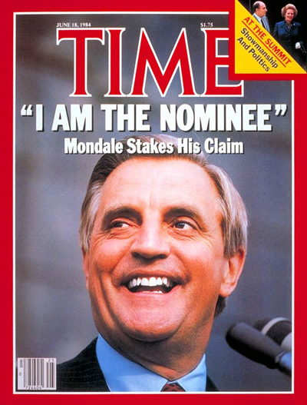
Hubert H. Humphrey
Elected Mayor of Minneapolis, 1948
Walter Mondale,
Democratic Presidential Nominee, 1984

Slide 14
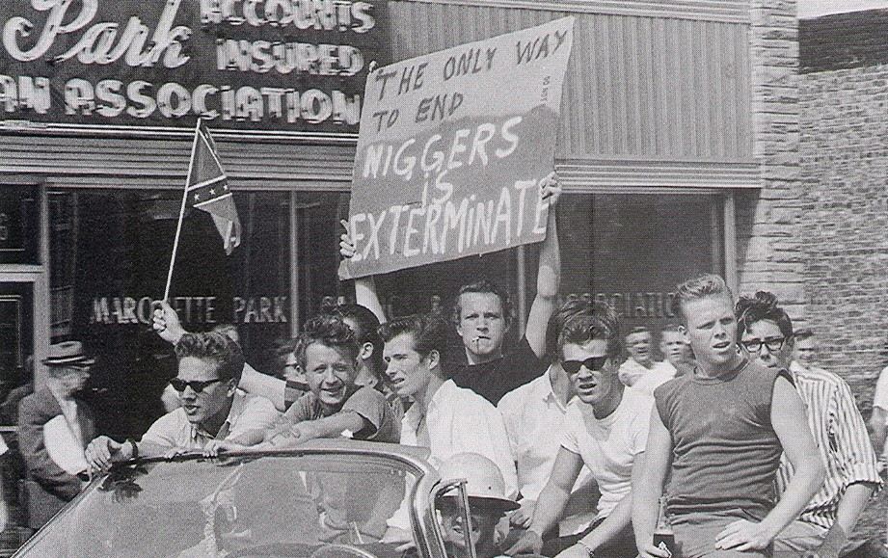
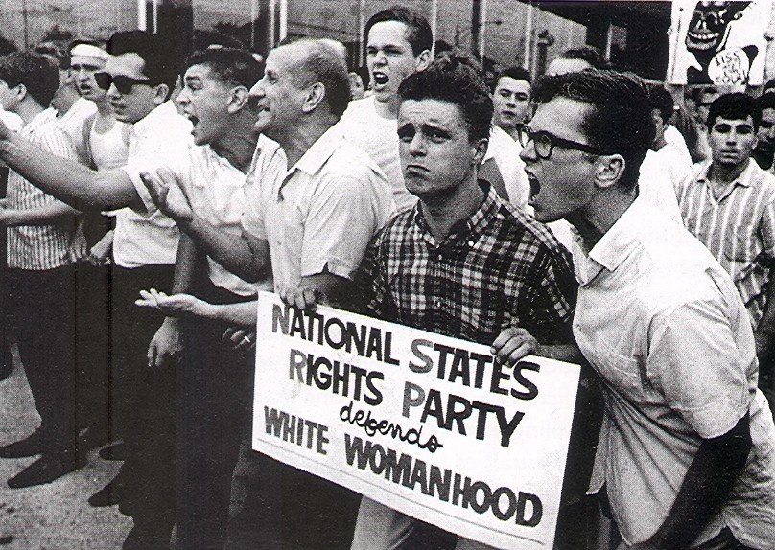
Opposition to Residential Integration, Cicero,
Opposition to School Busing, Chicago, both, 1966

Slide 15
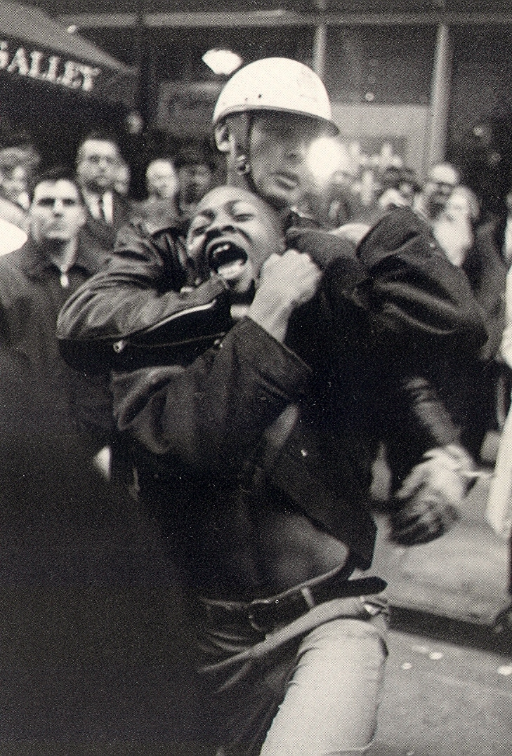
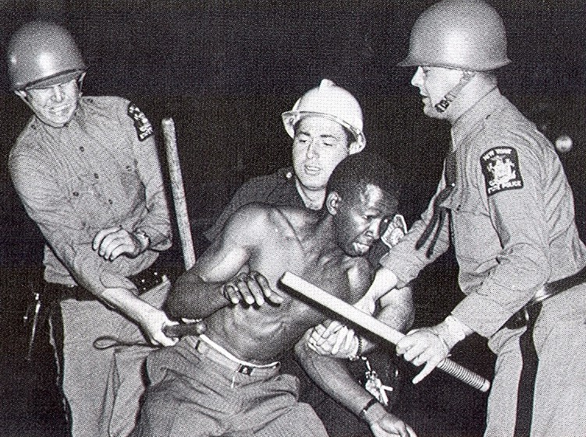
Police Brutality, Rochester, New York, 1964, NYC, 1966

Slide 16
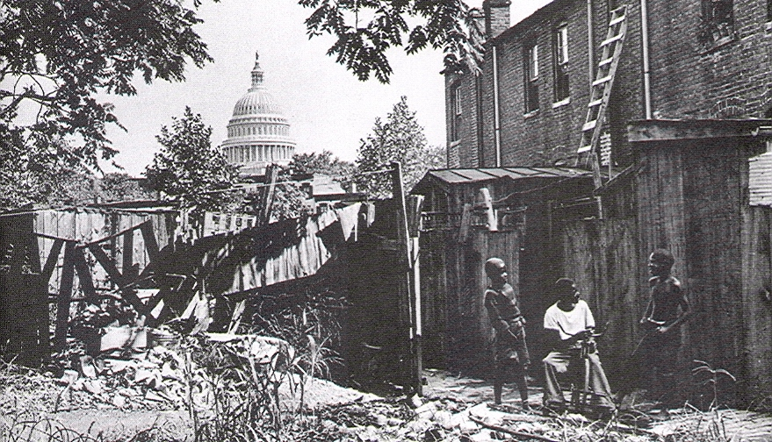
Washington, D.C., 1960

Slide 17
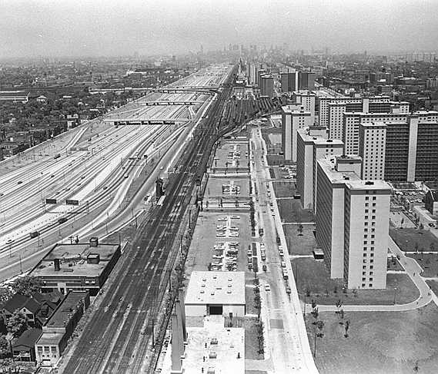
Robert Taylor Homes, Chicago, 1964

Slide 18
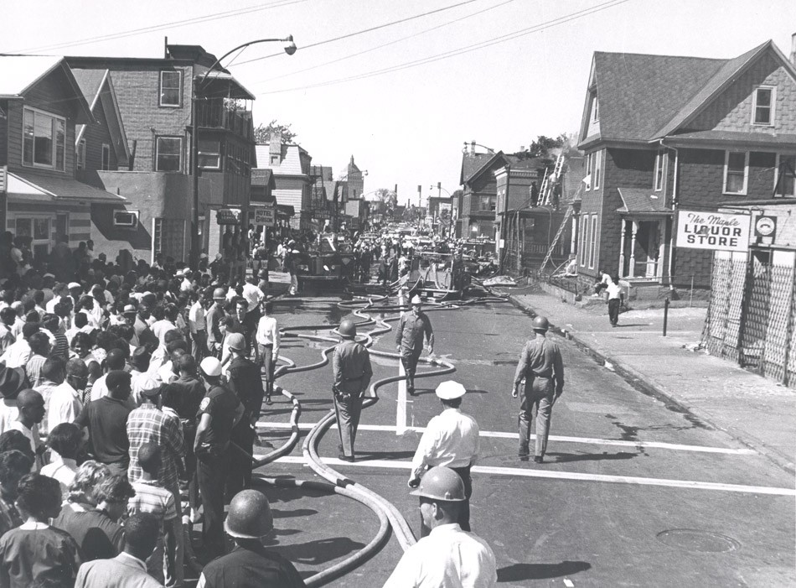
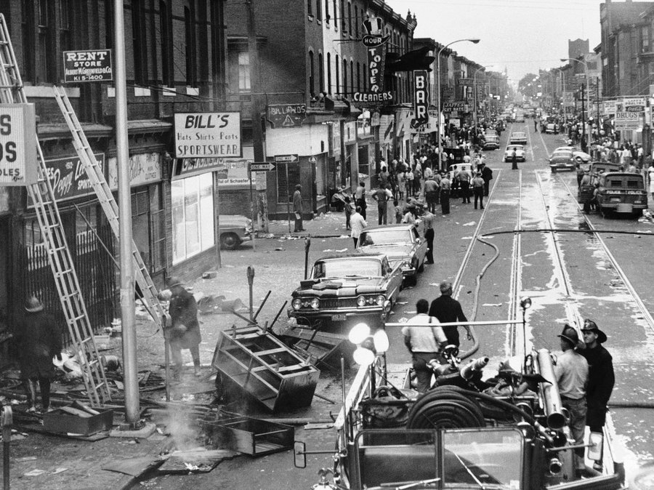
Race Riots, 1964
(Left: Rochester, N.Y, Right: Philadelphia)

Slide 19
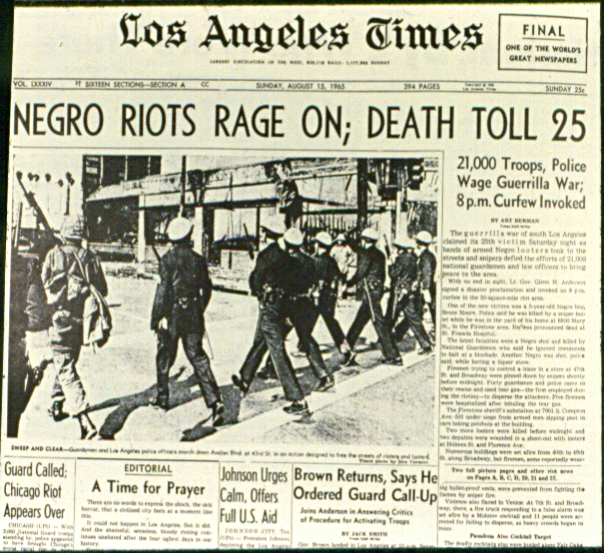

Slide 20
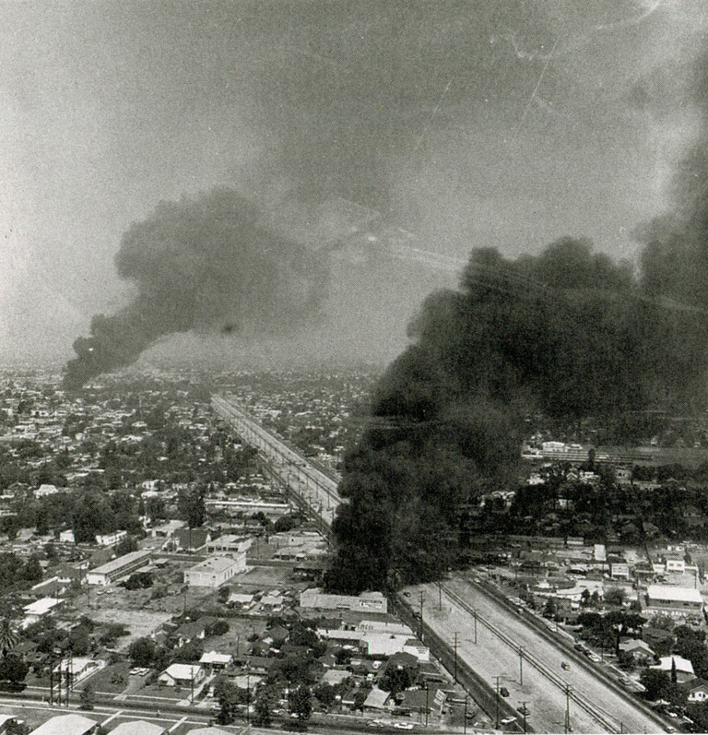
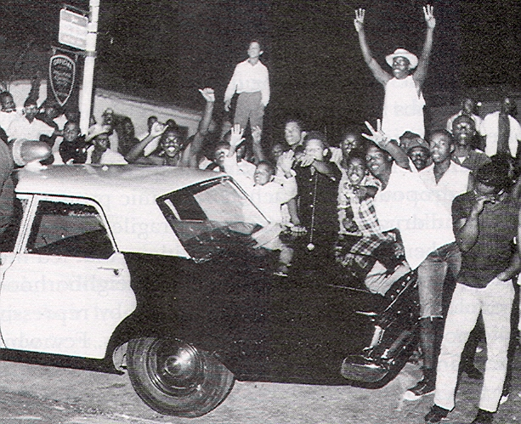
Watts, 1965

Slide 21
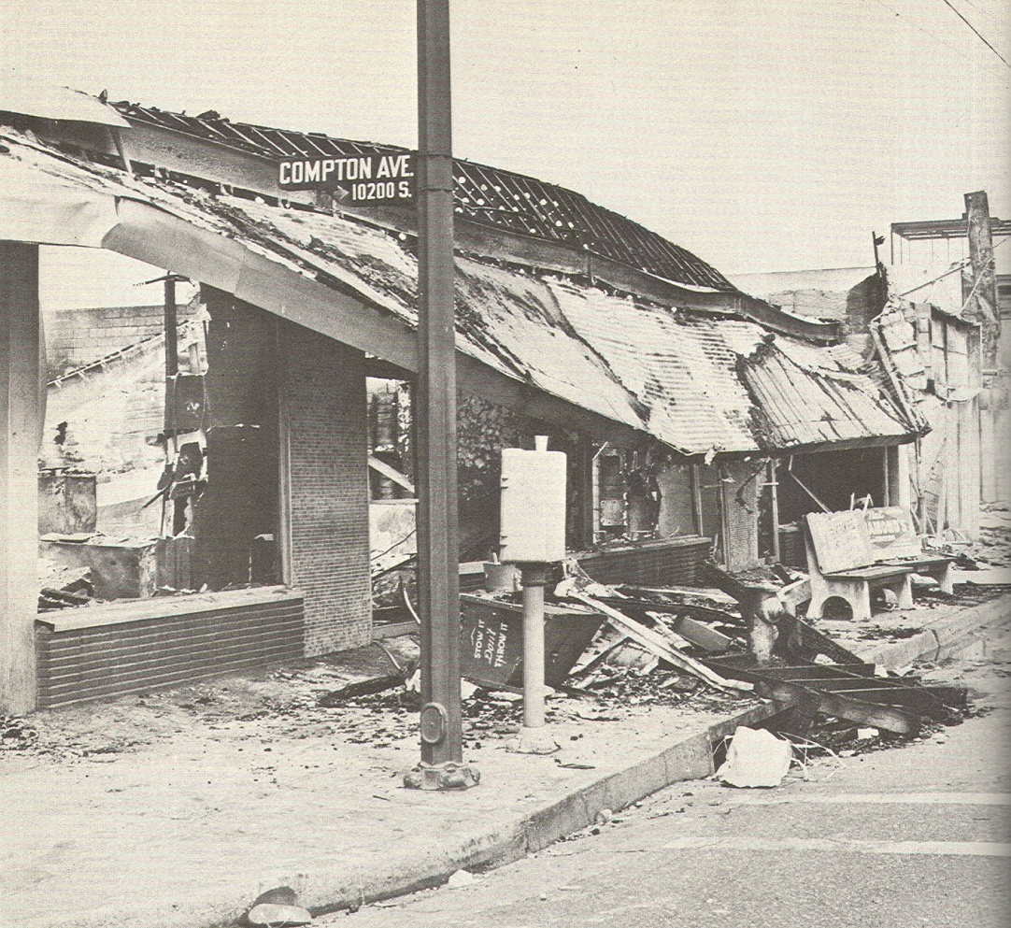
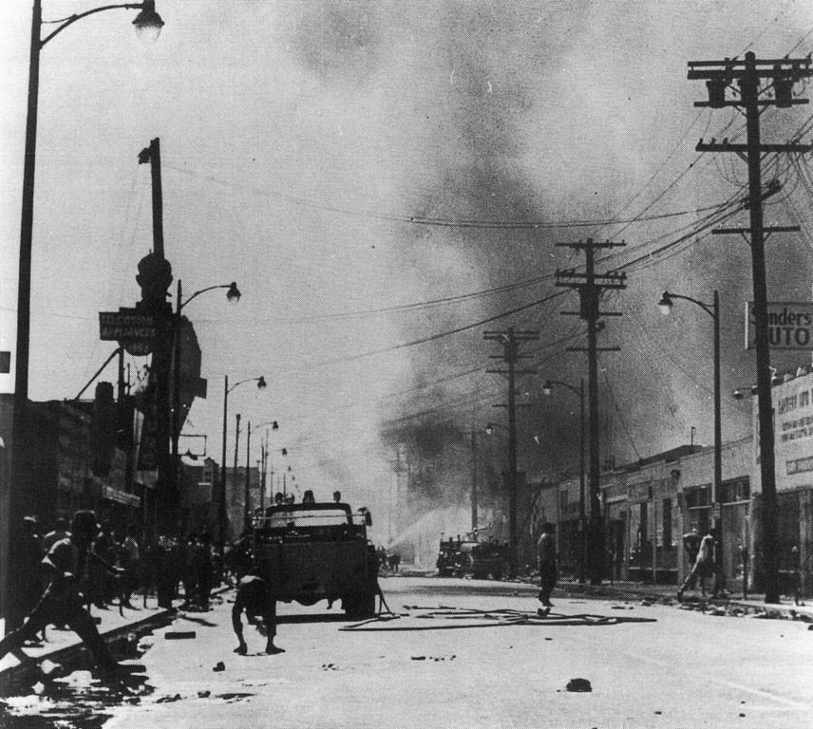
Left: 103rd Street
Right: Compton Ave and 108th Street

Slide 22
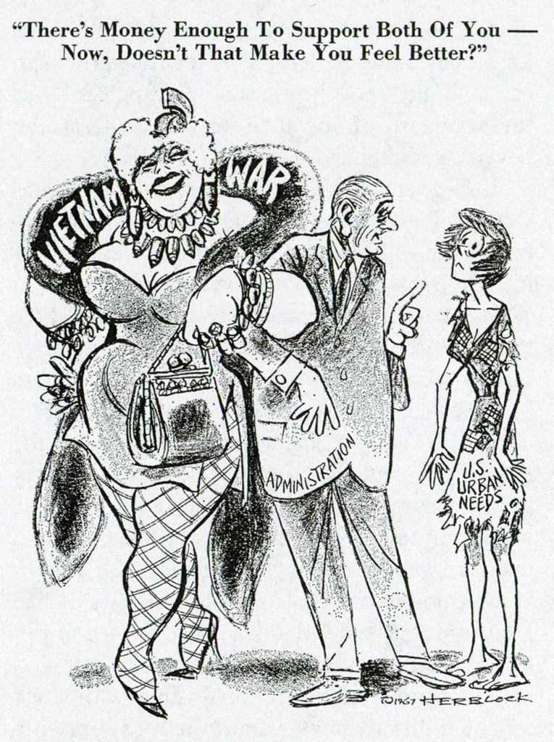
Guns or Butter?

Slide 23
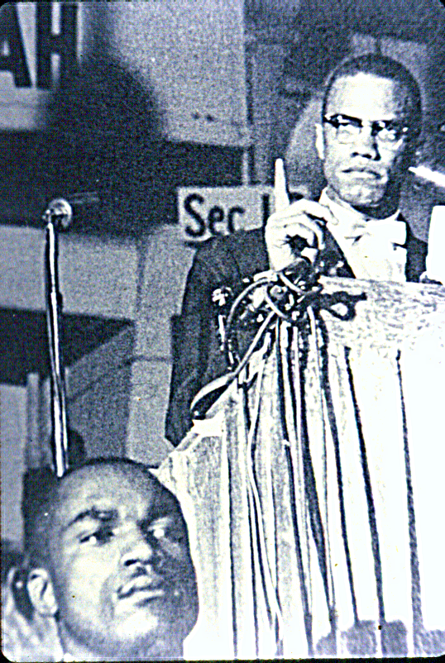
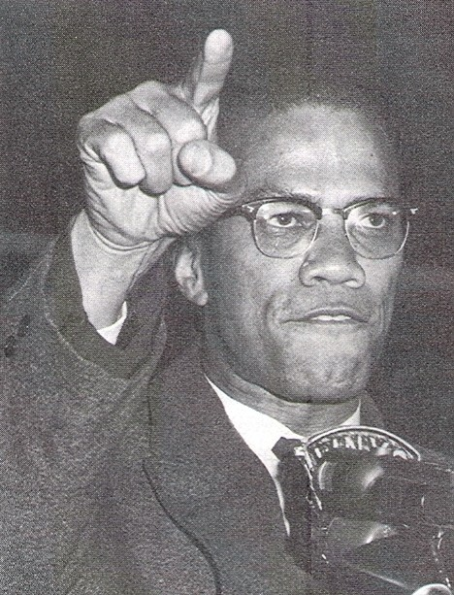

Slide 24
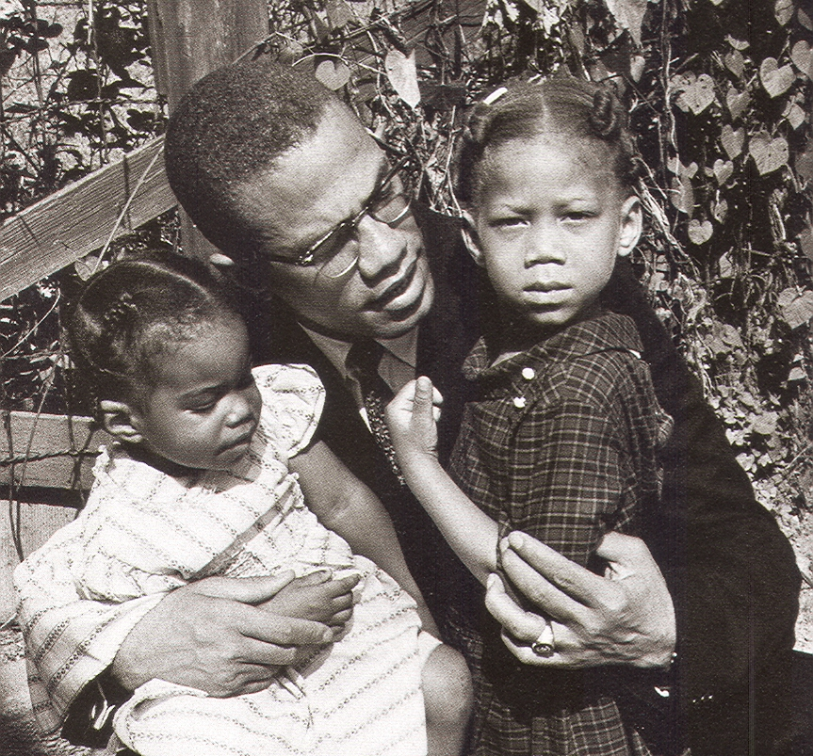
Malcolm and His Girls, 1965

Slide 25
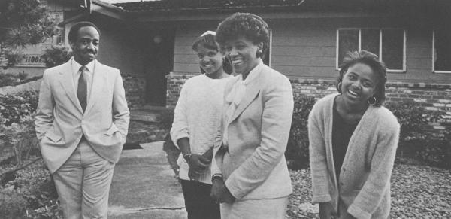
Middle Class Blacks

Slide 26
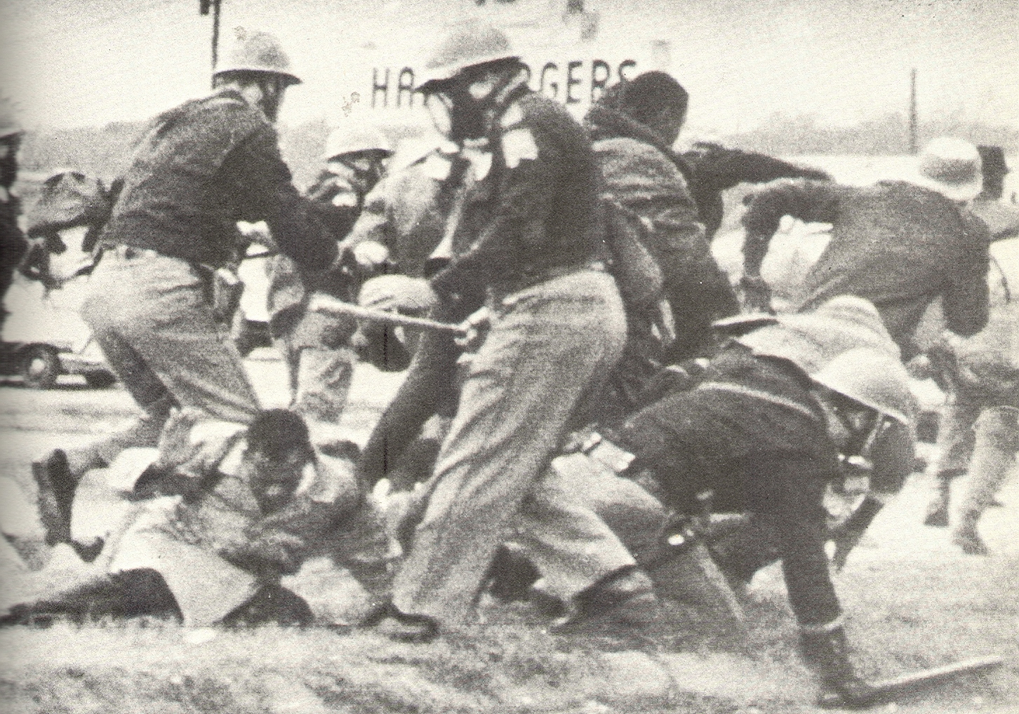
Beating of Demonstrators at Selma, 1965

Slide 27
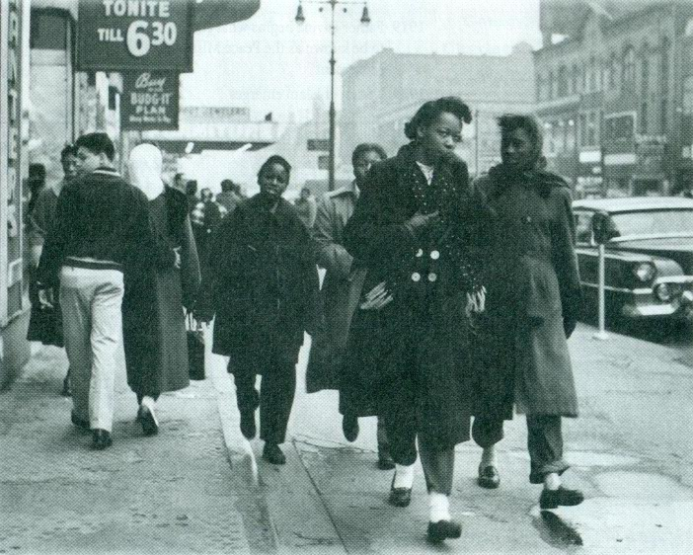
Seventh Avenue, Harlem, 1956

Slide 28
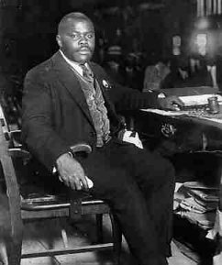
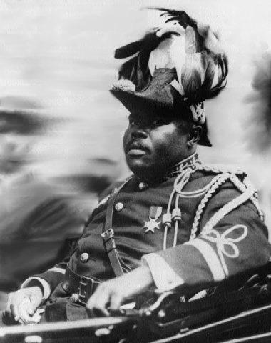
Marcus Garvey and the Roots of Black Power

Slide 29
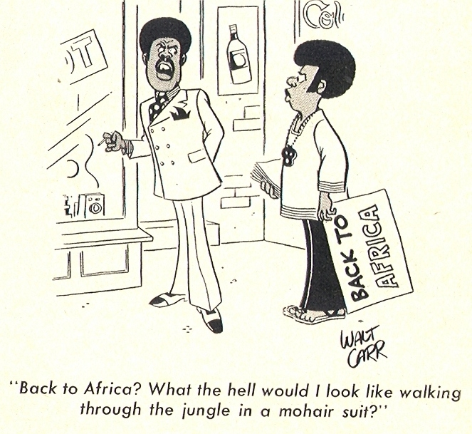
Ambivalent Identification with Africa

Slide 30
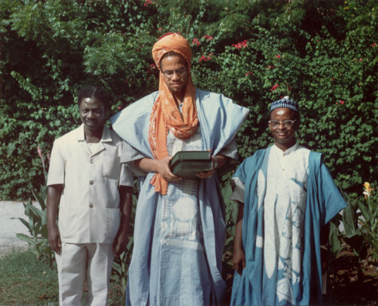
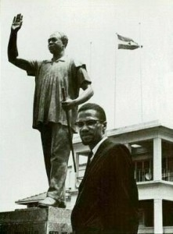
I don’t feel I am a visitor in Ghana or in any part of Africa. I feel that I am at home—
Malcolm X at the University of Ghana, May 13, 1964

Slide 31
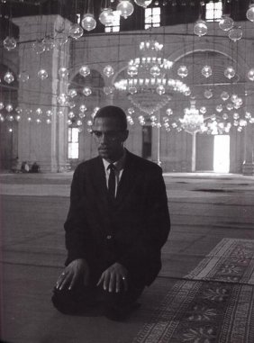
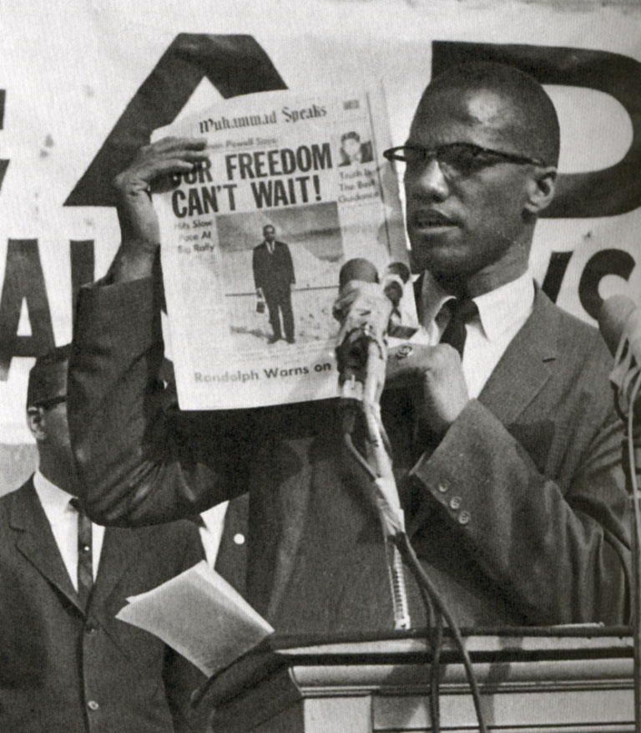
Malcolm X in Mecca and Egypt, 1964

Slide 32
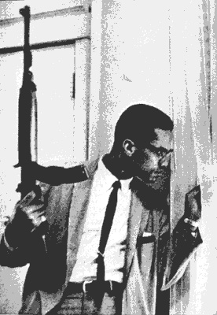

Slide 33
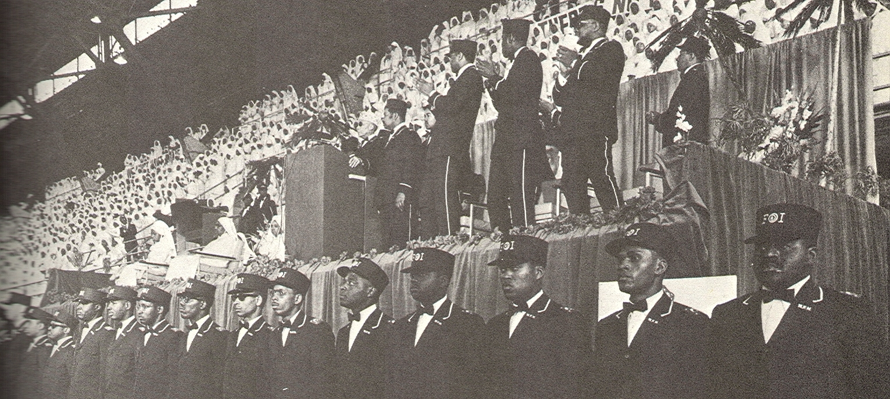
Malcolm and The Nation of Islam, 1963

Slide 34
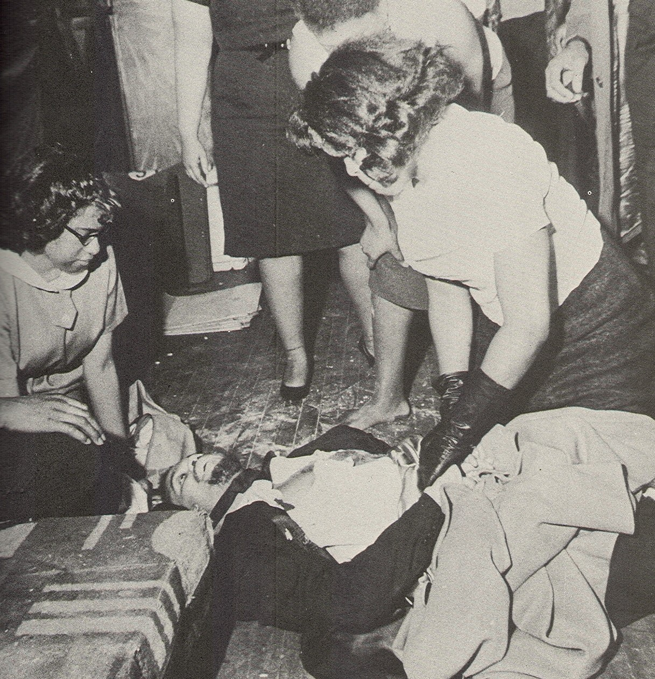

Slide 35
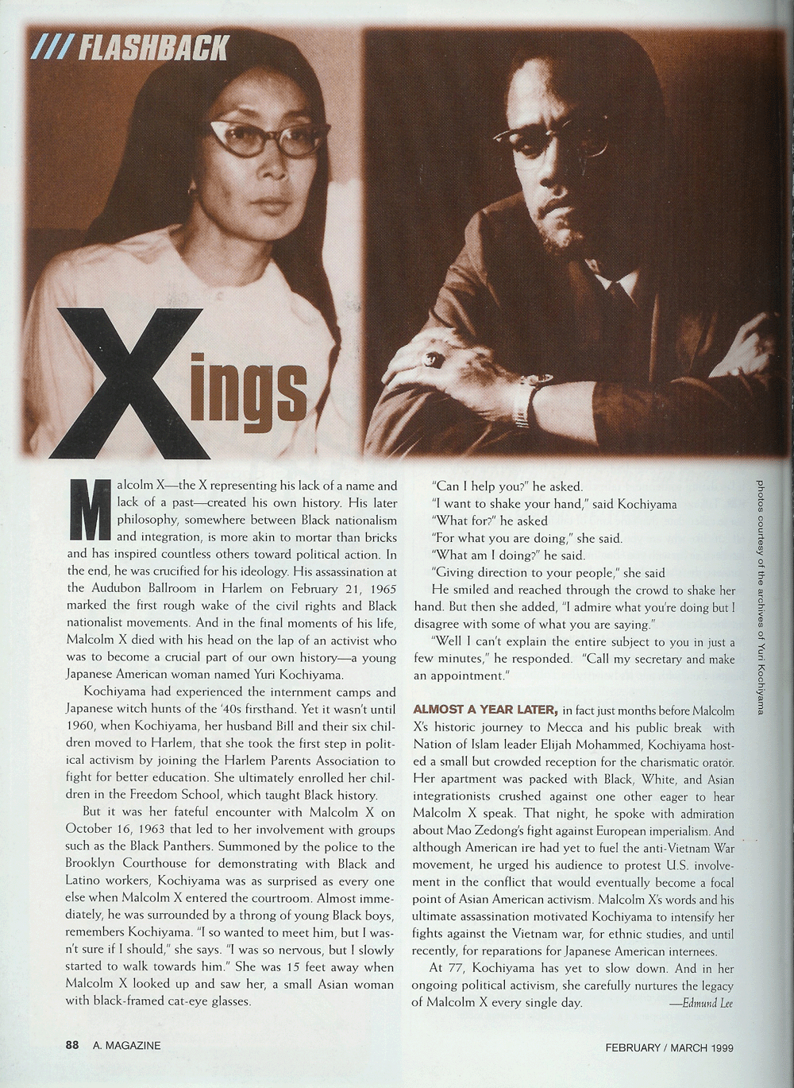
Yuri Kochiyama and Malcolm X

Slide 36
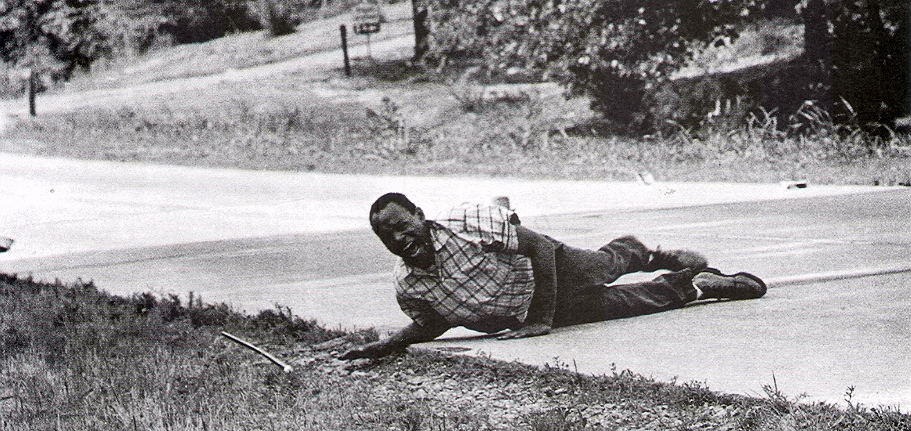
James Meredith Shot During His March Against Fear, June 1966

Slide 37
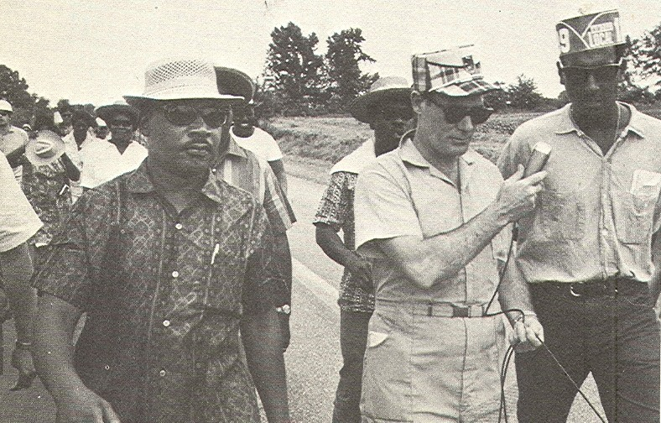

Slide 38
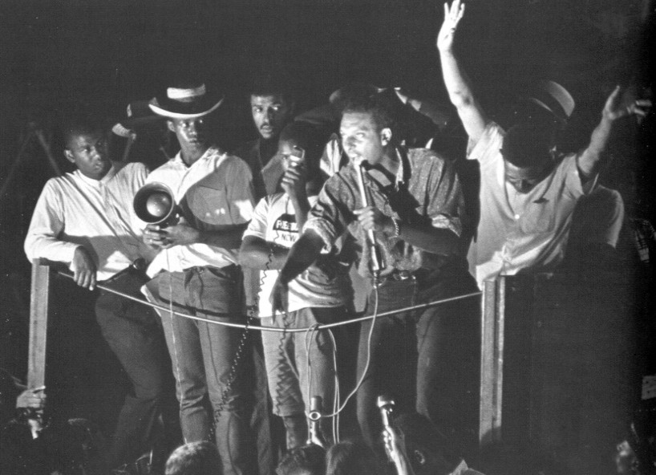
Stokely Carmichael’s First Black Power Speech, Greenwood, Mississippi, June 16, 1966

Slide 39
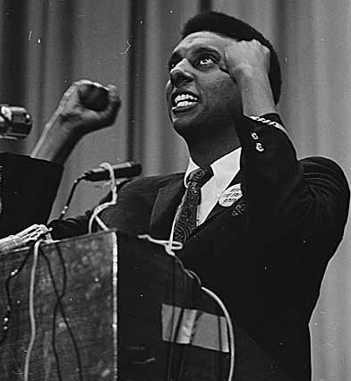
Stokely Carmichael at Garfield High, April 1967

Slide 40

Viet Cong Fighters, 1966

Slide 41

High School Student Demonstrators,
Social Circle, California, Feb. 15, 1968

Slide 42


Lowndes County (Alabama) Freedom Democratic Organization

Slide 43




The Roots of Black Power
David Walker, Henry Highland Garnet, Maj. Martin R. Delany, Booker T. Washington, Marcus Garvey

Slide 44

Black Power Press Conference in Newark, 1967

Slide 45


The Debate Over Black Power
Meet the Press, August 1966,
Sepia Magazine, September 1966

Slide 46



Slide 47

Tommie Smith and John Carlos,
Mexico City Olympics, 1968

Slide 48

Howard University Commencement, 1969

Slide 49

Jesse Jackson and Canadian Black Power Advocates

Slide 50


Bloods: Black Soldiers in Vietnam, 1968

Slide 51

Aretha Franklin, From Pop Star to the Queen of Soul
“Respect”
“You Make Me Feel Like a Natural Woman”

Slide 52

Claiming Malcolm’s Legacy
Cultural Nationalism
Revolutionary Nationalism

Slide 53

US Wedding, Los Angeles, 1966

Slide 54


Cultural Liberation:
Play in Charleston, West Virginia, 1967
Black Arts West: Seattle, 1969

Slide 55


Leaders of Cultural Nationalism:
Maulana Ron Karenga (left) of Los Angeles
Amiri Baraka of Newark

Slide 56

Bobby Seale & Huey P. Newton, 1967

Slide 57

Panthers at the California State Capitol, Sacramento, 1967

Slide 58



The Panthers Rainbow Coalition:
Young Lords in Chicago, Brown Berets in Los Angeles, Yellow Peril in San Francisco

Slide 59

Panther Rally at the Federal Courthouse, Seattle, 1969

Slide 60

Bobby Seale on Racial Hatred
When a man walks up and says we are anti-white, I say, yeah, we hate something alright. We hate the oppression that we live under. If you got enough energy to sit down and hate a white person just because of the color of his skin, you’re wasting a lot of energy. You’d better take some of that energy and start dealing with oppressive conditions.

Slide 61

Panther Rally in Chicago, 1968

Slide 62


Slide 63

Recruiting Women into the Black Panther Party

Slide 64

Panthers on the Steps of the State Capitol at Olympia

Slide 65



The Panthers: The International Impact
Black Panther Woman at Rally in Brixton (London), 1972
Black Panthers in Israel, 1972
Dalit Panther Party, India, Founded, 1972

Slide 66

Panther Feeding Child at Free Huey Rally, Oakland, 1968

Slide 67


Aaron Dixon at the Free Breakfast Program (Seattle)
Carolyn Downs Family Medical Center (Seattle)

Slide 68


Slide 69

Panther Politics, 1973
Bobby Seale Running for Oakland Mayor,
Elaine Brown Running for Oakland City Council

Slide 70


The Black Nationalist Alternative:
The Honorable Elijah Muhammad and The Nation of Islam

Slide 71

Black Belt Republic Poster

Slide 72

UCLA Shootout, January 17,1969
Campbell Hall, 1201: Room Where John Huggins and Alphonse “Bunchy” Carter were killed

Slide 73
Leading Black Power Groups in Seattle
Seattle Congress of Racial Equality
Seattle Student Non-Violent Coordinating Committee
The Black Panther Party
Central Area Committee for Peace and Improvement
Black Arts West
The United Black Front

Slide 74

The Feminist Critique of Black Power: Black Women March in Washington, D.C., 1971
Total black liberation is impossible if black women are silenced. No black woman can become a modern Harriett Tubman if she is chained to an ironing board....
Unidentified Black Panther woman

Slide 75

Major Urban Uprising, 1965-1968

Slide 76


1968: Chicago’s West Side and Washington D.C. Following the Assassination of
Dr. Martin Luther King

Slide 77


Black Panther Survival Programs

Slide 78
J. Edgar Hoover on the Panther Survival Programs
You state that the [FBI] under the counter-intelligence program should not attack programs of community interest such as the Black Panther Party’s “Breakfast for Children.” You have obviously missed the point. This program was formed by the BPP…to create an image of civility, assume community control of Negroes, and to fill adolescent children with their insidious poison.

Slide 79

COINTELPRO Memorandum, 1968

Slide 80

Crude COINTELPRO Drawing, 1969

Slide 81


Fred Hampton (in White Shirt) with Members of the Chicago Black Panther Party, 1968
Door of Hampton Apartment after Raid on December 4, 1969

Slide 82

Elaine Brown, Chairwoman of the Black Panther Party, 1974-1977
I saw my friends’ brains splattered on the sidewalk by police bullets. I saw their faces in caskets. Things got so bad that funeral attire became a regular part of our wardrobe. I became paranoid. I always looked over my shoulder....

Slide 83

Stokely Carmichael and H. Rap Brown at Columbia University Student Take-Over, 1968

Slide 84


Maynard Jackson, Mayor of Atlanta, 1973
Harold Washington, Mayor of Chicago, 1983

Slide 85
BIG CITY MAYORS, 1967--
Left> Maynard Jackson, Mayor of Atlanta, 1973
Carl Stokes, Cleveland, 1967
Kenneth Gibson, Newark, 1969
Tom Bradley, Los Angeles, 1972
Maynard Jackson, Atlanta, 1973
Walter Washington, Washington, D.C., 1975
Harold Washington, Chicago, 1983
Wilson Goode, Philadelphia, 1984
David Dinkins, New York City, 1989
Norm Rice, Seattle, 1989
Lee Brown, Houston, 1997

Slide 86

Presidential Candidate Jesse Jackson Addressing the 1984 Democratic Party Convention in San Francisco

Slide 87

Anti-Apartheid Protests, Milwaukee, Wisconsin, 1985

Slide 88

Million Man March, October 16, 1995

Slide 89


Slide 90

U.W. Student Protests in Favor of Black Studies, 1969

Slide 91



Nikki Giovanni, Lorraine Hansberry, Maya Angelou

Slide 92

“Dark Divas”
New Black Arts West Production in Seattle: September 2010

Slide 93


Toni Morrison and August Wilson

Slide 94


NWA and Tupac

Slide 95


Black Power at the Royal Wedding, May 19, 2018

