Slide 1
We Shall Overcome
1946-1965

Slide 2
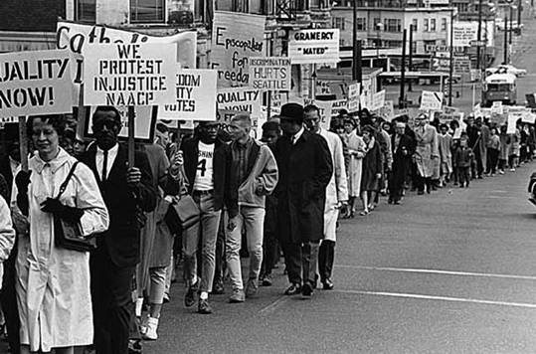
Civil Rights Demonstration in Seattle, June 1965

Slide 3
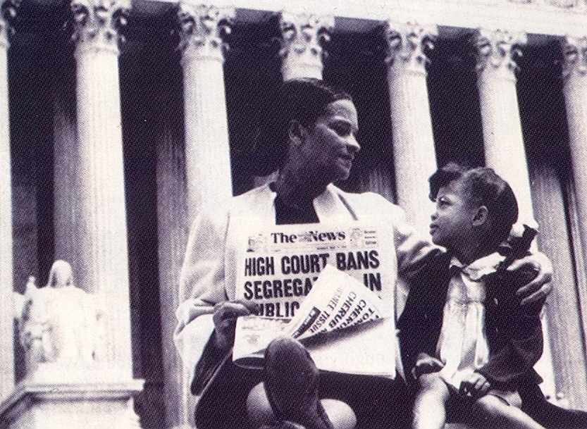

Slide 4
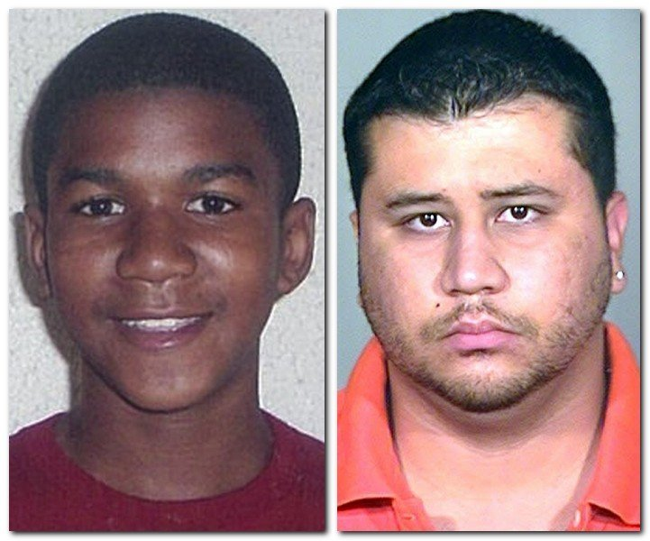
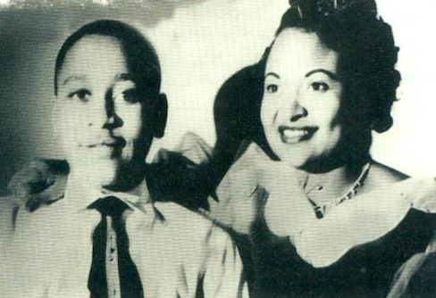
The Emmitt Till Case, 1955
Trayvon Martin, 2013

Slide 5
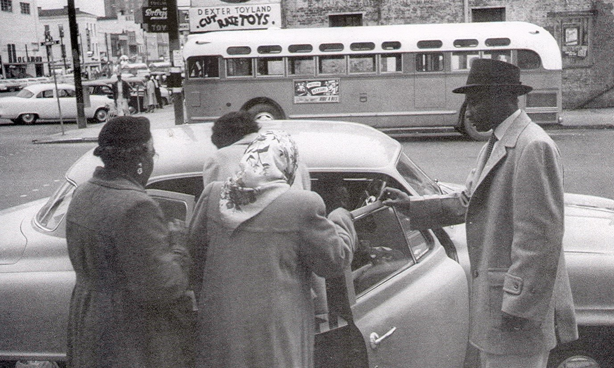
Carpooling During the Montgomery Bus Boycott, 1956

Slide 6
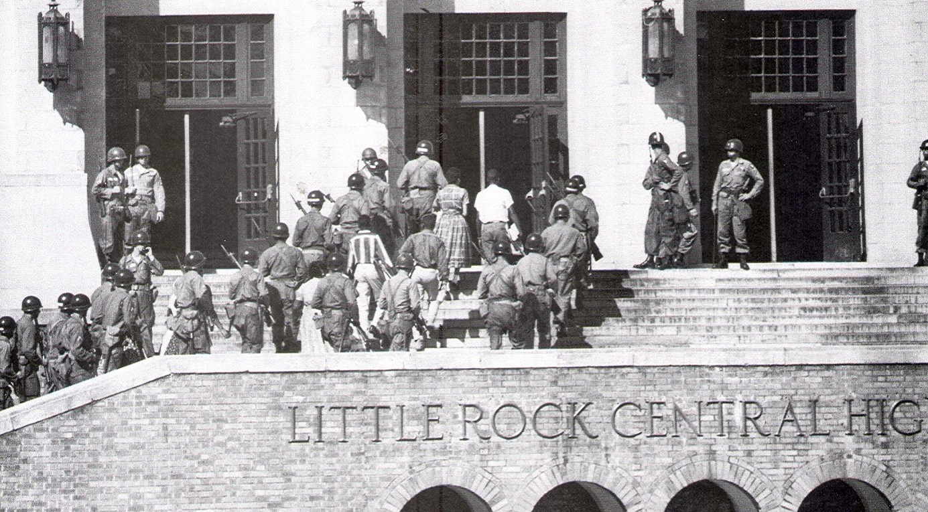

Slide 7
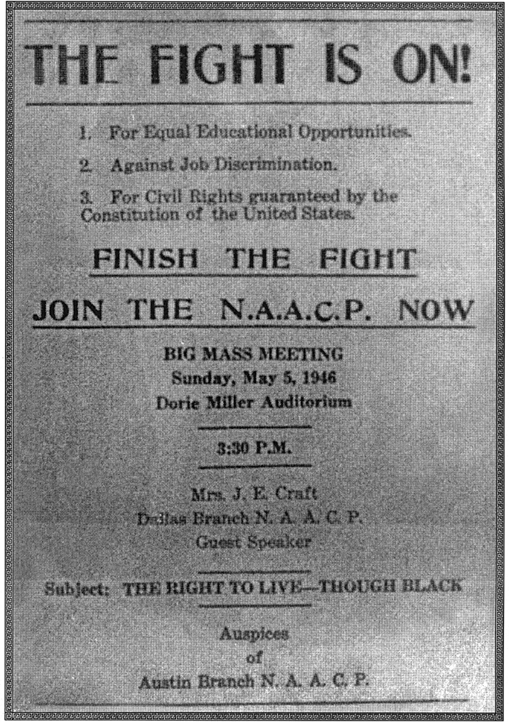
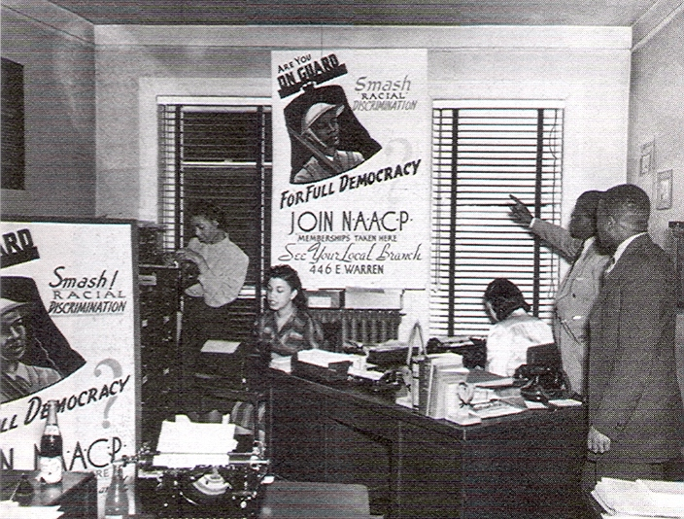
NAACP Office, Austin, Texas, 1946

Slide 8
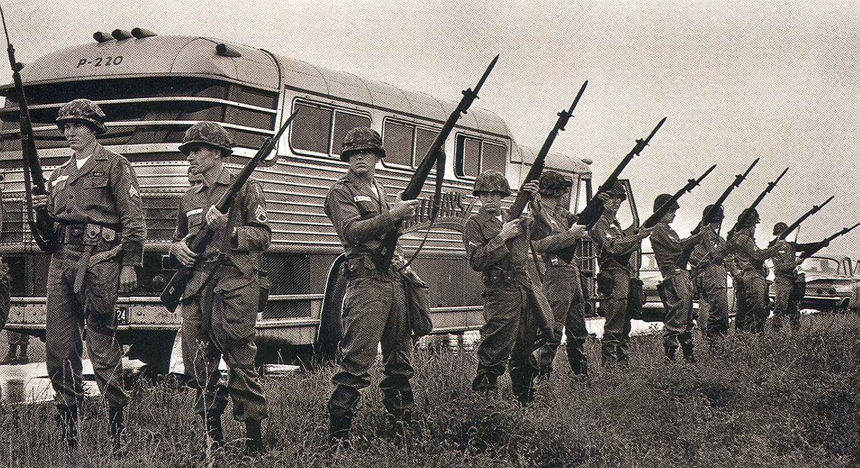
Federal Troops Guarding Freedom Riders Bus Near Mississippi-Alabama Border, 1961

Slide 9
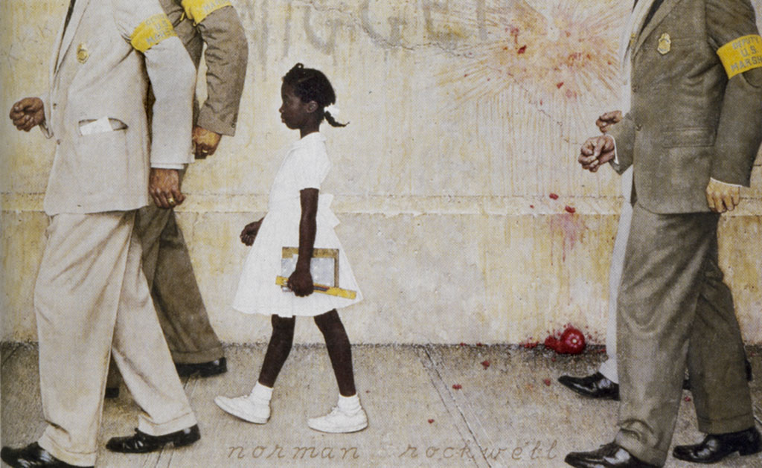
U.S. Marshals Guarding Ruby Bridges,
New Orleans, 1960

Slide 10
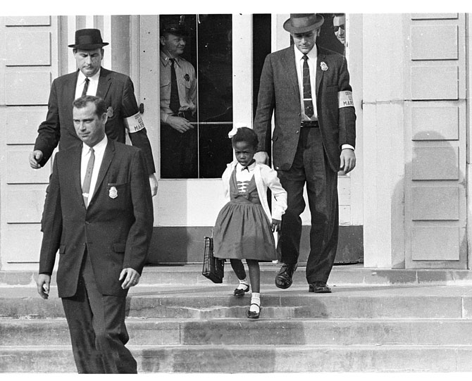

Slide 11
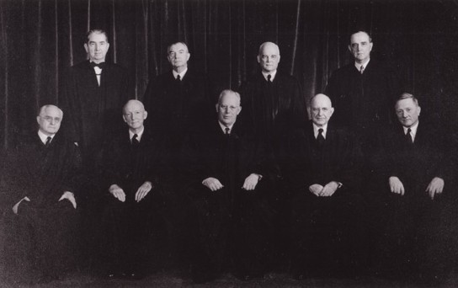
The United States Supreme Court, 1954

Slide 12
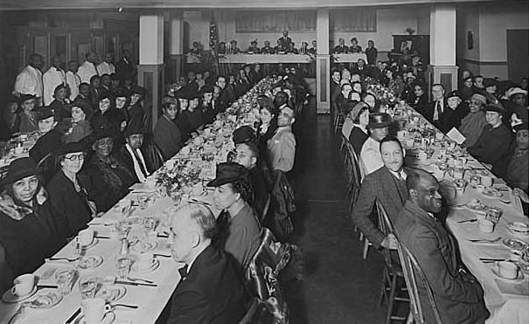
NAACP Dinner, Mt. Zion Baptist Church, Seattle, 1945

Slide 13
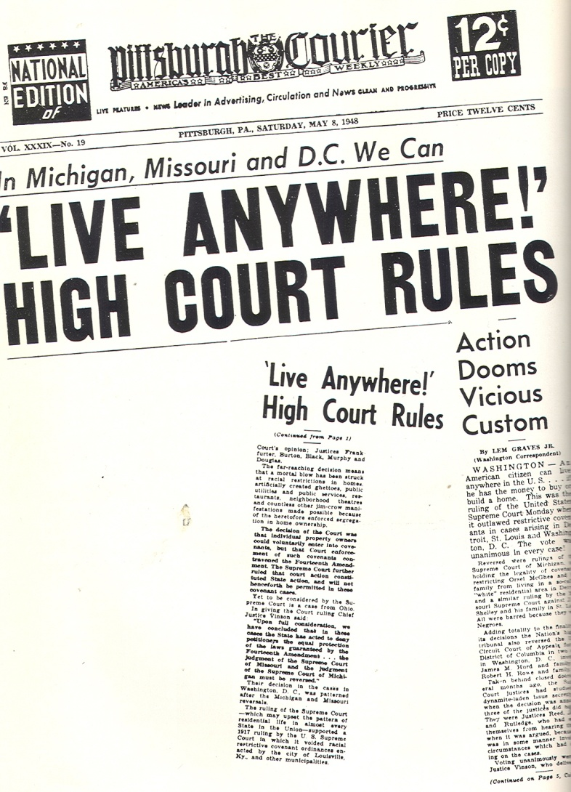
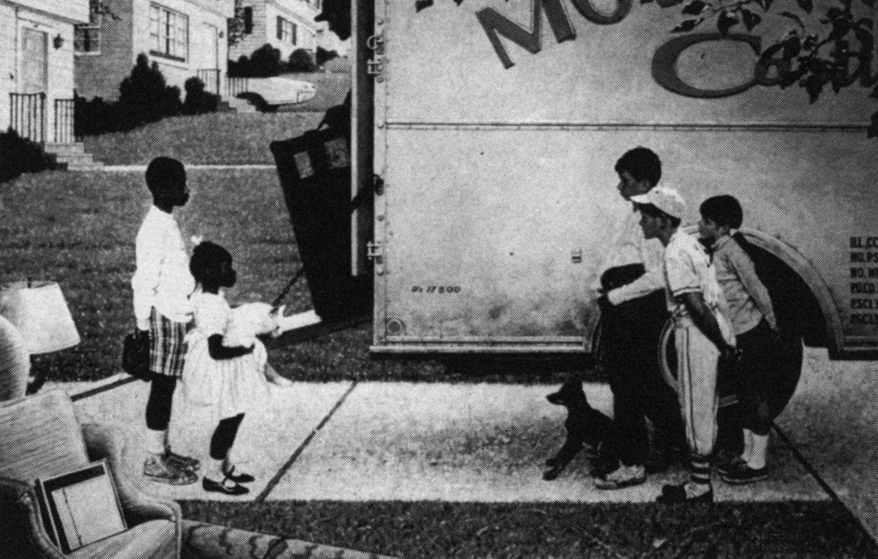
NAACP Victory Against Restrictive Covenants, 1948

Slide 14
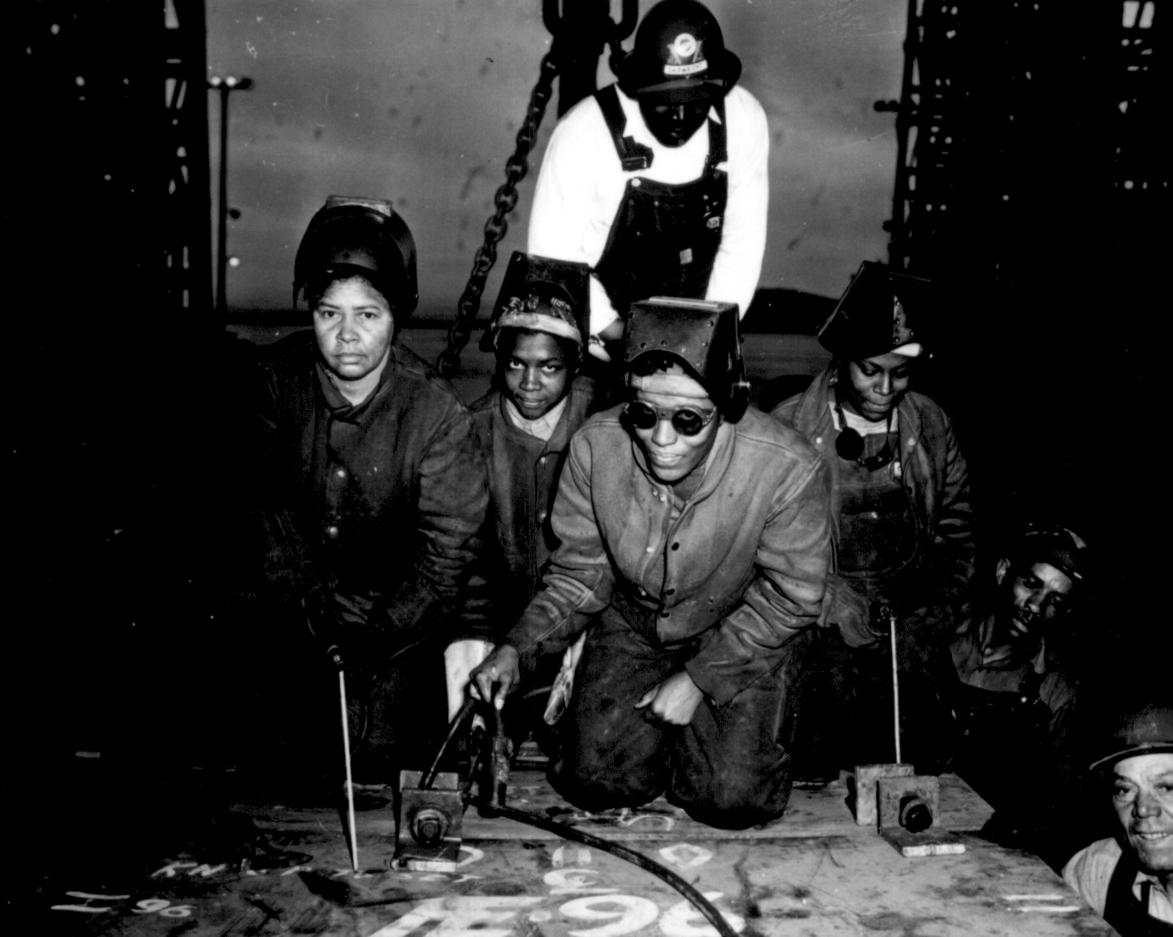

Slide 15
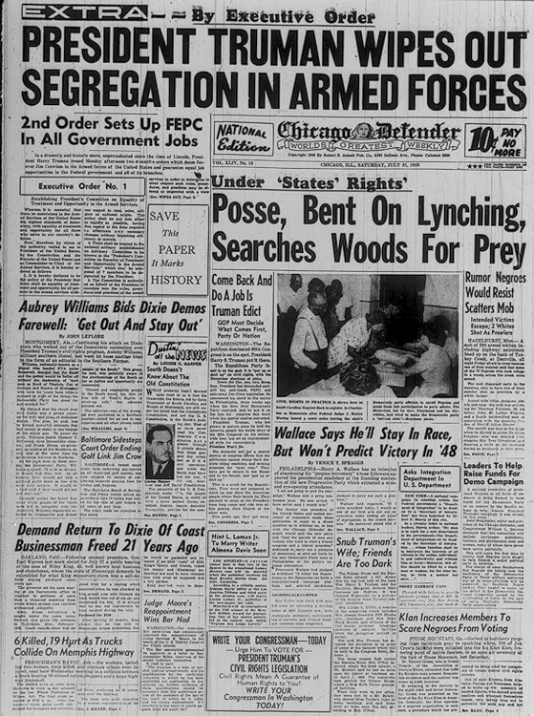
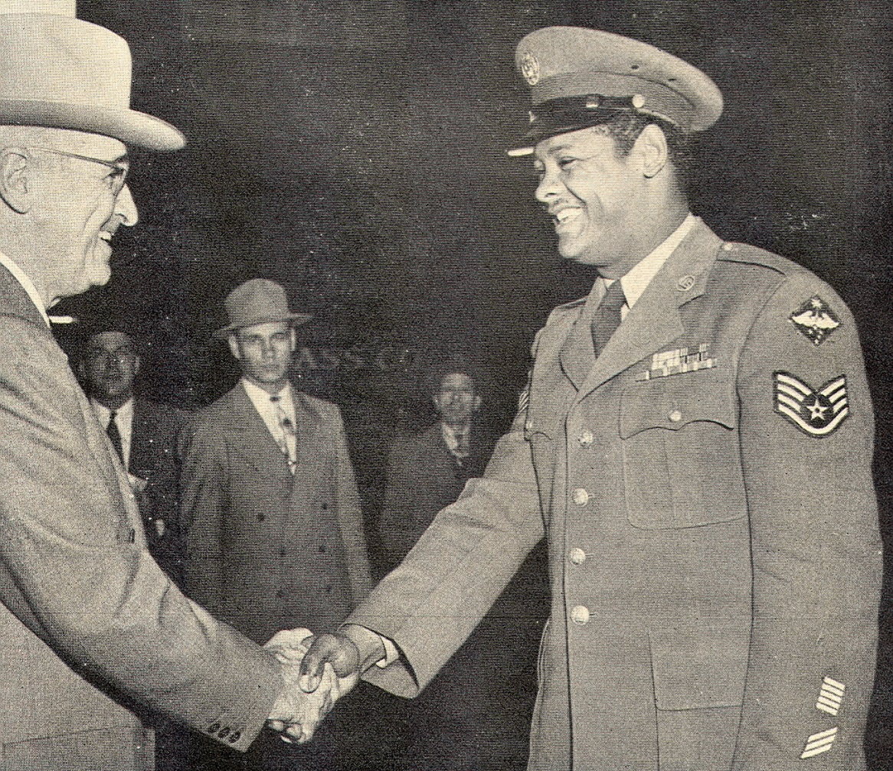
President Harry Truman and Civil Rights

Slide 16
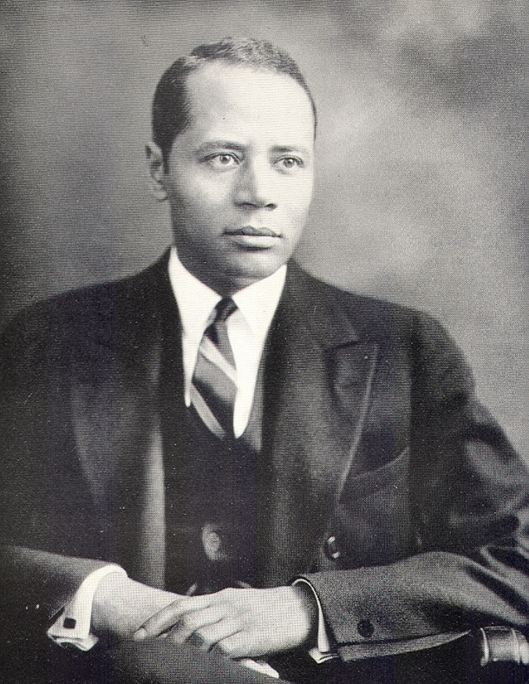
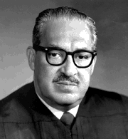
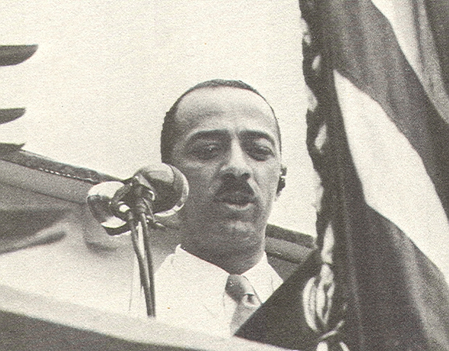
Charles Houston, William Hastie, Thurgood Marshall

Slide 17
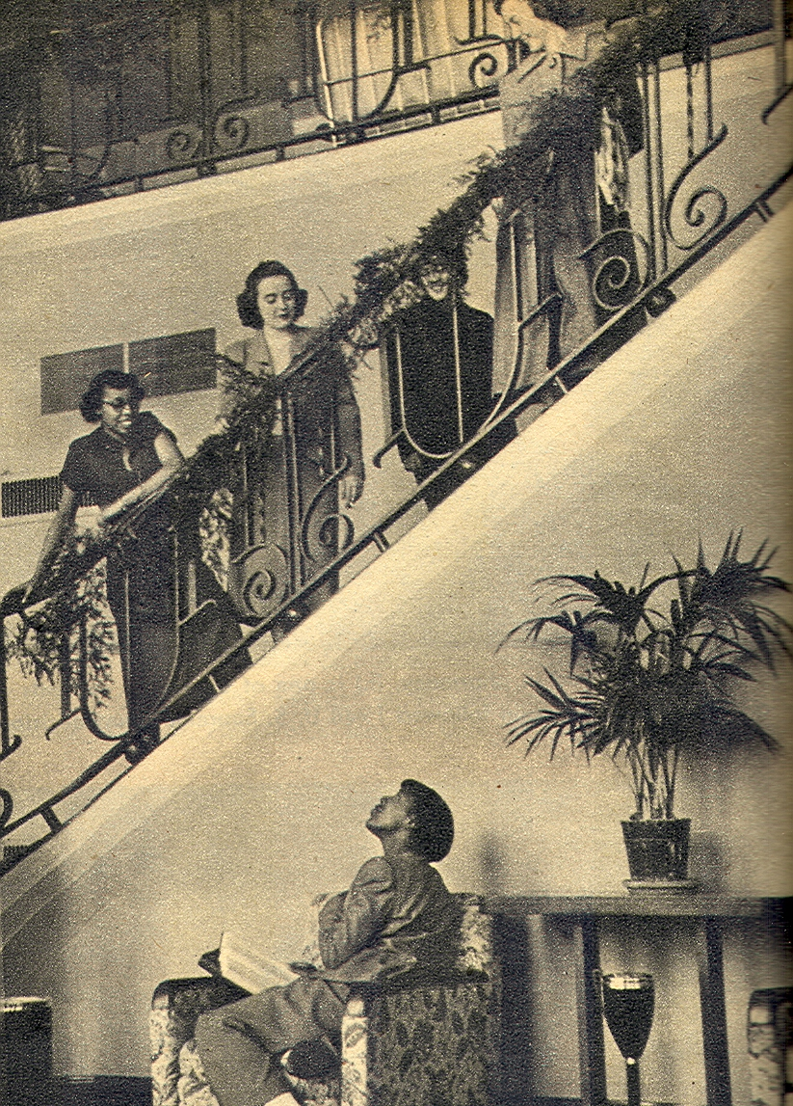
Betty Newby (sitting) and Betty Thurman on Stairs, with other University of Kentucky School of Education Students, 1951

Slide 18
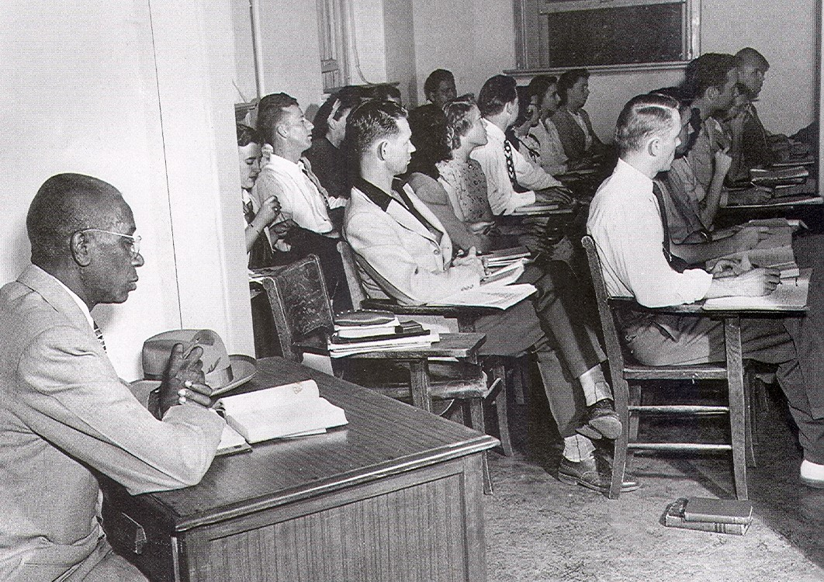
G.W. McLaurin in the “Negro Row” at the University of Oklahoma, 1950

Slide 19
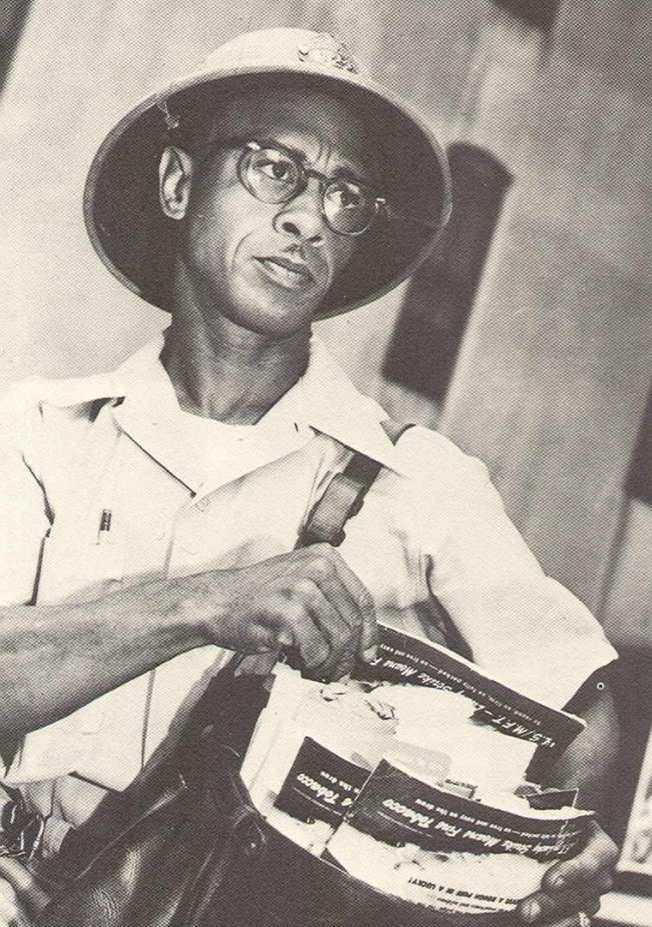
Heman Sweatt Integrates the University of Texas Law School, 1950

Slide 20
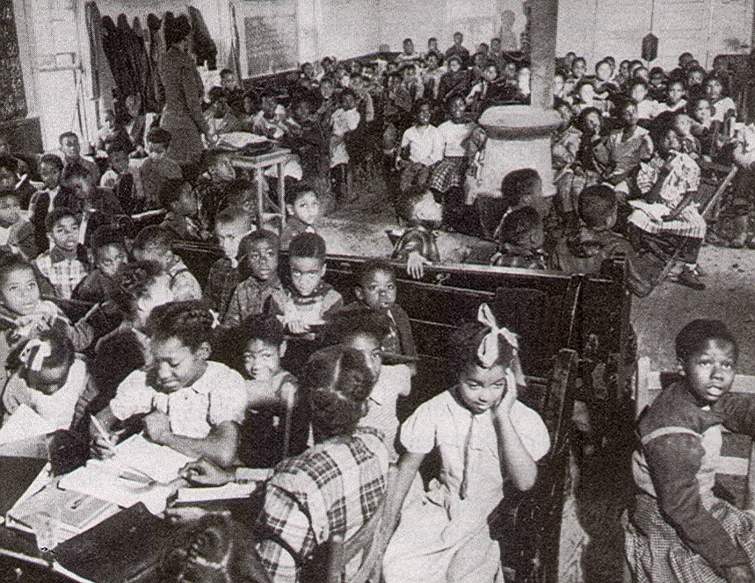
Single Room Black School,
West Memphis, Arkansas, 1949

Slide 21
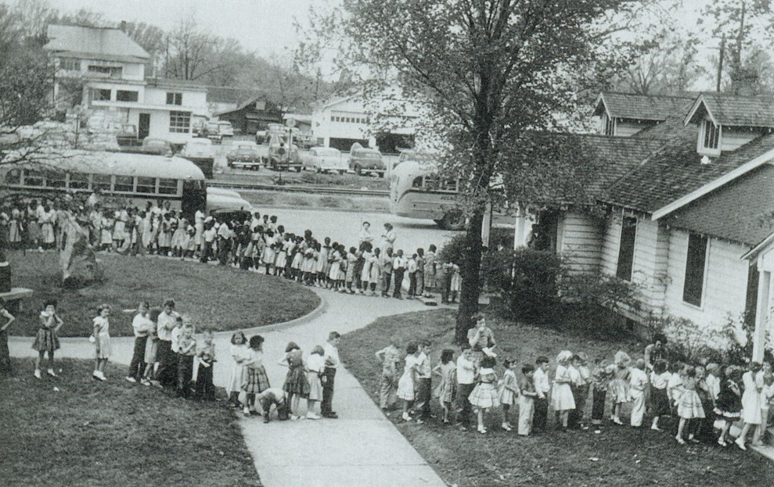
Arkansas School Children Receiving Polio Shots, 1957

Slide 22
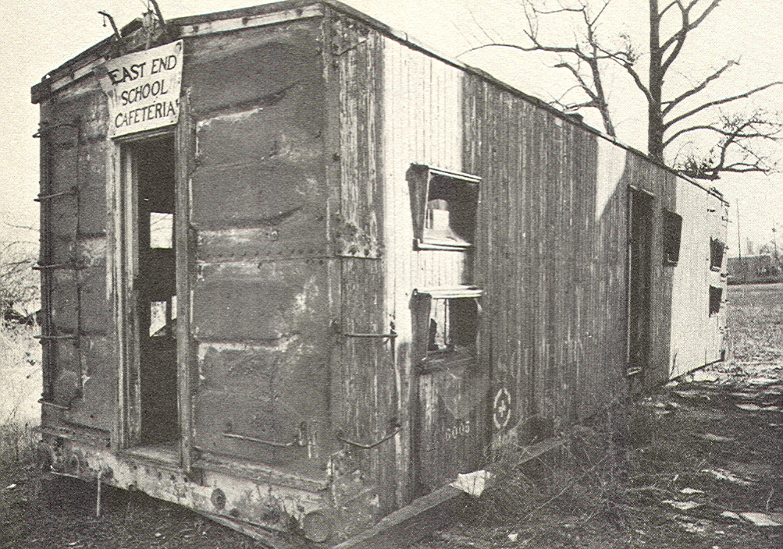
The Cost of Segregation
Right: Black School Cafeteria, Selma, Alabama, 1954
Average Daily Per Pupil Expense in All Public Schools in the South, 1950
Whites $ 49.30
Blacks $ 17.04
By States:
Georgia:
Whites $ 43.00
Blacks $ 13.00
Mississippi:
Whites $ 41.00
Blacks $ 9.00
Comparison:
California $ 99.00
New York $ 108.00
Washington $ 84.00

Slide 23
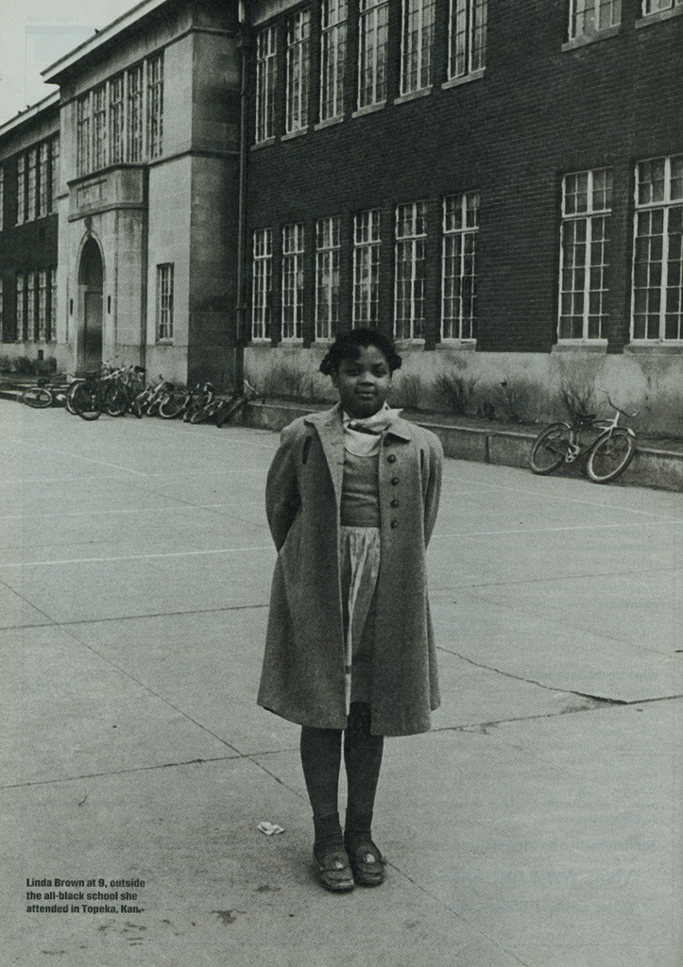
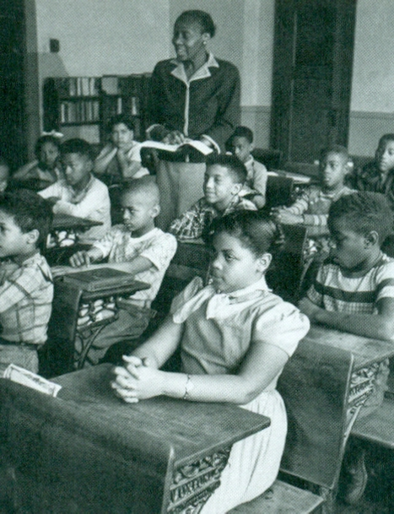
Linda Brown of Brown v. Board of Education
Left in Front of White Neighborhood School,
Right, in Segregated Black Class, Topeka, Kansas, 1950

Slide 24
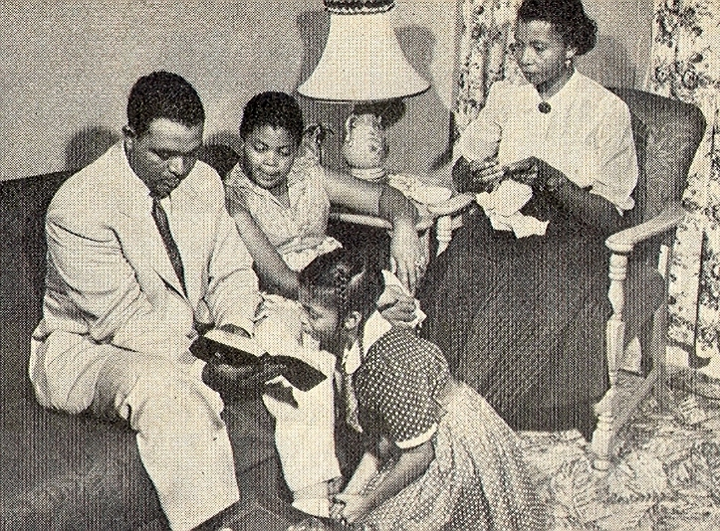
Oliver Brown, Linda Brown, and the Rest of the Brown Family, 1952

Slide 25
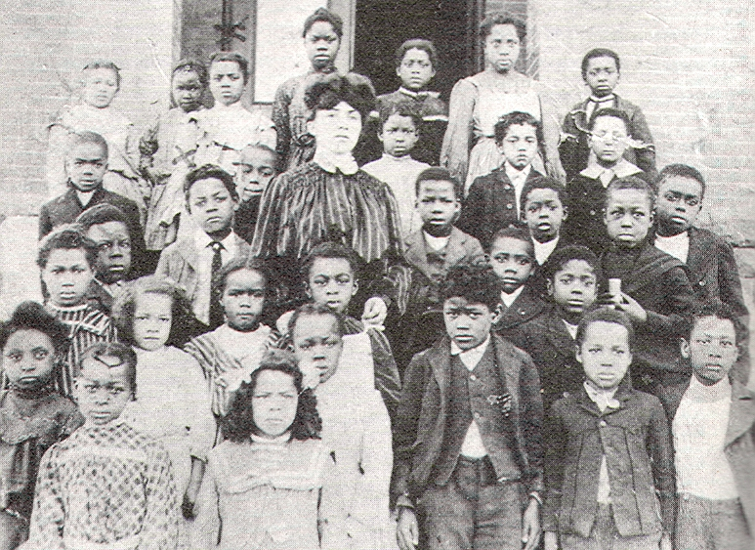
School Segregation in the West
All-black school, Topeka, Kansas, ca.1878
We hear of no Irish schools, no German schools, no Swedish schools. No, not one. All the children in the city are at liberty to attend the school nearest them, except the poor child, that God...chose to create with a black face instead of a white one.
We say to every colored man and woman...to come together to resolve that you will no longer submit to unjust discrimination on account of your color. This thing has gone on long enough, and now it if can be stopped, let’s stop it.
  William Eagleson, Topeka Colored Citizen, Sept. 20, 1878

Slide 26
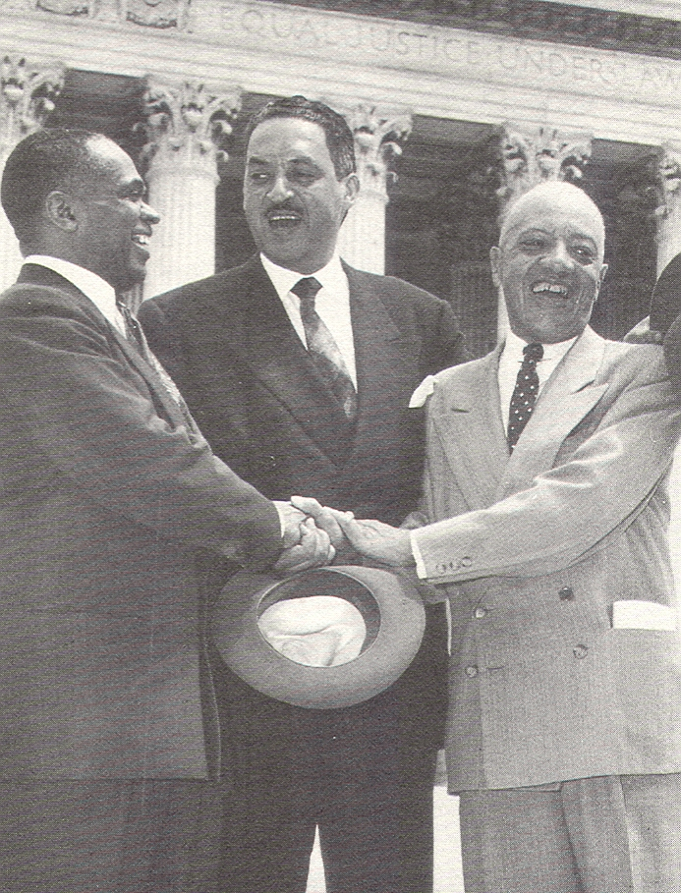
The Brown Decision, May 17, 1954
Segregation with the sanction of law...has a tendency to retard the educational and mental development of negro children and deprive them of the benefits they would receive in a racially integrated school system.
Chief Justice Earl Warren

Slide 27
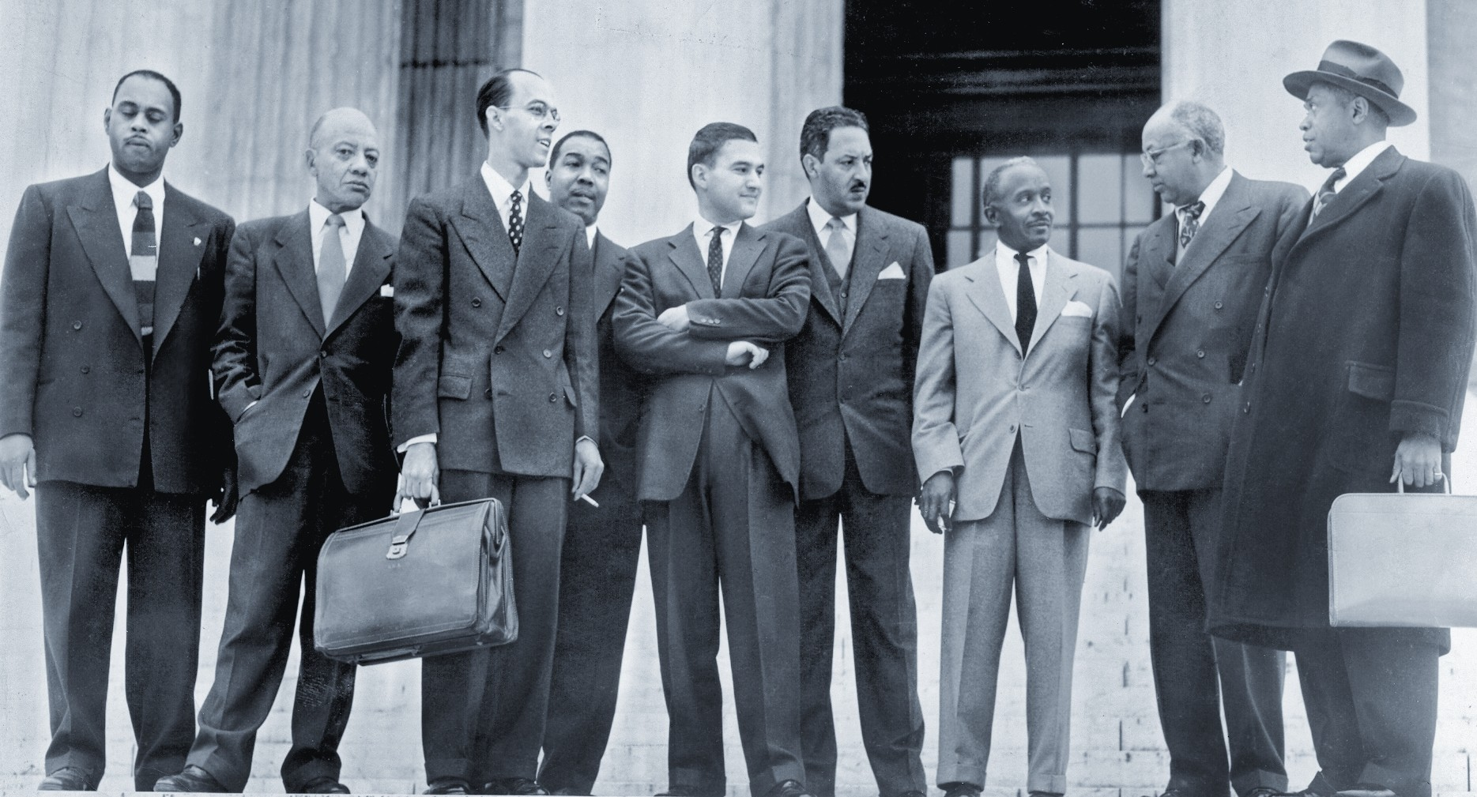
Attorneys Who Argued the Brown Case:
John Scott, James Nabrit, Spottswood Robinson, Frank Reeves, Jack Greenberg, Thurgood Marshall, Louis Redding, Ulysses Simpson Tate, George Haynes

Slide 28

The South’s Massive Resistance Campaign, 1954- ?
Impeach Earl Warren Sign in Central Alabama

Slide 29
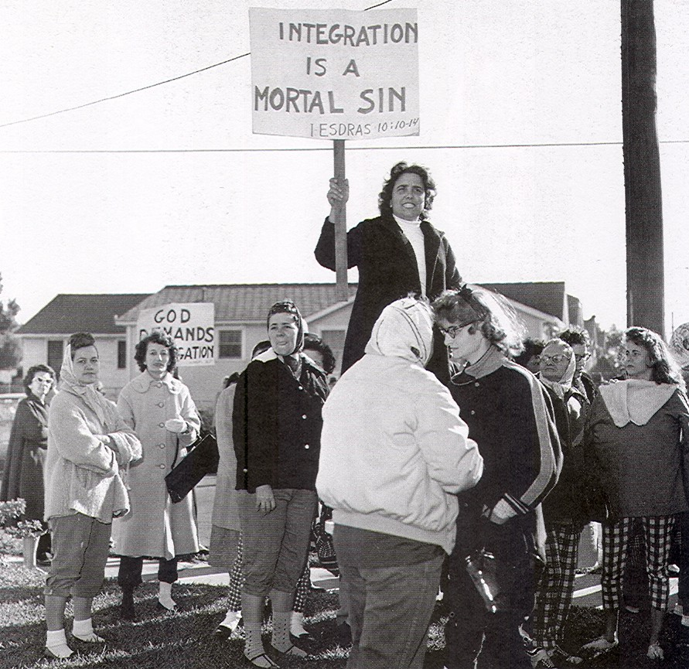
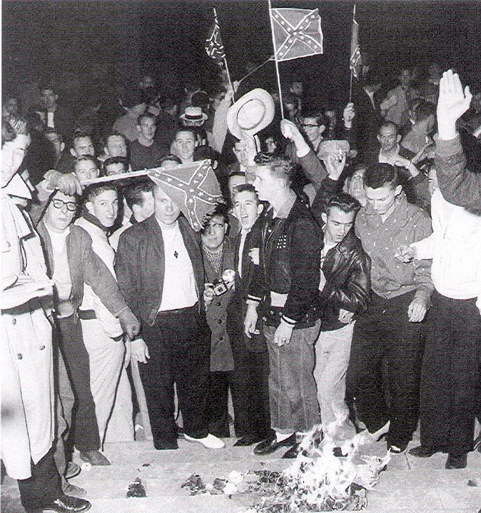
Opposition to School Desegregation

Slide 30

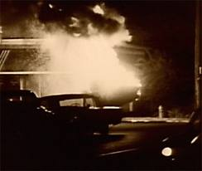
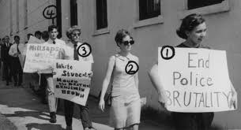
The Mississippi Sovereignty Commission
Mississippi’s CIA

Slide 31
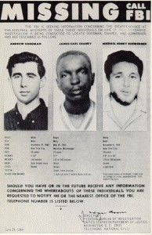
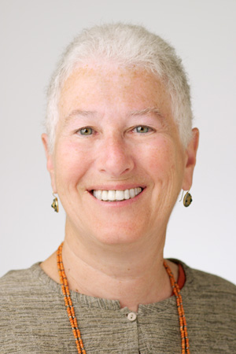
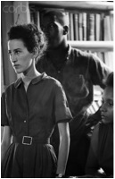
Seattleite Rita Bender and the Campaign Against the Mississippi Sovereignty Commission

Slide 32
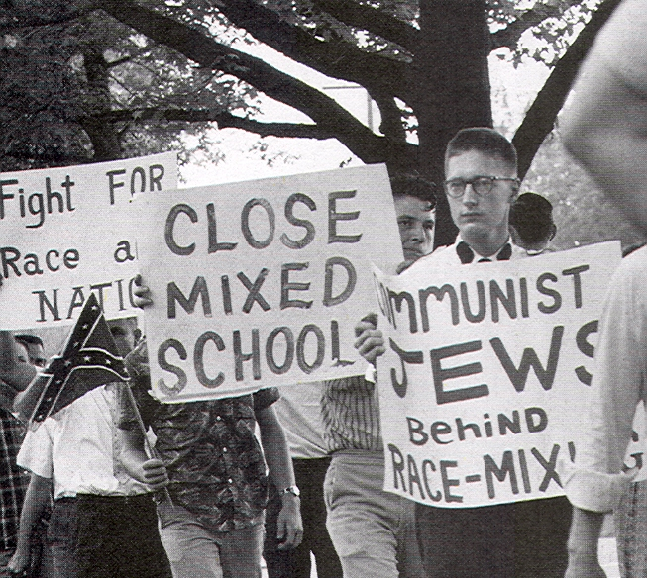
The Civil Rights-Communist Nexus
Whereas the NAACP is a captive of the international Communist conspiracy, it shall be unlawful for any citizen of the state to join said organization of the NAACP or to be employed by the state, school district, county or municipality so long as such membership is maintained.
  Arkansas State Law, Enacted, 1958

Slide 33
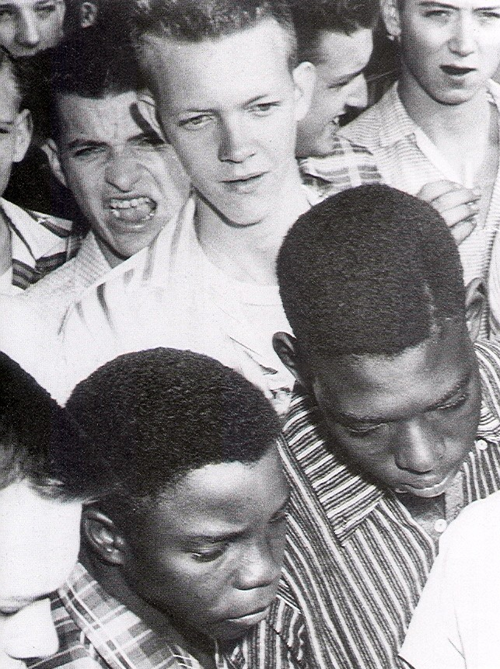
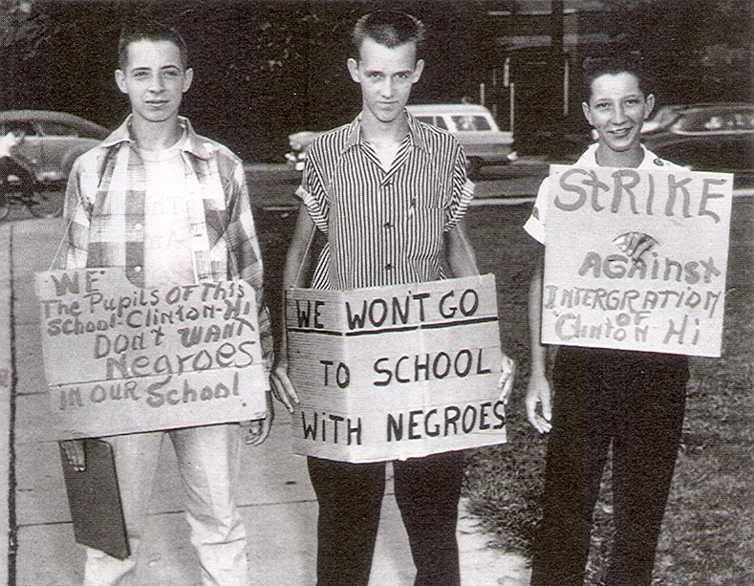
Black Students Turned Away from North Little
Rock High School, 1957,
Anti-Integration Protest, Clinton, Tennesse,1956

Slide 34
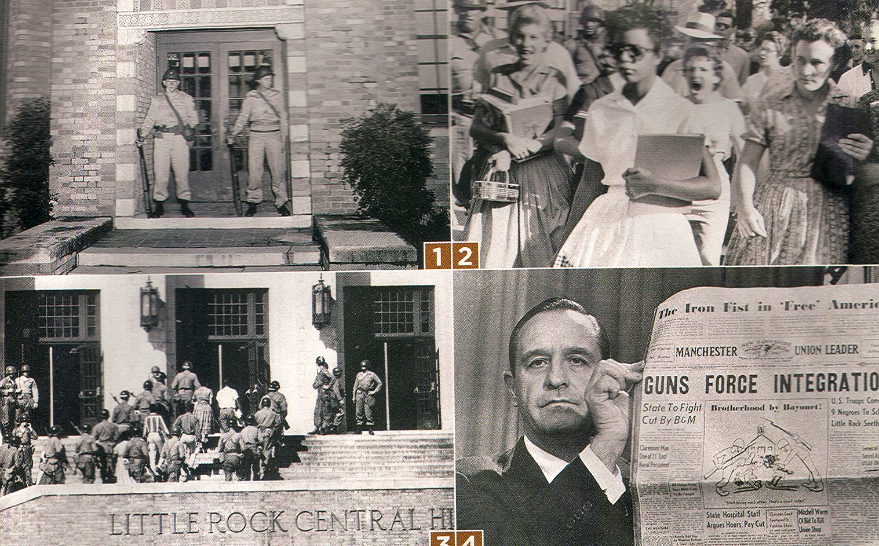

Slide 35
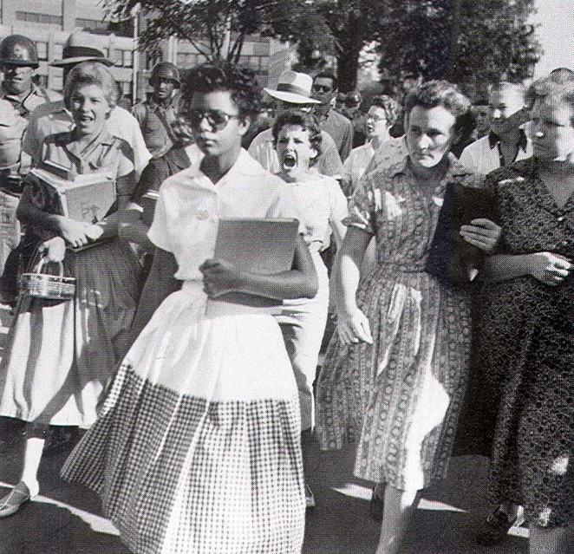
Elizabeth Eckford Surrounded by Mob, Little Rock, 1957

Slide 36
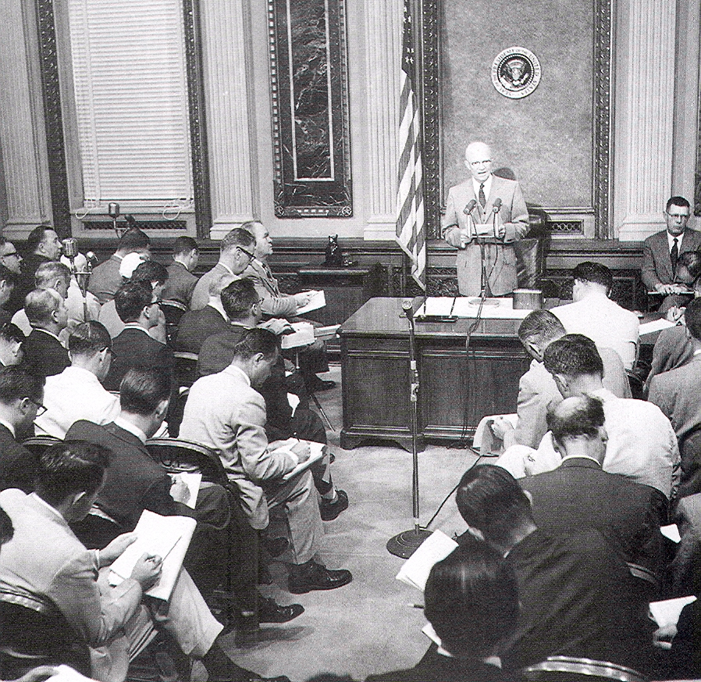
President Dwight Eisenhower Holding a Press Conference on the Little Rock Crisis, 1957

Slide 37
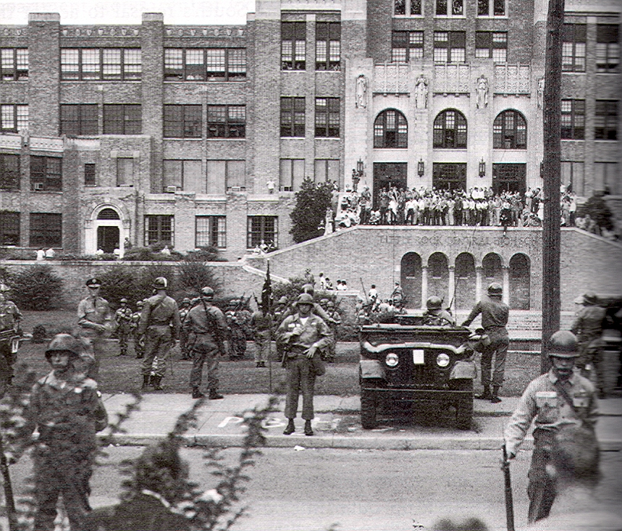
U.S. Army Troops Guarding Black Children at Little Rock High School, 1958

Slide 38
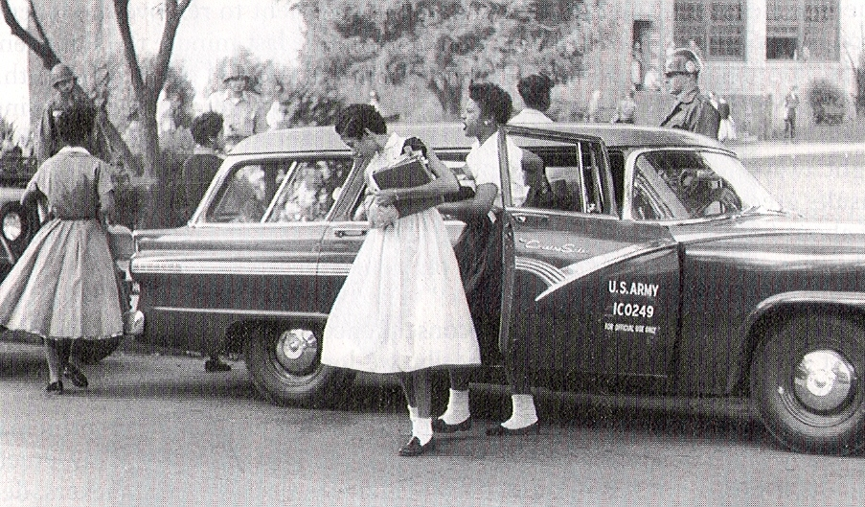
Federal Troops Escorting Black Students to Little Rock High School, 1958

Slide 39
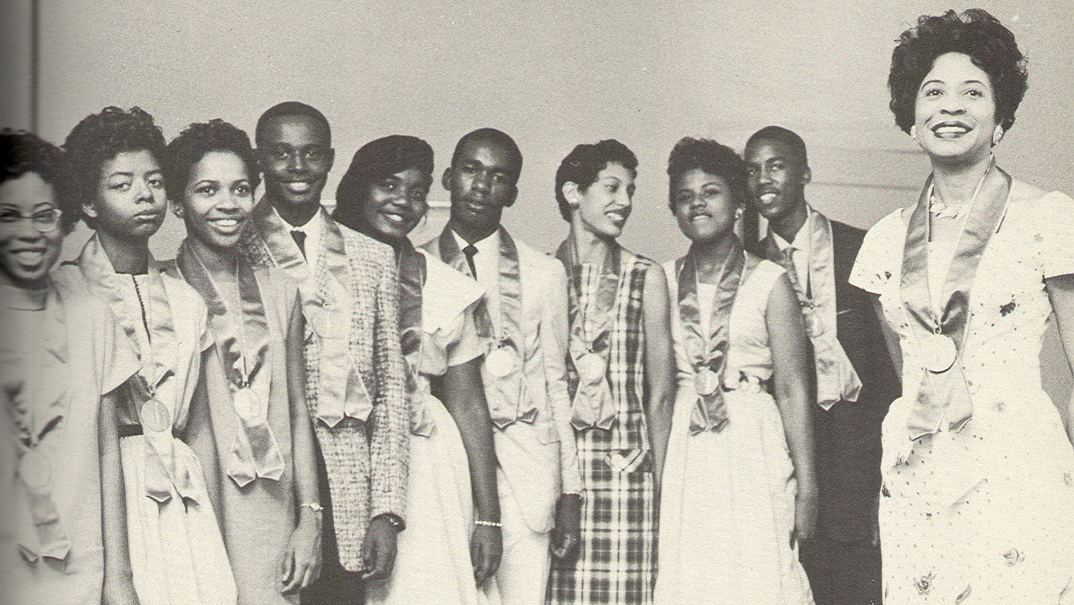
Daisy Bates and the Little Rock Nine, 1959

Slide 40
The Brown Decision, May 17, 1954
Segregation with the sanction of law...has a tendency to retard the educational and mental development of negro children and deprive them of the benefits they would receive in a racially integrated school system.
Chief Justice Earl Warren

Slide 41
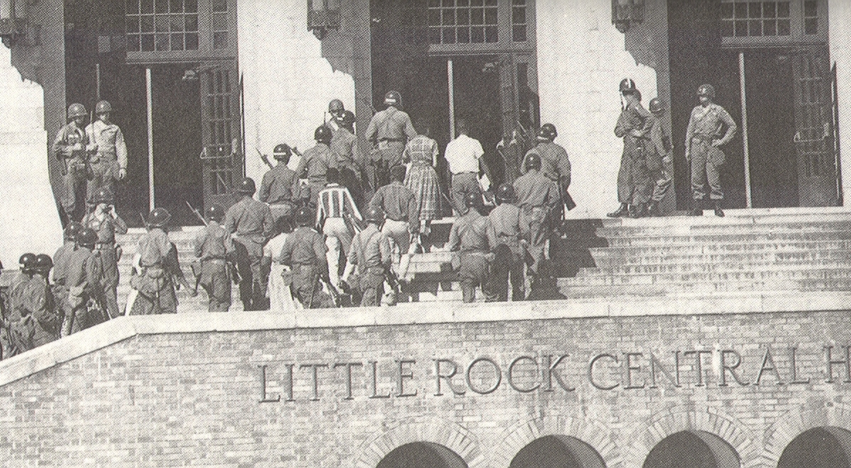
Central High School, Little Rock, Arkansas,1957

Slide 42
Civil Rights Act of 1957
An Act to provide means of further securing and protecting the civil rights of persons within the jurisdiction of the United States.
Be it enacted by the Senate and House of Representatives of the United States of America in Congress assembled,
PART I. ESTABLISHMENT OF THE COMMISSION ON CIVIL RIGHTS
Section 101.
(a) There is created in the executive branch of the Government a Commission on Civil Rights (hereinafter called the "Commission").
(b) The Commission shall be composed of six members who shall be appointed by the President by and with the advice and consent of the Senate. Not more than three of the members shall at any one time be of the same political party.
(c) The President shall designate one of the members of the Commission as Chairman and one as Vice Chairman. The Vice Chairman shall act as Chairman in the absence or disability of the Chairman, or in the event of a vacancy in that office.
(d) Any vacancy in the Commission shall not affect its powers and shall be filled in the same manner, and subject to the same limitations with respect to party affiliations as the original appointment was made.
(e) Four members of the Commission shall constitute a quorum.
Section 102. Rules of Procedure of the Commission
(a) The chairman or one designated by him to act as Chairman at a hearing of the Commission shall announce in an opening statement the subject of the hearing.

Slide 43

The Montgomery Bus Boycott, 1955-1956
“Walking for Freedom”

Slide 44


Martin and Coretta Scott King, on the Steps of Dexter Avenue Baptist Church, Montgomery, 1956

Slide 45


Slide 46

Black Voting in the South, 1960
(Left) Tent City, Haywood, County, Tennessee
(Right) Eligible Voters Not Allowed to Vote
The Entire South 65%
Georgia 76%
Alabama 89%
Mississippi 99%

Slide 47


The South Carolina Primary, 2016 (Tomorrow)
Left: Voters for Bernie Sanders
Right: Voters for Hillary Clinton

Slide 48


Slide 49

Overton Park Zoo, Memphis, 1962

Slide 50

Segregation in America, 1960
You could not go to a white restaurant; you sat at a special place at the movie house; and Lord knows you sat at the back of the bus. It didn’t make any difference if you were rich or poor, if you were black you were nothing.
You might have a hundred dollars in your pocket, but if you went to the store you would wait at the side until all the clerks got through with all the white folks... Then the clerk would finally look at you and say, “Oh did you want something? I didn’t see you there.”

Slide 51

University of New Mexico, 1948

Slide 52


Civil Rights Demonstrations,
Oklahoma City, Oklahoma, 1958

Slide 53

Civil Rights Demonstrators,
Nashville, Tennessee, March 1960

Slide 54

Sympathy Demonstration for Nashville Sit-Ins,
University of Washington, April 1960

Slide 55


Seattle, 1960, Albany, Georgia, 1962

Slide 56

Presidential Candidate John Kennedy Campaigning in Harlem with Congressman Adam Clayton Powell and Eleanor Roosevelt, 1960

Slide 57


Hubert H. Humphrey
Left: At The Democratic National Convention, 1948
Right: With Martin Luther King, 1960

Slide 58

Celebration of Ghana’s Independence, 1957

Slide 59

Baby Boomers Come of Age

Slide 60

The Greensboro Four:
Ezell Blair, Joseph McNeil
David Richmond, Franklin McCain

Slide 61

Day Two of the Greensboro Sit-ins

Slide 62

Raleigh, North Carolina Protests, February 1960

Slide 63


Left: College Students in Civil Rights March, Nashville, Tennessee, March 1960, Right, 20 Year-old Julian Bond, Leader of the Atlanta Sit-in Movement

Slide 64

The police said, “Everybody’s under arrest.” So all the students got up and marched to the wagon. Then they turned and looked around at the lunch counter again, and the second wave of students had all taken seats...then a third wave. No matter what they did and how many they arrested, there was still a lunch counter full of students—Diane Nash

Slide 65


College Students Reading Textbooks in Atlanta Jail
Rev. James Lawson Arrested in Nashville

Slide 66

Protester Arrested in Richmond, Virginia, April 1960

Slide 67


Left: Lunch Counter Protests in Houston, June 1960
Right: Young Dan Rather, 1963

Slide 68


Founders of SNCC, April 15, 1960:
Ella Baker and Marion Berry

Slide 69


Rita Schwerner, SNCC Worker, 1964
Rita Bender, Civil Rights Activist, 2004

Slide 70

Tent City, Fayette County, Tennessee, 1960

Slide 71

Bob Moses (Left) with Cleve Jordan, Mississippi Civil Rights Leader, 1962

Slide 72


Albany, Georgia Protests, 1962

Slide 73

Map of the Civil Rights Movement in the South, 1957-1965

Slide 74


Freedom Rides, 1961

Slide 75


Slide 76

Civil Rights Scorecard, 1960-1963
Left: Jackson, Mississippi Sit-in, 1963
2,000 demonstrations
150,000 people involved
10,000 people arrested
Hundreds beaten by mobs or police
17 had died in civil rights-related incidents

Slide 77


Birmingham, 1963

Slide 78


Birmingham, 1963

Slide 79


Slide 80


Medgar Evers Assassinated, June 12, 1963
Evers Funeral Procession, Jackson, Mississippi

Slide 81

Bayard Rustin and A. Philip Randolph Announce the March on Washington for August 28, 1963

Slide 82
The “Big Five” Civil Rights Organizations
Conservatives:
National Association for the Advancement of Colored People (NAACP)
National Urban League (NUL)
Moderates:
Southern Christian Leadership Conference (SCLC)
Radicals:
Student Non-Violent Coordinating Committee (SNCC)
Congress of Racial Equality (CORE)

Slide 83


Slide 84

Program of the March on Washington, August 28, 1963

Slide 85

A. Philip Randolph Speech at the 1963 March on Washington
Let the nation and the world know the meaning of our numbers. We are not a pressure group, we are not an organization or a group of organizations. We are not a mob. We are the advance guard of a massive moral revolution for jobs and freedom….

Slide 86
A. Philip Randolph Speech at the 1963 March on Washington
But this civil rights revolution is not confined to the Negro, nor is it confined to civil rights, for our white allies know that they cannot be free while we are not, and we know we have no future in a society in which six million black and white people are unemployed and millions live in poverty….

Slide 87




Slide 88


Slide 89


Slide 90

Edith Lee Payne at the March on Washington, 1963

Slide 91

John Lewis, 23, Chairman of SNCC Speaks at the March on Washington

Slide 92

The Kennedy Assassination, Dallas, Nov. 22, 1963

Slide 93


Freedom Summer, 1964

Slide 94


Freedom Summer, 1964
Three Lives for Mississippi

Slide 95
Rita Schwerner, SNCC Worker, 1964
Rita Bender, Civil Rights Activist, 2004

Slide 96
A Letter from Mississippi to Parents in Seattle, 1964
Dear Mom and Dad:
This letter is hard to write because I would like so much to communicate how I feel and I don't know if I can. It is very hard to answer to your attitude that if I loved you I wouldn't do this--hard, because the thought is cruel. I can only hope you have the sensitivity to understand that I can both love you very much and desire to go to Mississippi. I have no way of demonstrating my love. It is simply a fact and that is all I can say....
I hope you will accept my decision even if you do not agree with me. There comes a time when you have to do things which your parents do not agree with.... Convictions are worthless in themselves. In fact, if they don't become actions, they are worse than worthless--they become a force of evil in themselves. You can't run away from a broadened awareness.... If you try, it follows you in your conscience, or you become a self-deceiving person who has numbed some of his humanness. I think you have to live to the fullest extent to which you have gained an awareness or you are less than the human being you are capable of being.... This doesn't apply just to civil rights or social consciousness but to all the experiences of life....
Love, Bonnie

Slide 97

Lyndon Baines Johnson Signing the Civil Rights Act, June 1964

Slide 98
The Civil Rights Act of 1964
An Act
To enforce the constitutional right to vote, to confer jurisdiction upon the district courts of the United States to provide injunctive relief against discrimination in public accommodations, to authorize the Attorney General to institute suits to protect constitutional rights in public facilities and public education, to extend the Commission on Civil Rights, to prevent discrimination in federally assisted programs, to establish a Commission on Equal Employment Opportunity, and for other purposes.
Be it enacted by the Senate and House of Representatives of the United States of America in Congress assembled, That this Act may be cited as the "Civil Rights Act of 1964".
TITLE I--VOTING RIGHTS
SEC. 101. Section 2004 of the Revised Statutes (42 U.S.C. 1971), as amended by section 131 of the Civil Rights Act of 1957 (71 Stat. 637), and as further amended by section 601 of the Civil Rights Act of 1960 (74 Stat. 90), is further amended as follows:
(a) Insert "1" after "(a)" in subsection (a) and add at the end of subsection (a) the following new paragraphs:
"(2) No person acting under color of law shall--
"(A) in determining whether any individual is qualified under State law or laws to vote in any Federal election, apply any standard, practice, or procedure different from the standards, practices, or procedures applied under such law or laws to other individuals within the same county, parish, or similar political subdivision who have been found by State officials to be qualified to vote;

Slide 99

Give My Mom a Job

Slide 100

Washington Post Front Page Story on the Passage of the Civil Rights Bill, July 2, 1964

Slide 101


Slide 102

UC Free Speech Protest, Berkeley, 1964

Slide 103


Slide 104

Anti-War Protest, Washington, D.C., 1969

Slide 105


Slide 106


Anti-Apartheid Protests in Johannesburg, 1966, 1980

Slide 107


“We Shall Overcome” in Tiananmen Square,
Beijing, 1989

Slide 108

The Arab Spring Protests, 2011

Slide 109


