Slide 1
World War II and The West Coast Migration

Slide 2
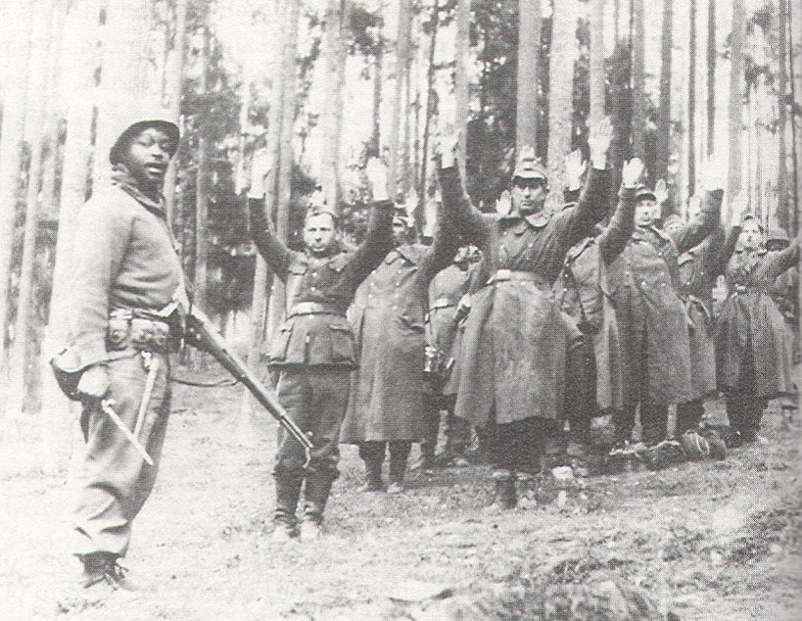

Slide 3
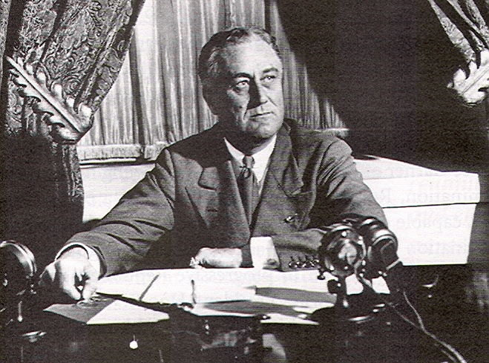
Franklin Delano Roosevelt:
President of the United States, 1933-1945

Slide 4
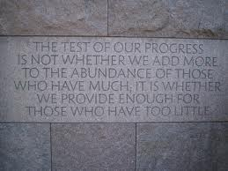
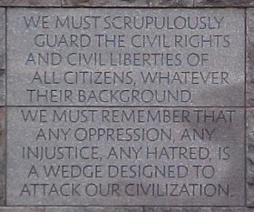
From the FDR Memorial:
Washington, D.C.

Slide 5
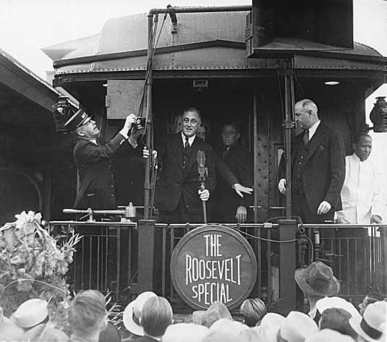
FDR Campaigning in Seattle, 1932

Slide 6
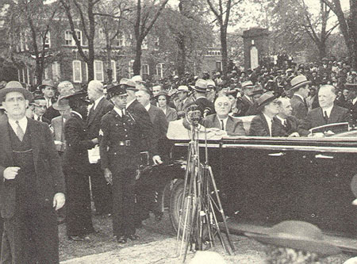
FDR at Tuskegee, March 30, 1939

Slide 7
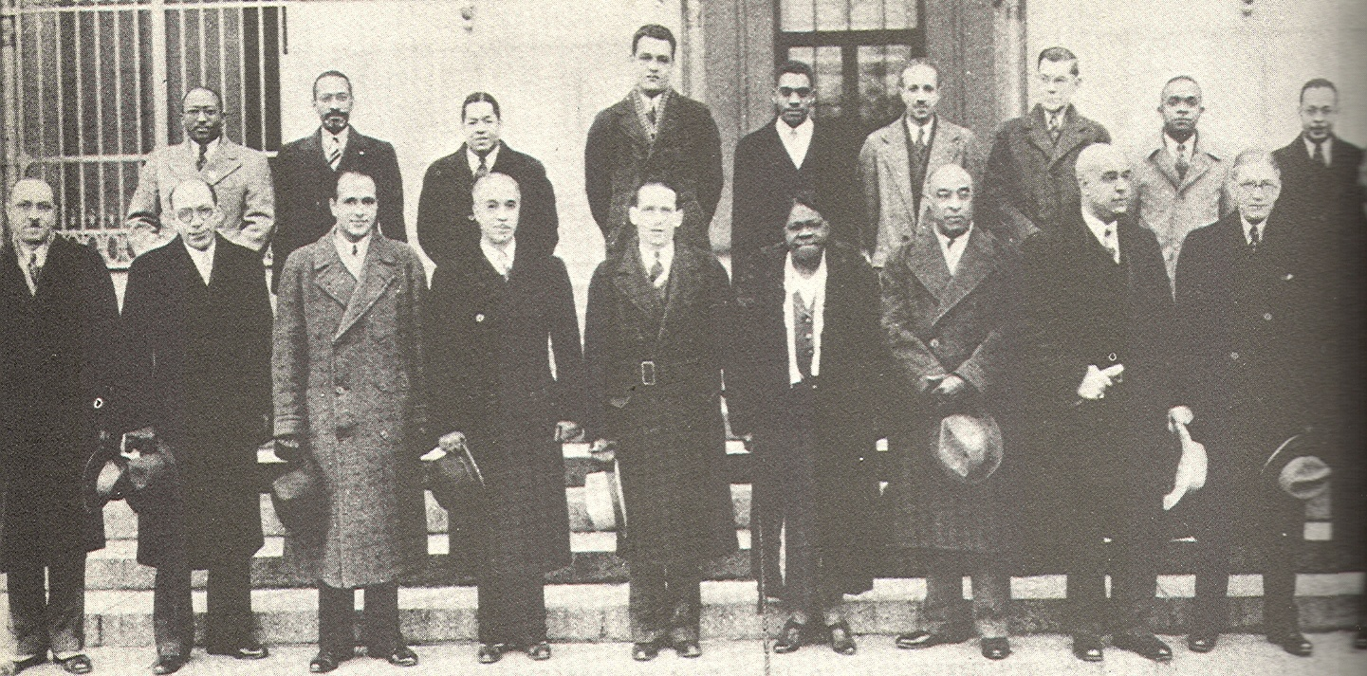
FDR’s Black Cabinet, 1936

Slide 8
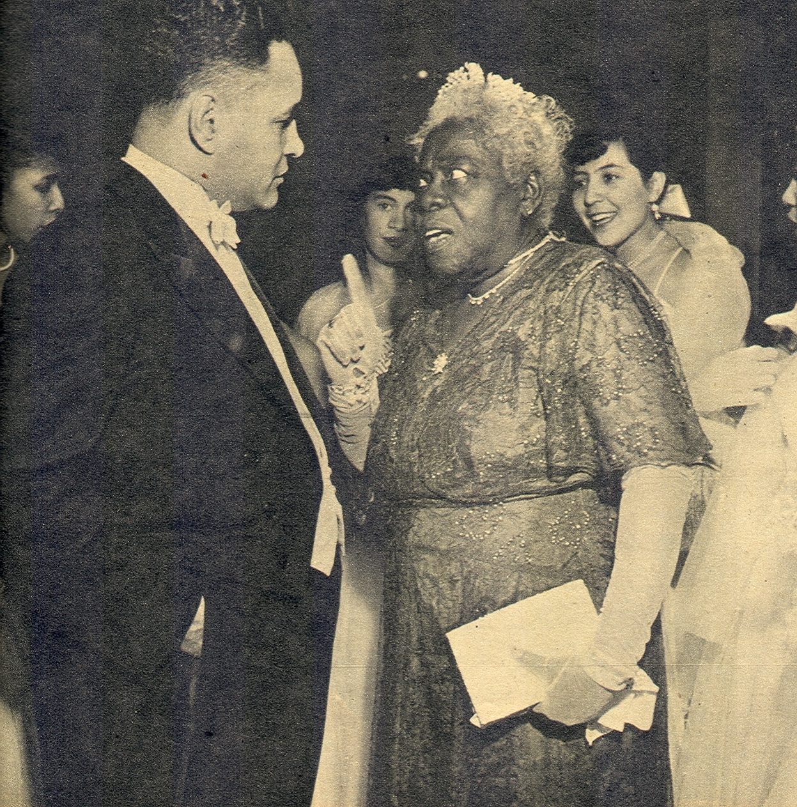
Ralph Bunche & Mary McLeod Bethune

Slide 9
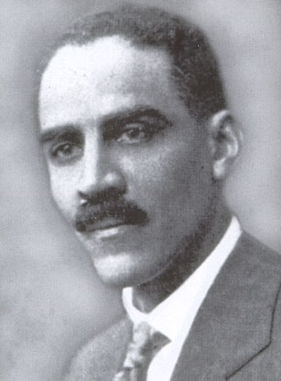
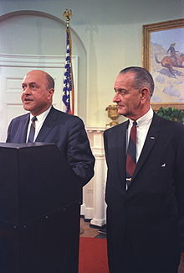
Eugene Kinkle Jones and Robert Weaver

Slide 10
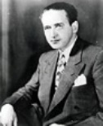
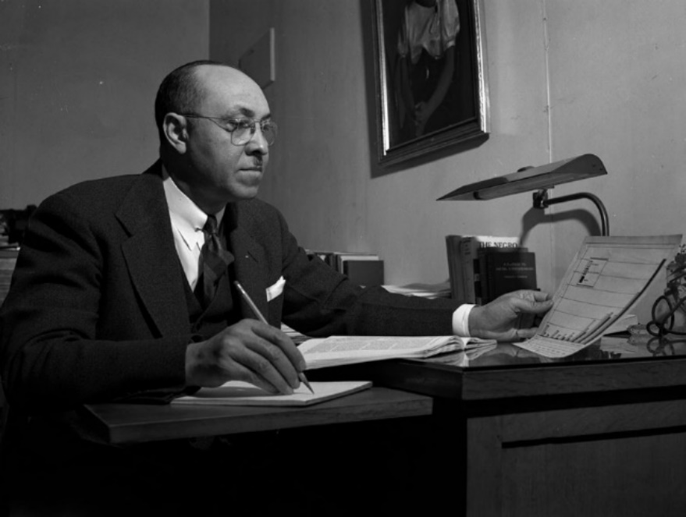
Frank Horne and Ambrose Caliver

Slide 11
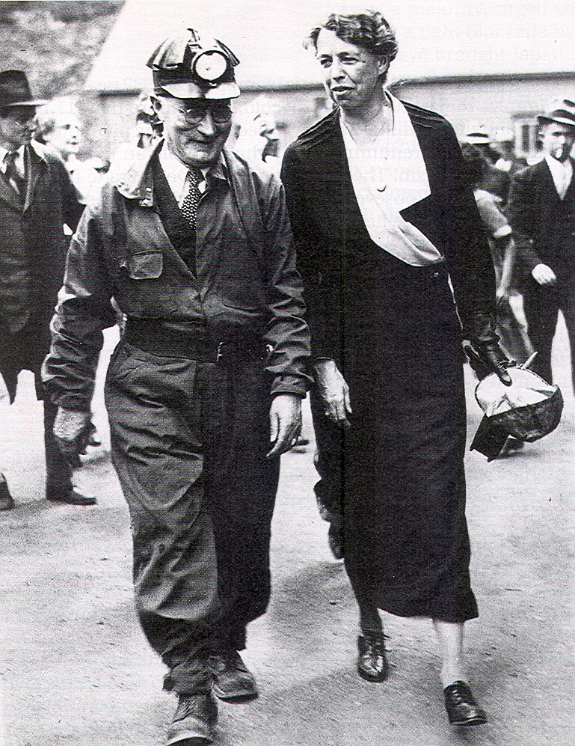
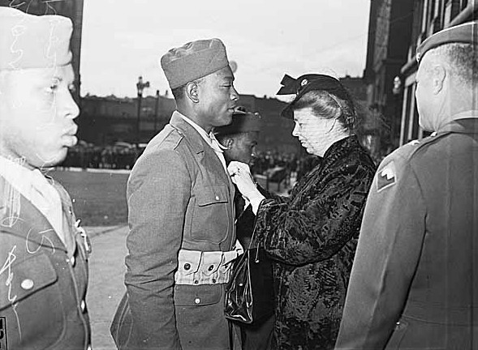
Eleanor Roosevelt
Visiting an Ohio Coal Mine and Honoring Black Soldiers at Fort Lawton (Seattle)

Slide 12
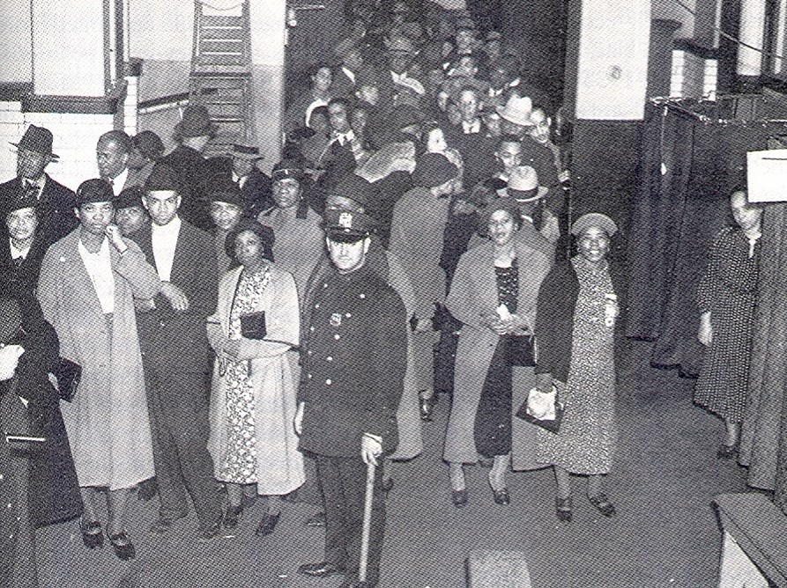
The Emerging New Deal Coalition:
Black Harlem Voters, 1936

Slide 13
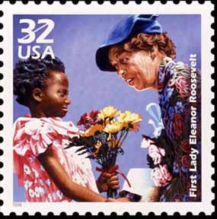
Eleanor Roosevelt on Black Rights, 1940
Any citizen in this country is entitled to equality before the law; to equality of education; to equality at earning a living. Those things are basic rights, belonging to every citizen...and we have an obligation...to stand up and be counted when it comes to the question of whether any minority groups does not have these rights as citizens of this country.
The minute we deny any rights of this kind to any citizen we are preparing the way for the denial of these rights to someone else.

Slide 14
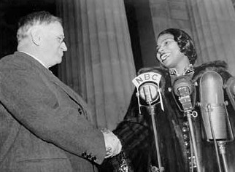
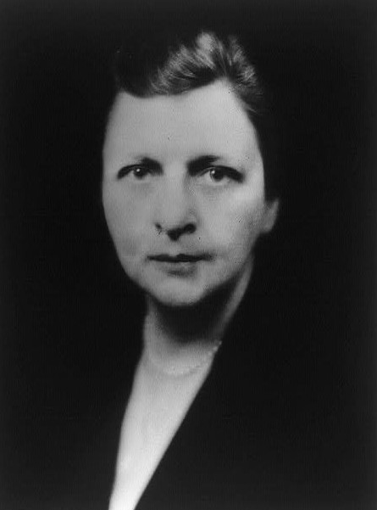
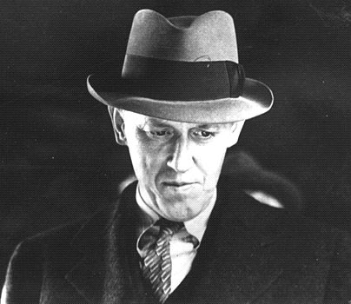
Harold Ickes, Harry Hopkins, Frances Perkins

Slide 15
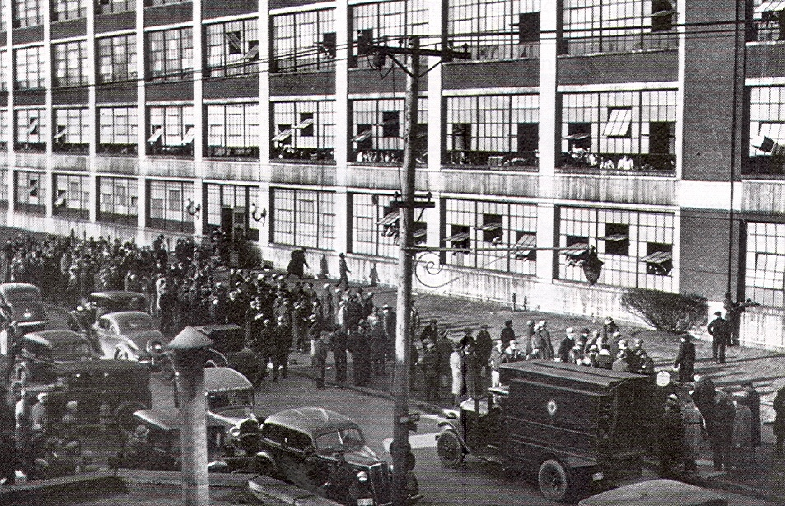
UAW Sit-Down Strike, Flint, Michigan, 1937

Slide 16
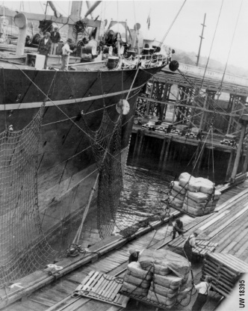
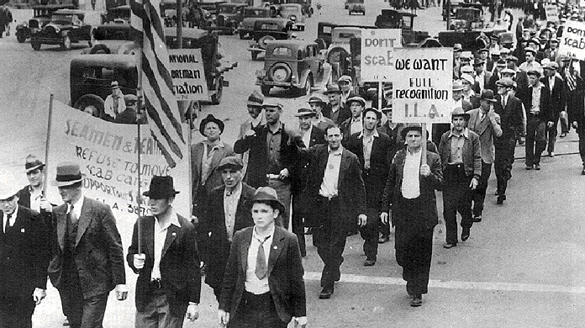
All-White Longshoremen’s Union on Strike, Seattle, 1934

Slide 17
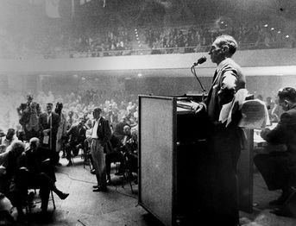
Harry Bridges,
International Longshoremen’s Union
If there are only two jobs on the docks, I want one of them to go to my Negro union brother.

Slide 18
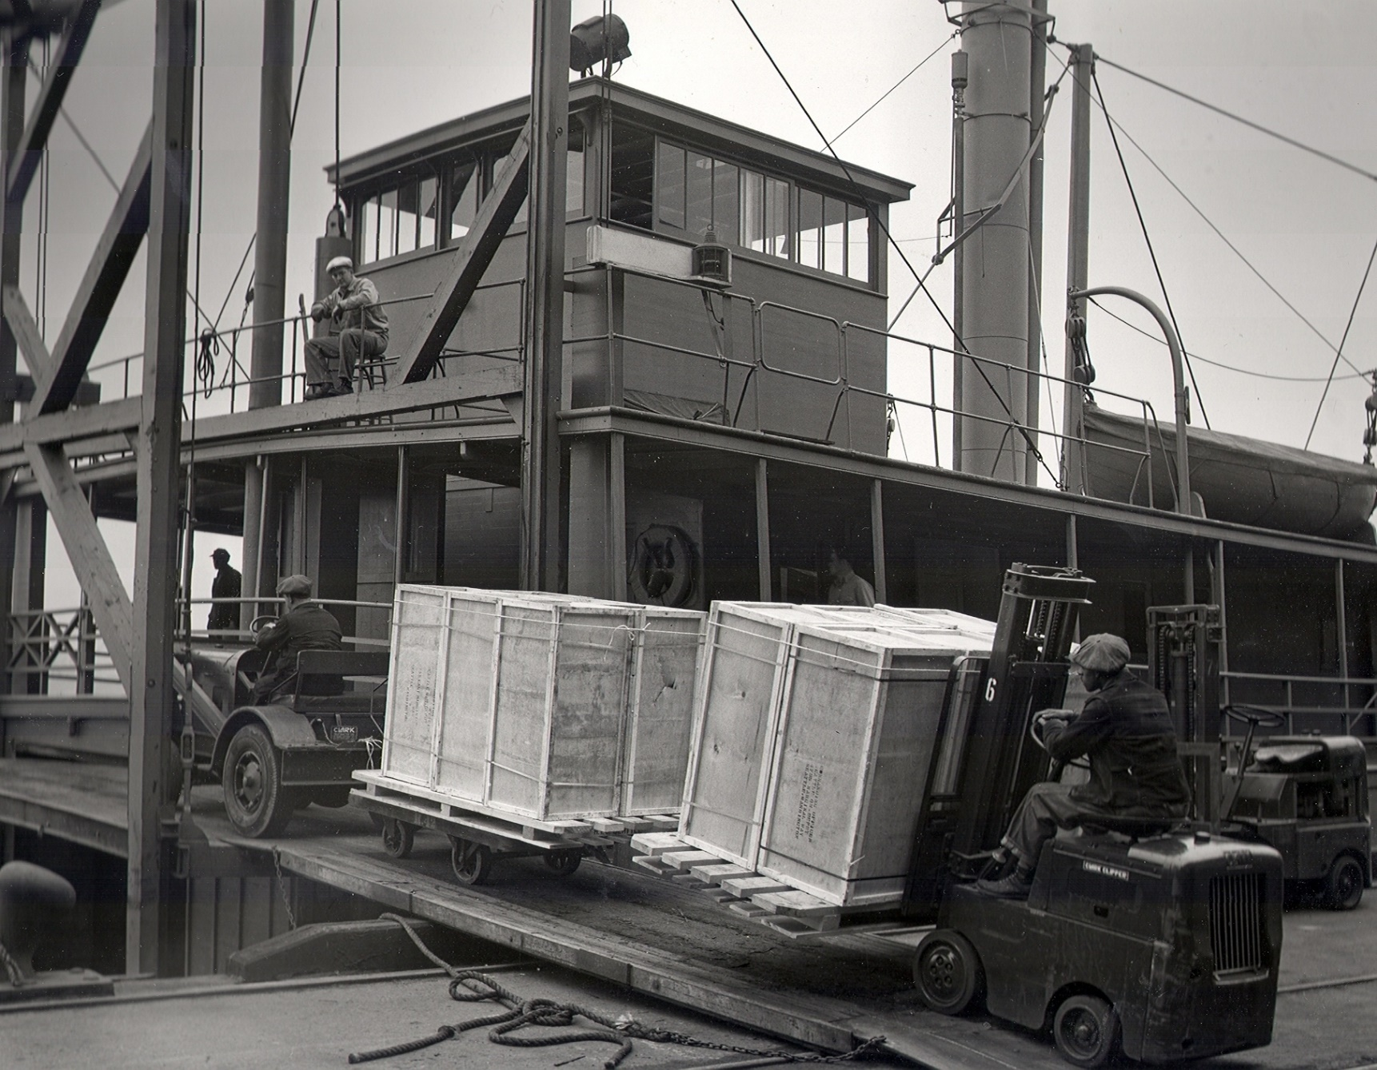
White and Black Longshoremen on the Seattle Docks, 1936

Slide 19
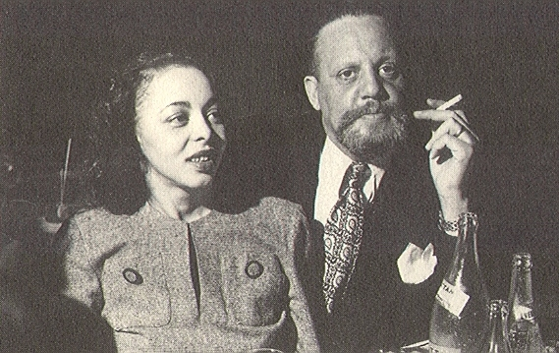
Horace Cayton, Jr. and Wife, Ruby in Chicago Nightclub, 1947

Slide 20
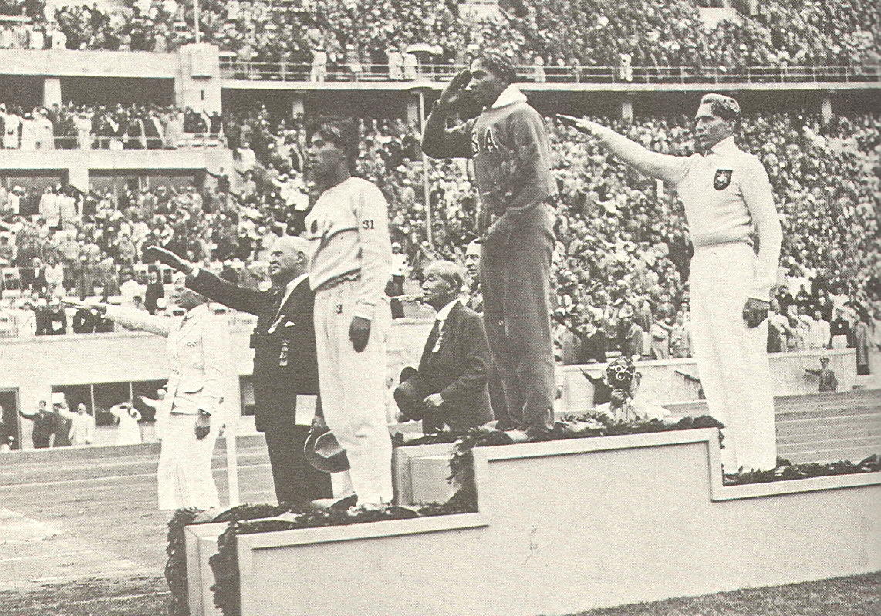
Jesse Owens and the 1936 Berlin Olympics

Slide 21
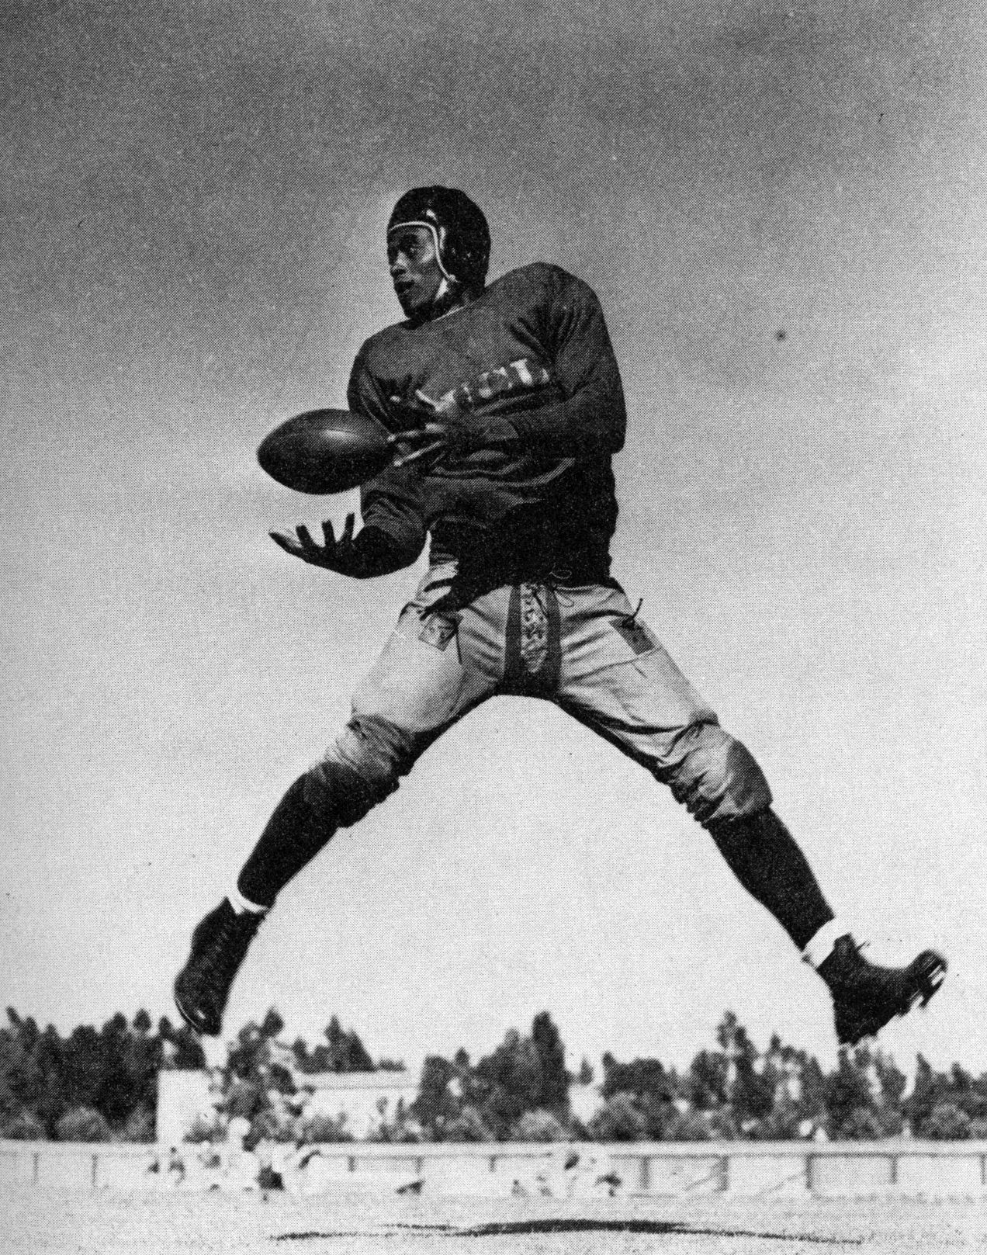
Woody Strode at UCLA, 1938

Slide 22
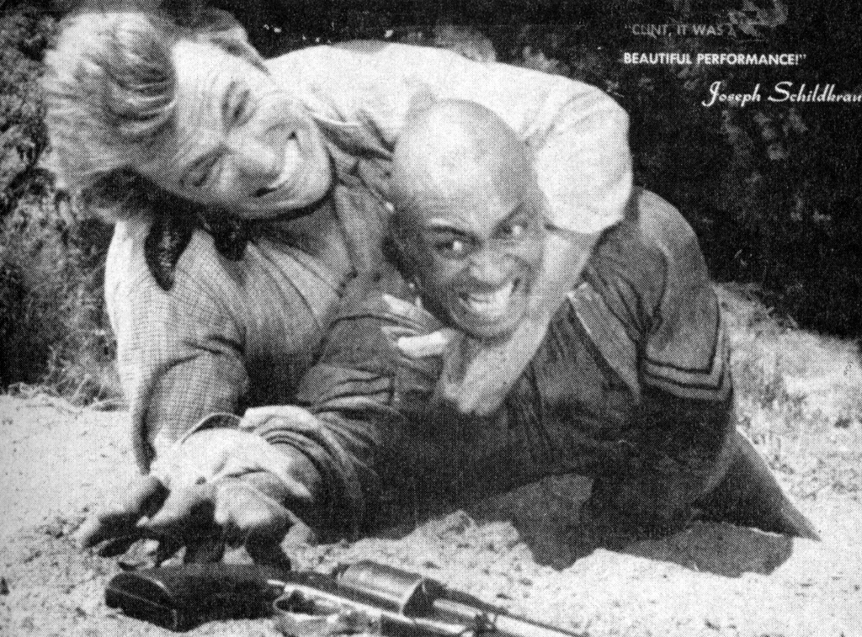
Black Cowboys and Hollywood: Clint Eastwood and Woody Strode in Rawhide Episode, 1961

Slide 23
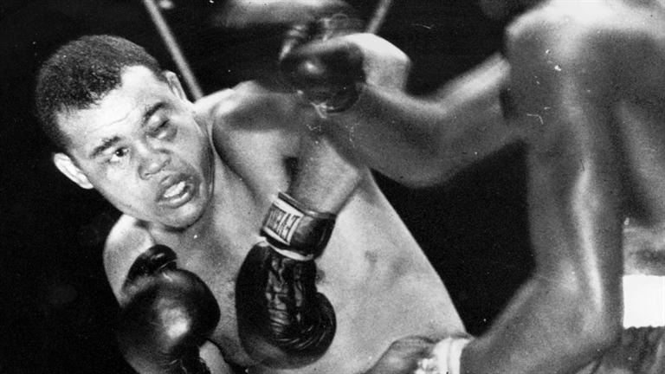
Joe Louis,
Heavyweight Champion, 1937-1949

Slide 24
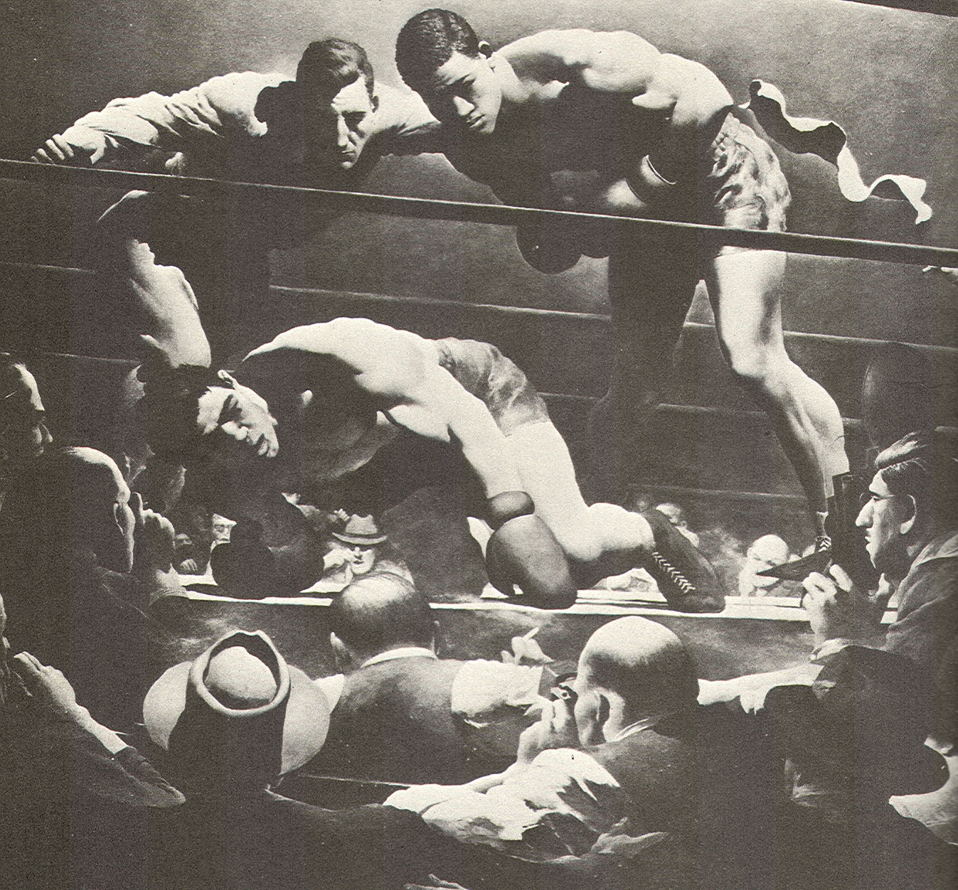
Joe Louis Knocks Out Max Schmeling, 1938

Slide 25
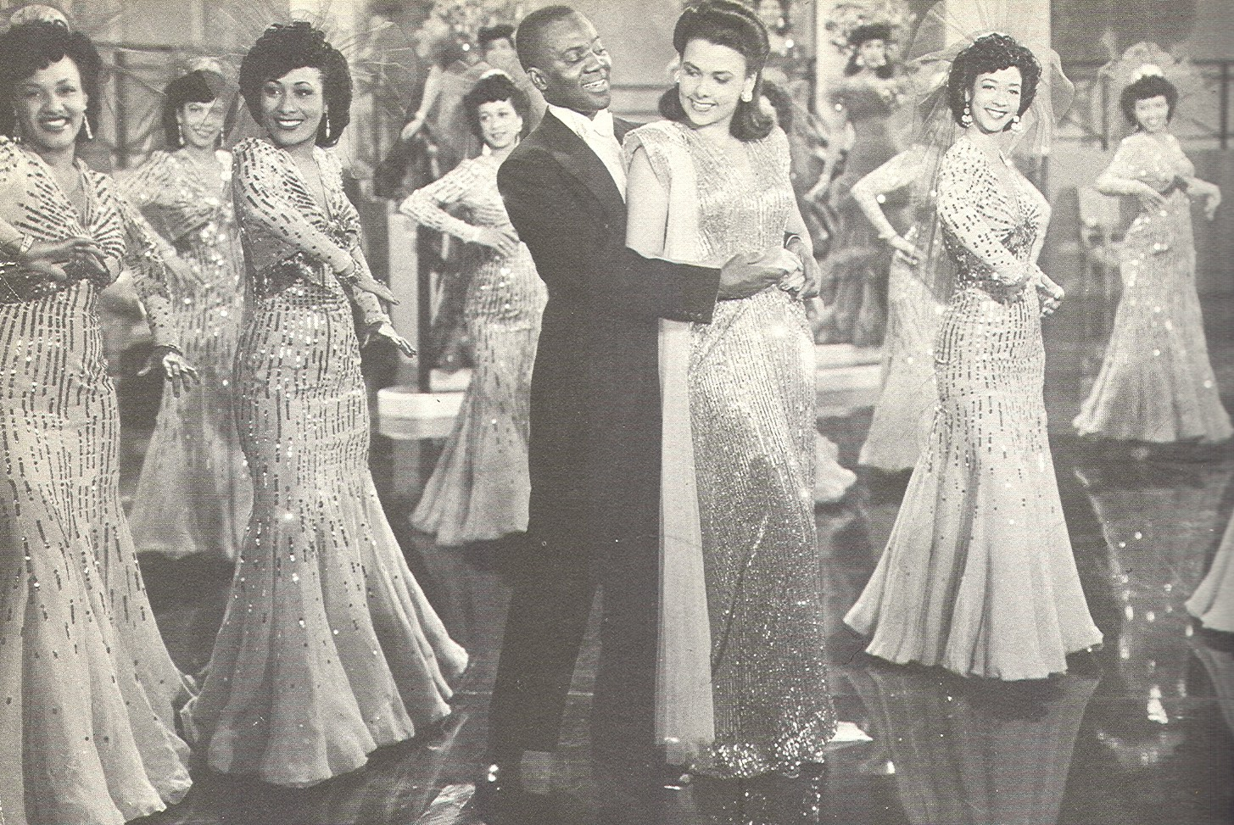
Bill “Bojangles” Robinson and Lena Horne in the Film,
“Stormy Weather,” 1943

Slide 26
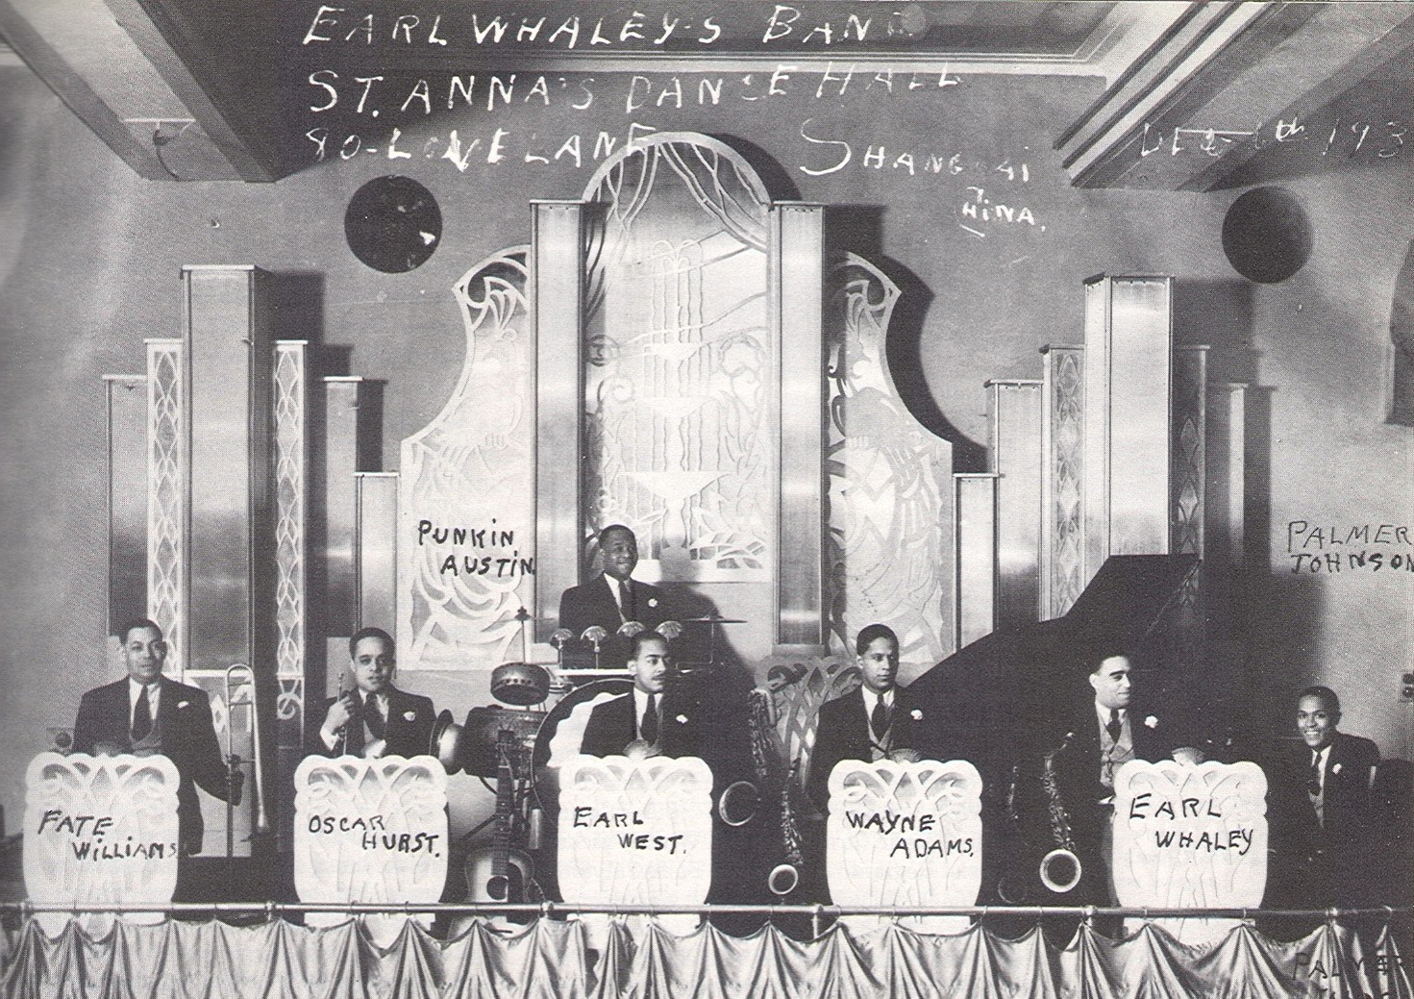
Earl Whaley Jazz Band in Shanghai, China, 1937

Slide 27
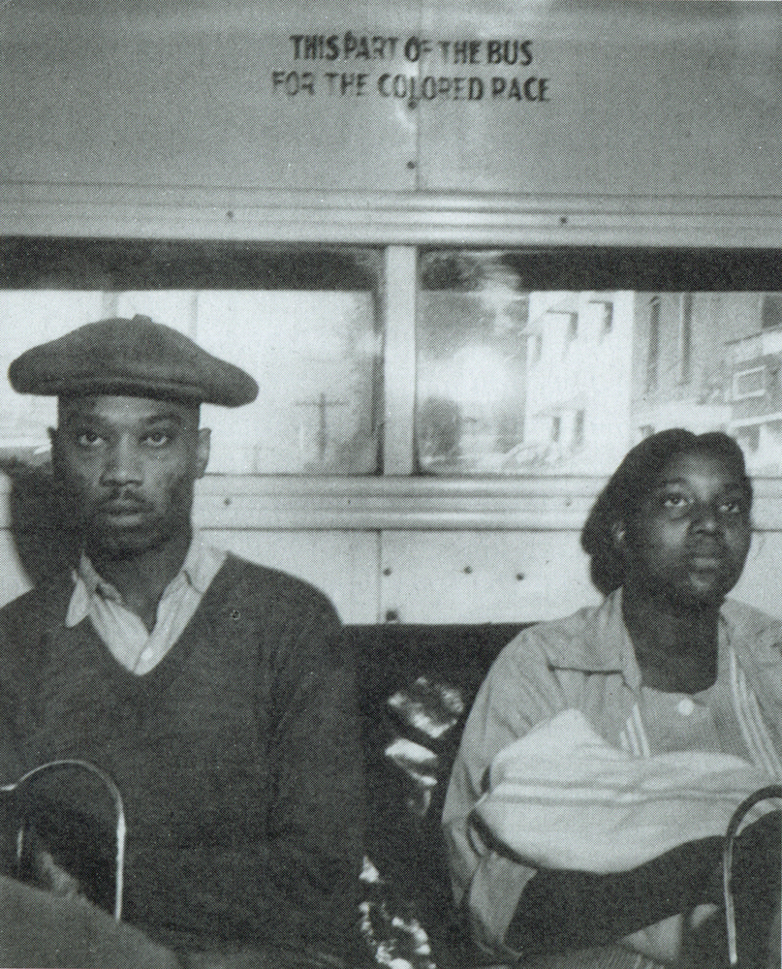
Segregated Houston City Bus, 1940

Slide 28
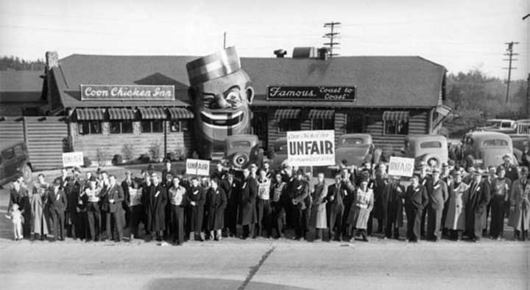
Coon Chicken Inn, Seattle, 1939

Slide 29
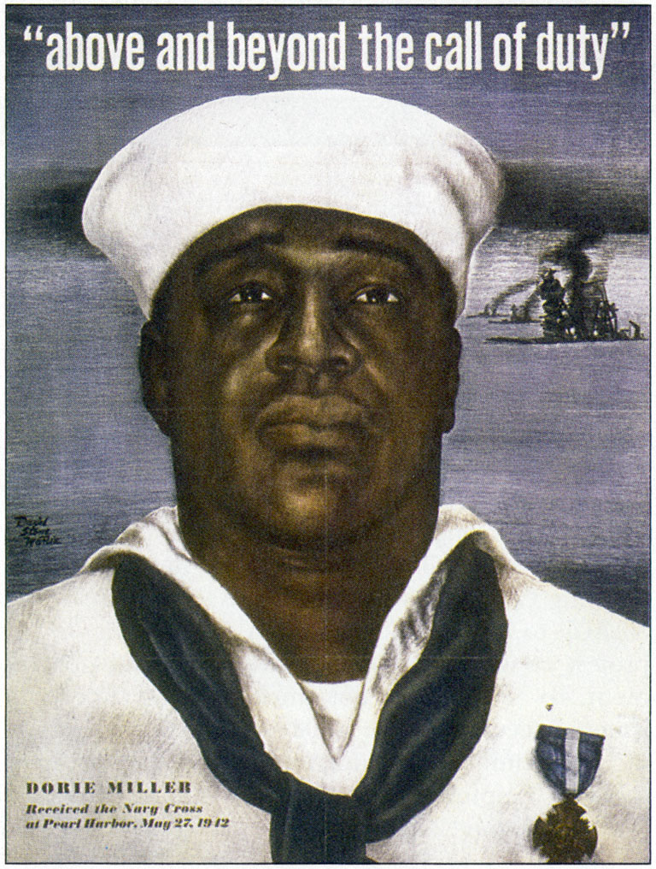
Dorie Miller Poster, U.S. Navy

Slide 30
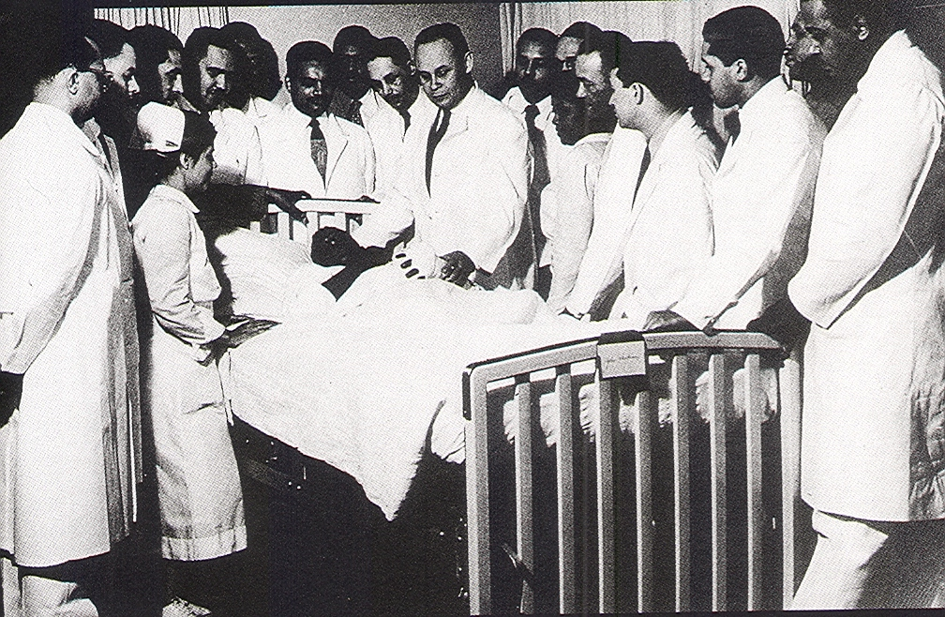
Dr. Charles Drew at Howard University Hospital, 1942

Slide 31
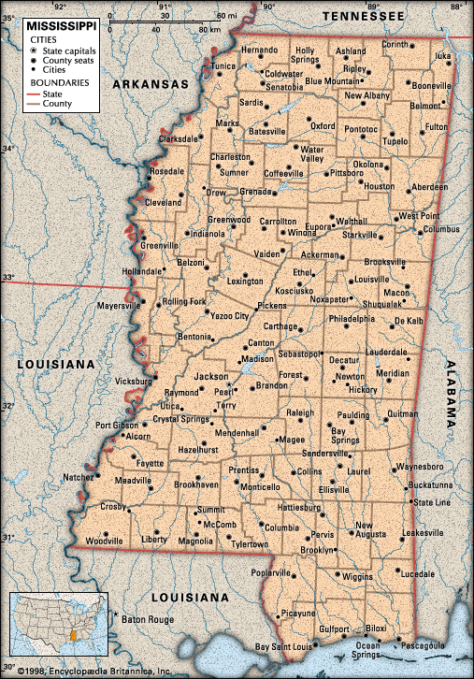

Slide 32
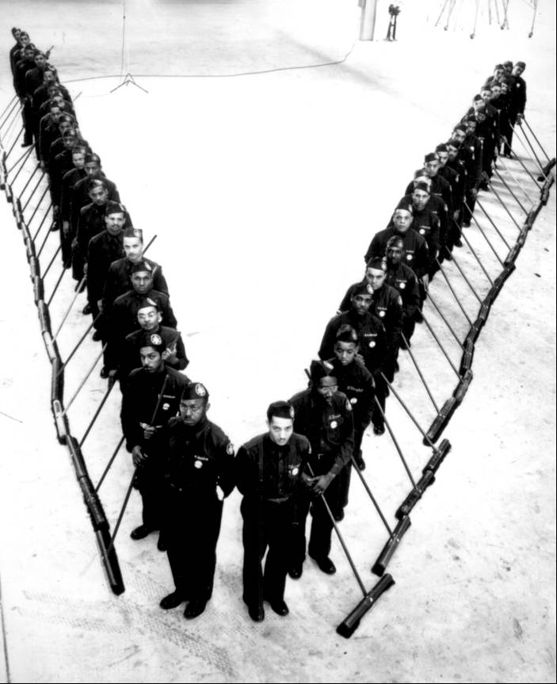
Janitors in Kansas City Aircraft Factory, 1940

Slide 33
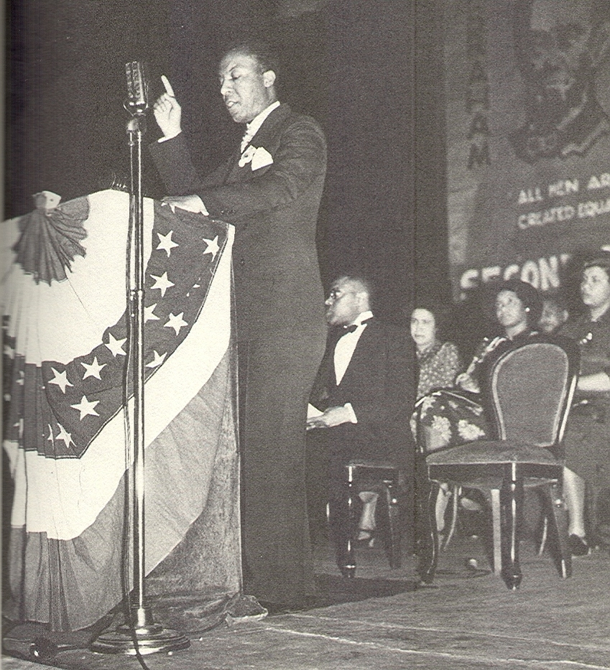
A. Philip Randolph

Slide 34
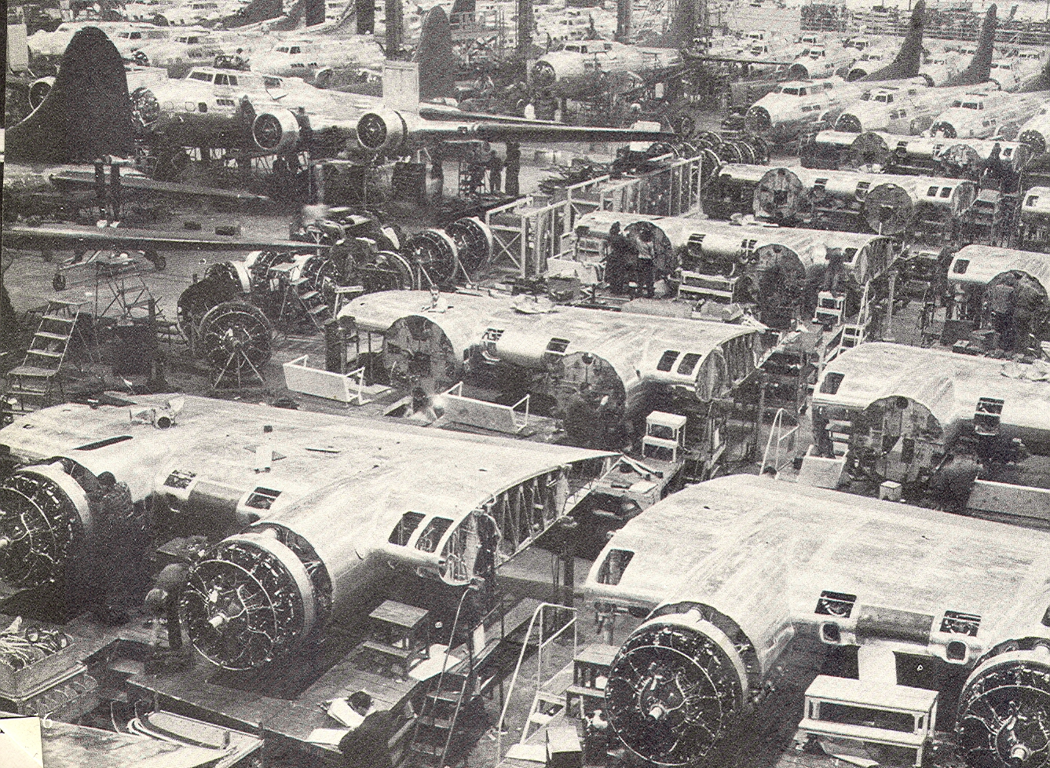
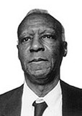
Asa Philip Randolph, 1941
Boeing Assembly Plant, Seattle,1941

Slide 35
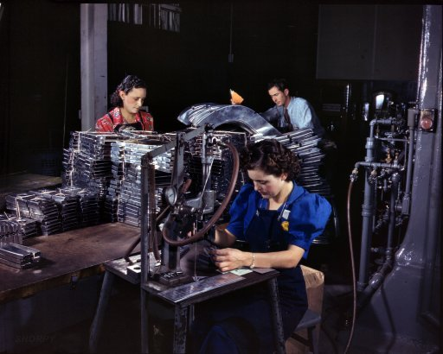
The President of North American Aviation on Black Employment, 1941
While we are in complete sympathy with the Negro, it is against company policy to employ them as mechanics or aircraft workers. There will be some jobs as janitors for Negroes… Regardless of their training as aircraft workers, we will not employ them in North American plants.

Slide 36
March on Washington:
The Beginning of a Movement
We ought to throw fifty thousand Negroes around the White House, bring them from all over the country, in jalopies, in trains, and any way they can get here...until we get some action [on the integration of defense plants] from the White House...
Unidentified Conference Participant

Slide 37
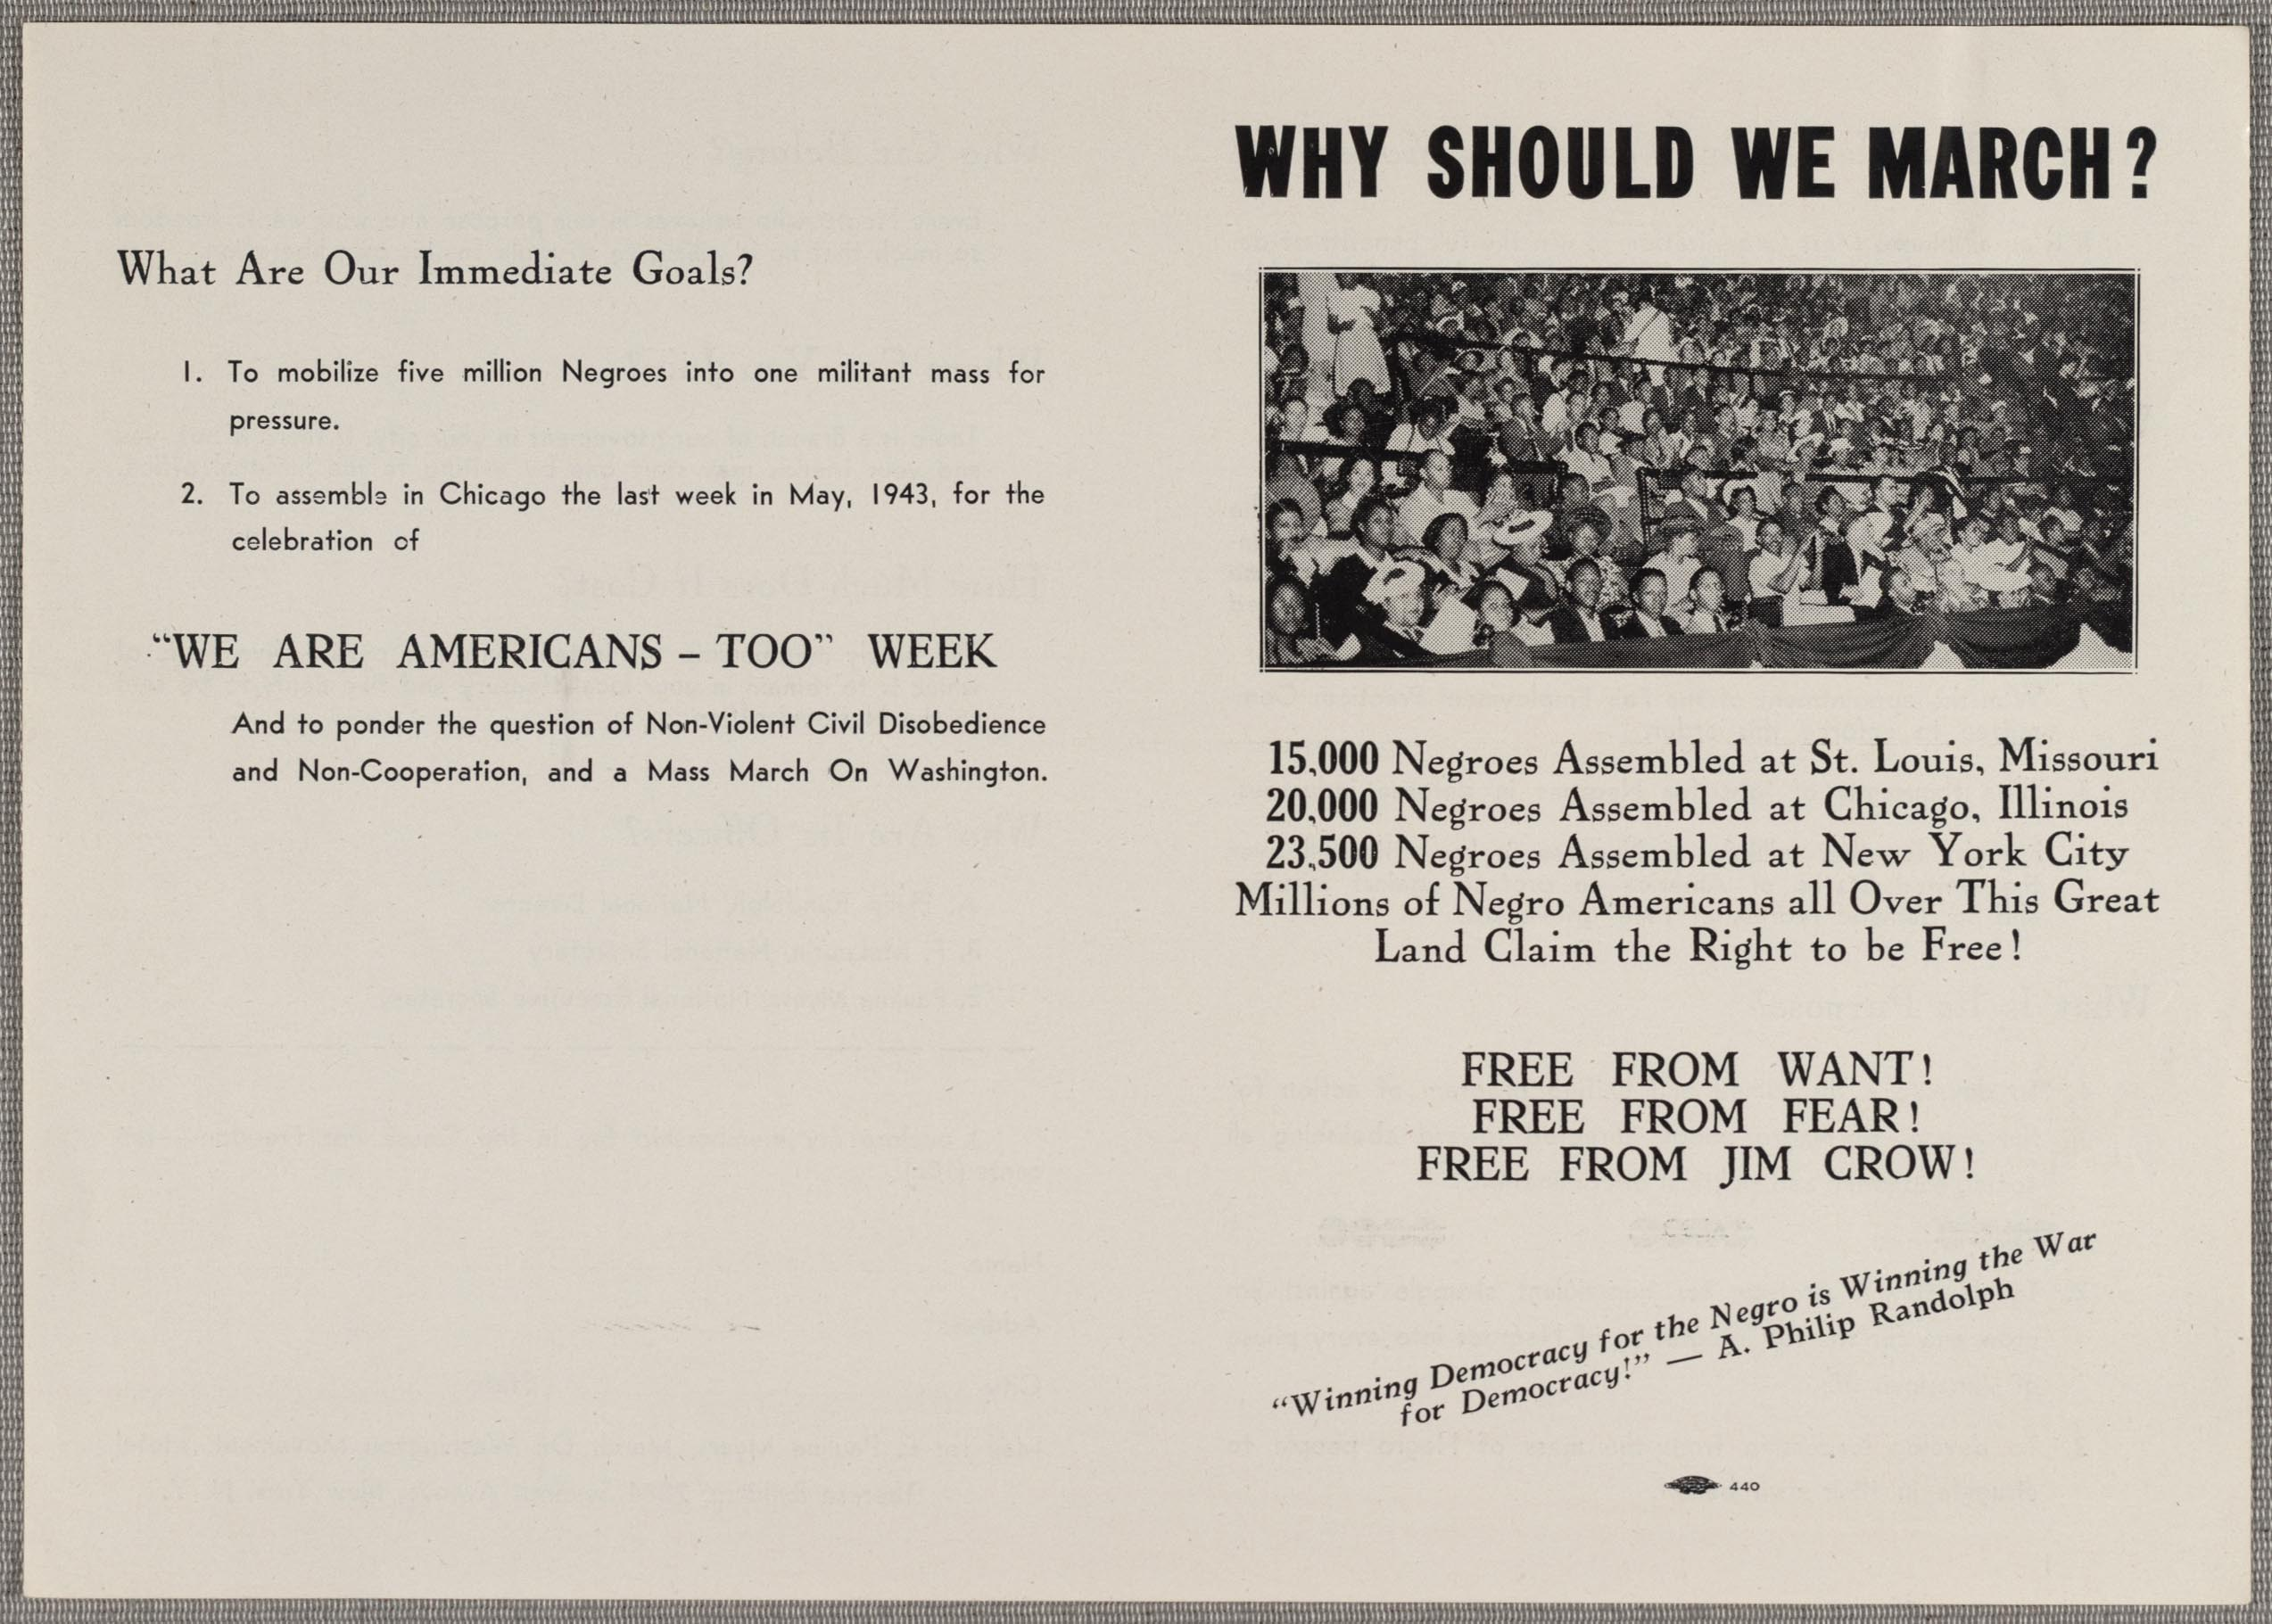
The March on Washington Movement, 1941-1945

Slide 38
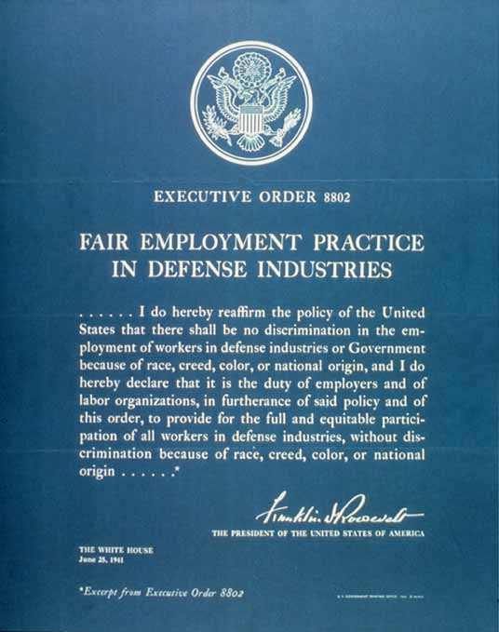
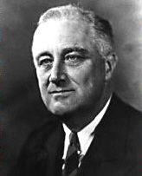
Franklin Roosevelt and
Executive Order 8802, June 25, 1941

Slide 39
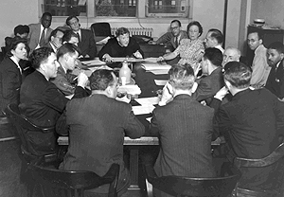
FEPC Hearing, Washington, D.C. 1942

Slide 40
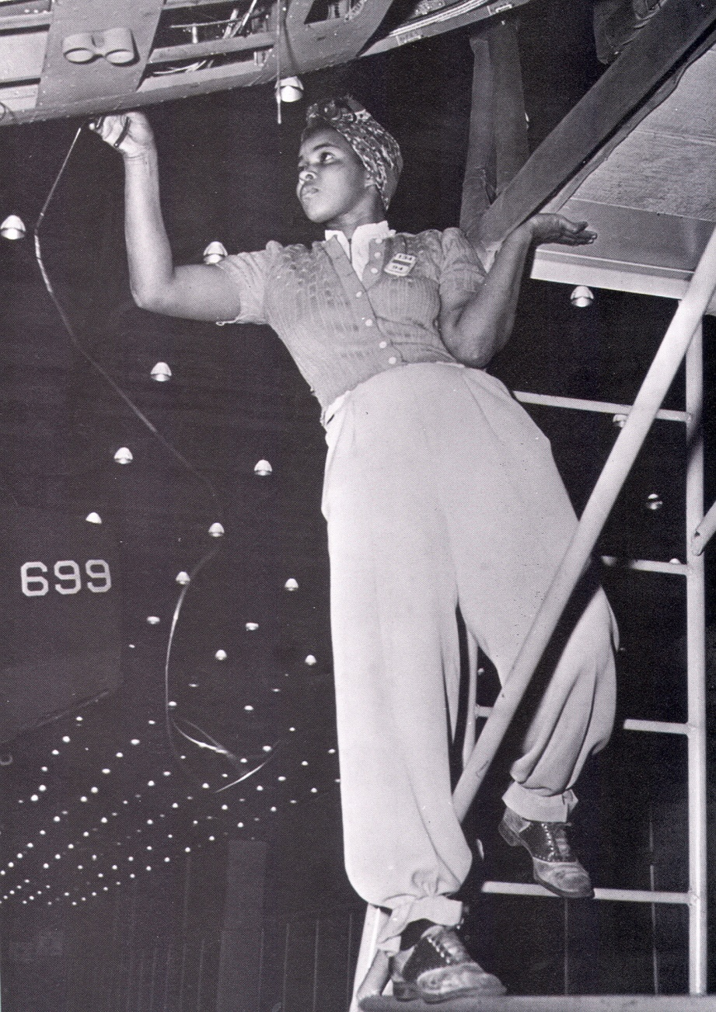
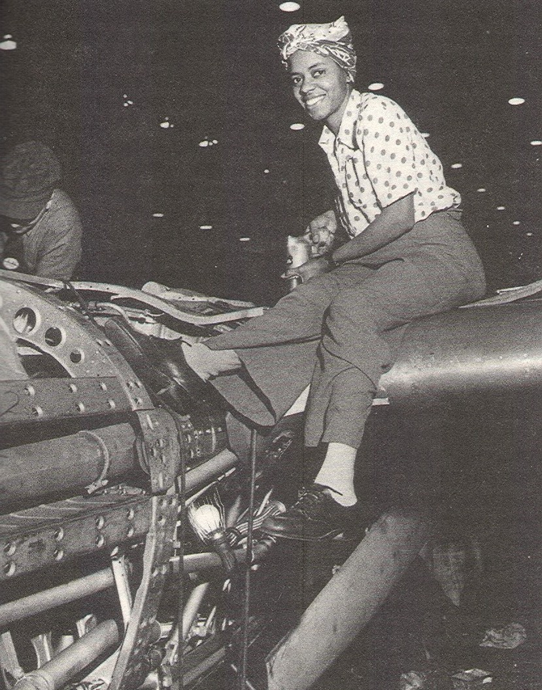
Black Aircraft Workers:
Los Angeles & Seattle, 1944

Slide 41
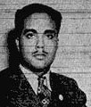
James Thompson and the Double V Campaign
Being an American of dark complexion and some 26 years, these questions flashed through my mind. Should I sacrifice my life to live half American? Will things be better for the next generation in the peace to follow? Would it be demanding too much to demand full citizenship rights in exchange for the sacrificing of my life? Is the kind of America I know worth defending?
These and other questions need answering; I want to know, and I believe every colored American, who is thinking, wants to know...
The V for victory sign is being displayed prominently in all so-called democratic countries which are fighting for victory over aggression, slavery, and tyranny. If this V sign means that to those now engaged in this great conflict, then let we colored Americans adopt the double V V for a double victory.
The first V for victory over our enemies from without, the second V or victory over our enemies from within. For surely those who perpetrate those ugly prejudices here are seeking to destroy our democratic form of government just as surely as the Axis forces."
Pittsburgh Courier, January 31, 1942

Slide 42

Logo of the Double V Campaign

Slide 43
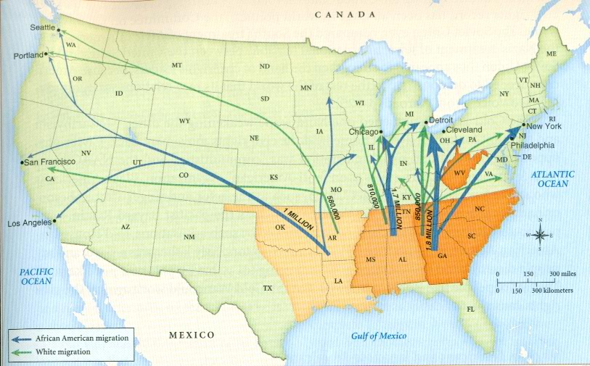
The Second Great Migration, 1942-1945

Slide 44

They came with their mementos, history, and hope all tied to the top of a car—unidentified author, 1945

Slide 45
Black Population Growth on the West Coast, 1940-1945
“The state of Arkansas has moved to California, the state of Texas has moved to California, and California has gone to hell!”
City 1940 Pop. 1945 Pop.
San Francisco/
Oakland 19,000 147,000
Los Angeles 64,000 218,000
Richmond, Ca. 800 23,000
Vallejo, Ca. 0 16,000
Seattle 3,000 15,000
Portland 1,900 22,000
Bremerton 77 3,000
Pasco 27 2,900
Vancouver, Wa. 12 4,000

Slide 46

Sinclair Park Community Church Sunday School,
Bremerton, 1944
Twelve year old Quincy Jones is one of the children in the center of the photo.

Slide 47

Continuing Opposition to Black Employment in
World War II
Left: Dr. Seuss Cartoon
We are not opposed to Harry Mills personally. We are fighting the entire Negro race. We cannot open our doors to Negro workers after having kept them closed all of this time.
  Unidentified Portland Longshore Union Official, 1942

Slide 48
Continuing Opposition to Black Employment in
World War II
Left: Dr. Seuss Cartoon
The Negro’s foot may be in the [defense plant] door but the bulk of his body remains tragically out in the cold.
  California Eagle, January, 1942

Slide 49

Boeing Flying Clipper, 1939

Slide 50

The Boeing Migration: 1940-1946
Left: Growth of the Boeing Workforce
Right: War Bond Rally at Boeing Field, 1943
The Boeing Workforce
September 1939 4,000
July 1941 10,000
September 1941 20,000
December 1941 30,000
July 1944 50,000
July 1946 11,000

Slide 51


The Northwest Enterprise Campaign to Open Boeing to Black Workers

Slide 52
The Northwest Enterprise on
Executive Order 8802
The President’s [Executive Order] issued to quiet the rising tide of Negroes’ protest against the hypocritical stand of industry and labor denying the Negroes’ right to work in plants holding contracts for national defense fall on deaf ears in the far Northwest.
  Northwest Enterprise, September 26, 1941

Slide 53

Challenging Discrimination From Within The Union:
Hugo Lundquist Addresses Local 741, April 28, 1941

Slide 54
James Duncan on Black Workers at Boeing
We have officially gone on record as agreeing to live up to the letter and spirit of the executive order whole-heartedly and without reservation. At the same time we rather resent that the war situation has been used to alter an old-established custom and do not feel it will be helpful to war production.
    James Duncan, IAM Representative, Local 751

Slide 55


Dorothy West Williams,
First Production Worker, Boeing Airplane Company, 1942

Slide 56

The Impact of the War on Black Women
It was Hitler who got us out of white folks’ kitchens.

Slide 57

Black Workers, Boeing Plant, Renton, 1944

Slide 58

Women Working at Boeing, 1943:
The Impact on Inez Sauer
The job really broadened me. [Before the war] I had no contact with Negroes except as maids or gardeners… We were brought up to think that colored people were not on the same economic or social level. I learned differently at Boeing. In fact I found that some of the black people I got to know there were very superior and certainly equal to me—equal to anyone I ever knew.
    Inez Sauer, Boeing Worker, 1945

Slide 59


Black Migrant Housing in Richmond, and Los Angeles, 1942

Slide 60

Wartime Housing in Los Angeles: The Deputy Mayor Describes Little Tokyo to a Congressional Committee, 1944
I urge that your committee take enough time to walk through the former Little Tokyo. Here you will find life as no human is expected to endure it.
Our records show families piling up four, five and six persons to a bedroom. In one case a family of five was living in a dirt floor garage with no sanitary facilities whatsoever. In an abandoned storefront twenty-one people were found to be living and paying approximately $50 a month for these quarters.

Slide 61


The Campaign Against Racial Discrimination in the Pacific Northwest in World War II

Slide 62


Slide 63



Police-Black Community Tensions, World War II

Slide 64

Woman Building Tank at Pacific Iron and Foundry, Renton, 1944

Slide 65

Mayor Devin on Racial Tension in Seattle, 1944
Devin is with Seattle Civic Unity Committee Executive Secretary Louise Blackman, 1950
The problem of racial tension is one which is fraught with dynamite and it is going to affect us not only during the War, but also after the War. It is our duty to face the problem together. If we do not do that, we shall not exist very long as a civilized city or as a nation.
  --Seattle Mayor William F. Devin
    Speech at the University of Washington, July 1944

Slide 66

Christian Friends for Racial Equality Luncheon, 1949

Slide 67



Dorothy Bullitt and King 5 Radio and TV

Slide 68

The Coleman Pool, West Seattle

Slide 69



The Migrants:
Images and Impressions

Slide 70
Recalling the Migrants:
Seattleites LeEtta King and Elva Moore Nicholas Remember
I know I was quite ashamed of them. They looked so bad. Women wearing dungarees and their heads tied up with a handkerchief. I just tried not to see them. (King)
A lot of them were awfully aggressive. They liked to fight. Down there [in the South] they had to step off the sidewalk and let the other fella pass by. They got up here and they would push the other fella off! (Nichols)

Slide 71

The Migrants: The Local Response
There was discord because [Seattle] had been such a small black community and although we had our share of segregation we felt that we were better off if we were less visible…the fewer of us the better off we were, and we felt that with more black people there would be more problems. Black people would come here and get arrested and be going to jail all the time and making a lot of noise and we would all suffer.
        Seattle Resident Maxine Pollard

Slide 72


We were Talking about “those sharecroppers.” We were all sharecroppers. We just got here first—Armeta Hearst, 1968

Slide 73

The Migrants:
A Northwest Enterprise Cartoon and Editorial,
March 22, 1944
As long as one member of our race compels criticism from other races for being uncouth, ignorant, and dirty, so does our entire race receive a full share of that criticism.

Slide 74

Washington State Legislator Charles Stokes (Seated) with Law Partner Philip Burton, 1951

Slide 75

Rev. Benjamin Davis Presided over the Growth of Mt. Zion Baptist Church in World War II From 300 Members to 1,200 Members

Slide 76

Aerial View, Seattle’s Central District, Nov. 1946

Slide 77

Horace Mann School, 2008

Slide 78

Japanese American & African American Kids at Collins Playfield, Seattle, 1947

Slide 79

Maya Angelou on the Transformation of
San Francisco’s Japantown into Little Harlem
The Yakamoto Sea Food Market quietly became Sammy’s Shoe Shine Parlor. Yashigira’s Hardware changed into La Salon de Beaute owned by Miss Clorinda Jackson... Where the odors of tempura and raw fish had dominated, the aroma of chitlings, greens, and ham hocks now prevailed...
No member of my family and note of the family friends mentioned the absent Japanese. It was as if they never owned or lived in the houses we inhabited... The Japanese were not white folks. Since they did not have to be feared, nether did they have to be considered.

Slide 80

Japanese Evacuation from Seattle, April 1942

Slide 81

The Jackson Street Community Council: Crowning Miss International Center, Adelia Avery, 1952

Slide 82

Interracial Couple, Seattle, 1947

Slide 83

Roy Wilkins of the NAACP
You can’t be against park benches marked “Jude” in Berlin and be for park benches marked “colored” in Jacksonville. (1944)

Slide 84




Marines at Okinawa, Soldiers in Calcutta,
WAC’s in London, Tankers in Vienna, 1945

Slide 85

Langston Hughes on the Four Freedoms and the African American Struggle for Racial Justice, 1944
We want the Four Freedoms to apply to black Americans as well as to the brutalized peoples of Europe and to other underprivileged peoples of the world. If now is not the time, there never was a time. Now Jews are asking for it. Now America is fighting to keep it. Now Nehru and Gandhi are sitting in jail silently demanding it for India. How anyone can believe American Negroes will not catch the freedom fever is beyond me.

