Slide 1
The UNIA and The Communist Party

Slide 2
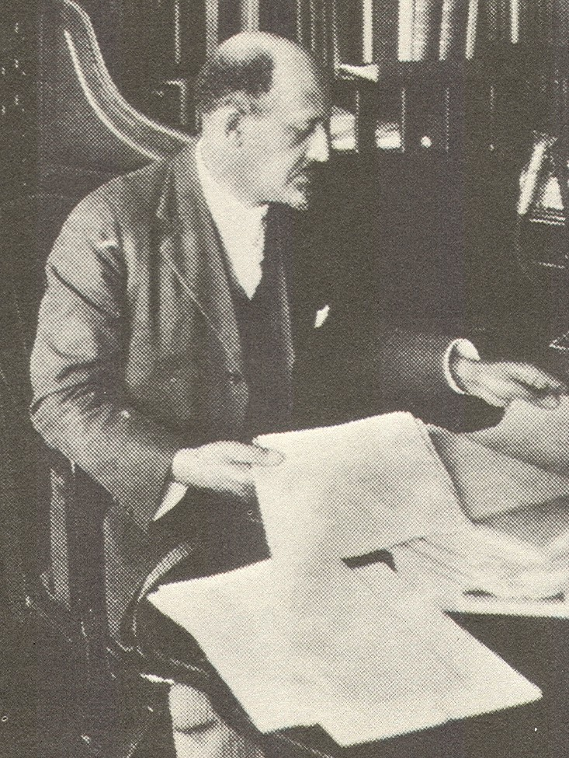
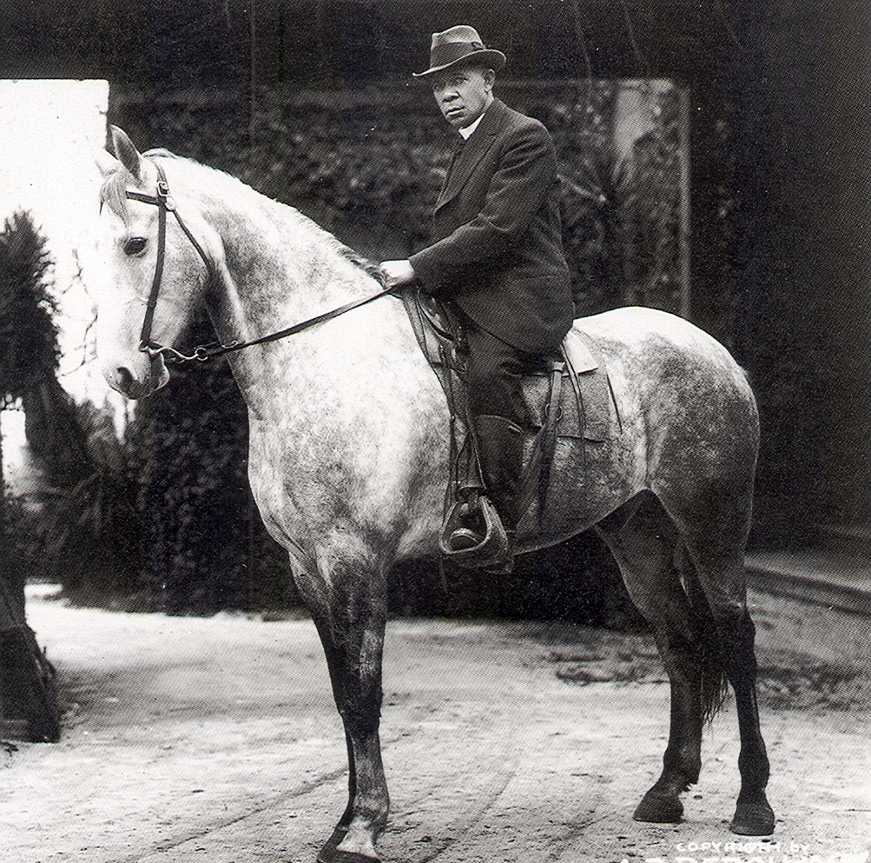

Slide 3
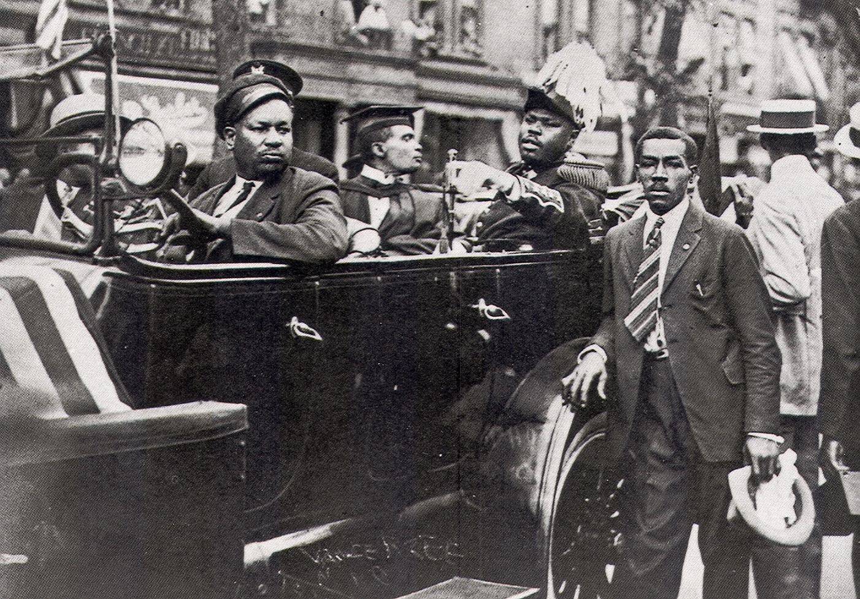
Marcus Garvey and the Universal Negro Improvement Association (UNIA)

Slide 4
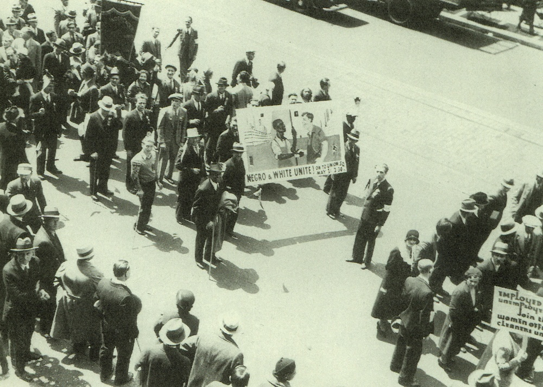
Communist Party Parade, Chicago, 1932

Slide 5
UNIA-Race Unity Across Class Lines
The Communist Party-Class Unity Across Race Lines

Slide 6
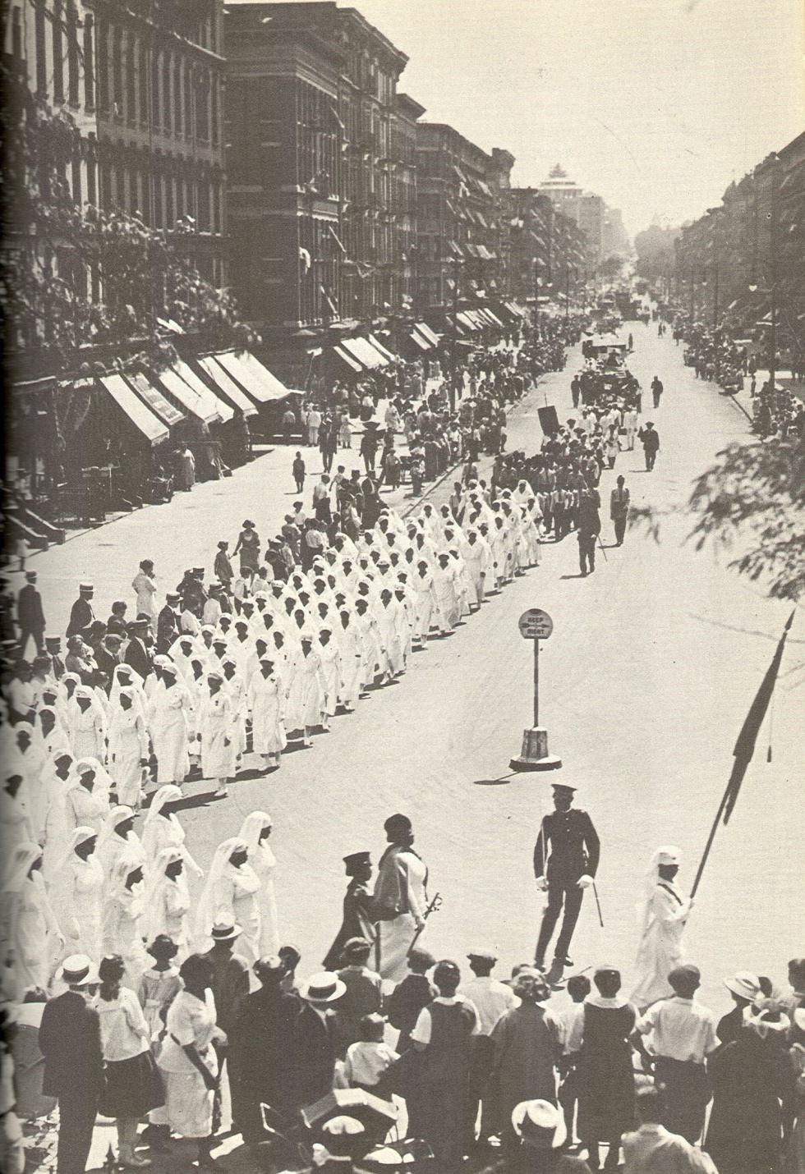
UNIA Parade, New York City, 1922

Slide 7
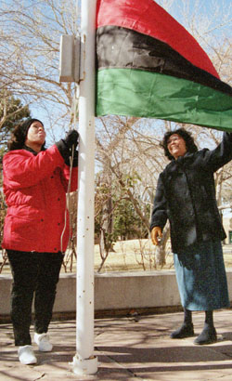
Red, Black and Green Flag:
The Garvey School, Los Angeles, 2005

Slide 8
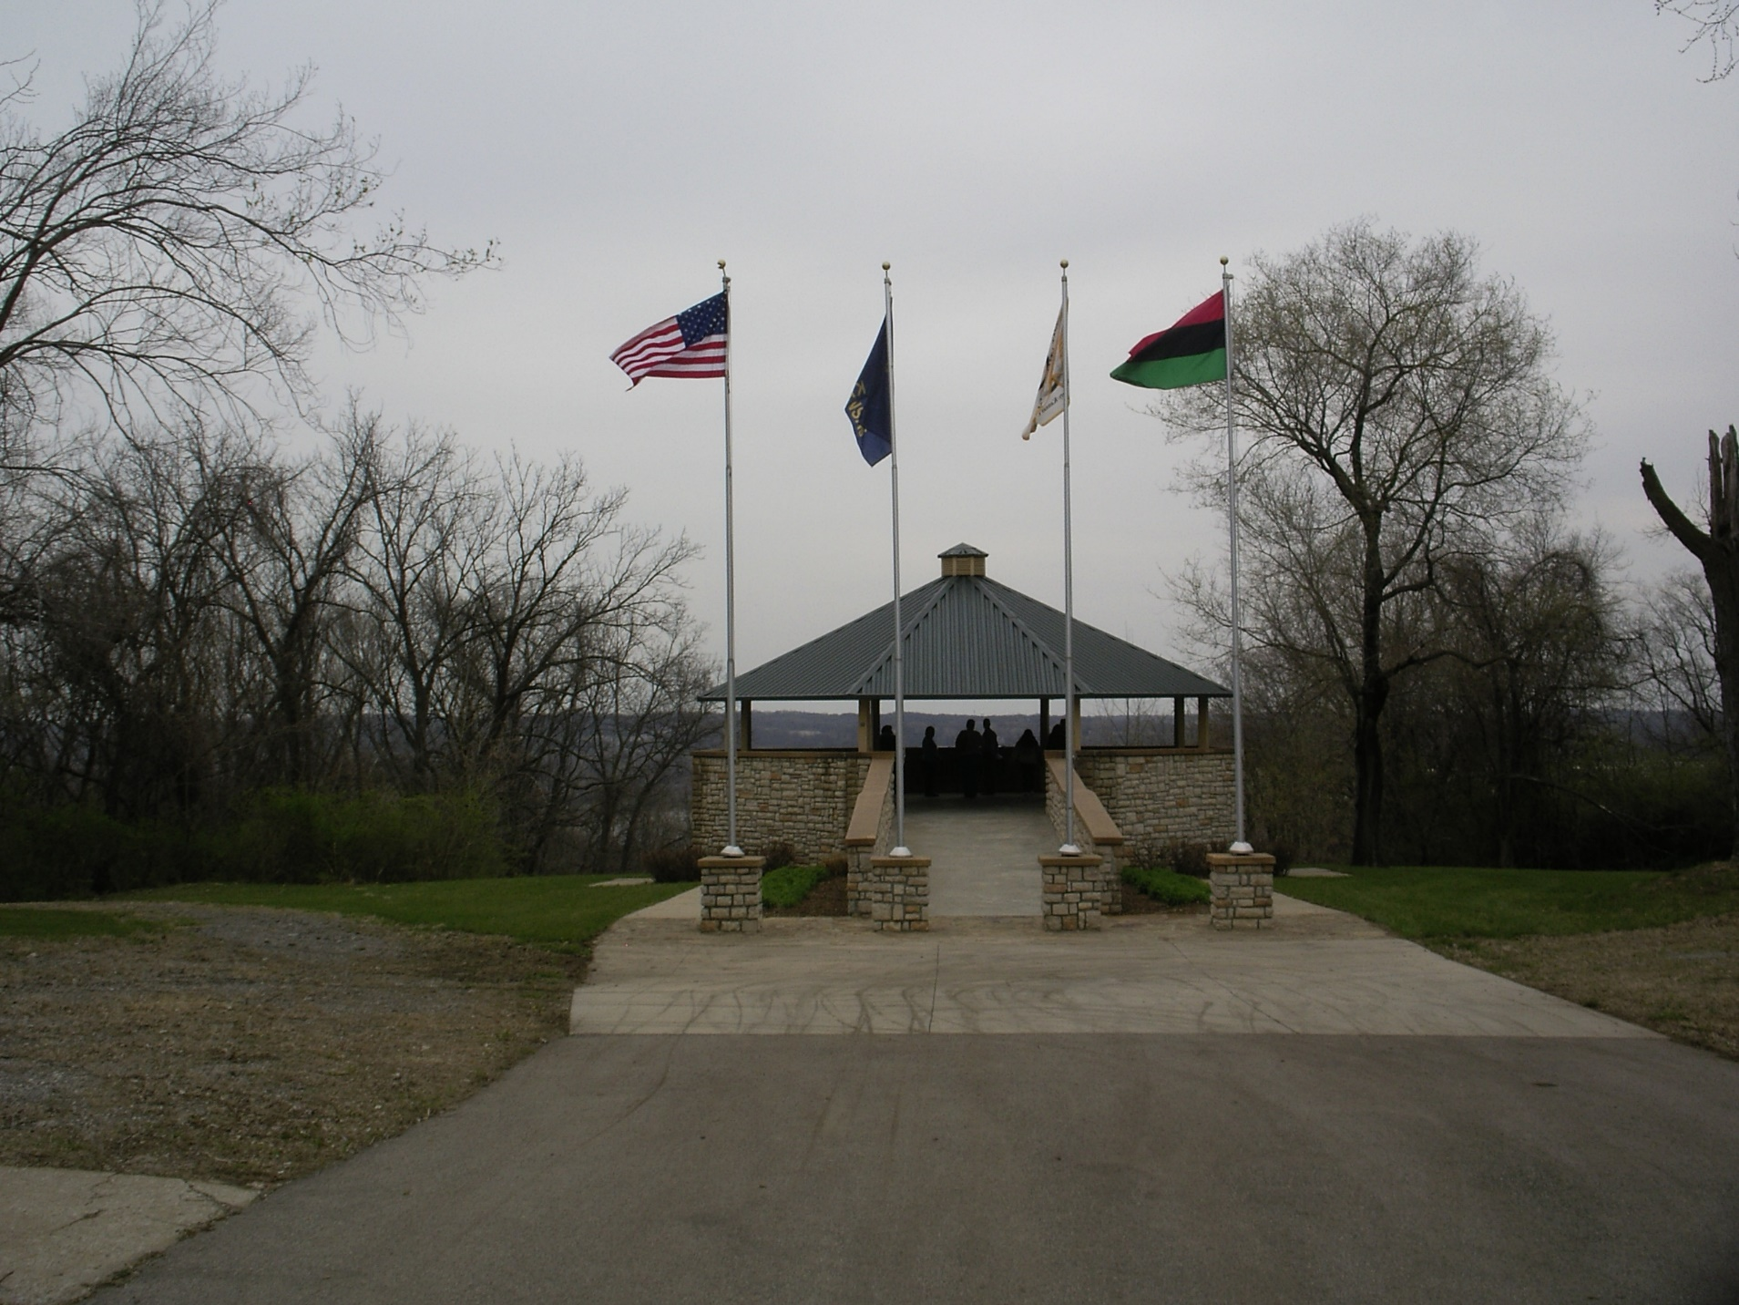
Quindaro Overlook: April 21, 2018

Slide 9
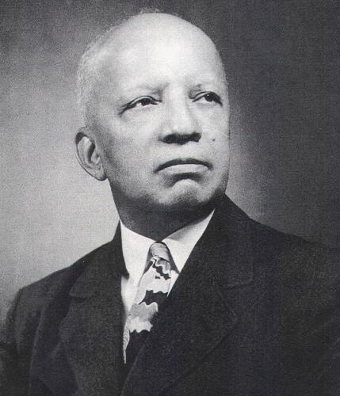
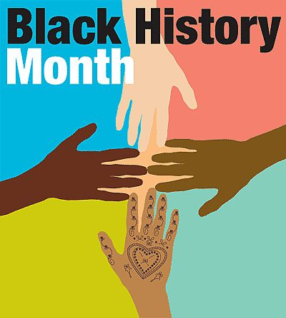
Carter G. Woodson, Founder of Black History Week, 1926

Slide 10
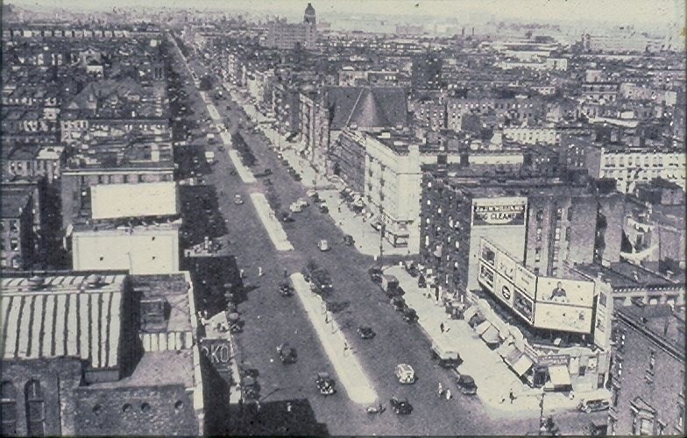

Slide 11

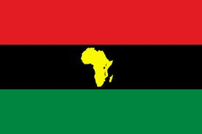

Slide 12
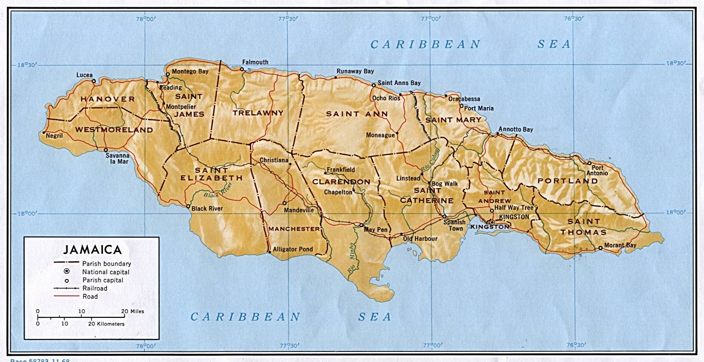

Slide 13
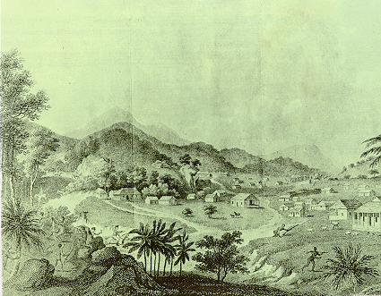
(L) Maroon Colony in Jamaica, ca. 1860
(R ) Jamaican Race/Class Hierarchy
White 5%
Bi-Racial 15%
Black 80%

Slide 14
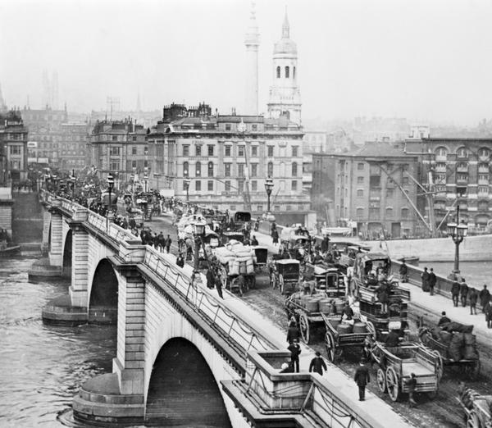
London in 1912

Slide 15
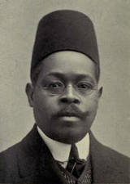
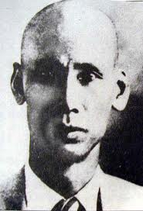
Duse Muhammad Ali,
Ho Chi Minh

Slide 16
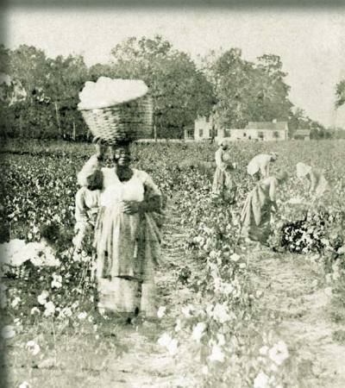
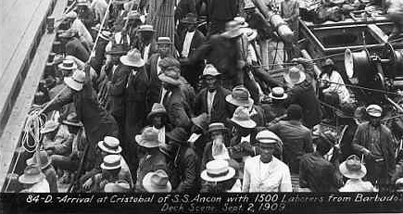
Black Workers in Georgia, 1905
Black Workers Bound for the Panama Canal, 1909

Slide 17
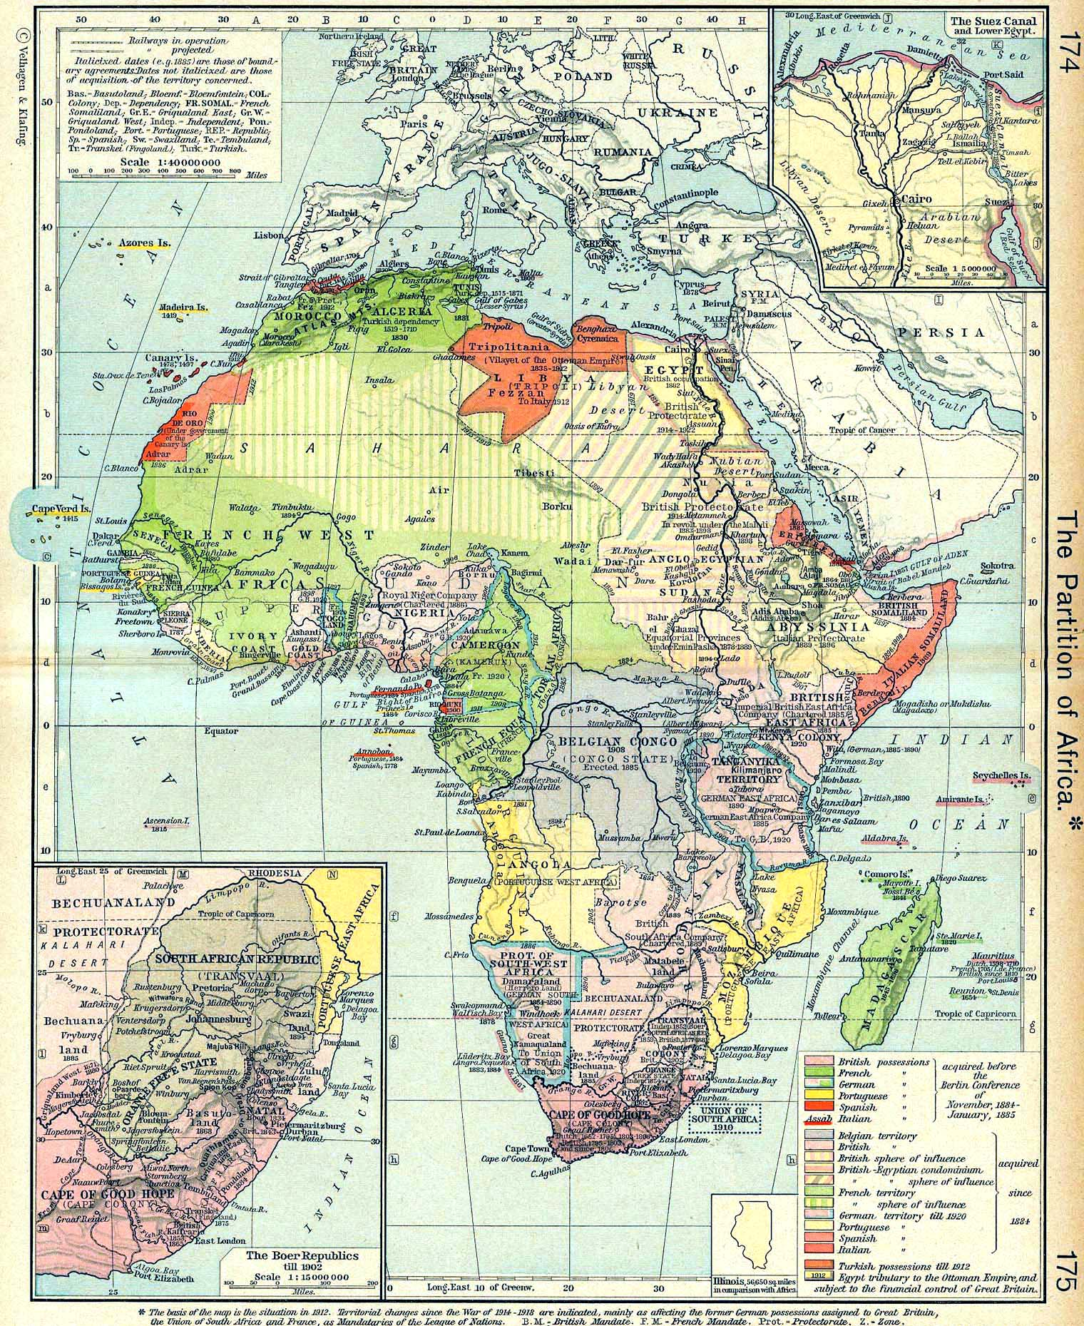
The European Partition of Africa, 1885-1910

Slide 18
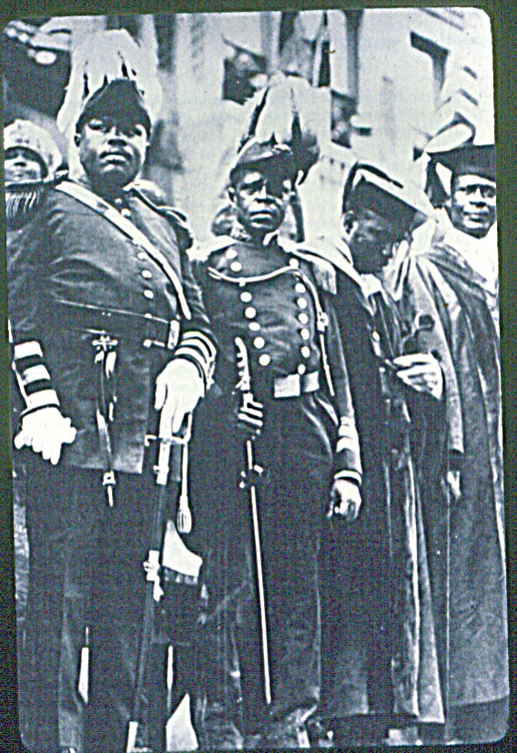
Partial Platform of the UNIA
1. Immediate end to European colonial rule in Africa.
2. Freedom for peoples of African descent to travel between their nations and the African continent.
3. Full civil and political rights for citizens of African descent in each country in which they reside.
4. The end of segregated districts, separate public conveyances, job discrimination, and lynching.

Slide 19
The UNIA on Racial Justice
We believe all men should live in peace with one another, but when races and nations provoke the anger of other races and nations by attempting to infringe upon their rights, war becomes inevitable, and the attempt in any way to free one’s self or protect one’s rights or heritage becomes justifiable.

Slide 20
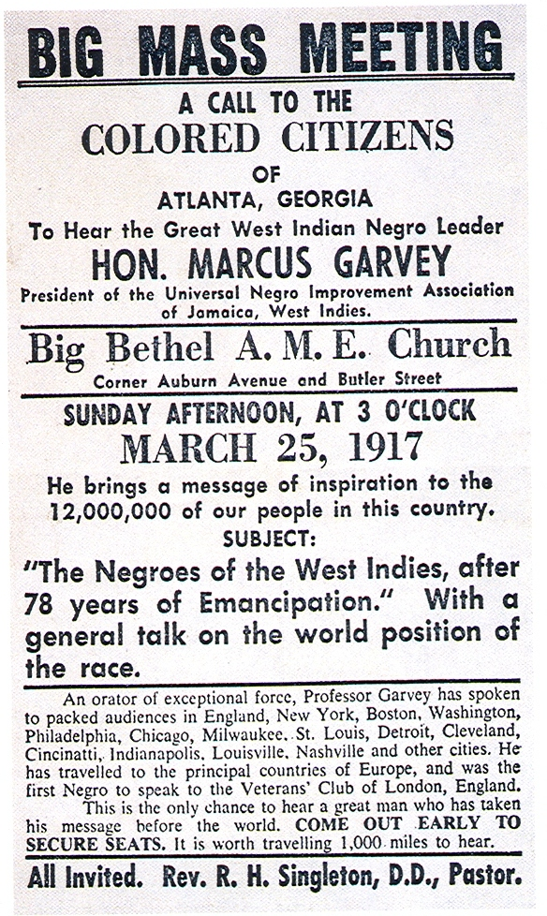

Slide 21
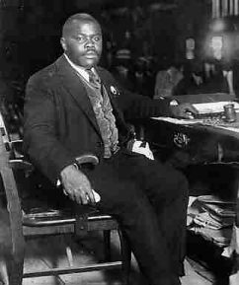
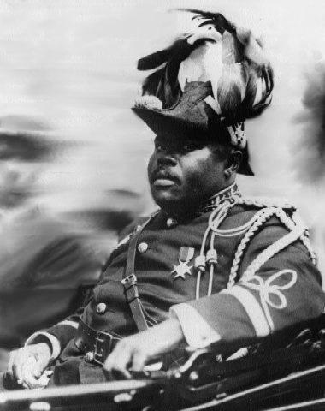

Slide 22
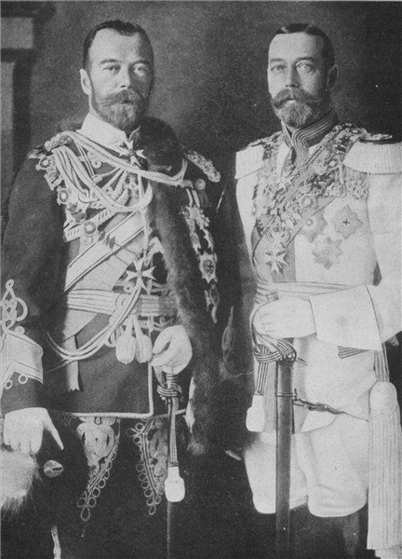
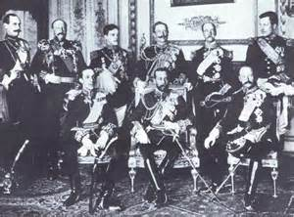
European Royalty on the Eve of World War I
On the Left, King George of England and Czar Nicholas of Russia, ca. 1912
On the Right, European Monarchs, 1914

Slide 23
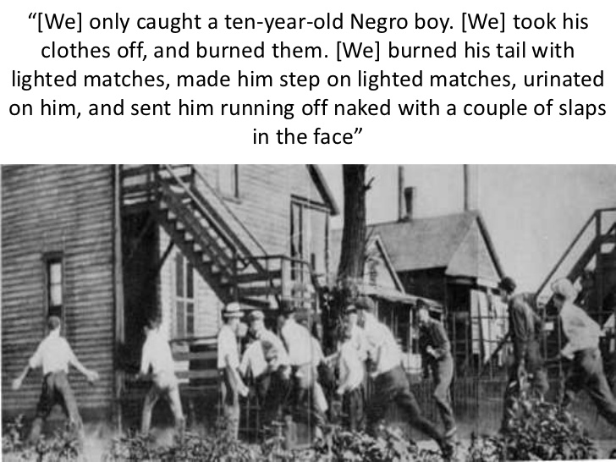
The Chicago Race Riot, 1919
Testimony from Riot Participants

Slide 24
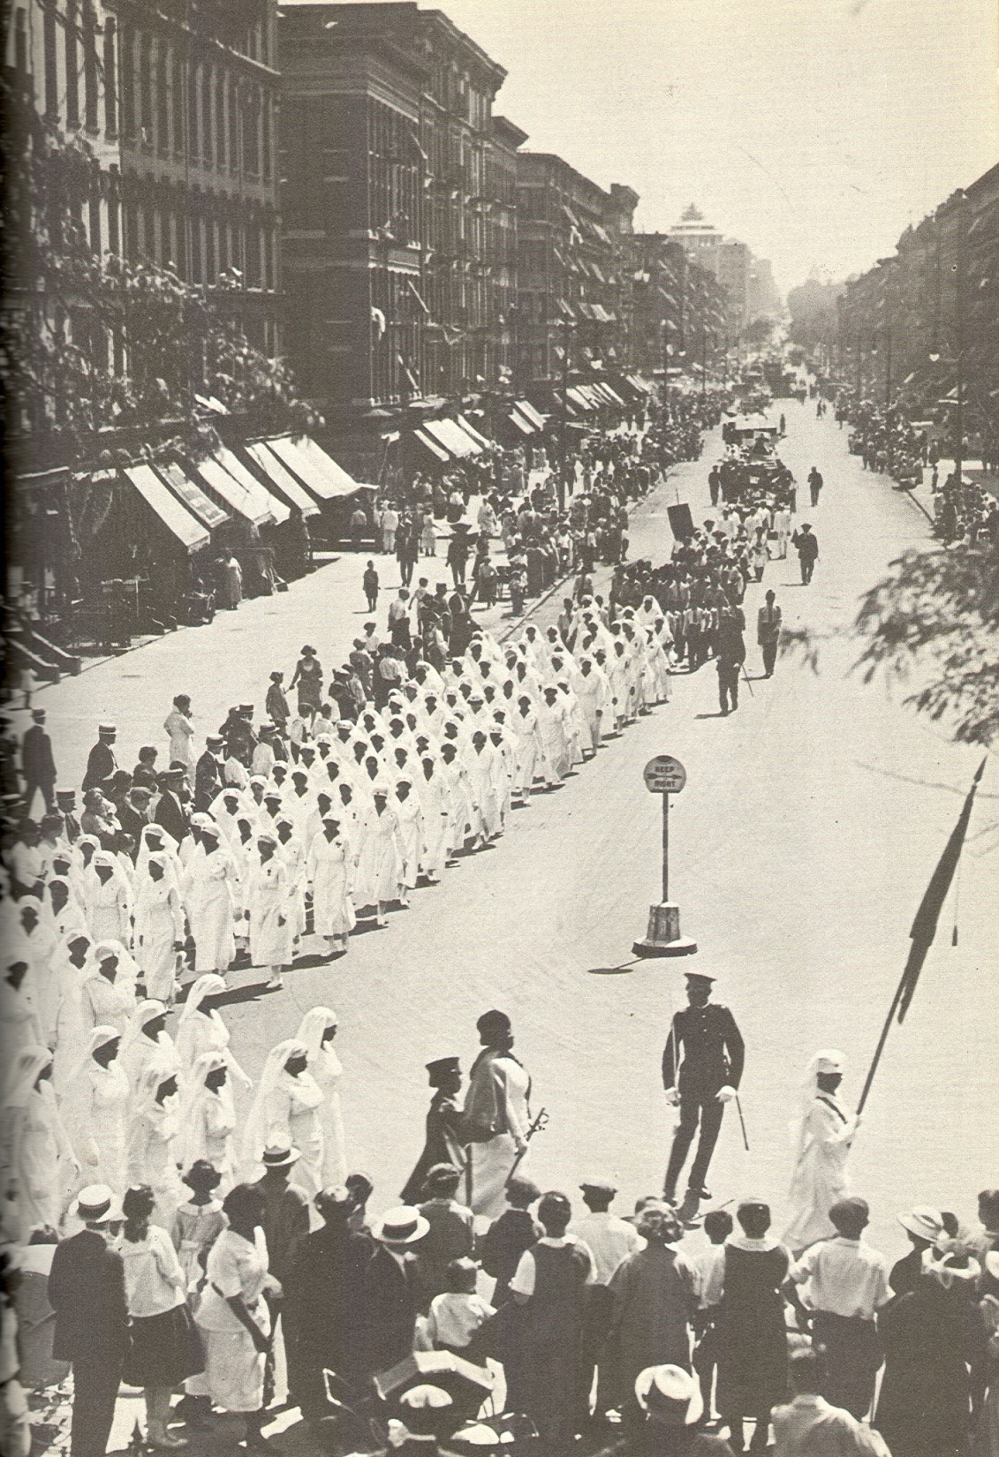

Slide 25
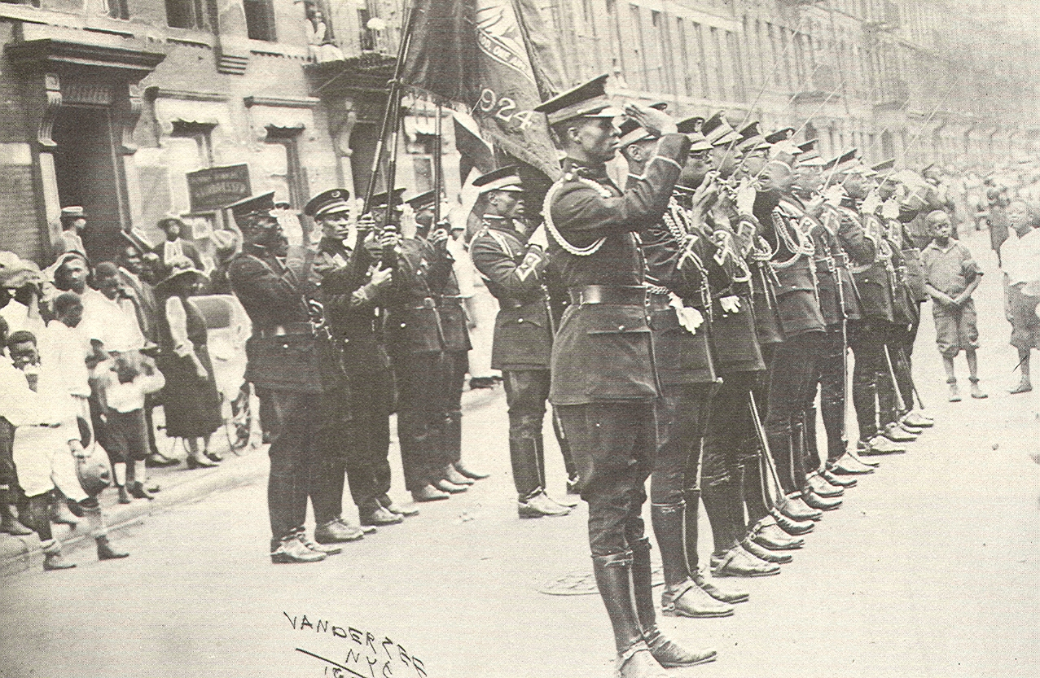
UNIA Rally: The African Legion, New York City, 1922

Slide 26
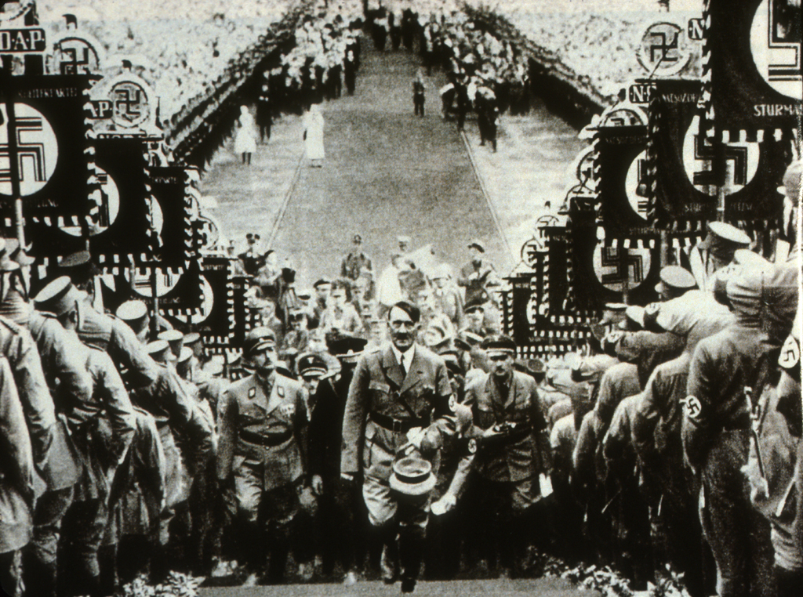

Slide 27
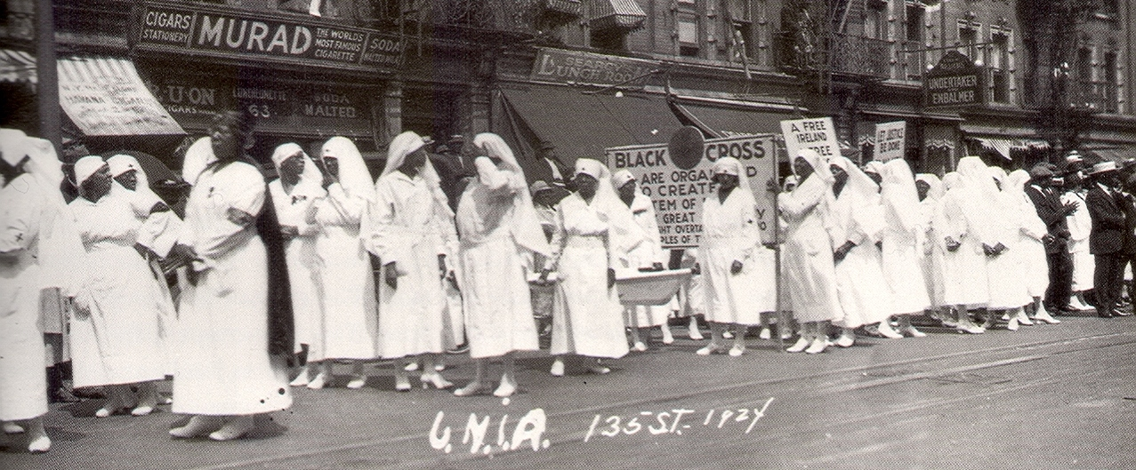
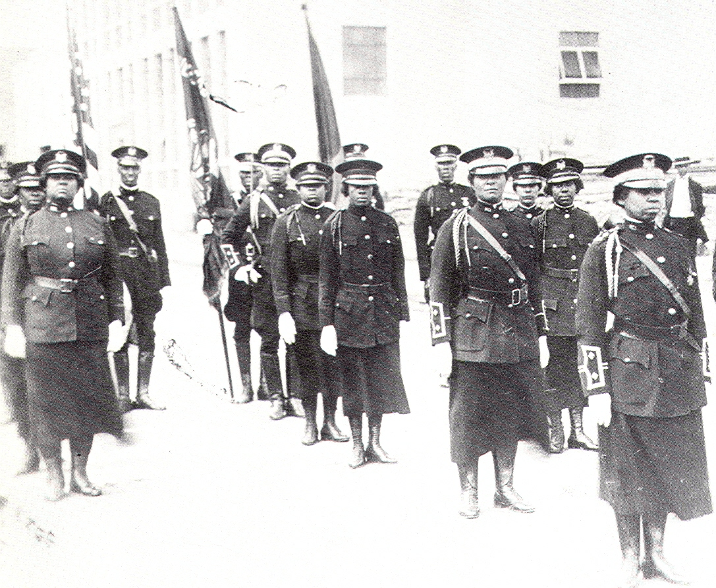

Slide 28
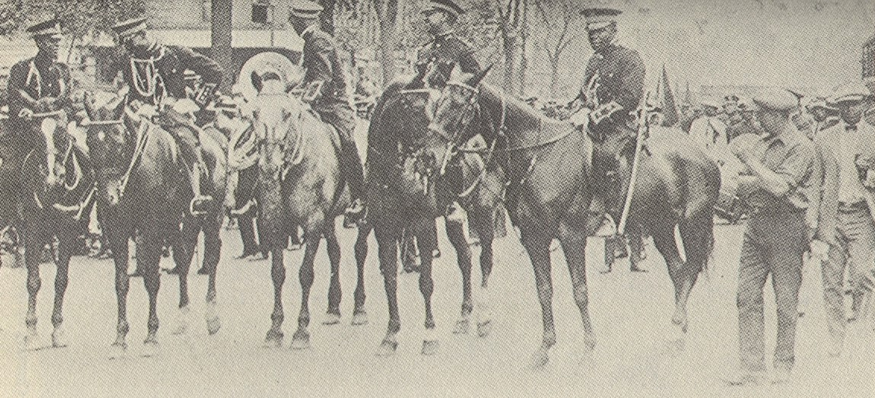
Mounted Members of the African Legion

Slide 29
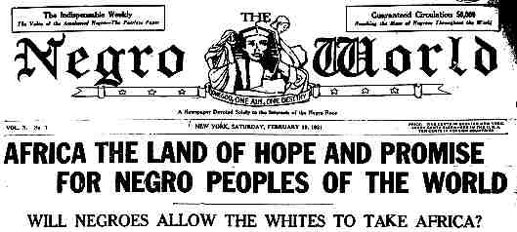
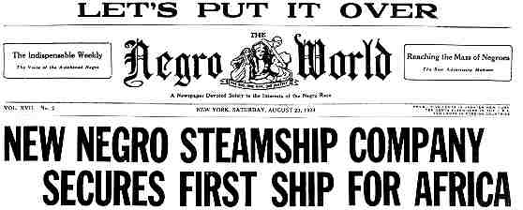
The Negro World

Slide 30
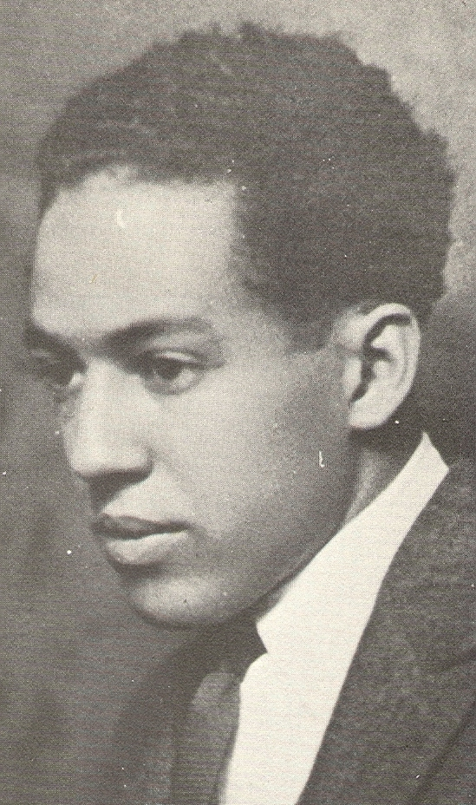
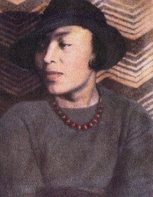
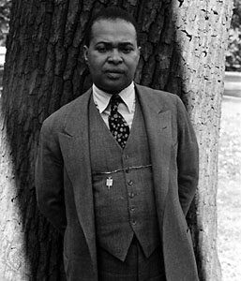
Countee Cullen, Zora Neale Hurston,
Langston Hughes

Slide 31
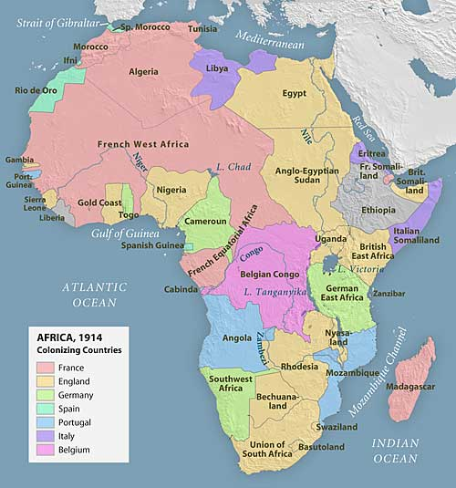

Slide 32
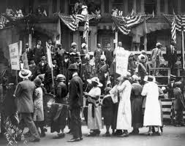
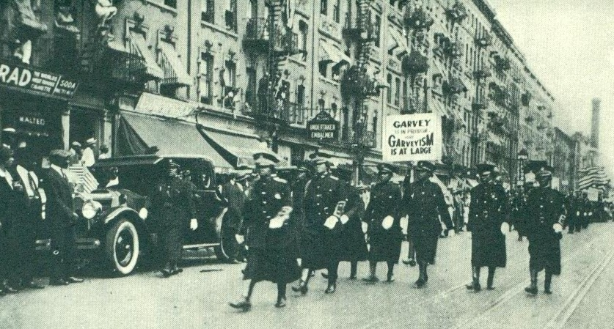
Left: UNIA Ralliy in New York City
Liberty Hall, NYC, on Right

Slide 33
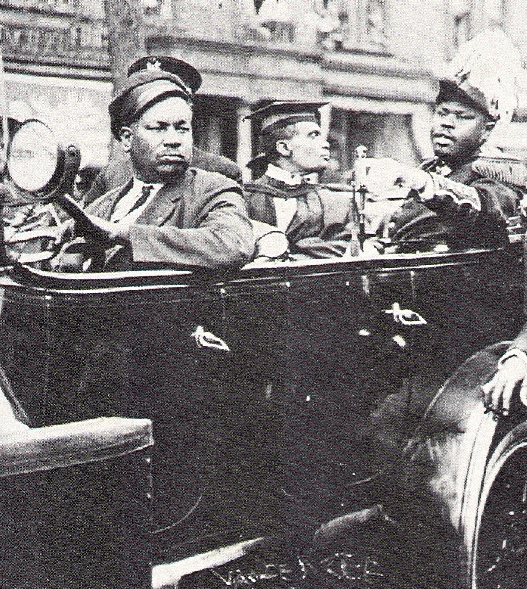
Memories of Marcus Garvey and the UNIA in Seattle
[The] UNIA had a place down on 12th and Washington…. I do remember Garvey’s visit to Seattle. We met him at the Union Station and the women and men were in uniform to greet him. I though he was going to be a big, tall man. He looked big in the pictures. He was almost as short as I.
Marguerite Johnson
[The UNIA] had marches on the Fourth of July. Women were dressed in their beautiful white uniforms...and a red, black and green sash. They were trying to teach us about Africa and…free Liberia. My father used to tell us to be proud of Africa, be proud of your race.
    Juanita Warfield Proctor

Slide 34
THE NAACP AND UNIA IN THE WEST, 1925:
NAACP CHAPTERS
Houston, 1912
Tacoma, 1912
Seattle, 1913
Oklahoma City, 1913
Portland, 1914
Denver, 1914
Los Angeles, 1914
San Antonio, 1914
Omaha, 1914
Albuquerque, 1914
San Francisco\Oakland, 1915
Dallas, 1915
Topeka , 1915
Boise, 1919
Salt Lake City, 1919
Phoenix, 1920
Tucson, 1922
Yuma, 1922
UNIA CHAPTERS
Omaha, 1919
Seattle, 1919
Tulsa, 1919
Oklahoma City, 1920
Phoenix, 1920
Fresno, 1920
Kansas City, 1920
Dallas, 1920
San Jose, 1920
Denver, 1921
Waco, 1921
Los Angeles, 1921
Colorado Springs, 1921
Oakland, 1921
San Diego, 1922
Portland, 1922
San Francisco, 1923

Slide 35
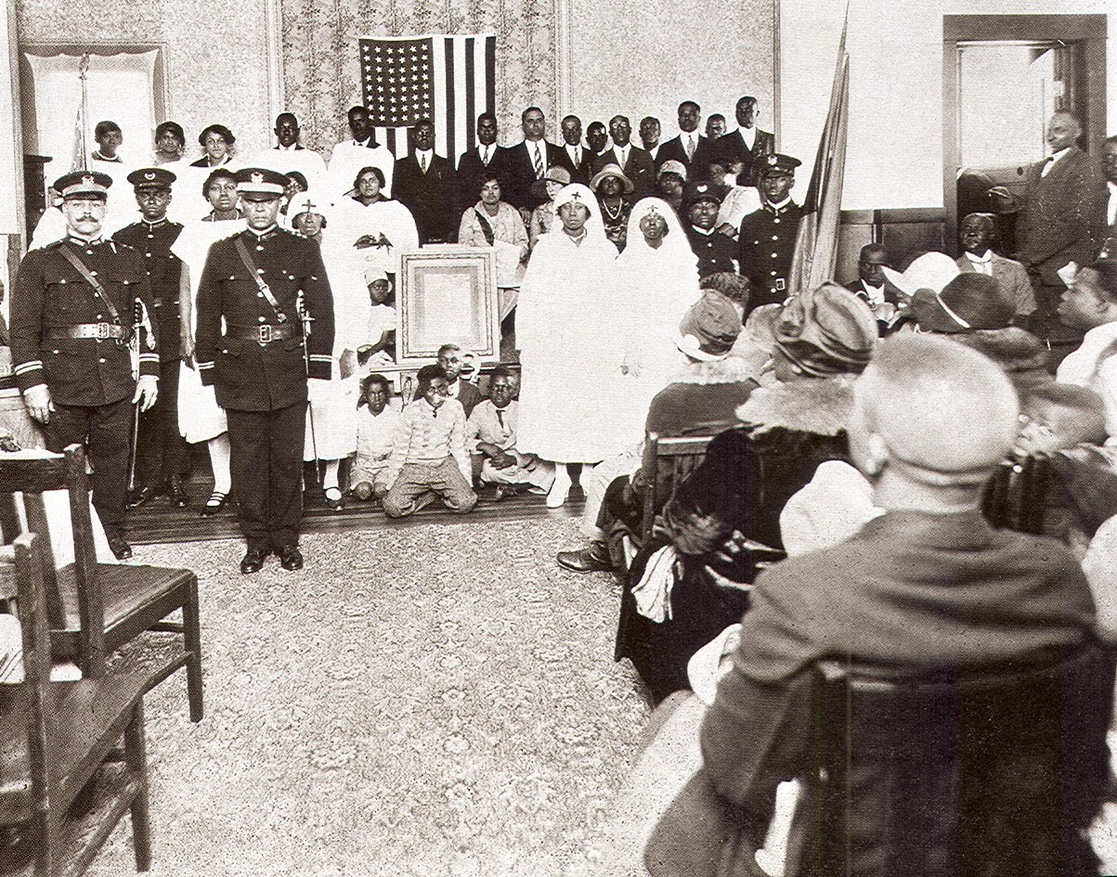
Oakland UNIA Meeting

Slide 36
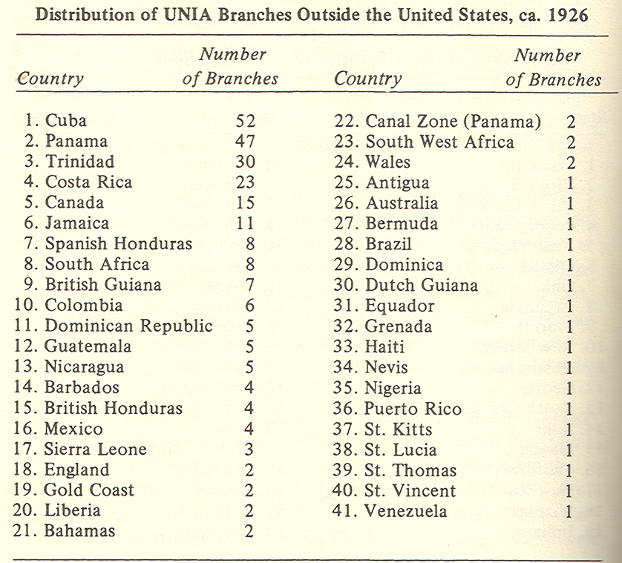
Outpost Garveyism: International

Slide 37
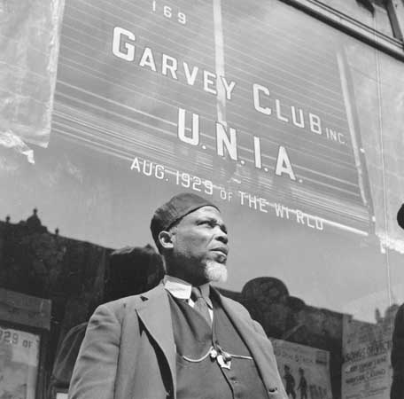
UNIA Supporter in British Honduras

Slide 38
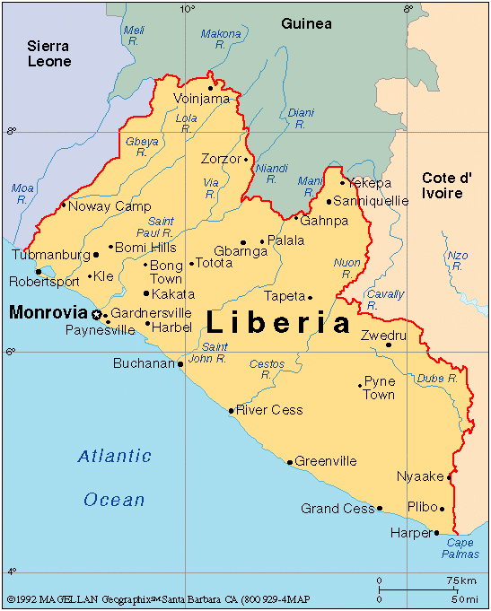

Slide 39
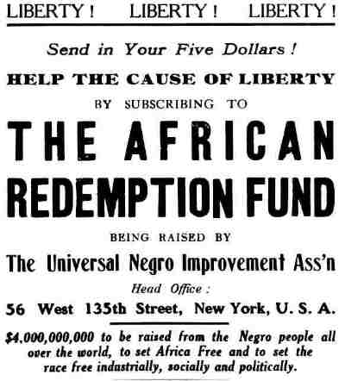

Slide 40
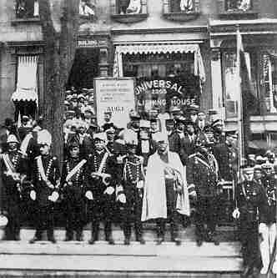
Garvey and UNIA Officials in Front of the Universal Publishing House

Slide 41
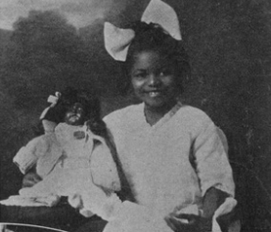
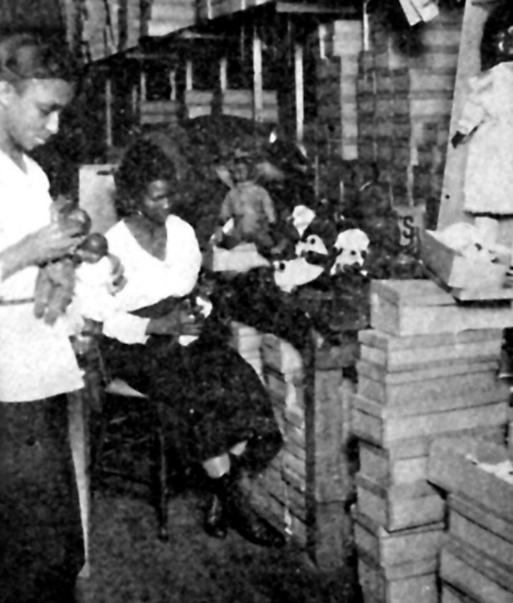
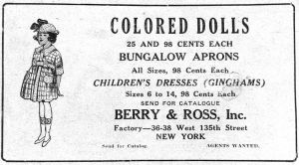
The UNIA Black Doll Campaign
(R ) UNIA Doll Factory

Slide 42


The Black Star Line

Slide 43


Slide 44



Garvey Opponents:
Chandler Owen, A. Philip Randolph,
W.E.B. DuBois

Slide 46


Slide 47

The Japanese Empire, 1920

Slide 48

Marcus Garvey and J. Edgar Hoover
Garvey is a West Indian negro and in addition to his activities in endeavoring to establish the Black Star Steamship Corporation he has also been particularly active among the radical elements in New York City in agitating the negro movement. Unfortunately...he has not violated any federal law whereby he could [be deported]. It occurs to me, however, from the attached clipping that there might be some proceeding against him for fraud in connection with his Black Star Line propaganda....
  J. E. Hoover, “Memorandum to Mr. Ridgley,” October 11, 1919.

Slide 49
Infiltration of the UNIA by the Newly Formed FBI

Slide 50
Friends of Negro Freedom
HARRY H. PACE, 2289 Seventh Avenue, New York City.
ROBERT S. ABBOTT, 3435 Indiana Avenue, Chicago, IL.
JOHN E. NAIL, 145 West 135th Street, New York City.
DR. JULIA P. COLEMAN, 118 West 130th Street, New York City.
WILLIAM PICKENS, 70 Fifth Avenue, New York City.
CHANDLER OWEN, 2305 Seventh Avenue, New York City
ROBERT W. BAGNALL, 70 Fifth Avenue, New York City
GEORGE W. HARRIS, 135 West 135th Street, New City.
Harry H. Pace is president of the Pace Phonograph Corporation.
Robert S. Abbott is editor and publisher of the "Chicago Defender."
John E. Nail is president of Nail and Parker, Inc., Real Estate
Julia P. Coleman is president of the Hair-Vim Chemical Co. Inc.
William Pickens is field secretary of the National Association for the Advancement of Colored People.
Chandler Owen is co-editor of The Messenger and co-executive secretary of the Friends of Negro Freedom.
Robert W. Bagnall is Director of Branches of the National Association for the Advancement of Colored People.
George W. Harris is a member of the Board of Alderman of New York City and editor of the New York News.

Slide 51

The Black Star Line, Fraud and the FBI

Slide 52

Marcus Garvey Surrounded by Federal Agents, 1924

Slide 53

Ku Klux Klan March on Pennsylvania, Avenue, Washington, D.C. 1925

Slide 54

“We were the first fascists.”

Slide 55




The Quotable Garvey

Slide 56



Malcolm X, The Panthers in Seattle, Amiri Baraka

Slide 57



Former Garveyites:
Michael Manley, Prime Minister, Jamaica
Kwame Nkrumah, First President of Ghana
Nnamdi Azikiwe, First President of Nigeria

Slide 58

Kwame Nkrumah on Marcus Garvey

Slide 59

Black Star Square, Accra, Ghana, 1998

Slide 60

Jomo Kenyatta and Thurgood Marshall, 1964

Slide 61


Kenneth Kaunda of Zambia at 30 and at 65

Slide 62

Celebrating Marcus Garvey in Nigeria

Slide 63

Theresa Brewer,
Head of the UNIA in Nova Scotia, 2006

Slide 64

The UNIA’s Contemporary Influence:
Assata Shakur’s Website, 2007

Slide 65

If every Negro could have put every dime, every penny into the sea, and if he might get in exchange the knowledge that he was somebody, that he meant something in this world, he would gladly do it... The [UNIA] was a loss in money but a gain in soul.
    Unidentified UNIA Supporter

Slide 66

The Communists and African America

Slide 67

Bernie Sanders on the
Campaign Trail, 2016

Slide 68


Socialism and the Class Struggle

Slide 69

Towns and Cities With Socialist Mayors, 1910

Slide 70

Eugene V. Debs, 1901
We have nothing special to offer the Negro. The Socialist Party is the Party of the whole working class, regardless of color—the whole working class of the whole world.

Slide 71

Jack London on Race and Socialism
I am a white man first and then a Socialist.

Slide 72



Slide 73


The Russian Revolution:
St. Petersburg, July 1917
Vladimir Lenin Addressing a Crowd, 1919

Slide 74
The Communist Promise:
“We are the vanguard of a workers movement that will overthrow the system, if not today, certainly tomorrow.”

Slide 75



Cyril Briggs and the Amsterdam News

Slide 76

Cyril Briggs and the Crusader, November 1920

Slide 77


African Blood Brotherhood Founders:
Cyril Briggs, Grace Campbell, Richard Moore

Slide 78


Slide 79


The Red Scare and Its Aftermath

Slide 80

Comintern:
The Sixth World Congress of Communists

Slide 81

Black Belt Republic Poster

Slide 82


Slide 83

“The U.S. Communist Party must consider the struggle on behalf of the Negro masses as one of its major tasks.”
Josef Stalin, 1928

Slide 84
Editorial in The Communist, 1929
It is essential for the Communist Party to make an energetic beginning now—at the present moment—with the organization of joint mass struggles of white and black workers against Negro oppression. This alone will enable us to get rid of the bourgeois white chauvinism which is polluting the ranks of the white workers of America...and to win over to our side these millions of Negroes as active fellow fighters in the struggle for the overthrow of bourgeois power throughout America.

Slide 85

The Communist View of Race in the United States

Slide 86
John Ballam on His Changed Attitudes Toward Black Americans
I realized that the attitude toward the NEGRO QUESTION is the ACID TEST for every communist, especially in America, and with the help and guidance of the Comintern, I PLEDGE MYSELF to work to uproot EVERY VESTIGE OF WHITE CHAUVINISM in our Party, wherever it appears.

Slide 87

Anti-Racism Trial in the Communist Party, 1930

Slide 88



The Ironic Consequences of the Communist Identification With the Black Struggle for Justice

Slide 89


Slide 90




The Ironic Consequences of the Communist Identification With the Black Struggle for Justice

Slide 91
“America is on the Brink of Collapse”
Michael W. Munz Letter to the Olympian, May 1, 2011
Today America is learning that under the misguided hand of Barack Obama’s socialism… our Founding Father’s dream of a free and strong America is in severe peril…. By definition, socialism embraces governmental control of production and transportation within a nation. To overthrow America, Obama has selfishly involved himself in our banking…health care [and] education. Future generations of Americans… under Obama’s misguided leadership, will be immersed in socialism, Marxism, and…the mess of communism….

Slide 92





Slide 93

Unemployed Single Women, New York, 1932

Slide 94

Communist Rally in Madison Square Garden, 1932

Slide 95


Slide 96

Hooverville in Seattle, 1932

Slide 97
Indiana Farmer to FDR on October 16, 1933
Last Spring I thought you really intended to do something. Now I have given it all up. Henceforth I am swearing eternal vengeance on the financial barons and I will do every single thing I can to bring about communism in this nation….

Slide 98
Black Unemployment Rates in Selected Cities, 1932
Pittsburgh 70%
Baltimore 65%
Chicago 58%
Detroit 52%

Slide 99

Lines of Black Unemployed in Harlem

Slide 100

Young Communist Street Orator, 1933

Slide 101
The Saturday Evening Post, 1935
Communist Party headquarters is a place where every Negro with a grievance can be sure of prompt action. If he has been fired, the Communists can be counted on to picket his employer. If he’s been evicted, the Communists will guard his furniture and take his case to court. If his gas has been cut off, the Communists will take his complaint, but not his unpaid bill, to the nearest office...
There is never a rally or parade in the Negro community in which the Communists do not get their banner in the front row and their speakers on the platform.

Slide 102

Communist-Sponsored Unemployment Rally, Downtown Seattle, 1933

Slide 103

Seattle Protest, 1937

Slide 104

All-White Longshoremen’s Union on Strike, Seattle, 1934

Slide 105


Slide 106

Anti-Communist Klan Poster,
Birmingham, Alabama, 1933

Slide 107

Angelo Herndon
(Center, with Glasses)

Slide 108

The Nine Scottsboro Boys
Arrested March 25, 1931
Andy Wright, 19
Haywood Patterson, 18
Olen Montgomery, 17
Ozie Powell, 16
Willie Roberson, 16
Charlie Weems, 16
Clarence Norris, 14
Eugene Williams, 13
Roy Wright, 12

Slide 109


“They Shall Not Die”
The Scottsboro Protests

Slide 110

Scottsboro Mothers and Ruby Bates

Slide 111

Scottsboro Rally in London, 1935

Slide 112

Ada Wright, Mother of Two Scottsboro Boys, in Glasgow, Scotland, July 4, 1932

Slide 113
Telegram from a Collective Farm in Siberia, 1934
We are greatly indignified [sic] by the intention of the American bourgeois court to carry out your death sentence on April 6. We know perfectly well that your only fault is your Negro origin and your being unemployed workers. Comrades, don’t lose courage. The end of capitalism is rapidly approaching.

Slide 114

The Middle Class and the Communist Party, The 1930s:
UW English Professor Hugh DeLacy Runs for the Seattle City Council, 1937

Slide 115

Washington Commonwealth Federation Convention in Seattle, 1940

Slide 116

“I will give you some idea of my activities and nothing but a shortage of [taxicab] fare ever keeps me from pursuing them. Monday night PWU Local of A.F. of L. meets at the Minor School portables. Tuesday night: The Negro Workers Council, meets in a portable at the Horace Mann School… Wednesday night, stay in and read late. Thursday: Party Unit always meets. Friday night, stay at home or visit in the neighborhood. Saturday: The Harriett Tubman Club meets, Sunday night the Workers Forum.
I try also to attend the P.T.A. at Garfield, which meets every third Thursday in the month. Of course, there are mass meetings, dances, and what not that come in at times. I’m having the time of my life and at the same time making some contribution to the working class I hope.”
Susie Revels Cayton, 1934

Slide 117

Revels Cayton on Why He Joined the Communist Party at the University of Washington in 1933
I didn’t learn anything about Communist theory. All I knew was that I found a group I fit into. They were this little island of decent people who had an ideological base not to be prejudiced.

Slide 118

Anthropologist St. Clair Drake on the Black Left in the 1930s
By 1932 I didn’t know any black social scientist who didn’t claim to be some kind of Marxist.

Slide 119

Leading Howard University Faculty, 1950

Slide 120

African American Intellectuals on a Visit to the Soviet Union, 1935

Slide 121

Langston Hughes (left) in Turkmenistan, one of the Soviet Republics, 1932

Slide 122


Black Migrants to the Soviet Union
Oliver Golden and Robert Robinson (Elected to Moscow City Council in 1934)

Slide 123


Richard Wright, “Bigger Thomas” and Native Son

Slide 124


Paul Robeson & Huddie Ledbetter (Leadbelly)

Slide 125


Billie Holiday and Band, 1942 /Strange Fruit

Slide 127

Poster from 1936 Communist Party Candidates for President and Vice President of the United States

Slide 128

Communist-Sponsored Anti-Police Brutality Rally, Harlem, 1941

Slide 129


The Communist Party and Ethnic America
(L) Communist Demonstration in Union Square, New York, 1929
(R ) Communist Party Headquarters, Lower East Side of New York, 1933

Slide 130

Red Cap Porters in Los Angeles, 1930

Slide 131

Sweet Daddy Grace, 1937

Slide 132
W.E.B. DuBois on the Communists, 1931
American Negroes do not propose to be the shock troops of the Communist Revolution, driven out in the front to death, cruelty, and humiliation in order to win victories for white workers... Negroes know perfectly well that whenever they try to lead revolution in America, the nation will unite as one fist to crush them and them alone.

Slide 133

Carter G. Woodson on the Communists, 1936
I have talked with any number of Negroes who call themselves Communists and I have never heard one express a desire to destroy anyone or anything but oppression.
Negroes who are charged with being Communists advocate the end of lynching, disfranchisement, peonage and [call for] equality in employment. If this makes a man a RED, the world’s greatest reformers belong to this class and we will have to condemn our greatest statesmen.
I

