Slide 1
The Rise of Militant Protest

Slide 2
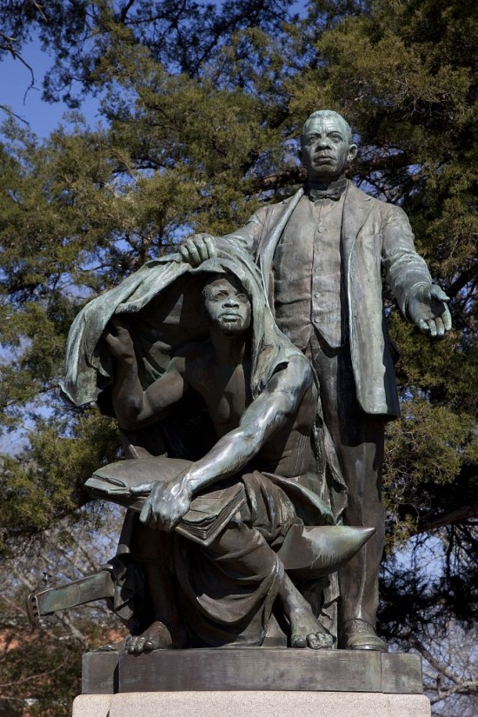
Booker T. Washington Lifting The Veil of Ignorance?

Slide 3
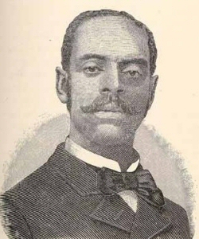
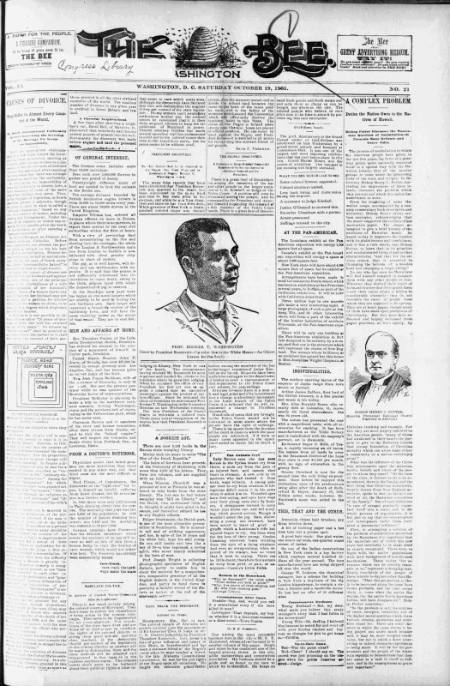
The Washington Bee, 1901
And Editor William Calvin Chase

Slide 4
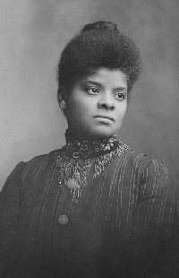
Ida B. Wells

Slide 5
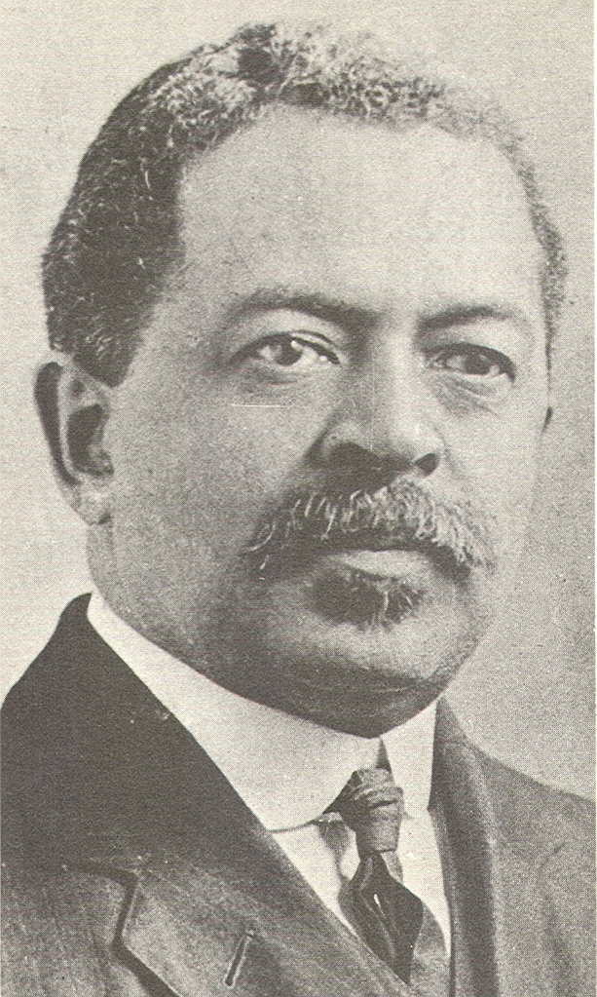
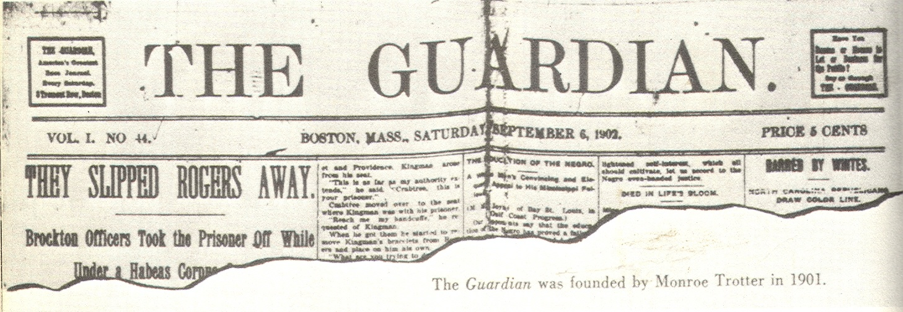
William Monroe Trotter and the Boston Guardian

Slide 6
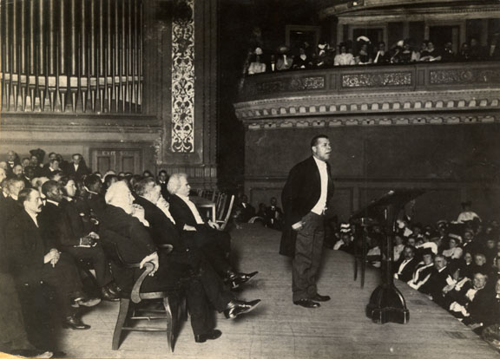
Booker T. Washington at Carnegie Hall with Mark Twain, 1905

Slide 7
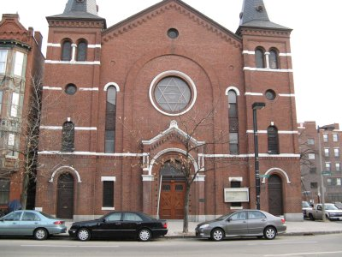
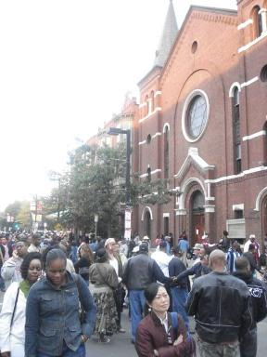
Columbus Avenue AME Zion Church, Boston

Slide 8
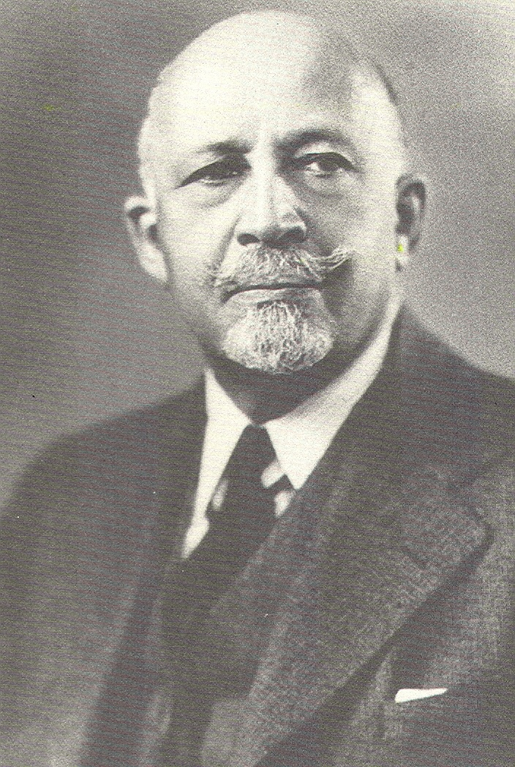
William Edward Burghardt DuBois

Slide 9
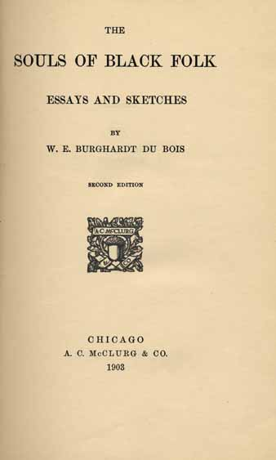
William Edward Burghardt DuBois

Slide 10
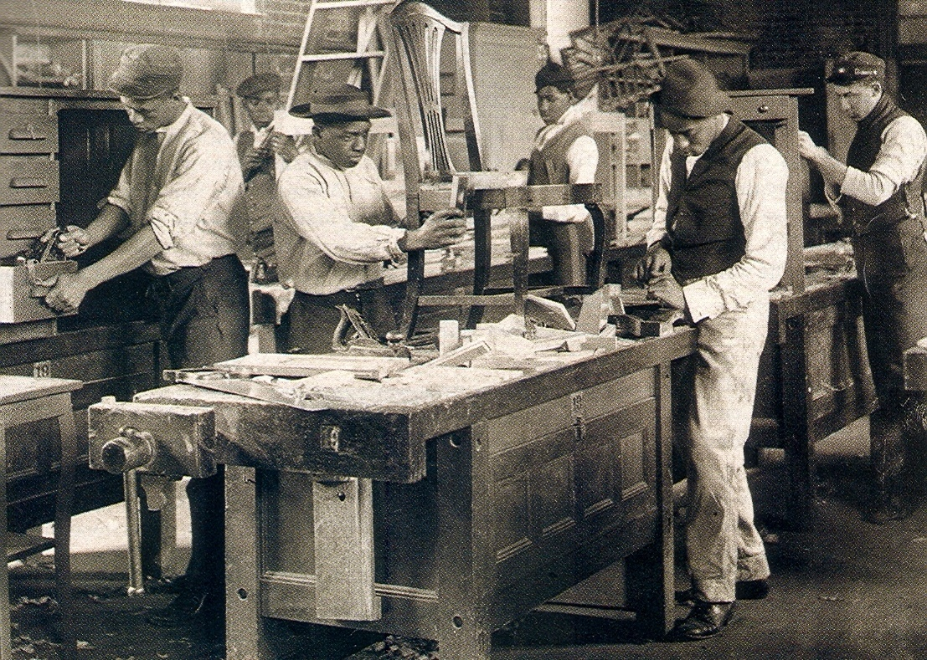
W.E. B. DuBois on Industrial Education at Tuskegee
It is not enough to teach a man to become a carpenter, one must also teach the carpenter to be a man.

Slide 11
Decline of Black Voting
        1890 1900
Alabama 181,000 3,000
Louisiana 130,000 1,300
Mississippi 123,000 300

Slide 12
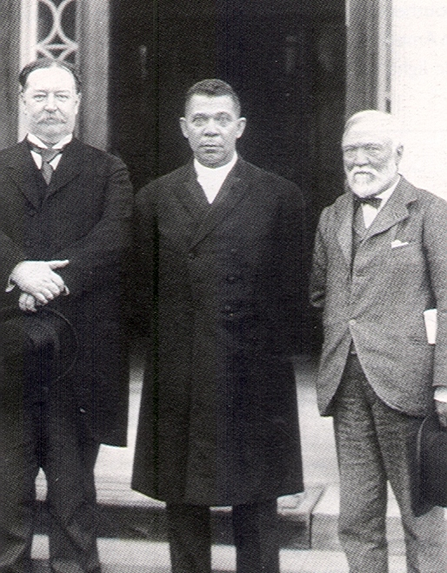
William Howard Taft, Booker T. Washington, and Andrew Carnegie
We repudiate the monstrous doctrine that the oppressor should be the sole authority as to the rights of the oppressed.

Slide 13
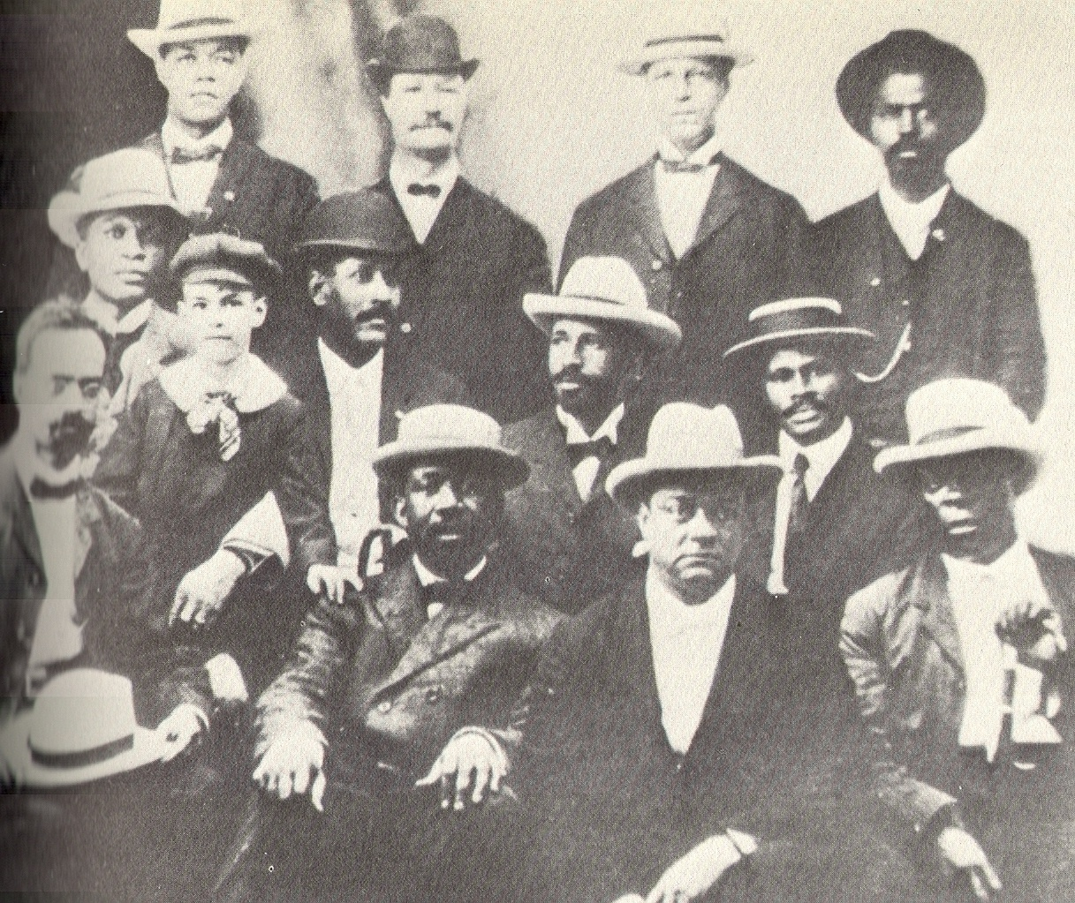
Founders of the Niagara Movement, 1905

Slide 14
The Niagara Platform
1. The right to protest
2. Full suffrage
3. The end of segregation
4. Industrial and higher education for Negroes
5. Equal employment opportunities
6. Freedom of speech and criticism
7. An unsubsidized and uncontrolled press
8. Federal aid to education

Slide 15
DuBois on the Necessity of Constant Protest
Agitate, protest, reveal the truth and refuse to be silenced. A moment’s let up… means a chance for the wolves of prejudice to get at our necks.

Slide 16
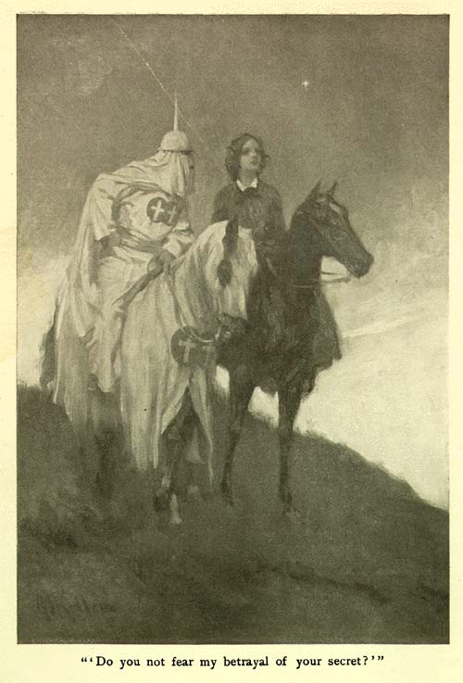
The Clansman

Slide 17
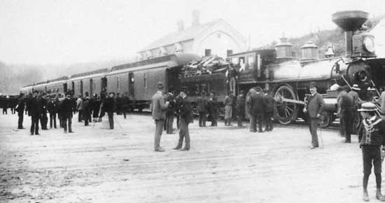
Railroad Passenger Train in Virginia, ca. 1900.

Slide 18
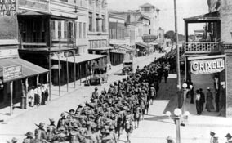
Black Soldiers Marching into Brownsville, Texas, 1906

Slide 19
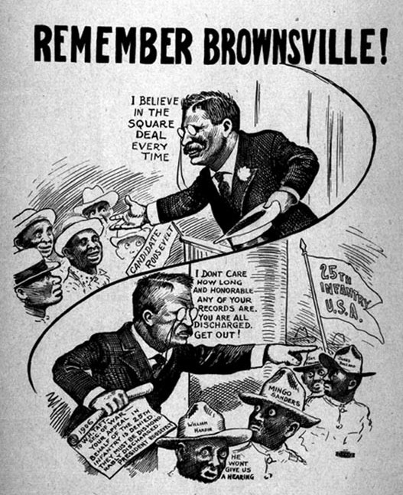
Anti-Roosevelt Cartoon in Chicago Newspaper, 1907

Slide 20
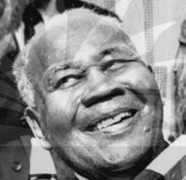
The Last Surviving Soldier of the Brownsville Affair
Dorsey Willis of Minneapolis, Minnesota, Pardoned by President Jimmy Carter, 1977

Slide 21
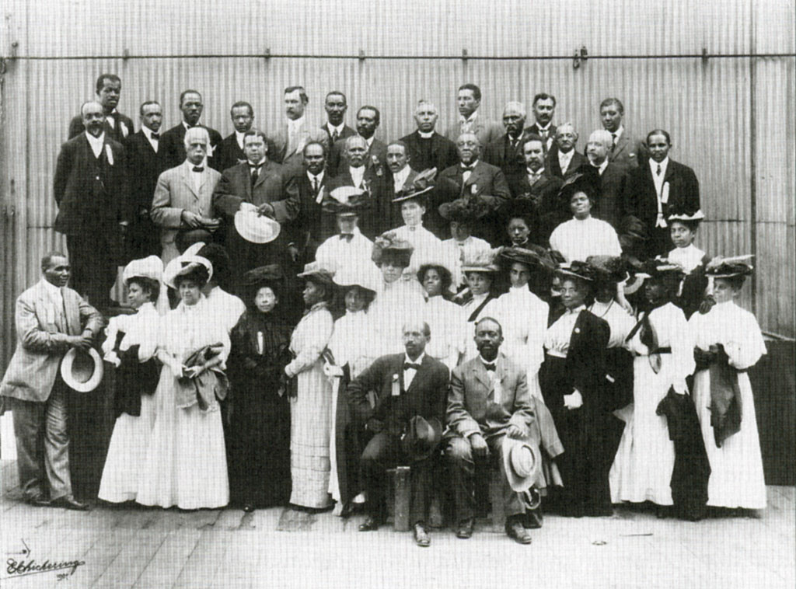
The Niagara Movement, 1908

Slide 22
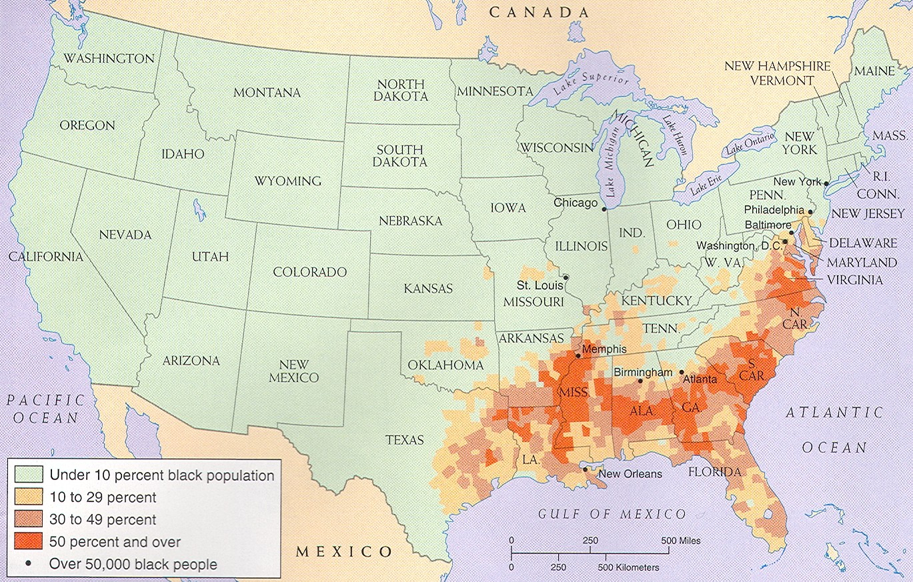
Black Population in the U.S., 1920

Slide 23
Trotter and DuBois

Slide 24
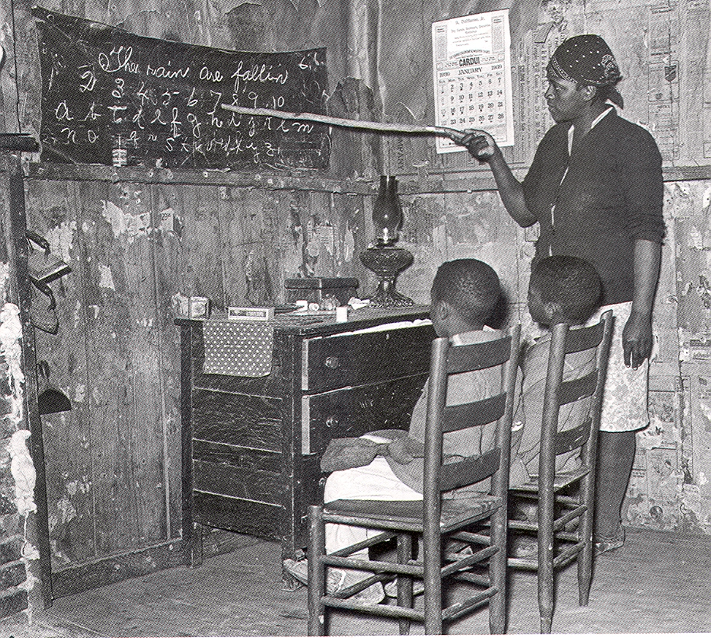
Segregated Education:
Rural Black School in Georgia, 1910

Slide 25
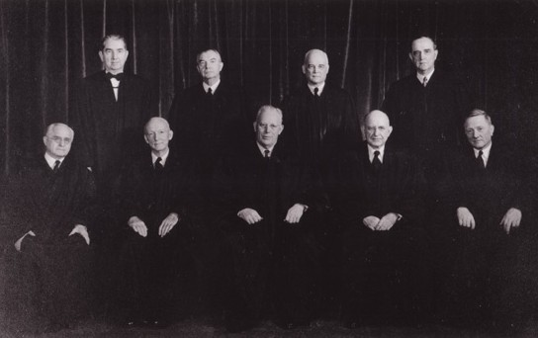
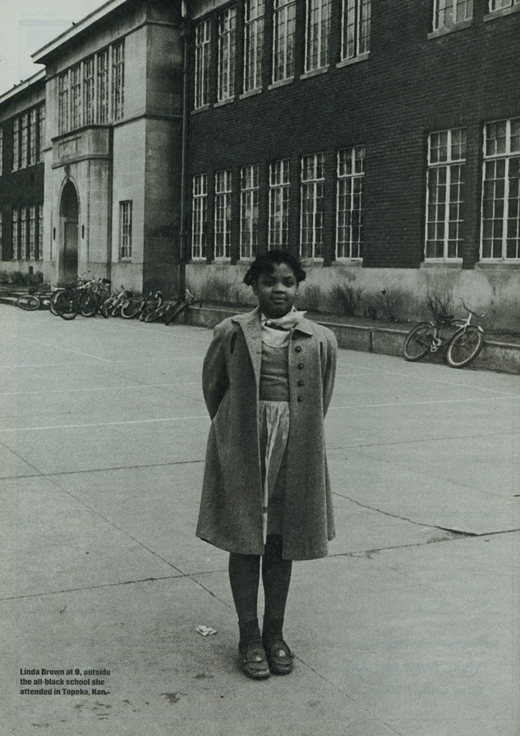
U.S. Supreme Court at the Time of the Brown Decision, 1954
(Linda Brown is on the Right)

Slide 26
The Right to Protest
We refuse to allow the impression to remain that the Negro-American assents to inferiority, is submissive under oppression, and apologetic before insults. Though helpless we may submit, but the voice of protest of ten million Americans must never cease to assail the ears of their fellows as long as America is unjust.

Slide 27
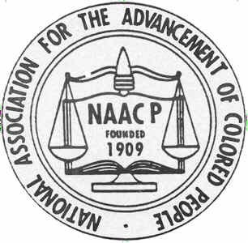
The NAACP Century, 1909-2009

Slide 28
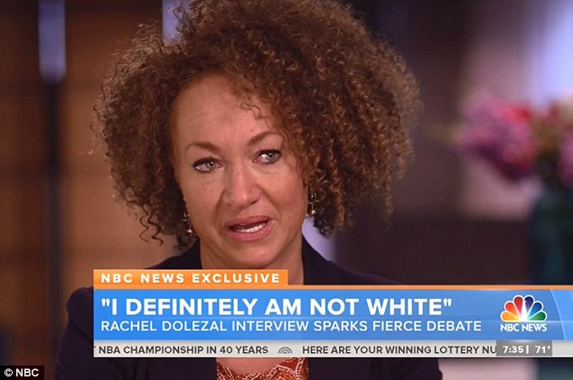
The Rachel Dolezal Controversy, 2015

Slide 29
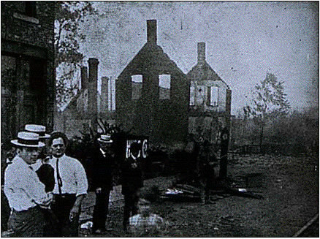
Springfield, Illinois Race Riot, 1908

Slide 30
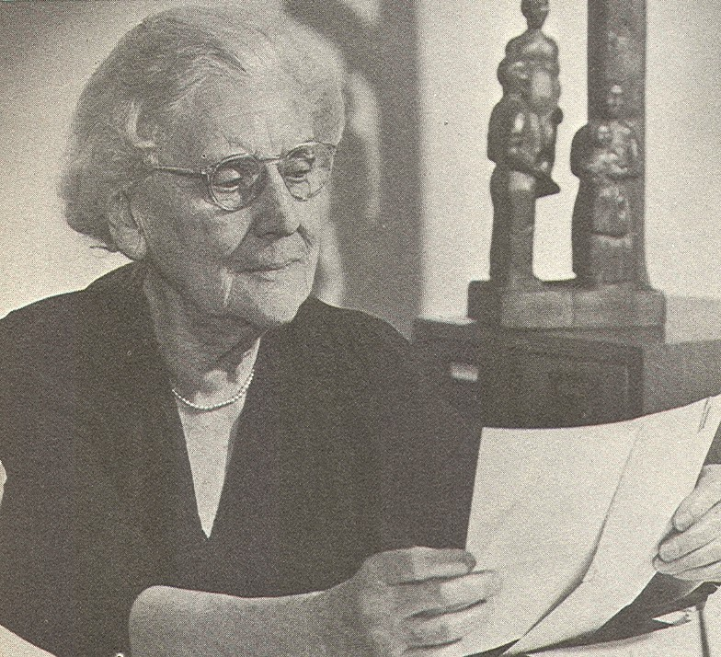
Mary White Ovington

Slide 31
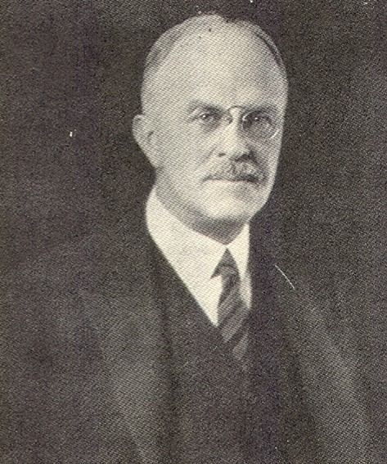
Oswald Garrison Villard

Slide 32
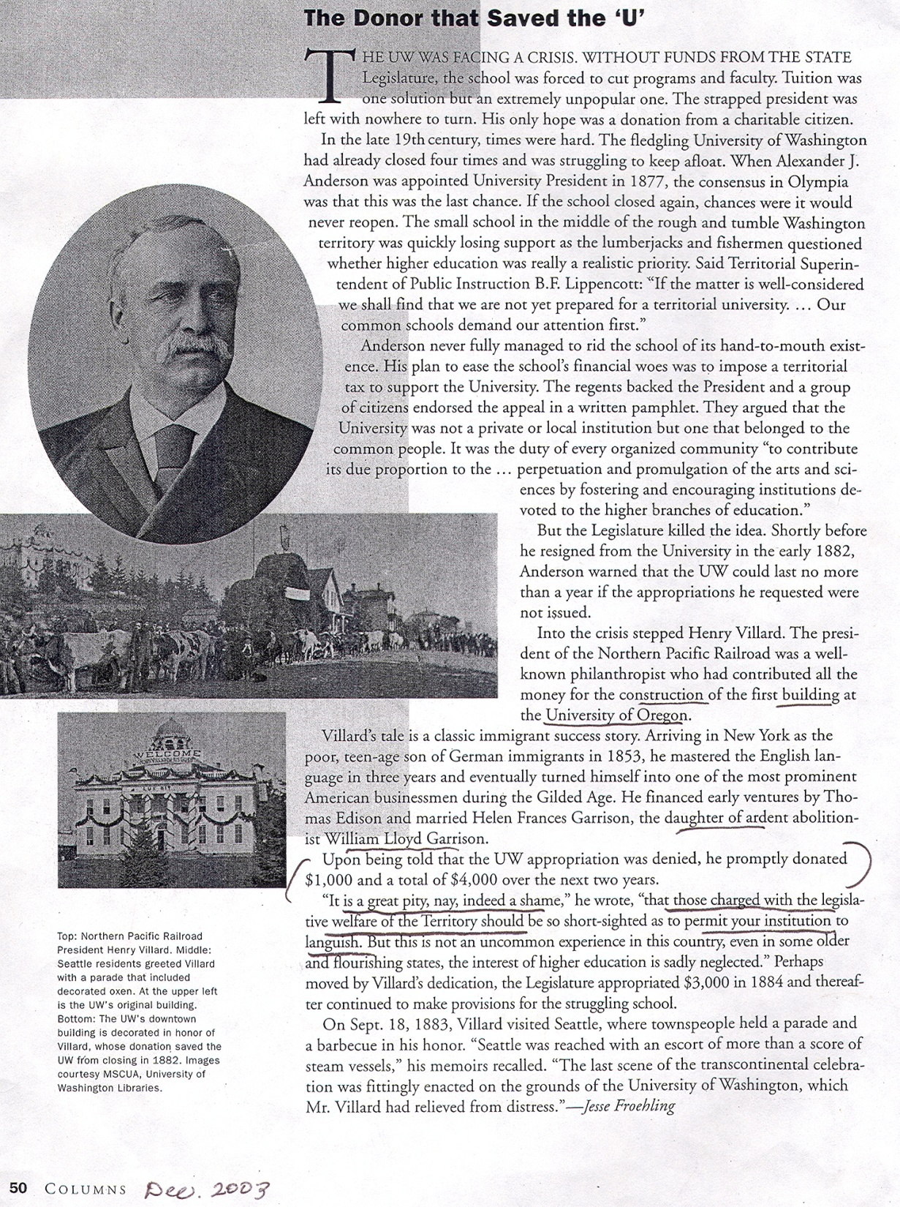

Slide 33
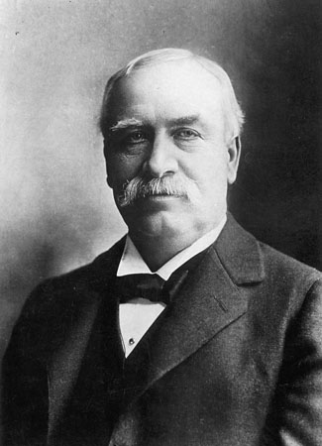
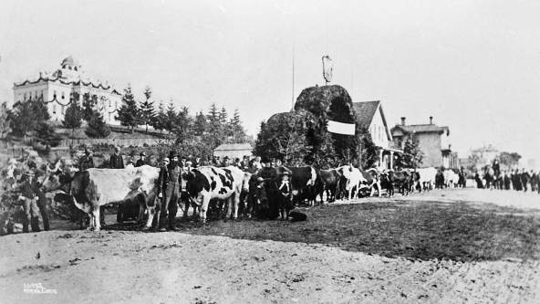
Fun Stuff: Henry Villard, $4,000 and the University of Washington
Left: Parade for Villard, Sept. 15, 1883

Slide 34
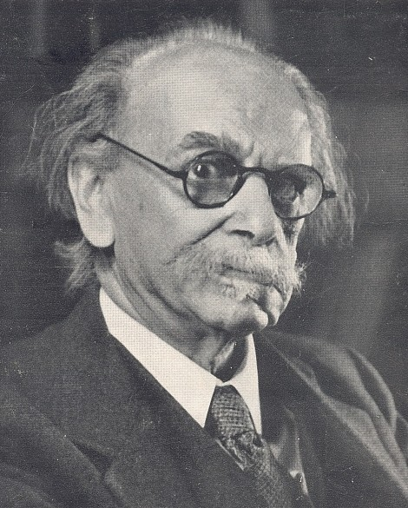
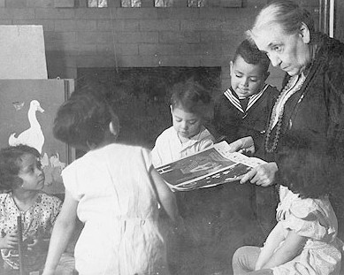
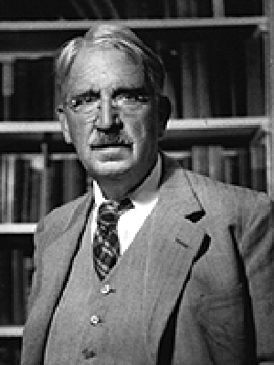
Prominent “First Members” of the NAACP:
Franz Boaz, Jane Addams, John Dewey

Slide 35
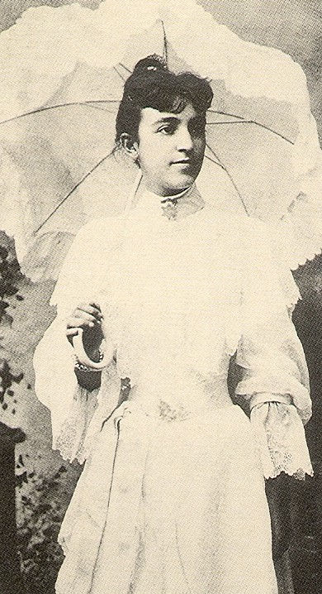
Black NAACP Founders:
Trotter, Wells, Mary Church Terrell, DuBois

Slide 36
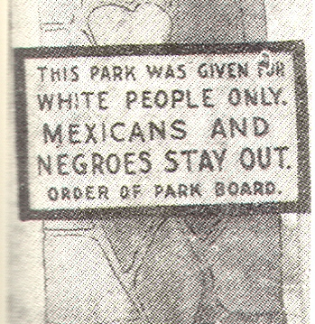

Slide 37
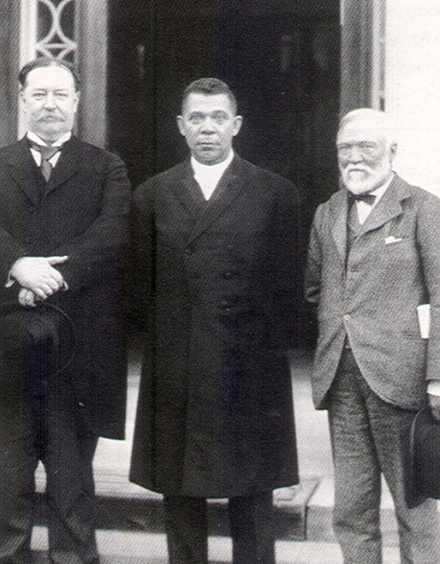

Slide 38
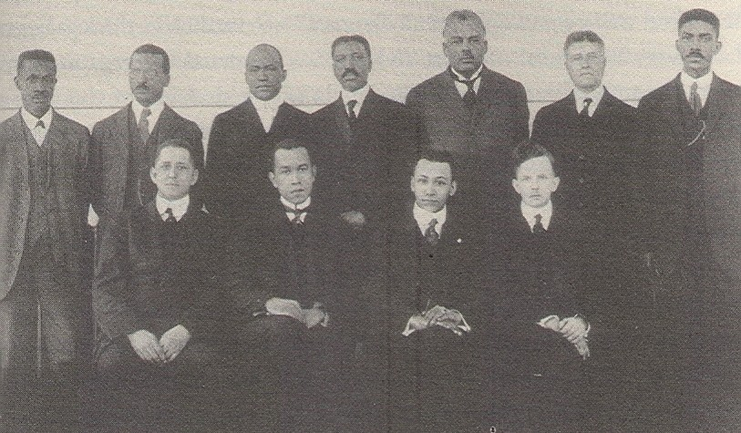
Officers and Members of the Atlanta NAACP, 1917

Slide 39
THE NAACP AND UNIA IN THE WEST, 1925:
NAACP CHAPTERS
Houston, 1912
Seattle, 1913
Oklahoma City, 1913
Portland, 1914
Denver, 1914
Albuquerque, 1914
Los Angeles, 1914
San Antonio, 1914
Omaha, 1914
Dallas, 1915
San Francisco\Oakland, 1915
Topeka, 1915
Salt Lake City, 1919
Boise, 1919
Phoenix, 1920
Tucson, 1922
Yuma, 1922
UNIA CHAPTERS
Omaha, 1919
Seattle, 1919
Tulsa, 1919
Oklahoma City, 1920
Phoenix, 1920
Fresno, 1920
Kansas City, 1920
Dallas, 1920
San Jose, 1920
Denver, 1921
Waco, 1921
Los Angeles, 1921
Colorado Springs, 1921
Oakland, 1921
San Diego, 1922
Portland, 1922
San Francisco, 1923

Slide 40
Founders of the Seattle NAACP, 1913
Dr. E. A. Johnson, Presbyterian Minister
Rev. J.L. Williams, Methodist Minister
Horace Cayton, Apartment House Owner
Samuel H. Stone, Caterer
G.W. Jones, Merchant-Tailor
J.I. Reams, Clothing Store Proprietor
Miss Zoe Young, Milliner
Bonita Wright, Property Owner
Mrs. R.J. Allen, Property Owner
Andrew Black, Attorney
Mrs. S.H. Stone, Property Owner
Rev. W.D. Carter, Baptist Minister
Samuel P. DeBow, Editor, Seattle Searchlight
William Chandler, Owner, Moving Express Company
Benjamin F. Tutt, Barber
Leticia Graves, Hairdresser
Alma Glass, Dressmaker
J.H. Graves, Chiropodist
Etta Hawkins, Property Owner
Beatrice Ball, Property Owner
G.W. Thompson, Grocer
L. Austin, (Occupation Not Listed)

Slide 41
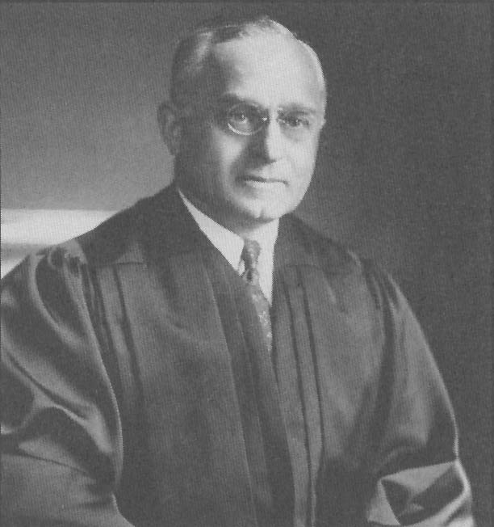
Supreme Court Justice Felix Frankfurter

Slide 42
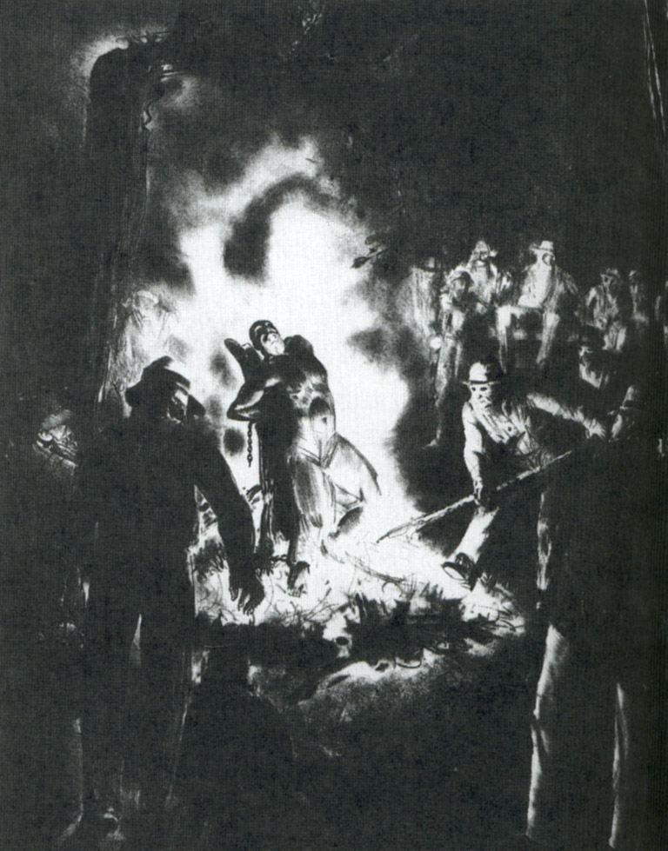
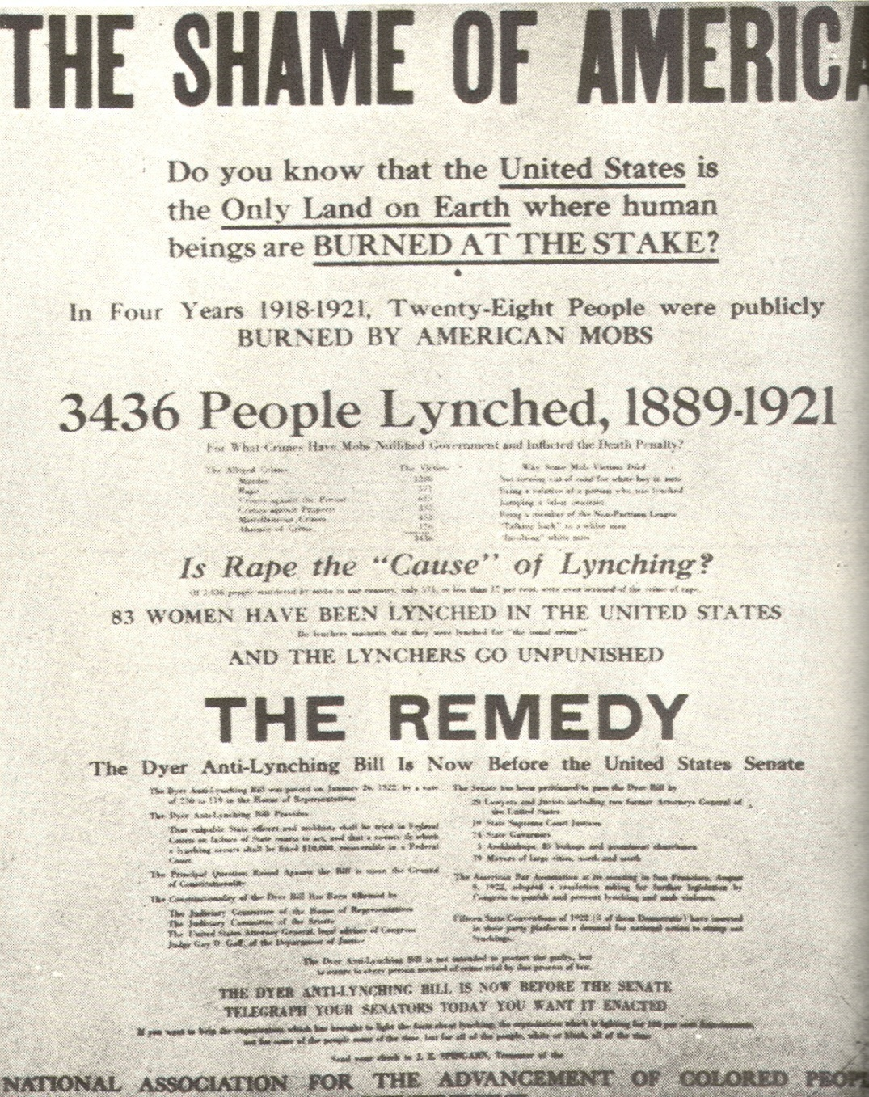
The NAACP and the Lynching Crisis

Slide 43
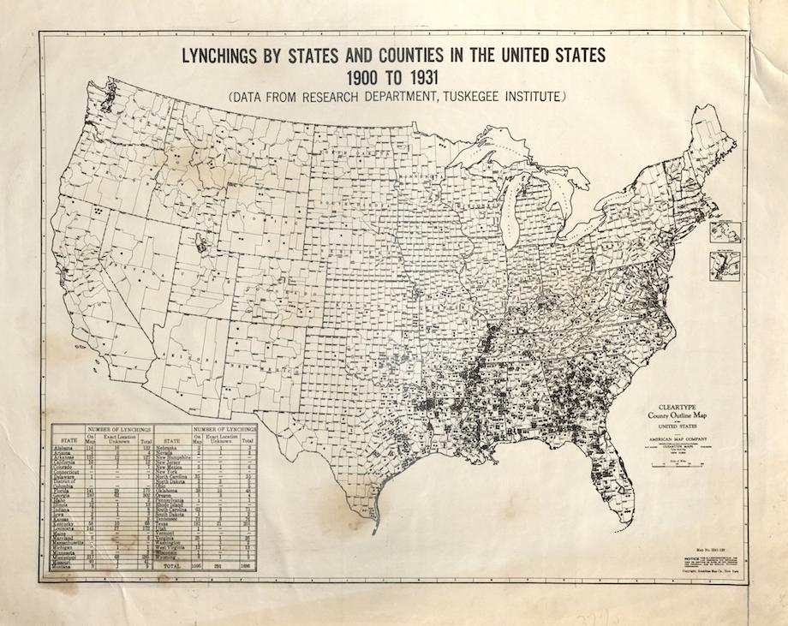
The Tuskegee Institute Lynching Map, 1931

Slide 44
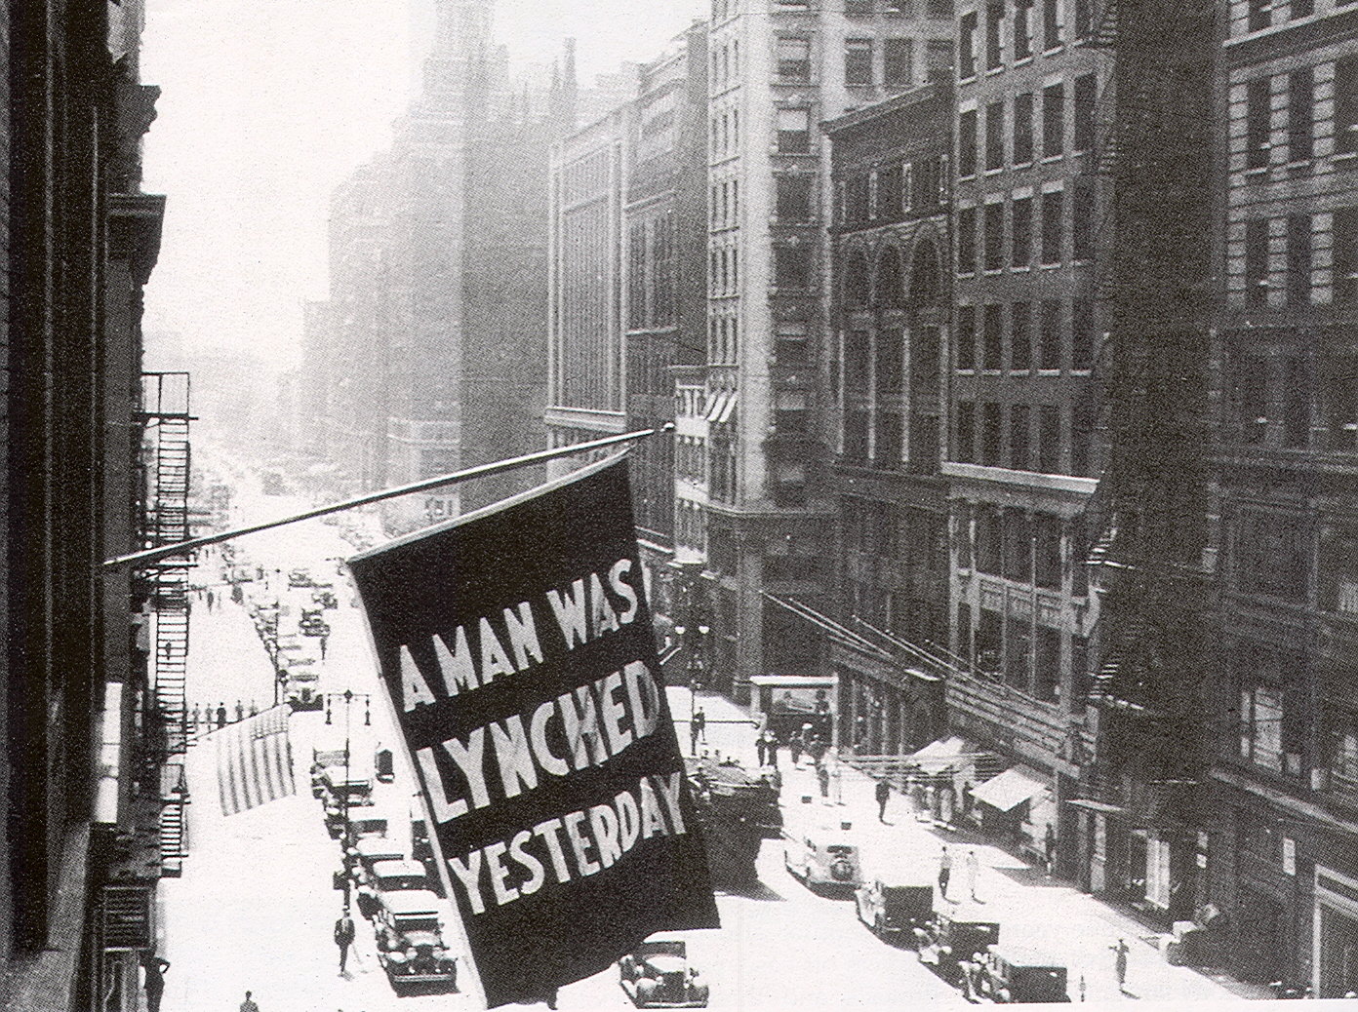
Banner Outside NAACP Headquarters in New York City

Slide 45
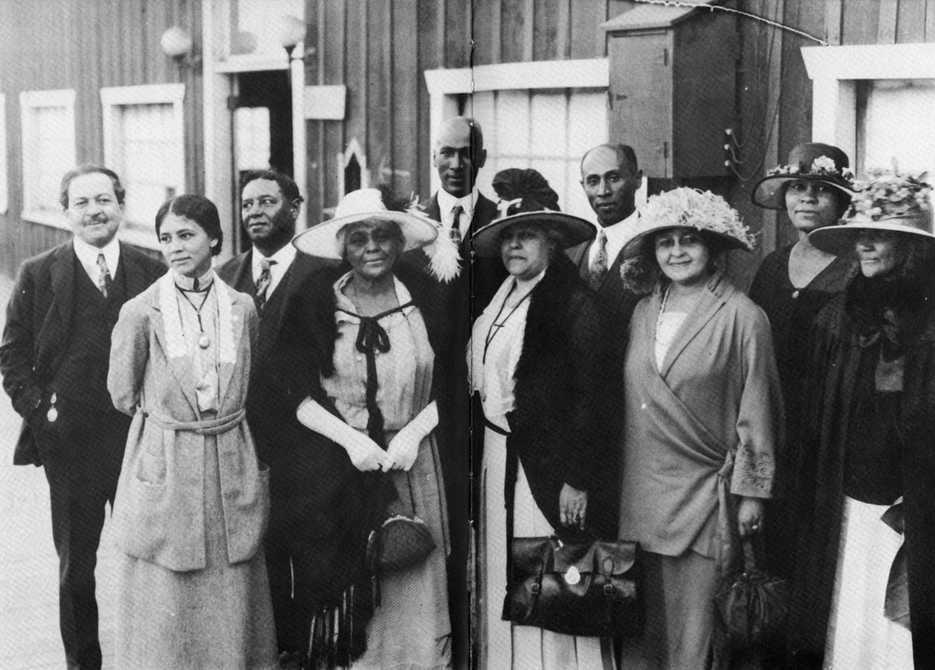
Executive Board of the Los Angeles NAACP, 1922

Slide 46
Oswald Garrison Villard

Slide 47
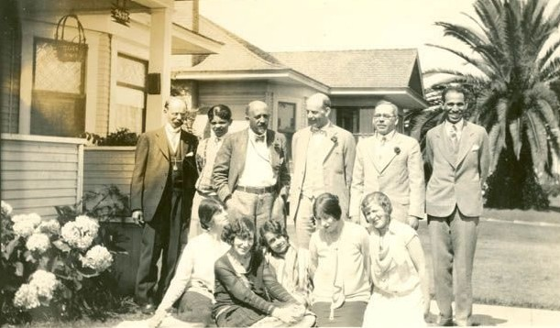
W.E.B Du Bois and the Founding Members of the San Diego NAACP, 1917

Slide 48
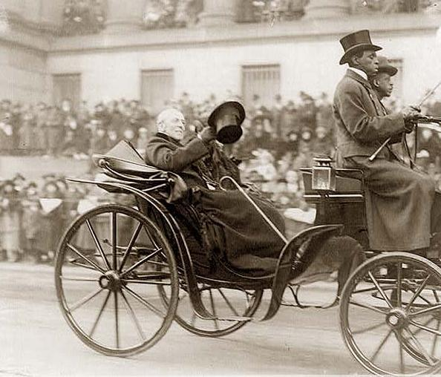
President Woodrow Wilson

Slide 49
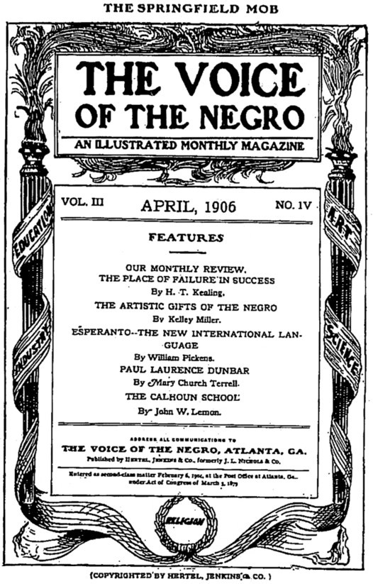

Slide 50
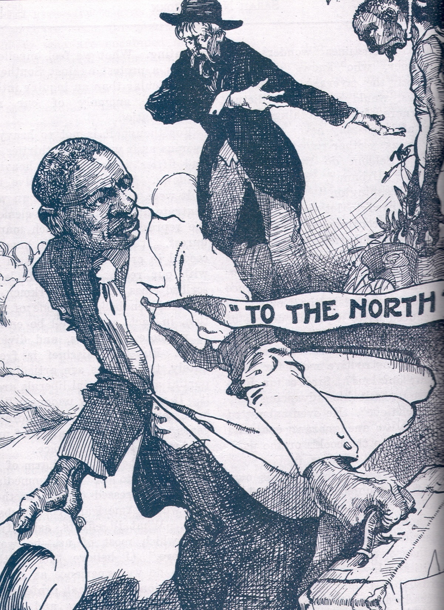

Slide 51
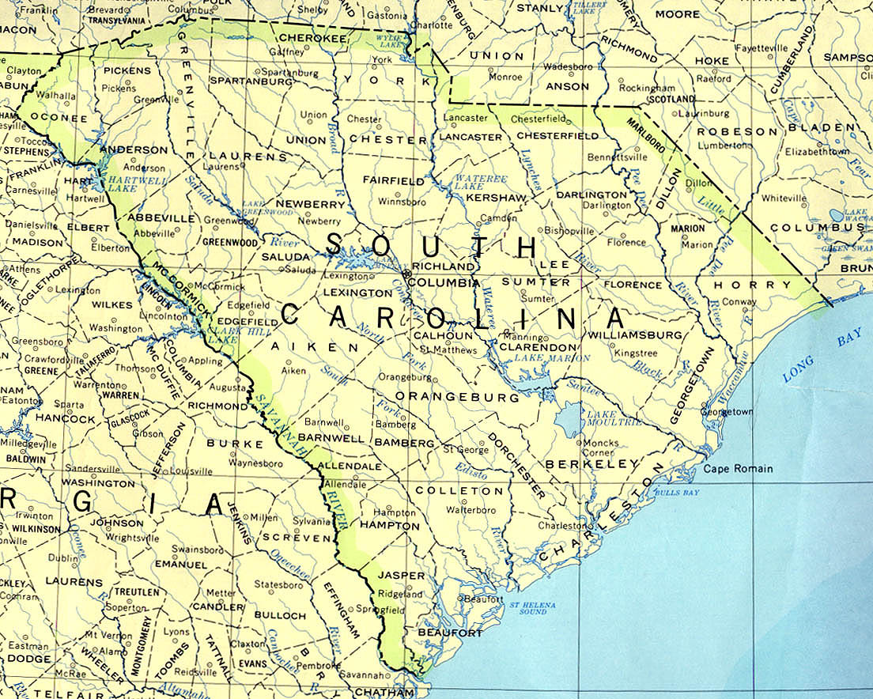
South Carolina in 1910

Slide 52


Slide 53



Slide 54


Slide 55

Ku Klux Klan Marching Up Pennsylvania Avenue, 1922

Slide 56
The Supreme Court and the
The Grandfather Clause, 1915
OPINION IN GUINN v. UNITED STATES
JUDGES: White, McKenna, Holmes, Day, Hughes, Van Devanter, Lamar, Pitney; McReynolds took no part in the consideration or decision of this case.
OPINION BY: WHITE
OPINION: MR. CHIEF JUSTICE WHITE delivered the opinion of the court.
This case is before us on a certificate drawn by the court below as the basis of two questions which are submitted for our solution in order to enable the court correctly to decide issues in a case which it has under consideration. Those issues arose from an indictment and conviction of certain election officers of the State of Oklahoma (the plaintiffs in error) of the crime of having conspired unlawfully, wilfully and fraudulently to deprive certain negro citizens, on account of their race and color, of a right to vote at a general election held in that State in 1910, they being entitled to vote under the state law and which right was secured to them by the Fifteenth Amendment to the Constitution of the United States. The prosecution was directly concerned with § 5508, Rev. Stat., now § 19 of the Penal Code which is as follows:

Slide 57


Buchanan v. Warley, 1917
Left: Map of Louisville, 1917
Right: Louisville Courier Article, 1916

Slide 58


W.E.B. DuBois and the Crisis

Slide 59

W.E.B. DuBois and the Crisis Staff, 1913

Slide 60

NAACP Cartoon: Woman to the Rescue

Slide 61

Ten Thousand People Participate in NAACP Silent Protest March, New York City, 1917

Slide 62
Prominent “First Members” of the NAACP:
Franz Boaz, Jane Addams, John Dewey

Slide 63

The New Negro Has No Fear

Slide 64



The East St. Louis Race Riot, 1917

Slide 65

Will Brown, Victim of the Omaha Courthouse Riot, September 28, 1919

Slide 66

The Tulsa Race Riot, 1921

