Slide 1
The Era of Accommodation

Slide 2


Stephon Clark, 1996-March 18, 2018

Slide 3
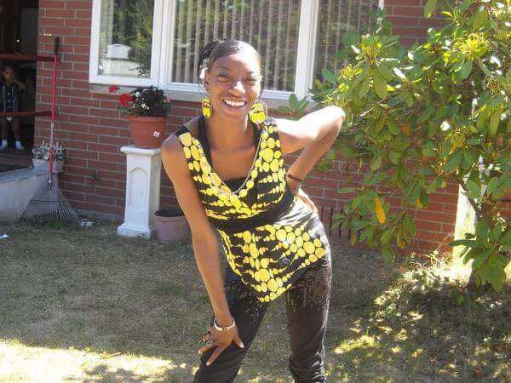
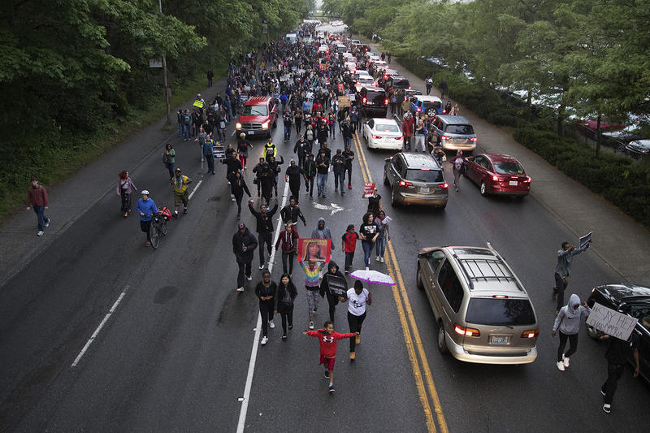
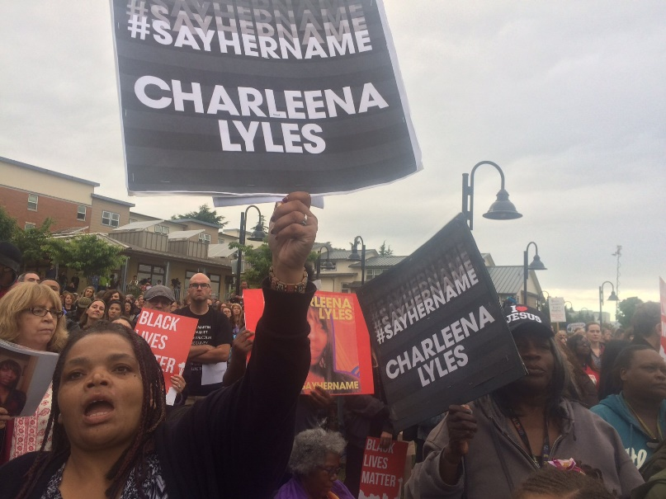
Charleena Lyles, 1987-2017

Slide 4
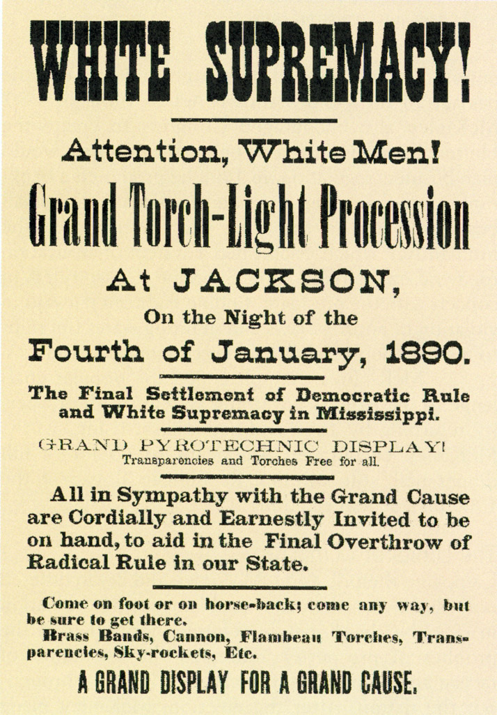

Slide 5
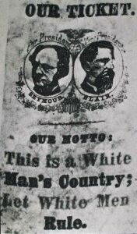
1868 Democratic Presidential Campaign Poster

Slide 6
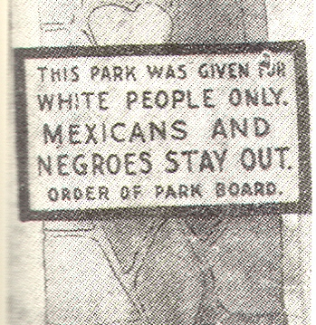
Houston, Texas Park Sign, 1900

Slide 7
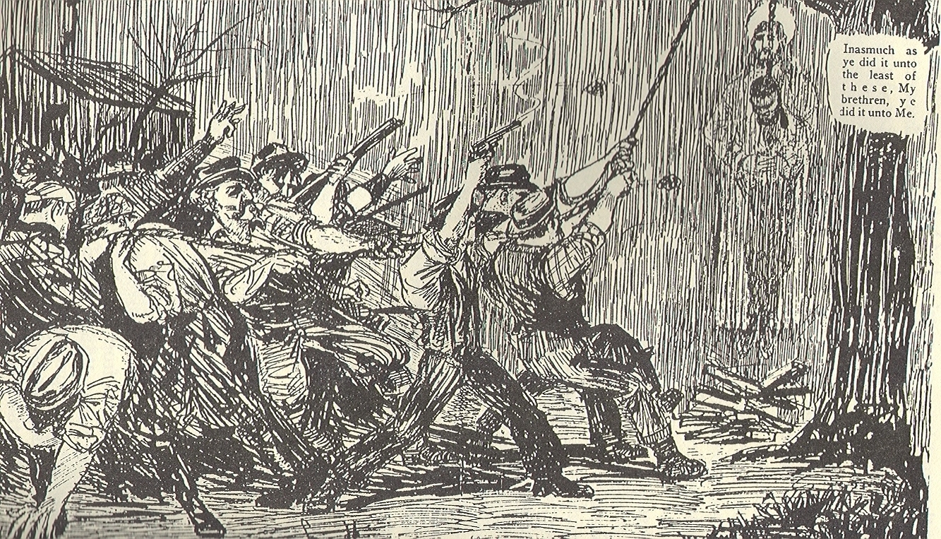
NAACP Anti-Lynching Cartoon

Slide 8
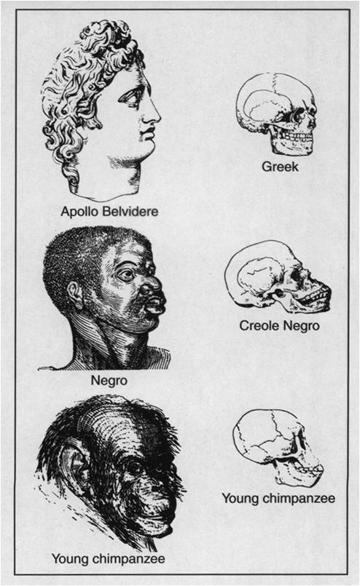

Social Darwinism and the Rise of Intellectual Raciam

Slide 9
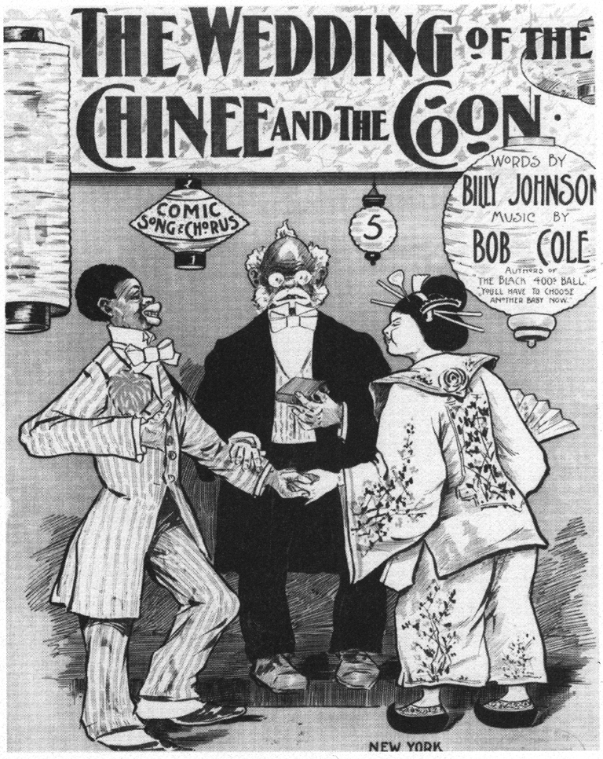

Slide 10

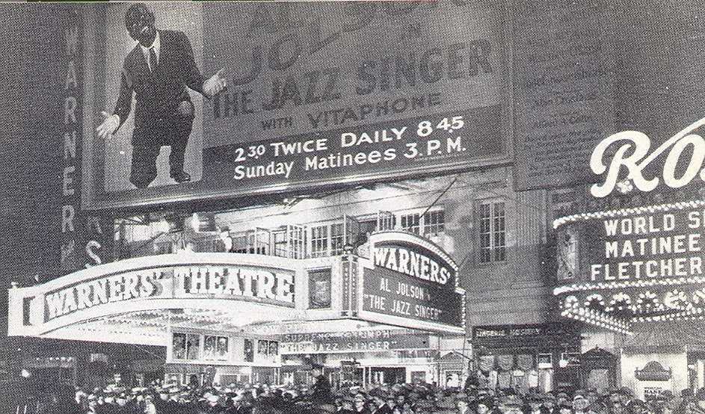
The Jazz Singer

Slide 11
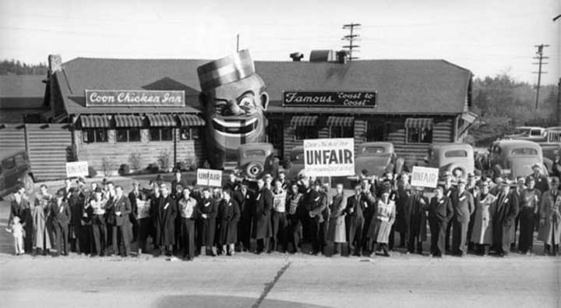

Slide 12
A Charlotte Segregationist on Race and White Supremacy, 1895
White supremacy is more than skin deep. Race is not simply about a silly thing like color; the order of the universe depends on race and “white” and “black” are mere outward manifestations of inner constitution.

Slide 13
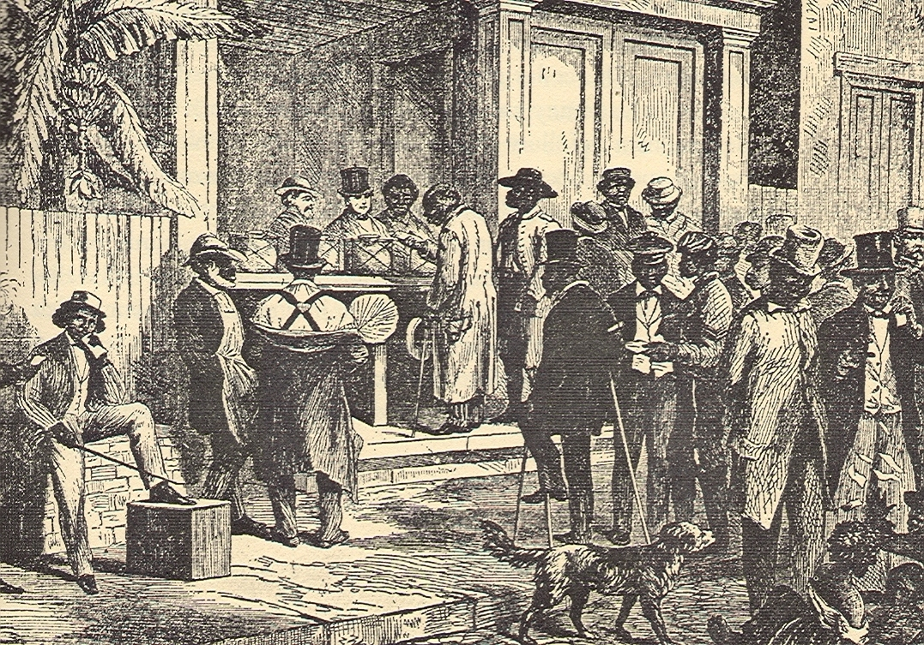
African Americans Voting in Charleston, South Carolina,1874

Slide 14
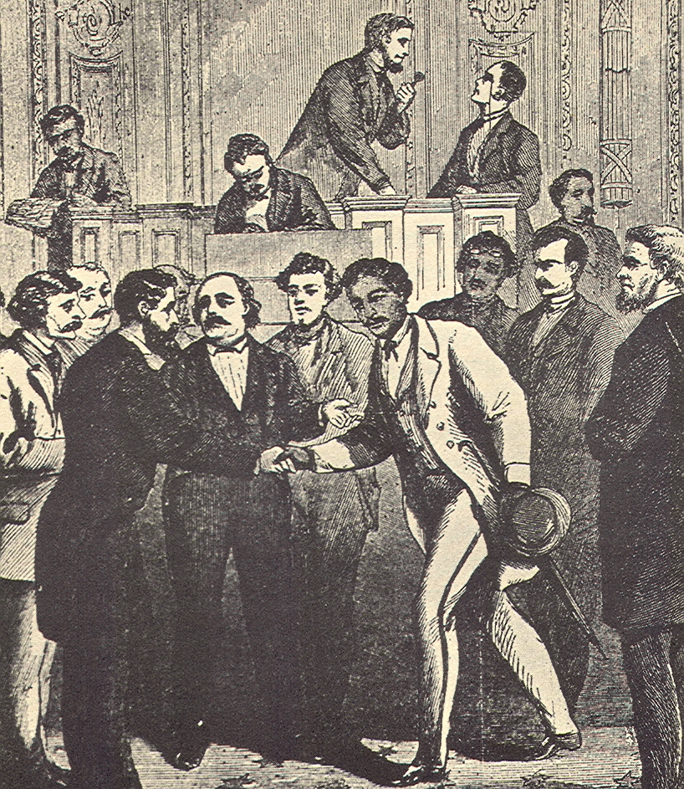
John W. Menard Enters Congress, 1870

Slide 15
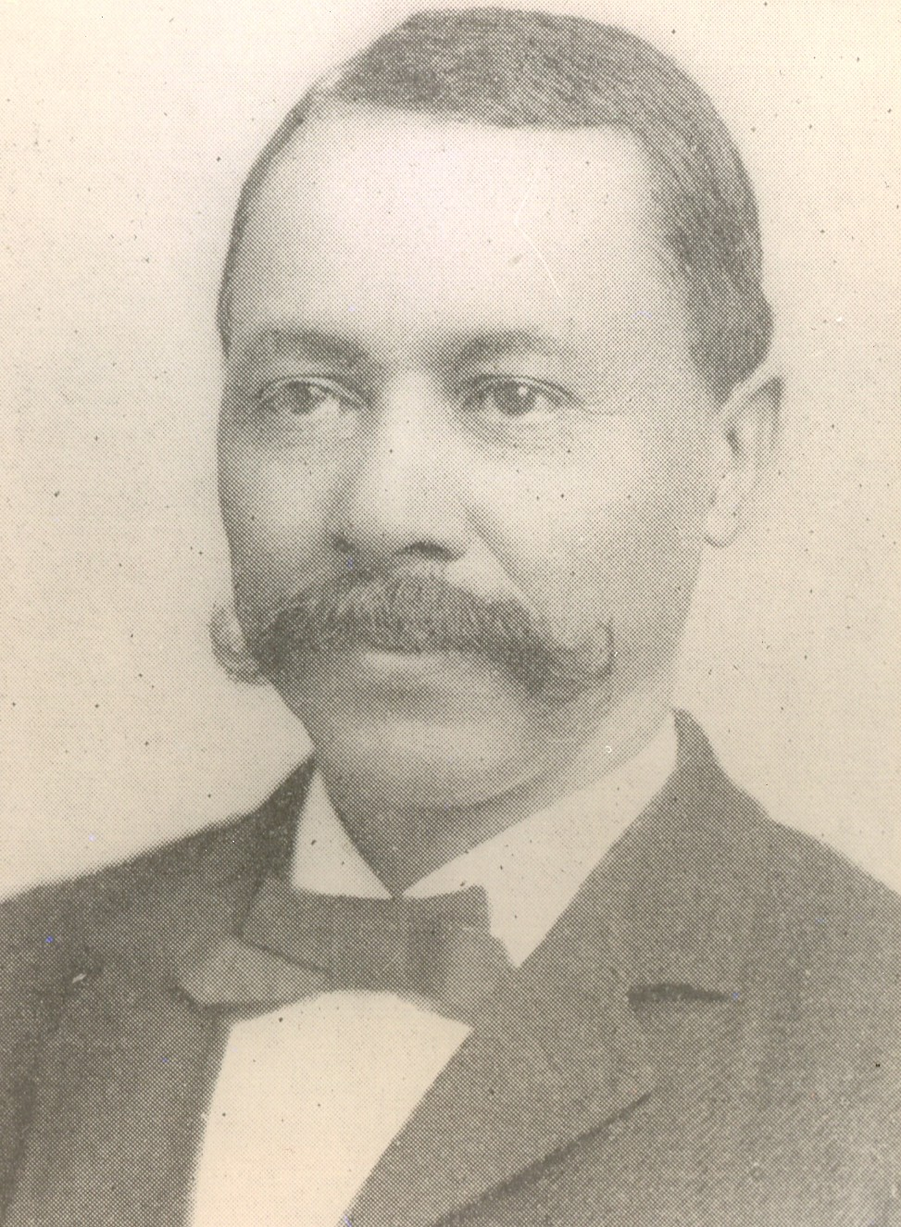
Ebenezer Bassett
Minister to Haiti, 1869
First Black Ambassador

Slide 16
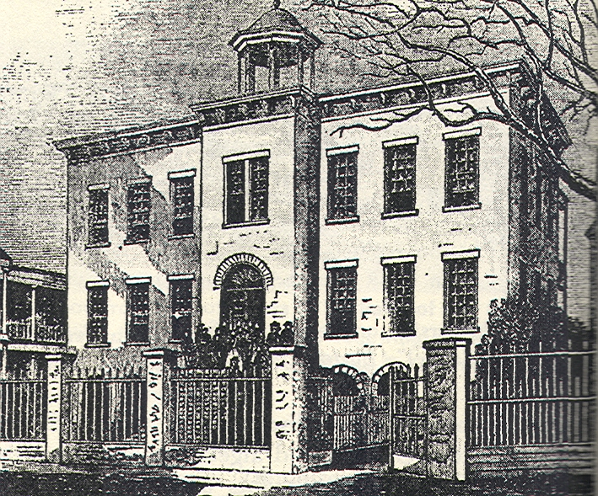
Charleston, South Carolina Hotel

Slide 17
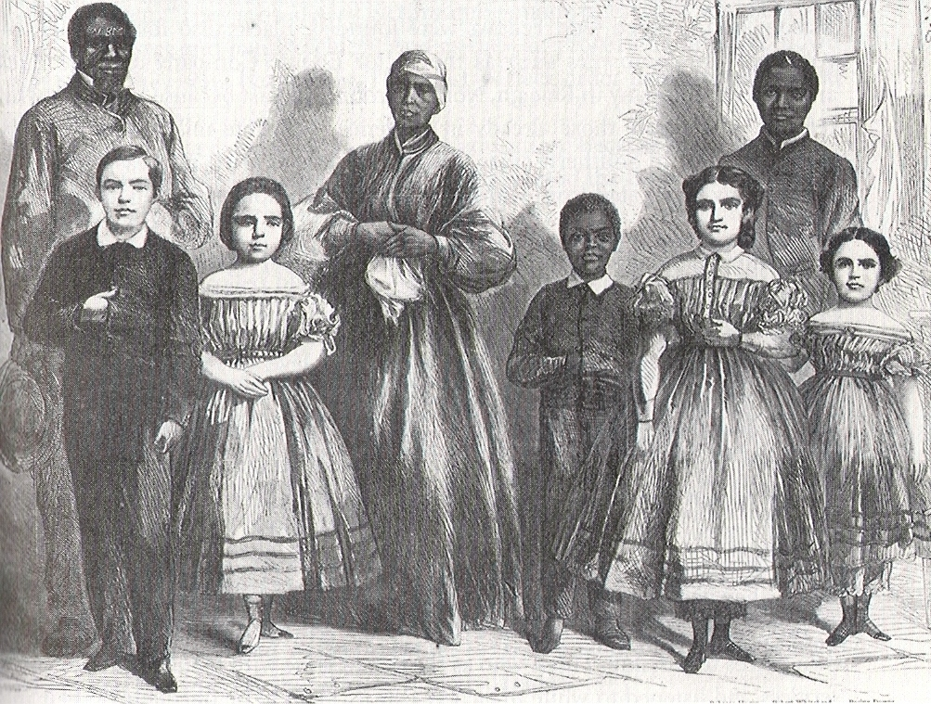
Integrated Public School,
New Orleans, Louisiana, 1870

Slide 18
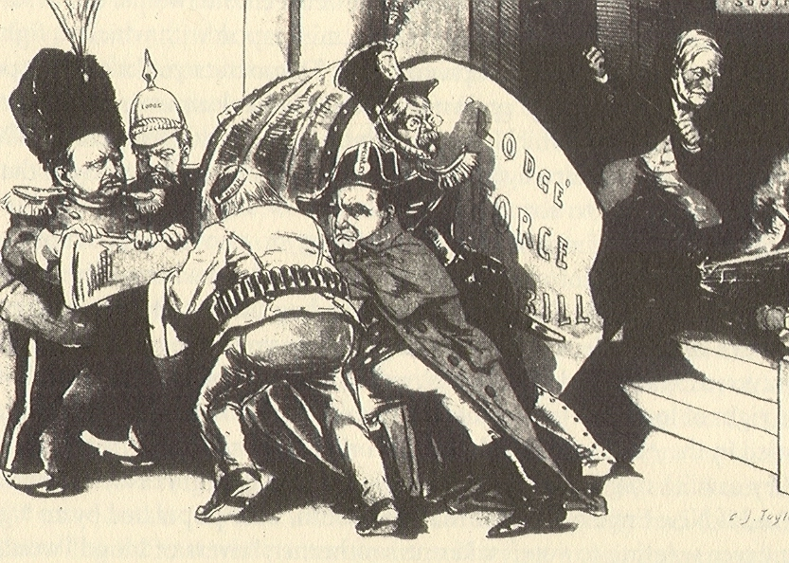
Anti-Force Bill Cartoon, 1890

Slide 19
AMENDMENT XIV Passed by Congress June 13, 1866.
Ratified July 9, 1868.
Section 1. All persons born or naturalized in the United States, and subject to the jurisdiction thereof, are citizens of the United States and of the State wherein they reside. No State shall make or enforce any law which shall abridge the privileges or immunities of citizens of the United States; nor shall any State deprive any person of life, liberty, or property, without due process of law; nor deny to any person within its jurisdiction the equal protection of the laws.
Section 2. Representatives shall be apportioned among the several States according to their respective numbers, counting the whole number of persons in each State, excluding Indians not taxed. But when the right to vote at any election for the choice of electors for President and Vice-President of the United States, Representatives in Congress, the Executive and Judicial officers of a State, or the members of the Legislature thereof, is denied to any of the male inhabitants of such State, being twenty-one years of age, and citizens of the United States, or in any way abridged, except for participation in rebellion, or other crime, the basis of representation therein shall be reduced in the proportion which the number of such male citizens shall bear to the whole number of male citizens twenty-one years of age in such State.

Slide 20
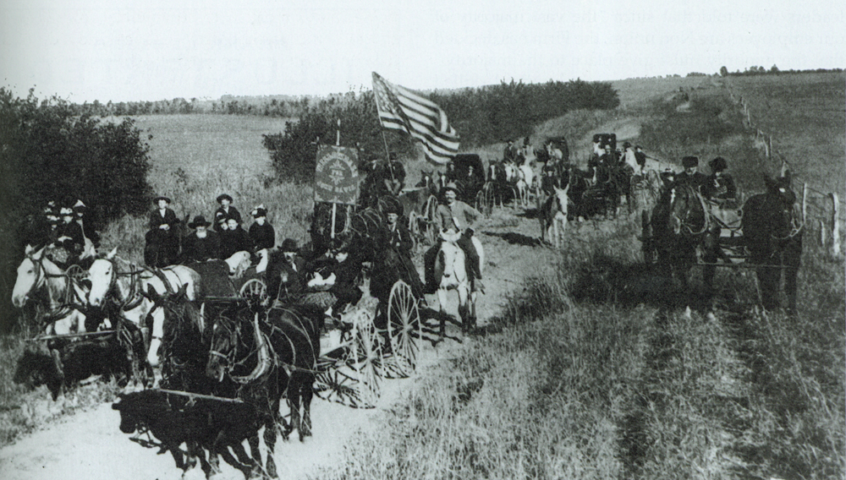
Populist Party Procession in Kansas, 1894

Slide 21
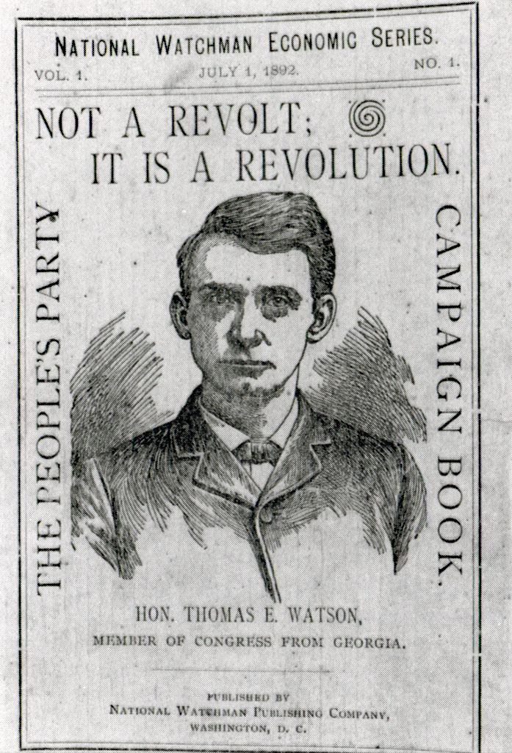
Thomas Watson

Slide 22
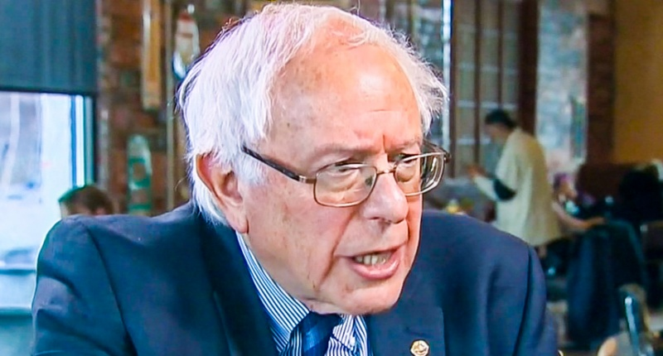

Populism: Old (1892) and New (2016), Left and Right

Slide 23
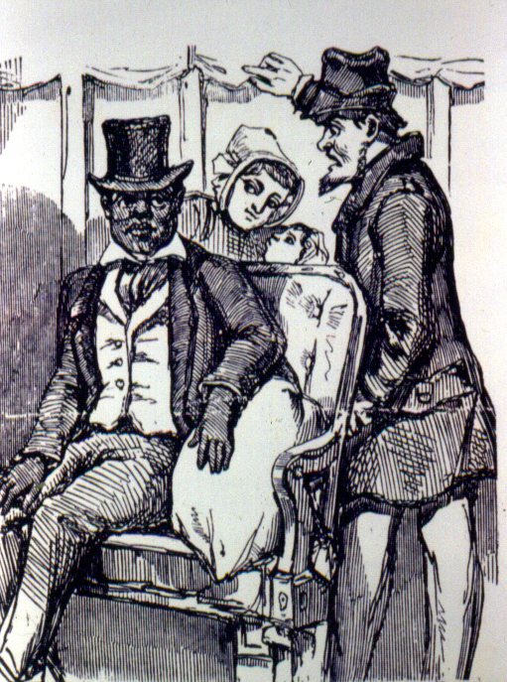
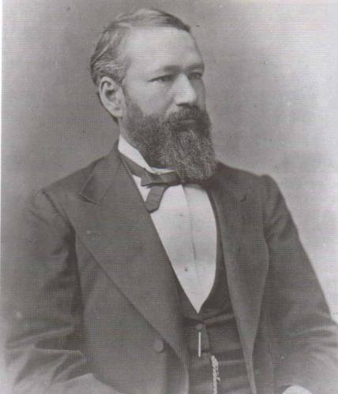
Plessy v. Ferguson Illustration, 1896 (left)
Homer Plessy (right)

Slide 24
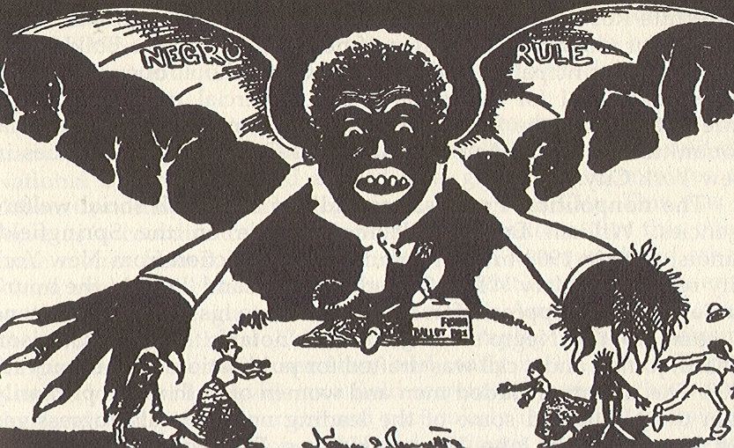

Slide 25
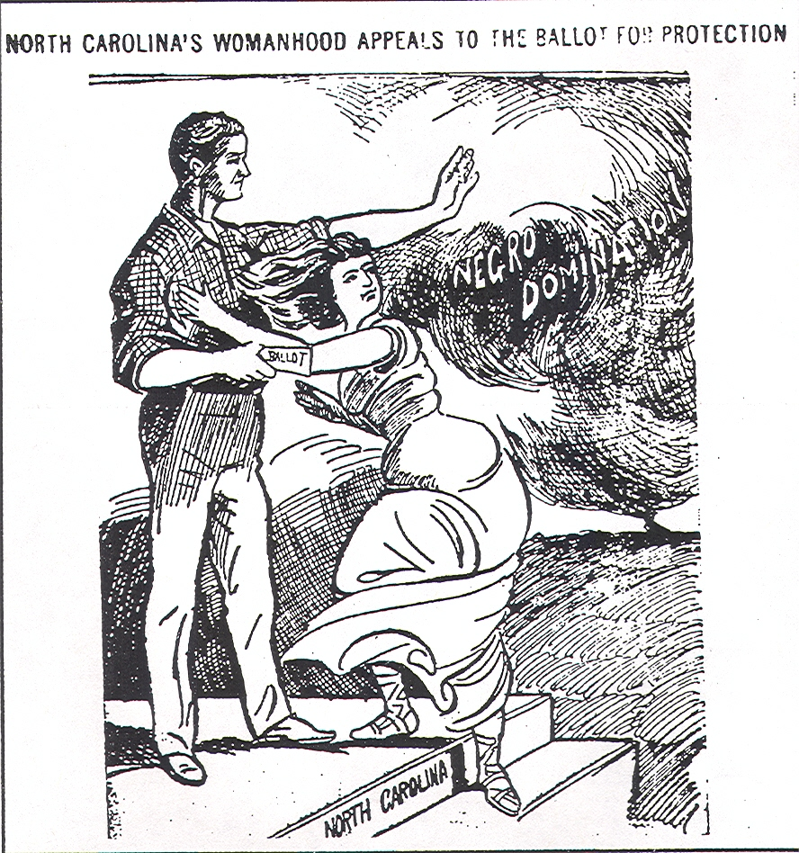
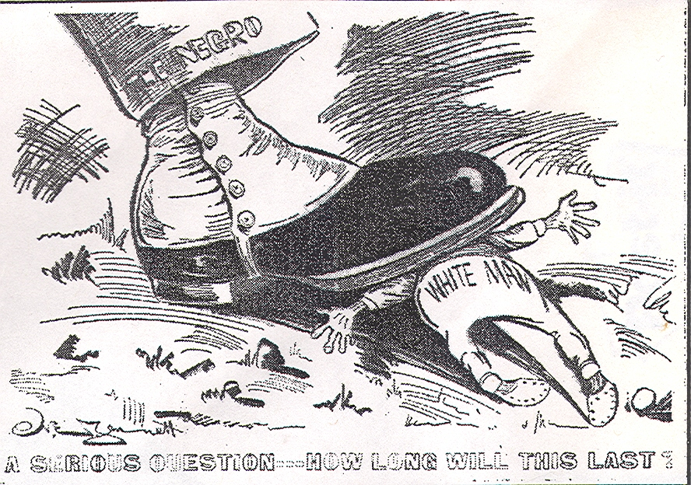
Playing the “Race Card” in Politics
North Carolina, 1898-1900

Slide 26
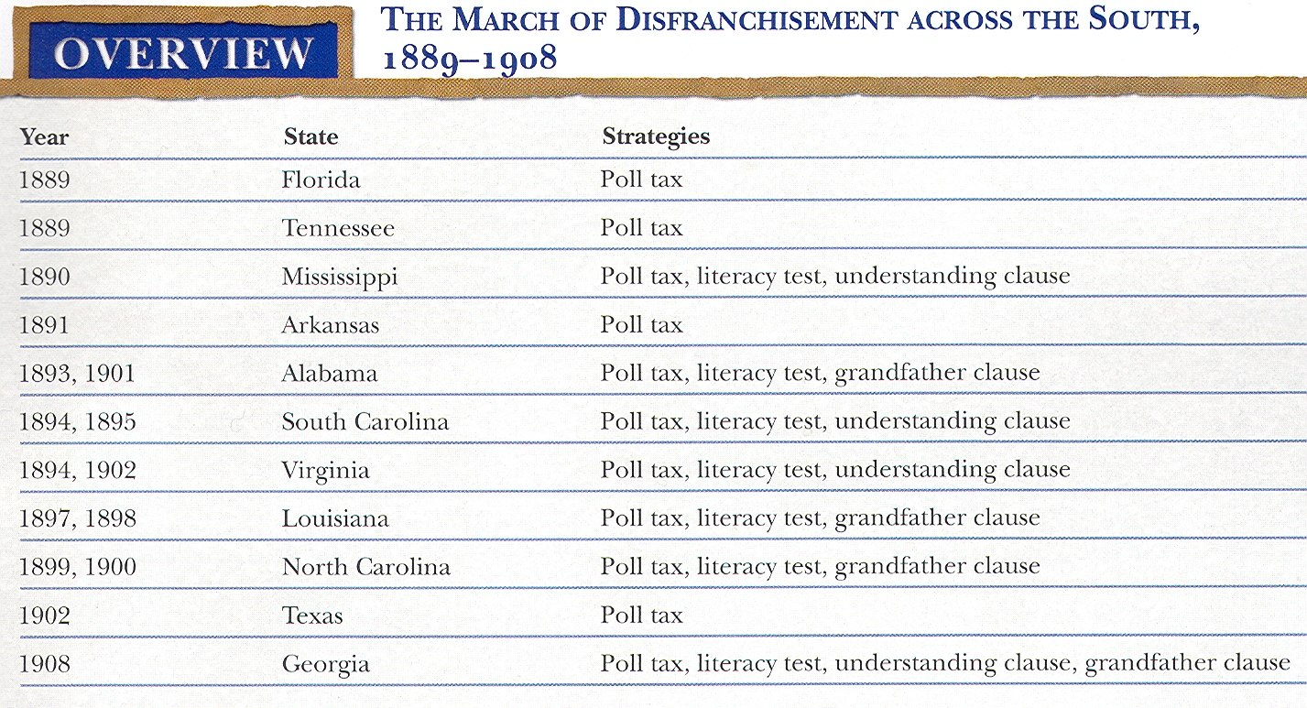

Slide 27
Decline of Black Voting
        1890 1900
Alabama 181,000 3,000
Louisiana 130,000 1,300
Mississippi 123,000 300

Slide 28
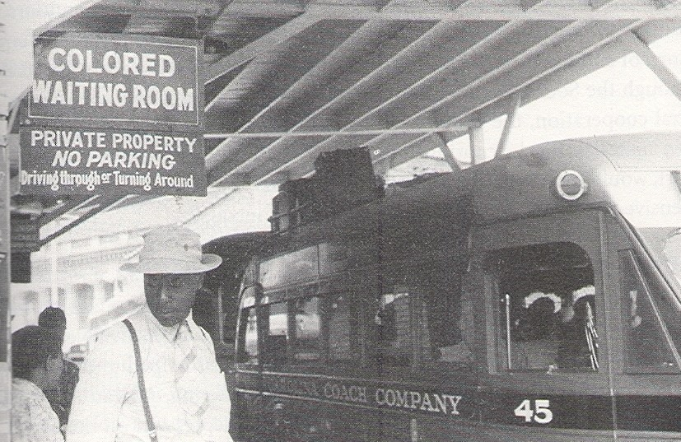

Slide 29
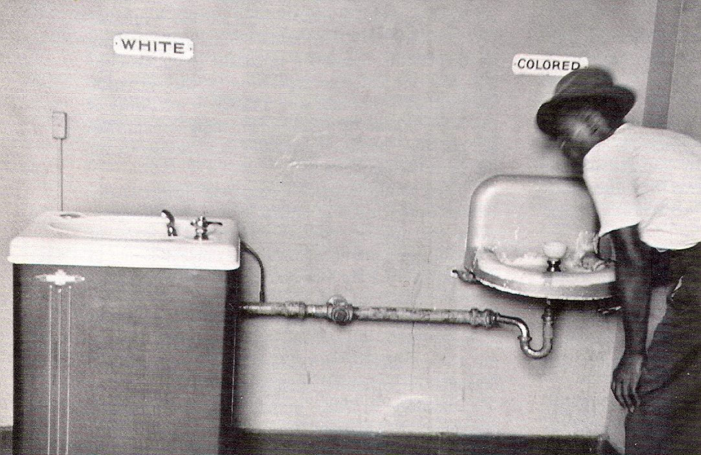
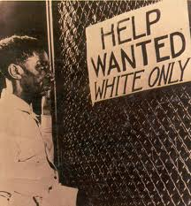
The Growth of Segregated America

Slide 30


Slide 31
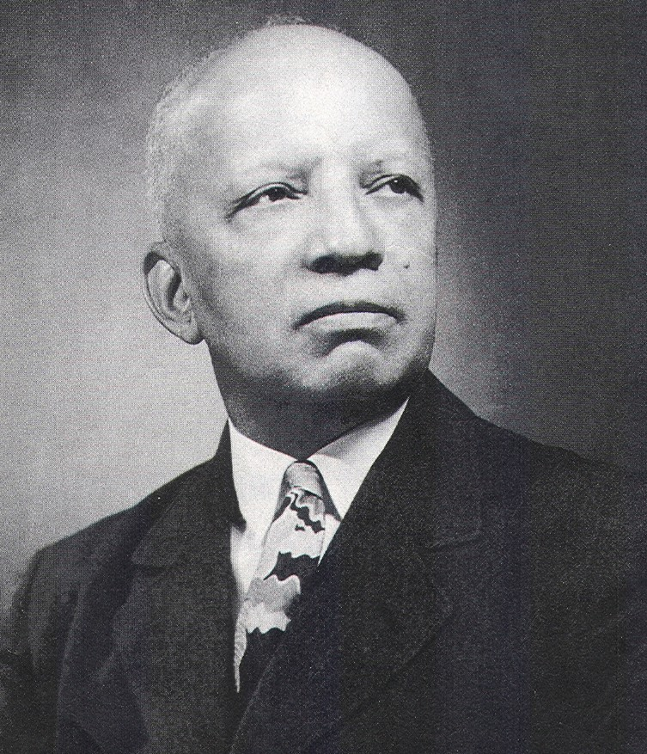
Carter G. Woodson, “Father of Black History Month,” on the Psychological Impact of Racial Segregation on African Americans
The imposition of racial segregation had to be so complete, so total that the negro himself would come to accept it as the natural order. He would find the “colored only” door on his own and if it did not exist he would ask for one.

Slide 32
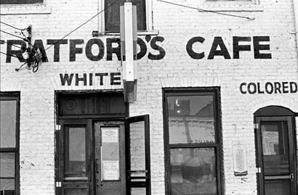
Segregated Restaurant, Memphis, Tennessee, 1920

Slide 33
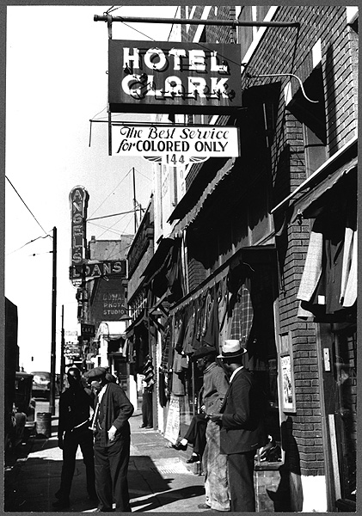
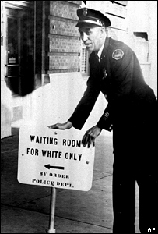
Segregated Hotel, New York City, ca. 1920
Segregated Waiting Room, Chicago, ca. 1924

Slide 34

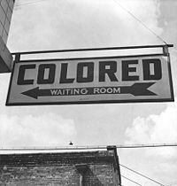
Segregation Signs:
Lincoln, Nebraska, ca. 1900
New Orleans, ca. 1905

Slide 35
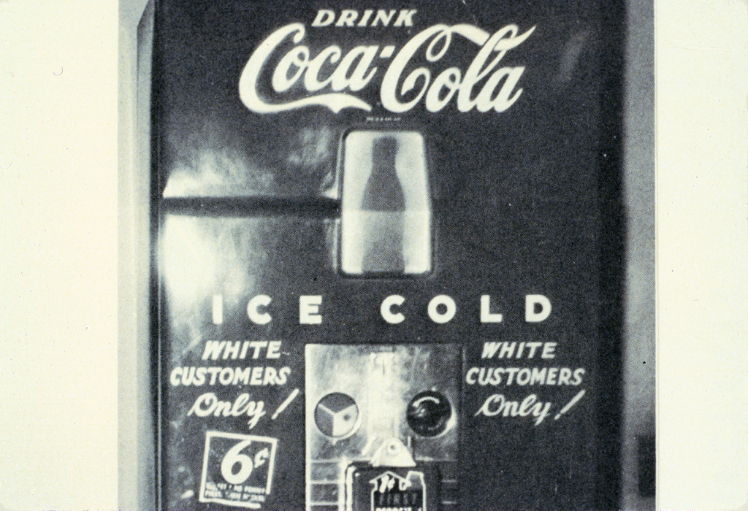

Slide 36
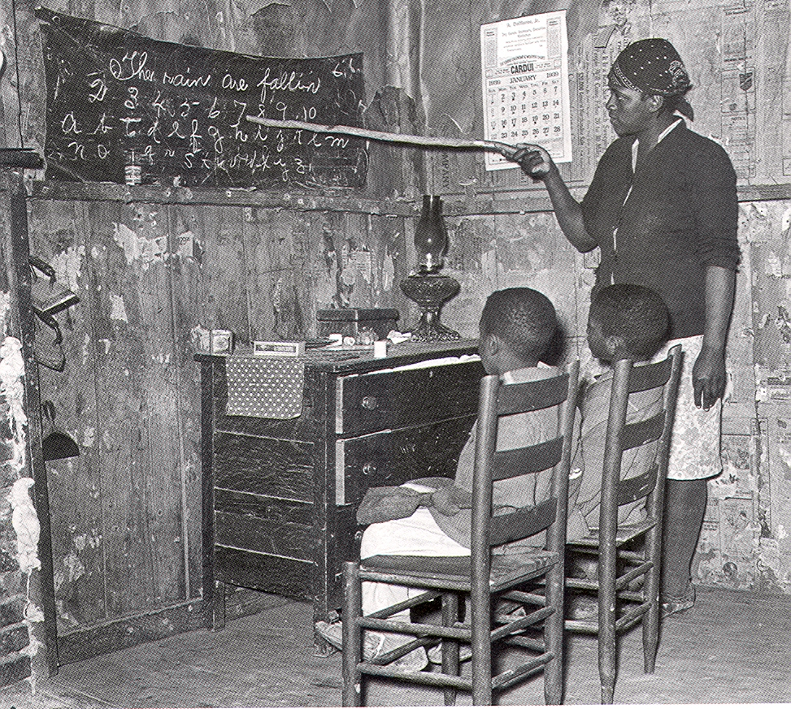
Segregated Education:
Rural Black School in Georgia, 1910

Slide 37
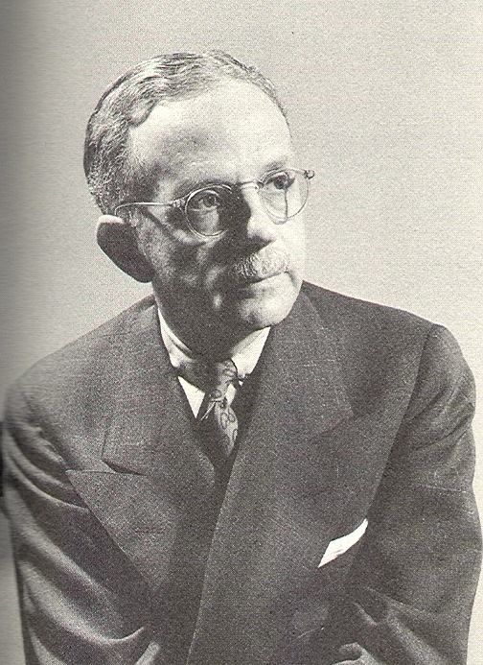
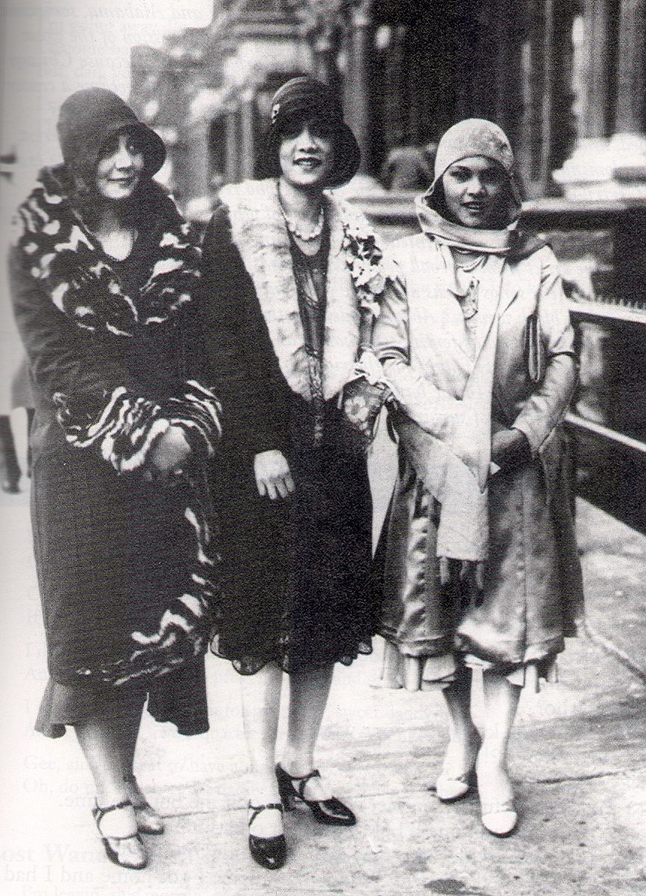
The “One Drop” Rule:
Walter F. White, NAACP Leader
Three Harlem Women, ca. 1925

Slide 38
The “One Drop” Rule:
Barbara Fields on the One Drop Rule
Because of the “one drop” rule, only in the United States could a white woman give birth to a “black” child but a black woman could never give birth to a “white” child.

Slide 39
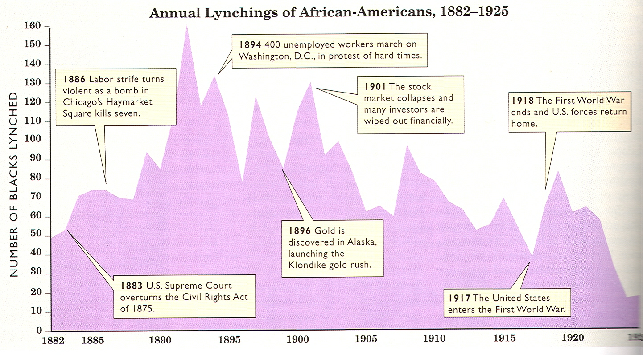

Slide 40
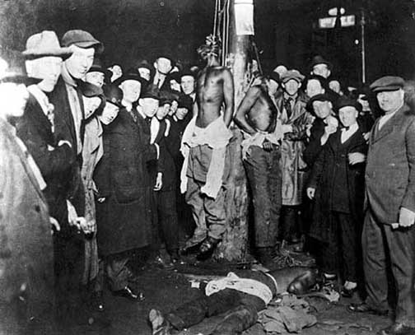
Duluth, Minnesota Lynching, 1920

Slide 41
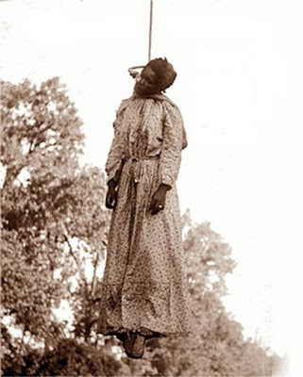
Black Woman Lynched in Oklahoma

Slide 42
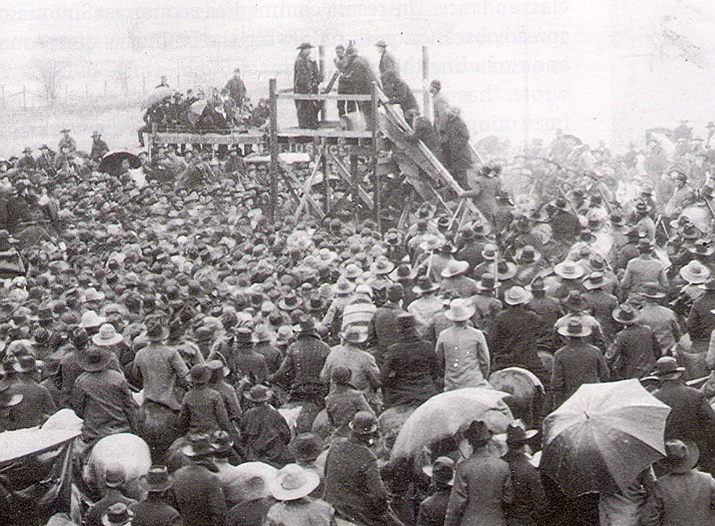
Lynching as Public Spectacle:
A lynching in Paris, Texas, 1892

Slide 43
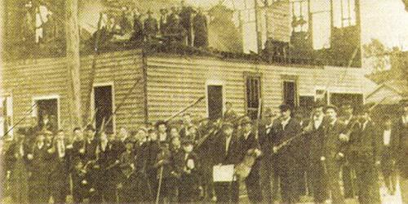
The Wilmington Race Riot, 1898

Slide 44
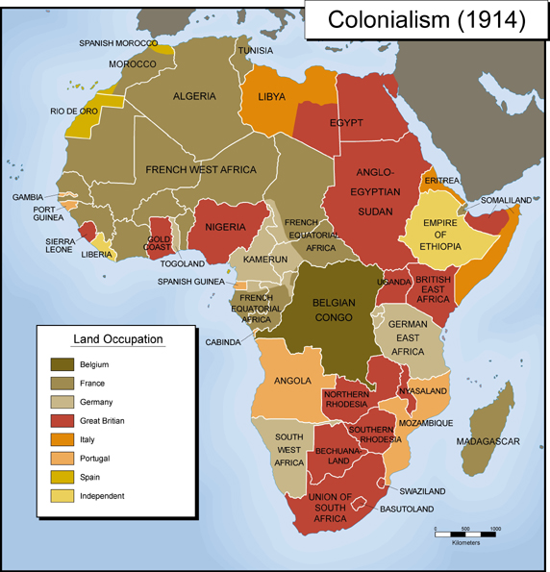
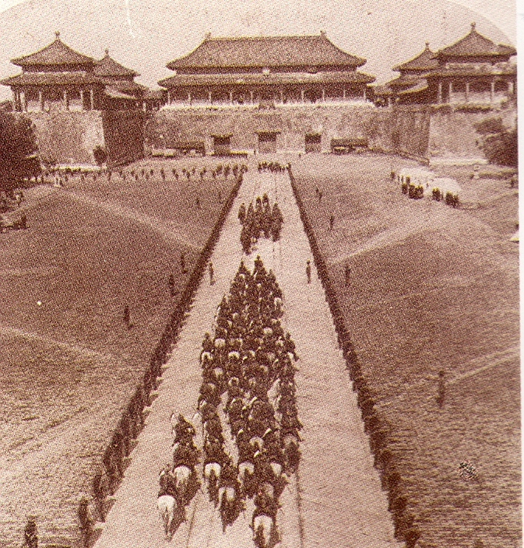
The Global Nexus:
Racism and Colonialism

Slide 45
Indiana Senator Albert Beveridge’s Speech on Expansion Before the U.S. Senate, January 9, 1900
Mr. President, the times call for candor. The Philippines are ours forever… And just beyond the Philippines are China’s illimitable markets. We will not retreat from either…. We will not abandon our opportunity in the Orient. We will not renounce our part in the mission of our race…of the civilization of the world. God has marked us as His chosen people…to lead in the regeneration of the world.
Mr. President, this question is deeper than any question of party politics… isolated policy…[or] constitutional power. It is elemental. It is racial. God has not been preparing the English-speaking and Teutonic peoples for a thousand years for nothing but vain and idle self-contemplation and self admiration. No! He has made us the master organizers of the world to establish system where chaos reigns…. He has made us adept in government that we may administer government among savages and senile peoples…. This is the divine mission of America, and it holds for us all the profit, all the glory, all the happiness possible to man….

Slide 46
National Origins Act (1924) Quota
Total Number of Immigrants, 164,667 per year
Regions:
Northwest Europe 142,483
Southern & Eastern Europe 18,439
Rest of the World 3,745
Individual Nations
Germany 51,227
Ireland 28,567
France 3,954
Italy 3,845
Hungary 473
Greece 100
All of Africa 1,120
All of East Asia 0

Slide 47
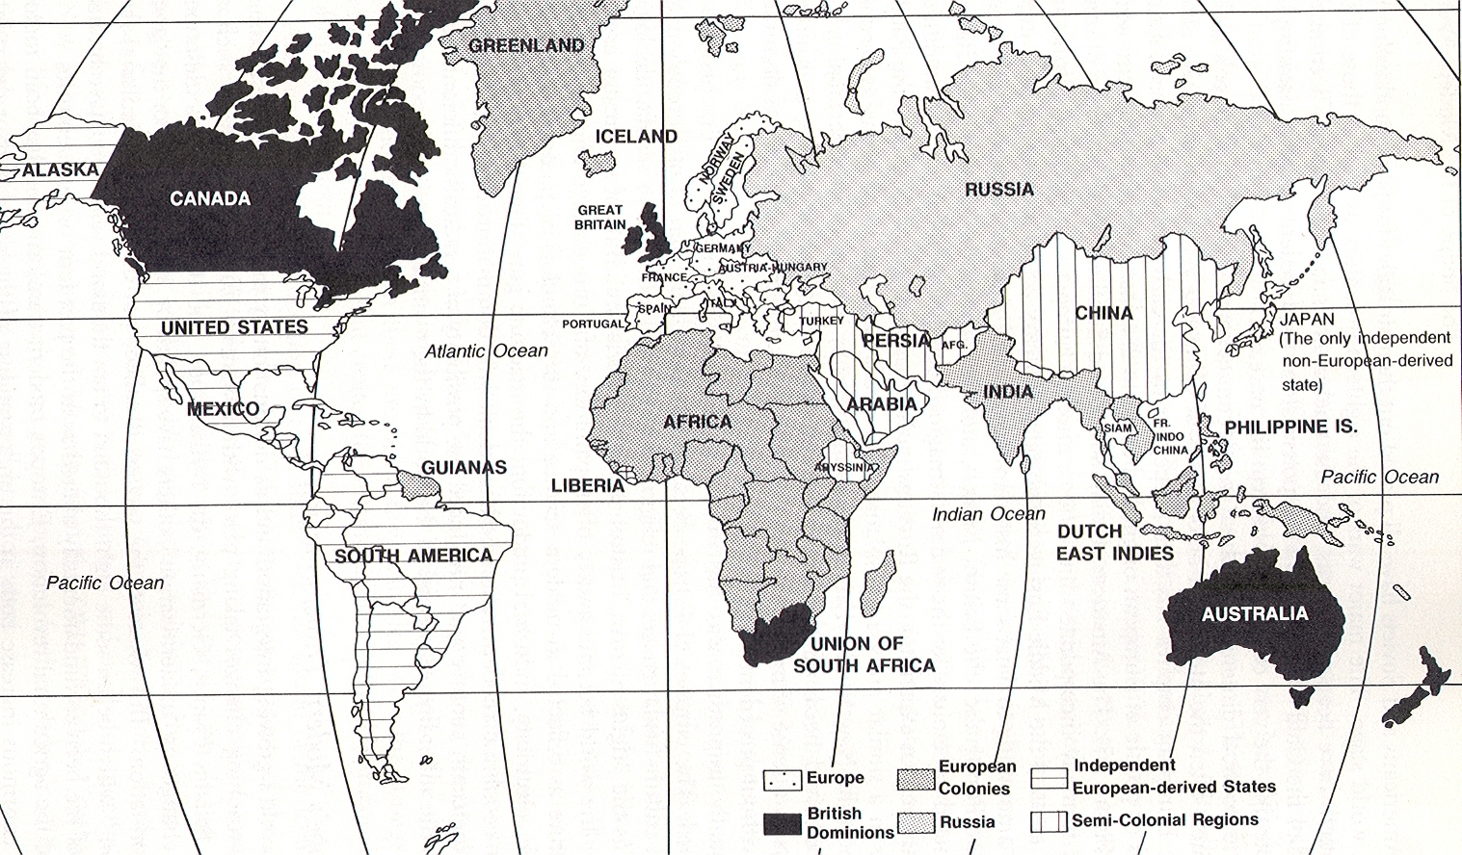
A European-Dominated World, 1900

Slide 48
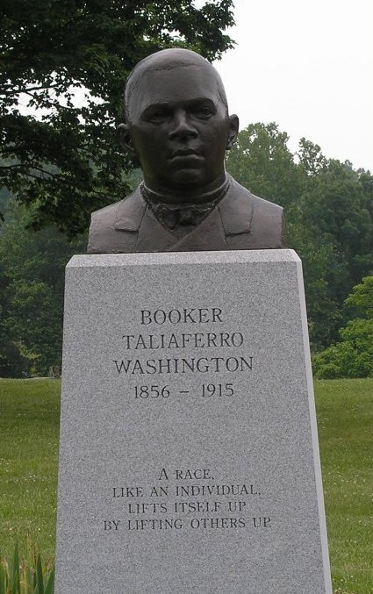

Slide 49
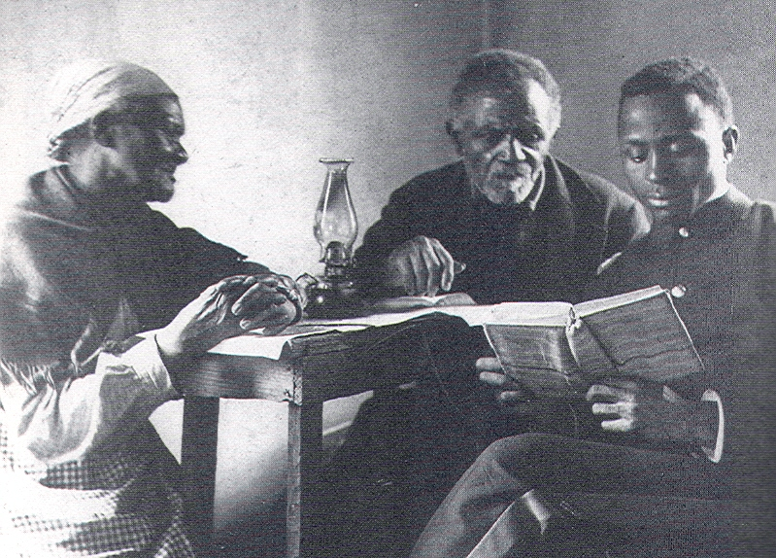
Slow, Steady Progress:
Hampton Student Helping Ex-Slaves Learn to Read

Slide 50
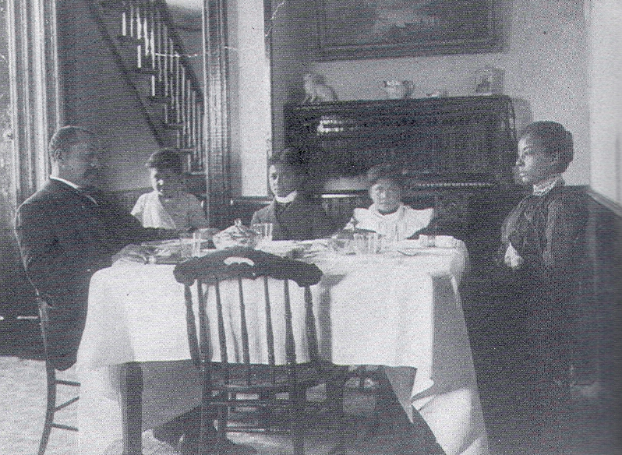
The Politics of Respectability:
Middle Class Black Family in Atlanta, Georgia, ca. 1890

Slide 51
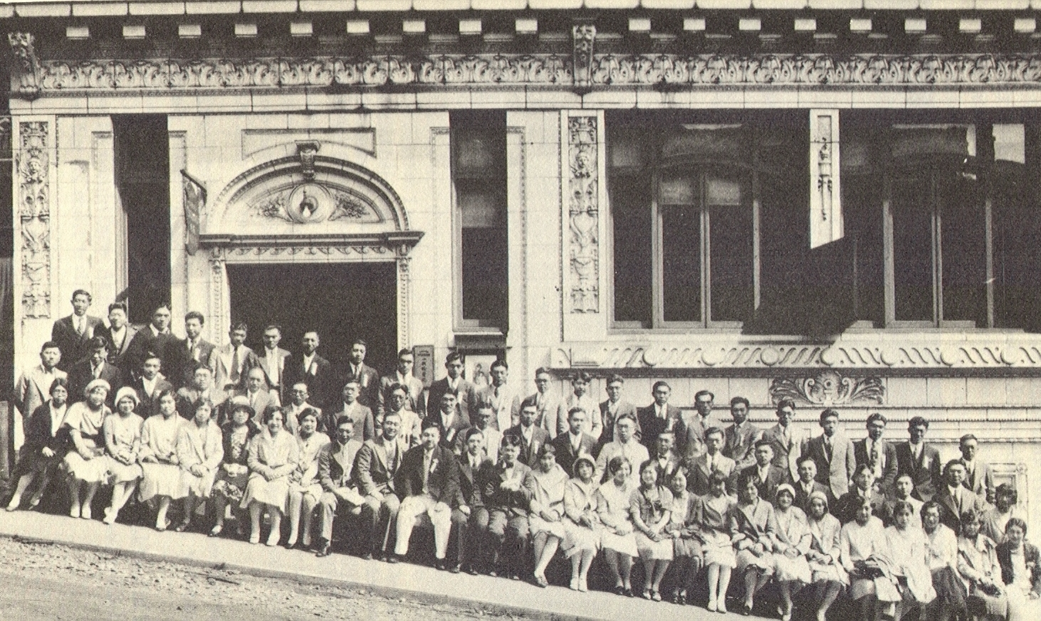

James Sakamoto and the Japanese American Citizen’s League (Seattle Convention, 1930)

Slide 52

New York City Protest Against Lynching and Race Riots, 1917

Slide 53


Slide 54


Booker T. Washington at Hampton, 1879

Slide 55

Spelman College Students, 1885

Slide 56

Tuskegee Campus, 1881

Slide 57

Tuskegee Classroom, 1902

Slide 58

Tuskegee Students, ca. 1895

Slide 59

Home Economics Class,
Tuskegee Institute, ca. 1903

Slide 60

The Oaks:
Booker T. Washington Home at Tuskegee

Slide 61

California Polytechnic State University, San Luis Obispo

Slide 62

Fun Stuff: Taylor Teaching U.S. History at Cal Poly, 1979

Slide 63


Slide 64

Washington Giving a Speech in Lakeland, Tennessee, n.d.

Slide 65
The Atlanta Compromise Speech: Three Excerpts
In all things that are purely social we can be as separate as the fingers, yet one as the hand in all things essential to mutual progress.
As we proved our loyalty to you in the past in nursing your children, watching by the sickbed of your mothers and fathers, so in the future, in our humble way, we shall stand by you with a devotion no foreigner can approach, ready to lay down our lives, if need be, in defense of yours.
The wisest among my race understand that agitation on questions of social equality is the extremist folly and that progress in the enjoyment of all the privileges that will come to us, must be the result of constant struggle rather than artificial forcing.

Slide 66

Booker T. Washington on the Black Response to Racial Oppression

Slide 67

William Howard Taft, Booker T. Washington, and Andrew Carnegie

Slide 68


Slide 69


Slide 70


John Hope of Morehouse College

Slide 71

The Washington (D.C.)Bee, 1901

Slide 72

The Afro-American Council Chapter in Oakland, California, ca. 1896

Slide 73

Charleston Black Bricklayers Union

Slide 74


Organizing Poster, Chicago
Samuel Gompers, Founder, American Federation of Labor (AFL)

Slide 75

King Cotton Postcard, 1907:
Sharecroppers near Memphis

Slide 76


Nineteenth Century Black Businesses:
(l) Publishing Company, Albany, New York
(r) Annie Turnbo Malone, St. Louis Cosmetics Manufacturer

Slide 77


The Atlanta Race Riot as Seen in Paris, France, 1906

Slide 78

Railroad Passenger Train in Virginia, ca. 1900.

Slide 79
Booker T. Washington on the Black Response to Racial Oppression

Slide 80
Booker T. Washington Visits Lewis and Clark High School, Spokane, March 10, 1913
[on Colonization in Africa] Someone advised that Negroes be put in a country by themselves and allowed to develop as a separate nation. But there would be two difficulties. First, it would require a wall around that land to keep the Negro in, and second, it would require about five walls to keep the White people out. There has never been a desirable land or climate into which the White has not penetrated.
Some have suggested that the Negro race just graciously and politely let itself die out, but it cannot do that. The race has grown from 3,000,000 to 6,000,000 and from being bondsmen have become owners of land equal in area to the New England states, not including Maine.

Slide 81

Booker T. Washington Lifting The Veil of Ignorance?

